Slide 1

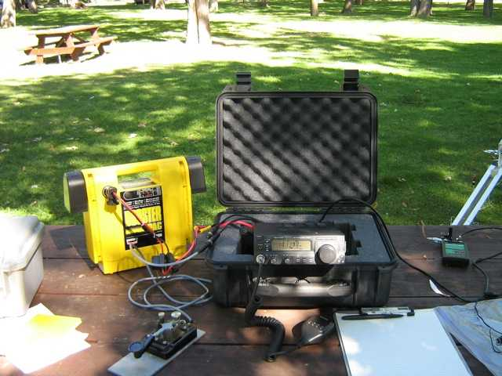
Portable HF Operating

Slide 2
Why operate a portable HF station ?
Physical space restrictions or restrictive covenants (condo) may make it difficult or impossible to erect HF antennas at home.
High RF noise levels in residential neighbourhoods resulting from power-lines and/or consumer electronics makes operation from home difficult.
Vacation or work travel (mini DX-pedition)
For fun ( 1 QSO in the field is worth 10 in the shack !)

Slide 3
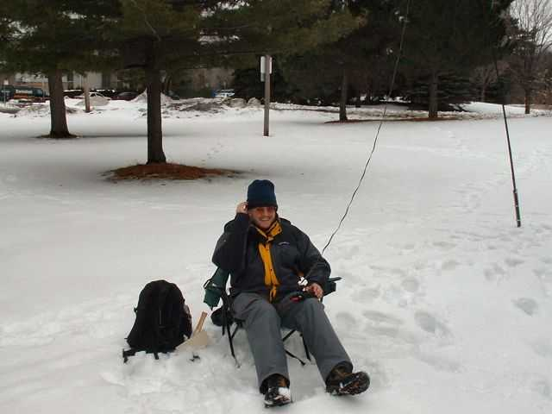
VA3SIE operating FYBO QRP contest

Slide 4
My Criteria for operating HF Portable
Short set-up time - on the air in less than 20 min.
Operate for 2 to 3 hours maximum during daytime.
Usually I provide my own antenna supports – I don't want to rely on Mother Nature.
No more than two trips to the car for gear.
Multi-band operation on 40m / 30m / 20m.
Your criteria may be different, it is up to you to decide what is important to you.

Slide 5
Expectations – What can you hope to achieve ?
Easy
  Ragchew QSOs within North America
  Some DX Contacts (at the mercy of propagation)
  Casual Contesting
Hard
  Competing with the “Big Guns” in contests
  Serious DXing (i.e. busting pileups)
Accept the fact that you won't be the loudest signal on the bands.

Slide 6
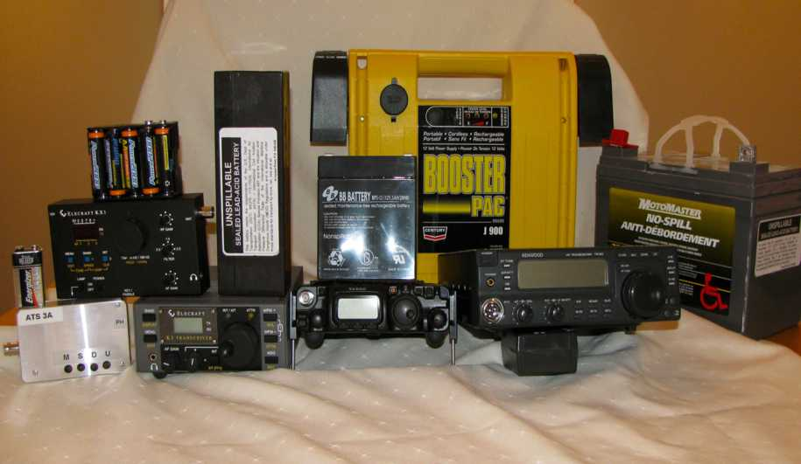
Power out & in ... the implications

Slide 7
Battery Weight vs Capacity
32 lbs - 32 Ah sealed lead acid 'wheelchair battery'
14.5 lbs - 18 Ah sealed lead acid Booster pack
4.5 lbs - 5 Ah sealed lead acid battery
2.0 lbs – 2 Ah sealed lead acid battery
0.5 lbs – 2.7 Ah (10 X 1.25v NiMH AA cells)
1.3 oz – 0.4 Ah 9V Alkaline 'Transistor battery'.

Slide 8
100 watts vs 25 watts vs 5 watts
Assume that while running 100 watts into a Hamstick you receive a 599 signal report ... all other factors being equal :
  At 25 watts out your signal report would be 589
  At 5 watts out your signal report would be 579
With a better antenna and reduced power output you can reduce your battery weight, achieve similar results and make your station more portable.

Slide 9
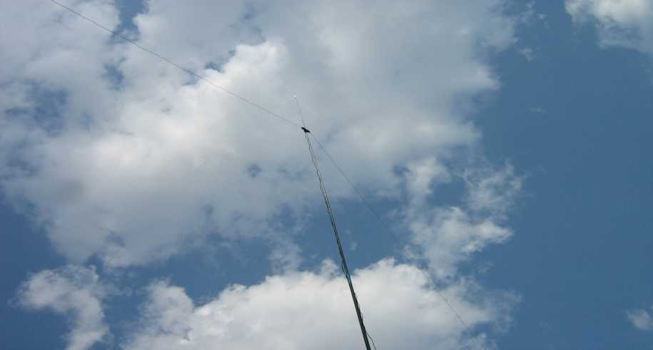
Some Practical HF Portable Antenna Ideas

Slide 10
EDZ – Extended Double Zepp
44 or 88 foot doublet - fed with twin-lead or ladder-line (Google 'Norcal Doublet')
44 ft version will operate on 40m through 10m
88 ft version adds 80m operation
Advantage over a 40m dipole is that major antenna lobes are broadside to antenna on all bands.
Can easily be matched by a tuner and installed as inverted-vee with a single antenna support.

Slide 11
Clip-Lead Multi-Band Dipole
Inner dipole is resonant on highest frequency of interest (i.e. 20m).
By jumpering the dipole end insulators with clip-leads, additional wire lengths are successively added on to make the antenna resonate on the next lowest band (i.e. 30m & 40m).
This antenna is a resonant dipole on each of the bands of interest.
May be fed with coax. No tuner needed.

Slide 12
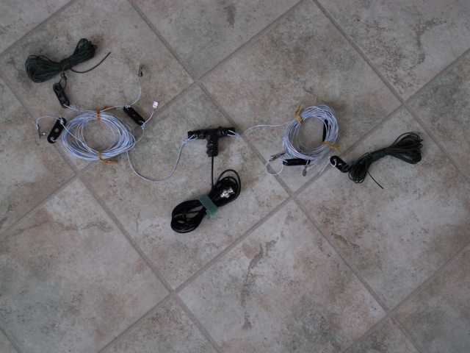
Clip lead Dipole

Slide 13
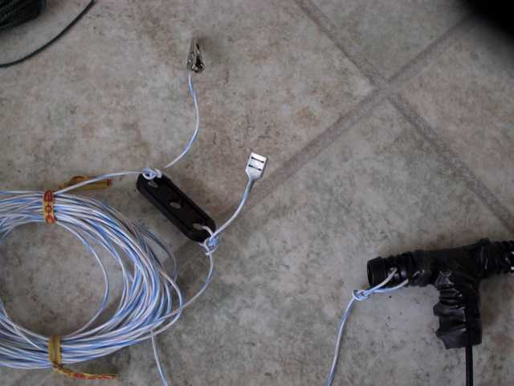
Clip Lead details

Slide 14
Short Vertical non-resonant Wire
Vertical 24 foot to 28 foot long wire
Use 4 to 20 ground radials each 16 feet long (1/8 wavelength at lowest operating frequency).
With a tuner, it will load on 40 m through 10m with ease
No feedline losses incurred as no feedline is needed.

Slide 15
Long vertical non-resonant wire
End-Fed 84 to 87 foot long wire
Use 4 to 20 ground radials at least 1/8 wave on lowest operating frequency
Will easily match on 80m through 10m with a tuner. (May even be used on 160 m).
Can be erected as an inverted-L (the taller the vertical section the better, with the leftover bit running horizontal to a tree etc.)
No feedline losses because there is no feedline

Slide 16
The 'WYE' a three wire Groundplane
Mono-band, upside-down Y shaped GP vertical
Vertical Radiator (234 /F Mhz = length in feet)
Two sloping elevated radials (246/F Mhz)
Good match to 50 ohm coax.
Attach coax centre conductor to vertical wire, braid to Ground plane. Hang from a tree / fiberglass pole etc.
(Hint for VHF use can be made out of stiff wire with an SO-239 as the center insulator. )

Slide 17
Portable Antenna Mast ideas
Shakespeare Wonderpole “Crappie” fishing pole – available in 10' , 13' and 20 foot lengths at about $1 per foot at Le Baron's.
DK9SQ and MFJ 10 meter long fiberglass masts are heavier duty than fishing poles and can also be used to support small VHF / UHF beam antennas -www.kangausa.com & www.mfj.com
Other fiberglass masts such as Jackite -www.jackite.com

Slide 18
Fiberglass Mast Support Ideas
Lee Valley Multi-Purpose Anchor Stake – item # ST110 – cost ~ $13
Homebrew bases – roll your own with ABS / PVC Pipe, aluminum or steel angle stock, spikes, SS hose clamps etc.
Other patio umbrella supports

Slide 19
Antenna construction ideas
PVC Tees can be used as center insulators; PVC joiners or synthetic wine corks can be used as end-insulators.
Fishing snap-swivels and crimp ring terminals can be utilized create a center support for a lightweight doublet or vertical wires attached to a fiberglass pole.
Wire - #22 to #24 AWG Teflon coated Silver plated from N2GO or #531- 'Invisible Toughcoat Silky' from the Wireman at www.thewireman.com

Slide 20
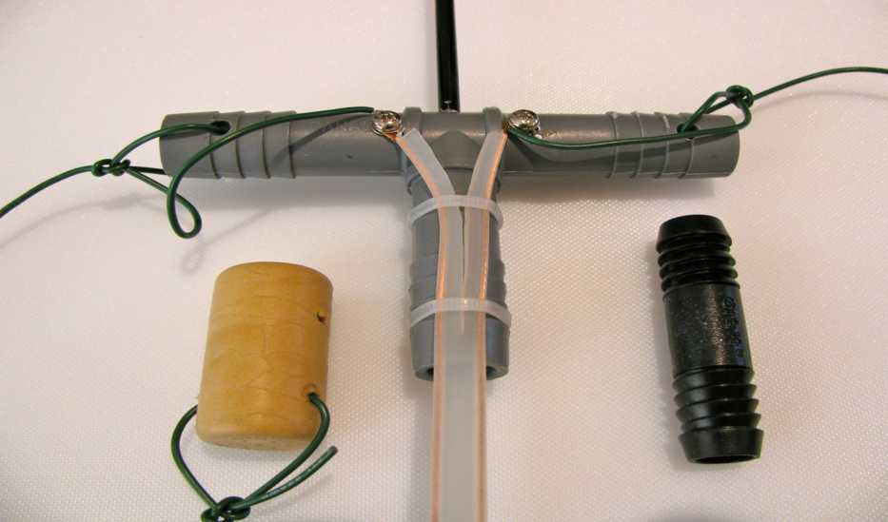
Antenna Insulators

Slide 21
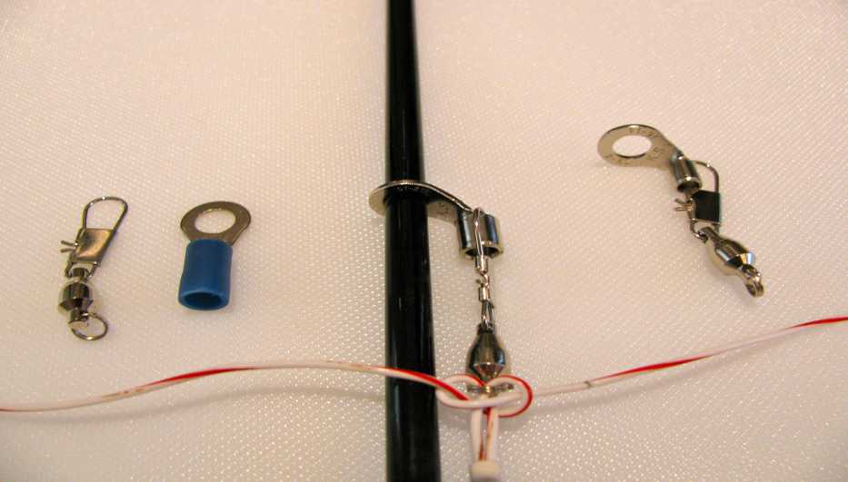
Ring Terminal doublet support

Slide 22
Safety
Consider RF exposure guidelines & implications of low antennas
5W of RF has a bite, higher power can cause RF burns. Ends of wire antennas are at high potential
Ensure that your antennas do not pose a risk to pedestrians, pets & children when operating from a public place.
RAC members have $1M in liability insurance

Slide 23
Observations
5W CW and 25W SSB are generally the lower limits for consistent reliable communications
When in doubt go with a horizontal antenna. Even a low doublet or dipole will generally outperform a vertical over average ground.
Verticals work well near salt water or areas with good soil conductivity (i.e. Farmland).
Automatic antenna tuners do work well and are extremely useful for matching multi-band antennas

Slide 24
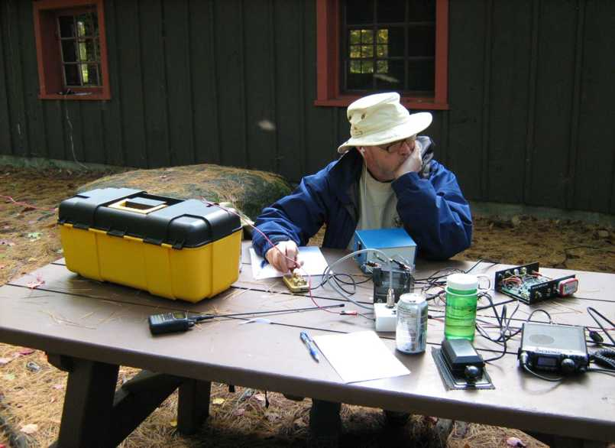
Have fun !

