Slide 1

Intercepting WW II Enemy Wireless Signals at
Ottawa Monitoring Station
Ernie Brown
VA3OEB

Slide 2
Intercepting Enemy Wireless
History of Ottawa Monitoring Station

Slide 3
Intercepting Enemy Wireless
History of Ottawa Monitoring Station
  VAA communications station c1926 (monitoring added c1930)

Slide 4
Intercepting Enemy Wireless
History of Ottawa Monitoring Station
  VAA communications station c1926 (monitoring added c1930)
  Circa 1935 crystal

Slide 5
Intercepting Enemy Wireless
History of Ottawa Monitoring Station
  VAA communications station c1926 (monitoring added c1930)
  Circa 1935 crystal
Locations
  Radio Test Rooms

Slide 6
Intercepting Enemy Wireless
History of Ottawa Monitoring Station
  VAA communications station c1926 (monitoring added c1930)
  Circa 1935 crystal
Locations
  Radio Test Rooms
  Central Experimental Farm Greenhouse

Slide 7
Intercepting Enemy Wireless
History of Ottawa Monitoring Station
  VAA communications station c1926 (monitoring added c1930)
  Circa 1935 crystal
Locations
  Radio Test Rooms
  Central Experimental Farm Greenhouse
  T. R. Booth Farmhouse

Slide 8
Intercepting Enemy Wireless
History of Ottawa Monitoring Station
  VAA communications station
  Circa 1935 crystal
Locations
  Radio Test Rooms
  Central Experimental Farm Greenhouse
  T. R. Booth Farmhouse
  New building - 1941

Slide 9
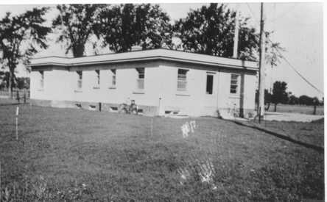
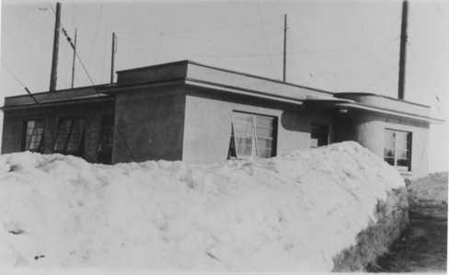
Intercepting Enemy Wireless
New Building - Summer 1942, Winter 1943

Slide 10
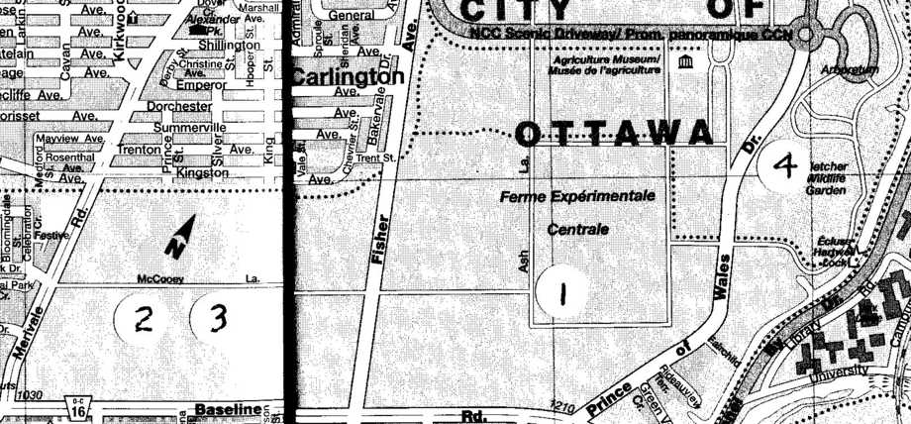
Intercepting Enemy Wireless
Site #1 is the former Booth Farmhouse location.
Site#2 is the location of the new station, where the building still stands among the trees.
Site #3 is the DF site.
Site #4 is the location of the RCN Station CFF.

Slide 11
Intercepting Enemy Wireless
Interdepartmental Agreement

Slide 12
Intercepting Enemy Wireless
Interdepartmental Agreement
  Objectives and Task

Slide 13
Interdepartmental Agreement
  Objectives and Task
  Growth 1939-41

Slide 14
Intercepting Enemy Wireless
Interdepartmental Agreement
  Objectives and Task
  Growth 1939-41
  Operations 1942-45

Slide 15
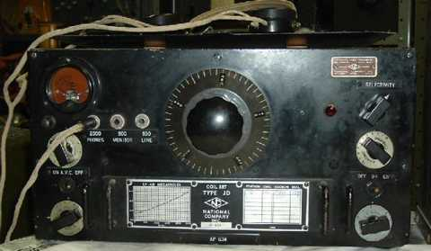
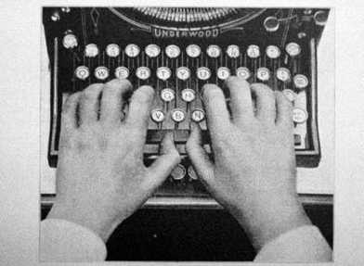
Intercepting Enemy Wireless
Sixteen Monitoring Positions, each with:
  HRO Receiver - used tuning coil “drawers”
  “Mill” (Manual typewriter - all caps/numerals)

Slide 16
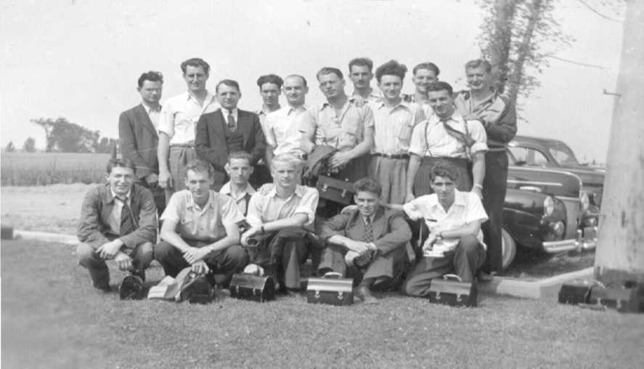
Intercepting Enemy Wireless
  Photo shows shift change at Ottawa Monitoring Station

Slide 17
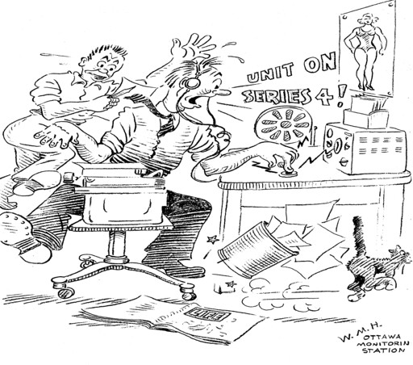
Intercepting Enemy Wireless
Identifying a Mobile Signal

Slide 18
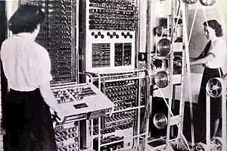
Intercepting Enemy Wireless
Intercepts left OMS by teletype to RCN HQ
Routed by trans-Atlantic cable to ultimate destination Bletchley Park for decryption by Colossus computer

Slide 19
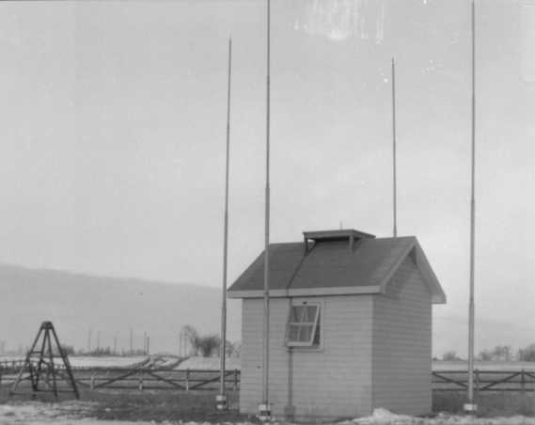
Intercepting Enemy Wireless
Manual Direction Finding in the field
Direction Finding Operations

Slide 20
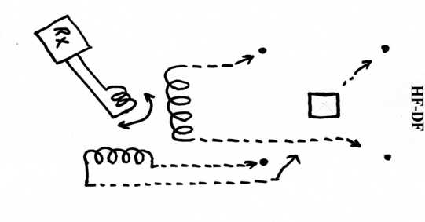
Intercepting Enemy Wireless
Direction-Finding Equipment
  HRO Receivers
  Manual Radiogoniometer
DF Procedures
Disposition of messages and bearings

Slide 21
Intercepting Enemy Wireless
Other Dept of Transport Monitoring Stations
Hartlen Point, N. S.
Strathburn, SW Ontario
Forest (near Rivers), Manitoba
Point Grey (Vancouver), B. C.

Slide 22
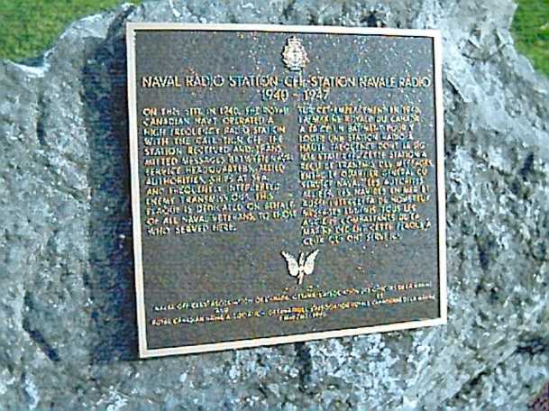
Intercepting Enemy Wireless
Naval Radio Station CFF Memorial Plaque

Slide 23
Intercepting Enemy Wireless
NAVAL RADIO STATION CFF
1940-1947
ON THIS SITE IN 1940 THE ROYAL CANADIAN NAVY OPERATED A HIGH FREQUENCY RADIO STATION WITH THE CALL SIGN CFF. THE STATION RECEIVED AND TRANSMITTED MESSAGES BETWEEN NAVAL SERVICE HEADQUARTERS, ALLIED AUTHORITIES, SHIPS AT SEA, AND FREQUENTLY INTERCEPTED ENEMY TRANSMISSIONS. THIS PLAQUE IS DEDICATED ON BEHALF OF ALL NAVAL VETERANS TO THOSE WHO SERVED HERE.
This is the inscription on the memorial plaque mounted on a large rock at the entrance to the Fletcher Wildflower Gardens, on the grounds of the Experimental Farm, south of the Arboretum, on the east side of the Prince of Wales Highway.

Slide 24
Intercepting Enemy Wireless
I transferred to Yukon (North West Staging Route) - 1943
Developments in radio intercept after VE Day
  Kana Code

Slide 25
Intercepting Enemy Wireless
I transferred to Yukon (North West Staging Route) 1943
Developments in radio intercept after VE Day
  Kana Code
  Point Grey, B.C.
  WRENS
  Lietrim
  USN postwar report listed 40 DF stations by 1945.
  There would have been 100’s of monitoring stations

Slide 26
Intercepting Enemy Wireless
Further reading:
On Ottawa Wireless Station -
http://members.shaw.ca/va3oeb/intercept.htm
On Canadian military signals intercept operations (WW II) -
http://jproc.ca/rrp/leitrim.html
On Bletchley Park, decryption and the Colossus computer -
http://www.codesandciphers.org.uk/lorenz/colossus.htm

Slide 27
Intercepting Enemy Wireless
Thank You
Questions?

