Slide 1

Merchant Navy ‘Sparks’ in the
Battle of the Atlantic
Experiences of a young
Radio Operator
on the North Atlantic in 1941

Slide 2
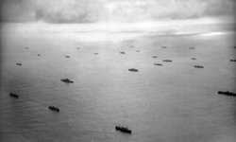
Merchant Navy ‘Sparks’
Typical Atlantic Convoy requiring extra Radio Operators in 1941
March, 1941 - Graduation from radio school with Radio Operator Certificate – 2nd Class (1st requires sea duty)
Reported to Holland America Line, Hoboken, N.J. on first assignment.

Slide 3
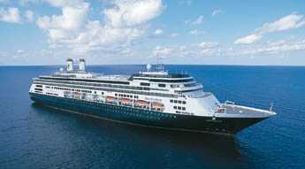
Merchant Navy ‘Sparks’
My assignment - the Maasdam. Not this one!
Photo shows Cruise Ship Maasdam (5)

Slide 4
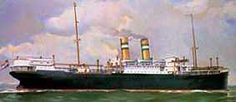

Merchant Navy ‘Sparks’
Signed onto Maasdam (3) – built in Holland 1921
Length: 470 ft
Beam: 58 ft
Draft: 27 ft loaded
Gross Weight: 8,812 tons

Slide 5
Merchant Navy ‘Sparks’
All holds and deck loaded – Jeeps in hold, 6X6 trucks lashed to hatch covers.
Passengers: 32 businessmen.
April 1 - Dep. Hoboken, N.J. to join a convoy out of Halifax
Landlubber at Sea
Radio Equipment:
  TRF Receiver
  Transmitter Sealed
  Emergency TX – Spark Gap with 10 inch coil
  Strict radio silence except for emergency call.
Sea Legs
Apr 4 - Arr. Halifax. Dozens of ships anchored in Bedford Basin.

Slide 6
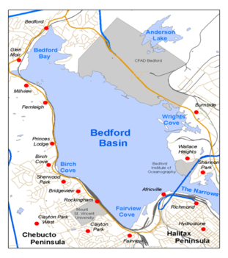
Merchant Navy ‘Sparks’
Apr 6 – Dep. Halifax for Liverpool - 39 ships leave single file from Bedford Basin through The Narrows to form Fast Convoy HX.119. “Smokers” to cut smoke or leave convoy.
Running at 7 Kt - Zig-Zag course - Rough weather
Apr 13 - Joined by HX.119B from Bermuda with 19 more.

Slide 7
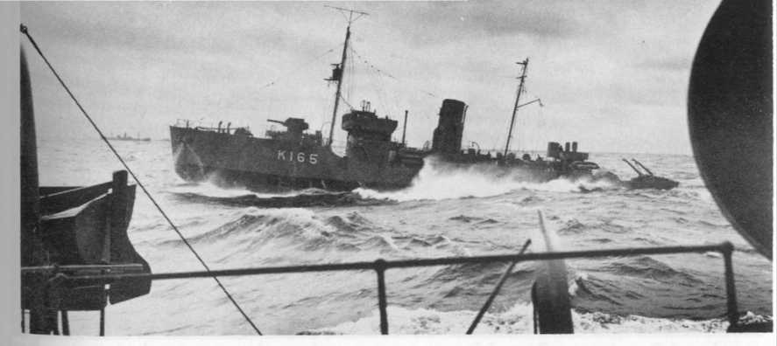
Merchant Navy ‘Sparks’
An RCN Corvette escorts convoys to mid-Atlantic gap. Photo courtesy of “The Sea is at our Gates” by Commander Tony German.

Slide 8
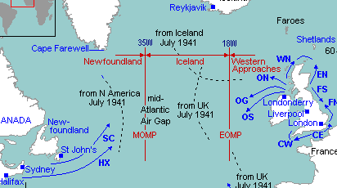
Merchant Navy ‘Sparks’
Map shows the limits of convoy protection by sea or air.
Between those limits, ships were on their own.

Slide 9
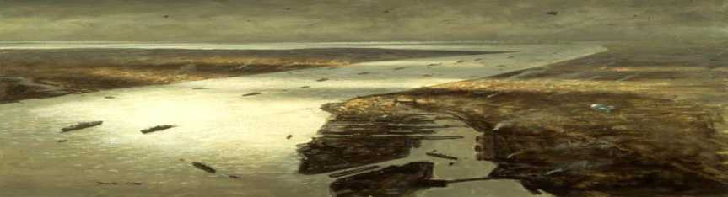
Merchant Navy ‘Sparks’
'A Convoy Arrives in Liverpool' by Charles David Cobb (1990). The first ships are entering Brunswick Dock. The others are heading for Birkenhead and the North Docks.
Apr 22 – Arr. Liverpool
We docked at Huskisson Dock (one of those North Docks)
Extended offloading.

Slide 10
Merchant Navy ‘Sparks’
May 2-8 - Massive Luftwaffe air raids of Liverpool docks – the “Hellfire of Liverpool” – heaviest bombing of a British city outside London (and it was our luck to be in the midst of all of it).
  681 medium bombers over 6 days and nights
  870 tons of high explosive bombs
  112,000 incendiary bombs
  Fires and explosions of ship cargoes and warehouses
  Ship on next dock on fire. Exploded, damaging Maasdam
  1741 people killed and 1154 injured in those few days.
  Firemen amazing in the face of grave danger. Many died.
No cargo or passengers loaded for return trip to New York.

Slide 11
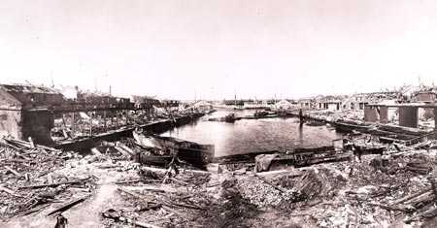

Merchant Navy ‘Sparks’
Liverpool Huskisson Docks following the May 2-8, 1941 air raids

Slide 12
Merchant Navy ‘Sparks’
May 12 - Dep. Liverpool for New York in Convoy OB.322
May 20 - Convoy dispersal. As escorts turn back, we’re on our own in the mid-Atlantic gap and running at brisk 16 kt.
Distress signals heard (SS Marconi and SS San Felix lost). Other distress signals from ships in eastbound convoy.
May 24/25 - Gulf Stream. Warm and humid. Welcome change from the North Atlantic.
May 24 Historical Note – German Battleship Bismarck sinks British Cruiser HMS Hood not that far north of us.
May 29 – Arr. New York
Shore Leave.
Took train home to Bradford, ON. Bought a uniform

Slide 13
Merchant Navy ‘Sparks’
Jun 8 - Return to Ship
Loading:
  war materiel, Hudson bombers on hatch covers, wings in hold.
  32 passengers include 11 US Marines for US Embassy duty in London, 18 American Red Cross nurses, Hollywood actor going home to join RAF, two businessmen.
Jun 11 – Dep. NY for Halifax to join east-bound convoy.
Jun 13 – Arr. Halifax. No shore leave. 100 or more ships in Bedford Basin.

Slide 14
Merchant Navy ‘Sparks’
June 16 – Dep. Halifax for Liverpool.
51 ships leave Bedford Basin single file to form Convoy HX.133 outside
June 17-21 – Fog
Some collisions
Near miss for Maasdam.
June 23 - MS Vigrid has engine trouble, falls back from convoy, torpedoed and sunk

Slide 15
Merchant Navy ‘Sparks’
June 24-26 - Under attack by ten U Boat “wolf-pack”
June 24 - Two ships lost
June 25 - One more ship lost
June 26 – 300 miles southwest of Iceland
  Tanker MT Tibia hit about 9 AM – not sunk. Back on station about noon.
  Our ship Maasdam hit about 9:30 PM and sinking!
  A minute later SS Malaya II hit and blew up.
  Our captain issued “Abandon Ship” order
  Muster at life-boats. Two useless, damage to our life-boat, foot wound to a Marine, head wound to 3rd Mate
  Three boats load and depart. Last boat loaded, leaking, soon swamped. Occupants swim to Havprins

Slide 16
Merchant Navy ‘Sparks’
Tanker MT Havprins stopped to clear bridge damage. Picks up one of our life-boats. Marines, some nurses and some others swim to Havprins. Two of the nurses drown.
Maasdam officers and four nurses stay in swamped lifeboat.
Havprins sends motor boat to tow us over so we can climb aboard Havprins via the rope ladders.
Designated rescue ship SS Randa picks up our other two life-boats. Heads for Iceland with wounded for urgent medical attention.
Tanker MT Kongsgaard hit and on fire. Abandoned, but later re-boarded and salvaged. Unbelievable bravery.

Slide 17
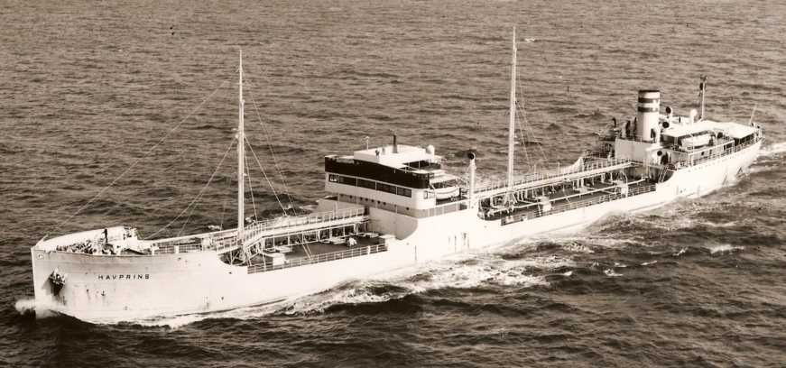
Merchant Navy ‘Sparks’
Tanker MT Havprins. Photo courtesy of the son of one of the 1941 Havprins crewmembers who found my website.

Slide 18
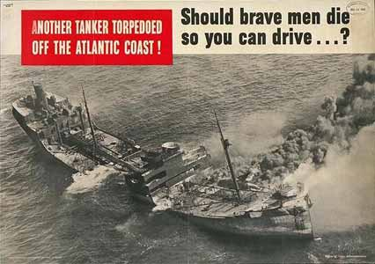
Merchant Navy ‘Sparks’
June 29 – SS Grayburn, carrying steel and trucks, left convoy. Torpedoed and sank.
July 4 - Arr Bristol on MT Havprins with part of our crew.
Wartime posters like above have new significance for me.
One month survivor leave for all the Maasdam crew.
Decided to take the train to Scotland to get away for a while

Slide 19
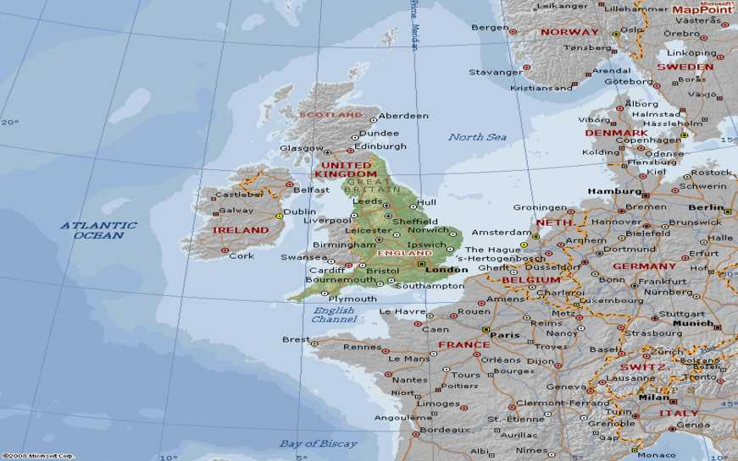
Merchant Navy ‘Sparks’

Slide 20
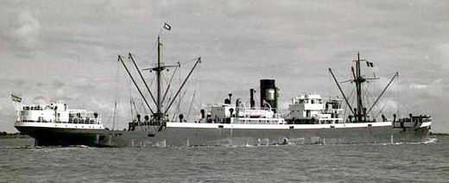
Merchant Navy ‘Sparks’
Aug 8 – Signed onto another Dutch ship in London.
MV Tuva 4652 tons - half size of Maasdam. Diesel/battery.
I got the only passenger cabin as no other passengers.
Aug 16 - Dep. London with “coasters”and barrage balloon
Load general supplies and 5 ton chain at Sunderland.
Aug 25 – Arr. Loch Ewe to join westbound convoy

Slide 21
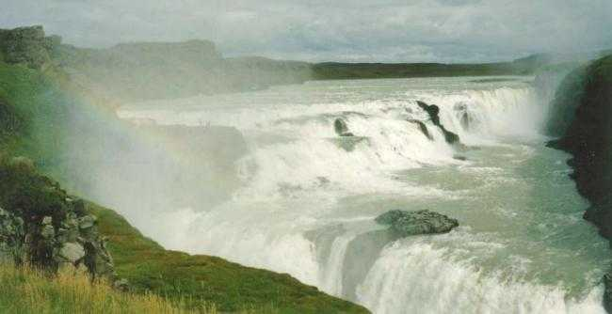
Merchant Navy ‘Sparks’
Sep 1 – Dep Loch Ewe with Convoy ON.11
Sep 4 – Leave convoy ON.11 and anchor at Reykjavik, Iceland to await dock space to offload.
Sep 10 – Docked. Offloading until Sep 27. Time for tour
Visited the Gullfoss waterfall (below)

Slide 22
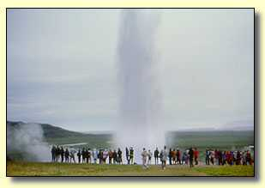
Merchant Navy ‘Sparks’
Also visited the hot-water Geysir (above).
Geothermal heated swimming pool, and city heating.
Sep 28 – Dep. Reykjavik for Tampa “in ballast” with Convoy ON.19A
Oct 2 – MV Tuva torpedoed at 4 AM! Crew quarters damage. Sinking fast. Abandon ship!!
One man pinned under debris. Had to be left behind.

Slide 23
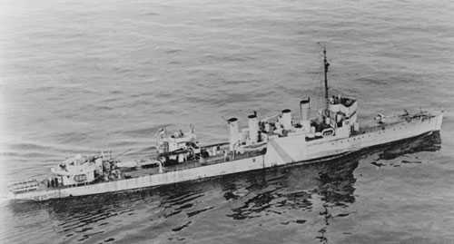
Merchant Navy ‘Sparks’
After an hour on life-boats and rafts, rest of crew rescued by Canadian destroyer HMCS St Croix – (US Lend-Lease four stacker, 1100 tons)

Slide 24
Merchant Navy ‘Sparks’
St Croix low on fuel. Had to return to St. John’s.
Oct 6 – Landed at St. John’s, NF. Overnight in hotel. Red Cross survivor kits much appreciated.
Oct 9 – Arr Halifax
Oct 26 – Paid off (less Scottish trip expenses). Homebound by Trans Canada Airlines Lockheed 10 (my first air trip)
While on leave I heard that DOT were recruiting experienced Radio Operators. Tough decision. Applied.
Later learned HMCS St Croix torpedoed Sep 20, 1943. 65 men lost. All but one of the 35 rescued by HMS Itchen were lost when Itchen was torpedoed two days after that rescue. Result: only one survivor of HMCS St Croix. Tragic.
After war learned that both U Boats U-564 and U-575, who had sunk my two ships, were sunk in 1943. All lost.

Slide 25
Merchant Navy ‘Sparks’
Statistics – North Atlantic Convoys
Convoys To Cargoes Delivered Lost
629 UK 26805 417
126 Med 6247 3
78 Murmansk 1400 85

Slide 26
Merchant Navy ‘Sparks’
North Atlantic Losses (All Causes)
Year Ships U Boats RCN
1939 47 6 0
1940 375 18 3
1941 496 19 3
1942 1006 35 4
1943 (toMar) 155 2 __
Total to date 2079 80 10
1943 (rest) 130 148 4
1944 31 111 7
1945 19 72 3
Total (period) 180 330 24 (2210 RCN sailors)

Slide 27
Merchant Navy ‘Sparks’
Battle of the Atlantic was eventually won because:
In 1943 Long-range aircraft started to patrol the Mid-Atlantic Gap.
“Hunter-Killer” groups of destroyers and frigates were dedicated to hunting and destroying U Boats.
RADAR performance improved and size/weight shrank to allow use in aircraft. Until the Schnorchel, U Boats could not surface to run engines and charge their batteries without risk of attack by aircraft.
Code Breaking the German Navy ciphers meant the allies could know where the U Boats would attack.

Slide 28
Merchant Navy ‘Sparks’
Losses WWII
Allied merchant ships (all causes) 5,800
Merchant seamen lost (British) 30,500
Merchant seamen lost (Canadian on Canadian ships) 1,487
Merchant seamen lost (Allied) 24,000
German U Boats on operations 863
German U Boats lost at sea 754
German U Boats destroyed 30
German sailors lost at sea 27,490
German U Boat losses reached 75%

Slide 29
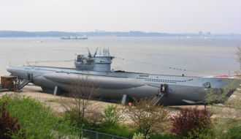
Merchant Navy ‘Sparks’
The enemy: a Type VII U Boat, the most common type in service during the early part of the Battle of the Atlantic.

Slide 30
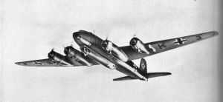
Merchant Navy ‘Sparks’
German Focke Wulf FW-200 Condor - 3000 km range
Flew from bases in Norway. They carried bombs but were most effective at spotting convoys for the U Boats

Slide 31
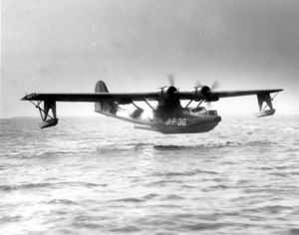
Merchant Navy ‘Sparks’
Catalina flying out of Iceland and Bermuda was the major allied anti-submarine aircraft in the early years of the Battle of the Atlantic. Range 4200 km.

Slide 32
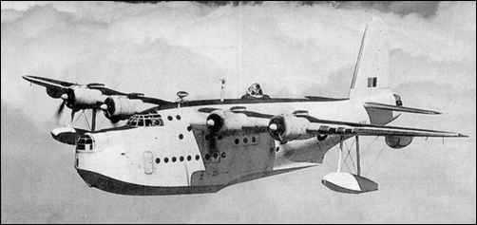
Merchant Navy ‘Sparks’
Short Sunderland Flying Boat flew out of Ireland doing low level patrols into the North Atlantic. Range 4220 km with crew of 10.

Slide 33
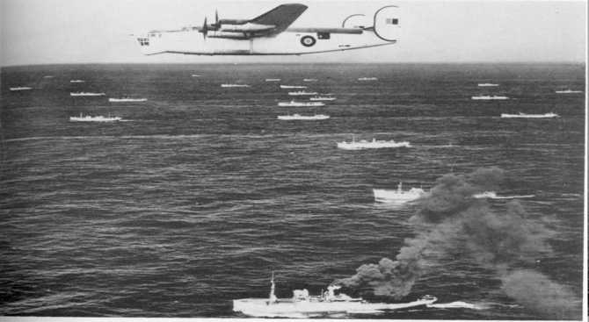
Merchant Navy ‘Sparks’
RAF ‘Liberator’ over “the mid-Atlantic gap” mid-1943. Standard 4200 km range greatly extended by using huge bomb-bay fuel tanks. Note the unwelcome smoker (foreground). Photo from “The Sea is at our Gates” by Commander Tony German.

Slide 34
Merchant Navy ‘Sparks’
Our allies, whose homelands were occupied, sailed their merchant ships wherever required, for the duration of the war.
Let us remember the veterans of all services, whose lives were changed forever by their experiences.
We remember especially those who did not survive.

Slide 35
Merchant Navy ‘Sparks’
Thank you for your attention
Any questions?
Sources:
http:/www.warsailors.com/convoys/index.html
http://members.shaw.ca/va3oeb
Book List available

