Slide 1
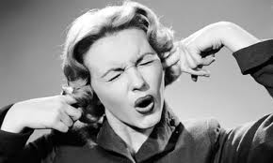
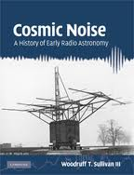
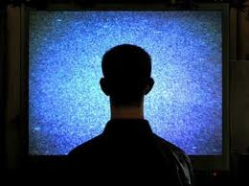
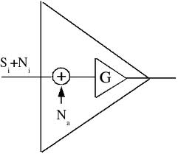
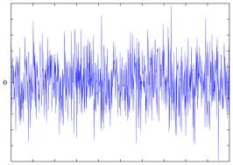
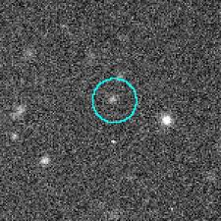
Noise Figure
Definitions and Measurements
What is this all about?...
Bertrand Zauhar, VE2ZAZ
ve2zaz@rac.ca
November 2011
VE2ZAZ

Slide 2
Today's Program on Noise Figure
What is RF noise, how to quantify it,
What is Noise Factor and Noise Figure,
Evolution of NF over the years,
NF in multiple stages,
How to measure NF,
Measurement Uncertainties,
The challenges in designing for best NF.
Hands on...
VE2ZAZ

Slide 3

What is RF Noise?
Various sources make RF Noise
  Thermal Noise arises from vibrations of conduction electrons and holes due to their finite temperature.
  Shot Noise arises from the quantized (not continuous) nature of current flow... electrons jump.
  Other random Noises in electronic devices.
  Excludes man-made noise
Every real life device or component (active or passive) generates RF noise, especially if its temperature is above absolute zero K.
Noise is what ultimately limits the performance of any system...
VE2ZAZ
Notes:
Thermal noise: Any electrical conductor contains electrons which are somewhat free to move around – more so in good conductors, less so in near-insulators. At normal temperatures, electrons are in random motion, although on average there is no net motion unless an electromotive force is applied. This random motion of electrons constitutes a fluctuating alternating current that can be detected as random noise. At any temperature above absolute zero (where all random motion stops) the thermal noise power generated in a conductor is proportional to its physical temperature on the absolute scale (measured in kelvin, K). Thermal noise is spread evenly over the electromagnetic spectrum (to beyond 5,000 GHz). We call this white noise. Therefore the noise power detected by a receiver is proportional to the bandwidth in which the noise is measured. We can then use temperature as an equivalent measure of thermal noise.
Shot noise: Shot noise is due to the corpuscular nature of transport. Shot noise is always associated with DC current ﬂow. In fact, it is required that there be DC current ﬂow or there is no Shot noise. Electrical currents do not ﬂow uniformly and do not vary smoothly in time like the standard water ﬂow analogy. Current ﬂow is not continuous, but results from the motion of charged particles (i.e. electrons and/or holes) which are discrete and independent. At some (supposedly small, presumed microscopic) level, currents vary in unpredictable ways. It is this unpredictable variation that generates Shot noise. This also spreads evenly over the electromagnetic spectrum (white noise).
Flicker Noise: (or 1/f noise) is a low frequency electronic noise phenomenon where the noise power follows a 1/f characteristic, so has pink power density spectrum. It occurs in almost all electronic devices, and can show up with a variety of other effects, such as impurities in a conductive channel, generation and recombination noise in a transistor due to base current, and so on. 1/f noise in current or voltage is always related to a DC current because it is a resistance fluctuation, which is transformed to voltage or current fluctuations via Ohm's law.

Slide 4
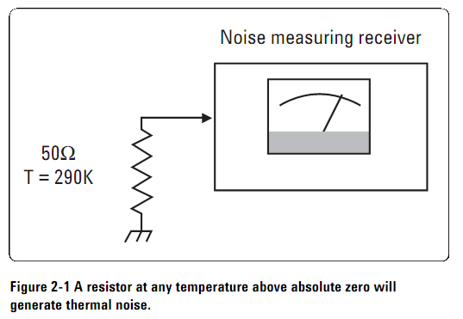
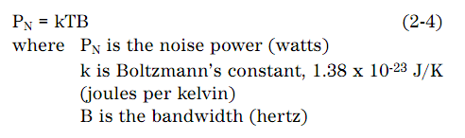
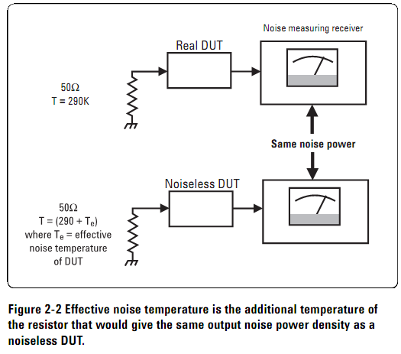

How to quantify RF noise?
Thermal Noise Power
Equiv. Noise Temperature
All types of RF noise are
captured in the above
definitions
At 290K, P_{N} = 4 x 10 ⁻²¹ W/Hz = -174dBm / Hz
Te = Equiv. Noise Temp. of DUT
G = Gain of DUT
Na = Additional DUT noise
VE2ZAZ
Notes:
Thermal noise power: Any electrical conductor contains electrons which are somewhat free to move around – more so in good conductors, less so in near-insulators. At normal temperatures, electrons are in random motion, although on average there is no net motion unless an electromotive force is applied. This random motion of electrons constitutes a fluctuating alternating current that can be detected as random noise. At any temperature above absolute zero (where all random motion stops) the thermal noise power generated in a conductor is proportional to its physical temperature on the absolute scale (measured in kelvin, K).
Equivalent noise Temp: Now imagine a device under test (DUT), such as an amplifier, connected between the 50Ω resistor and the noise-free receiver (Figure 2-2). The noise at the output of the DUT now has two components.
One is the amplified thermal noise from the input resistor at 290K. The second is the noise generated in the DUT itself. Note that the receiver cannot distinguish these two components of noise. To the receiver, the same output noise power density could be measured from a noise-free DUT with its input resistor heated to some higher temperature (290 + Te). In effect the real DUT is modeled as a noise-free equivalent device from which all internal noise sources have been removed. This is combined with an additional thermal noise source Te at the input. Te is the effective noise temperature of the DUT (sometimes called the equivalent noise temperature).
The advantage of the effective noise temperature concept is that it forms a common basis for measuring random electrical noise from any source, from a GaAsFET to a galaxy. There are many different types of electrical noise, and most of them are not truly thermal in origin. However, all types of random noise can be expressed as the equivalent amount of thermal noise that would be generated at a physical temperature Te.

Slide 5
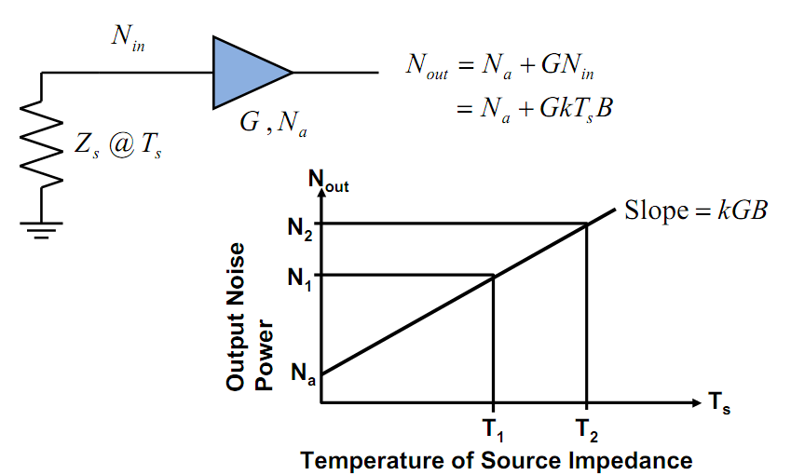
How to quantify RF noise?
Noise Power is linear with temperature.
DUT-added noise shifts the curve upward.
VE2ZAZ
Notes:
With a noise-free gain device, the red dotted line would represent the variation of Thermal noise power at the output as a function of temperature, with zero noise at zero Kelvin. The real life amplifier will instead cause a shift of output noise power due to its own generated noise. It is that shift upward that we want to measure.

Slide 6
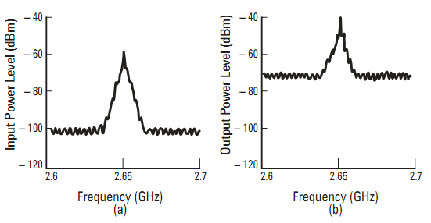
What is Noise Figure?
Noise figure (NF) is a measure of degradation of the signal-to-noise ratio (SNR) caused by the noise generated within a system.
  A perfect amplifier would amplify the noise at its input along with the signal, maintaining the same SNR at its input and output.
  A realistic amplifier also adds some extra noise from its own components and degrades the SNR.
Gain = 20dB
NF = 10dB
DUT
VE2ZAZ
Notes:
Figure (a) shows an example situation at the input of an amplifier. The depicted signal is 40 dB above the noise floor.
Figure (b) shows the situation at the amplifier output. The amplifier’s gain has boosted the signal by 20 dB. It also boosted the input noise level by 20 dB and then added its own noise. The output signal is now only 30 dB above the noise
floor. Since the degradation in signal-to-noise ratio is 10 dB, the amplifier has a 10 dB noise figure.

Slide 7



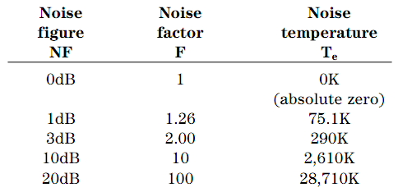
What is Noise Figure?
Mathematical representation
F = Noise FACTOR:
Signal-to-noise power ratio at the input divided by the signal-to-noise power ratio at the output. Always a positive value, >1.
NF = Noise FIGURE:
Logarithmic representation of Noise Factor, expressed in dB. Always a positive value, >0.
F = 1 + T_{e}/ T_{o}
where T_{o} = 290 K
VE2ZAZ

Slide 8
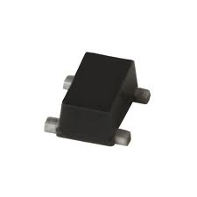


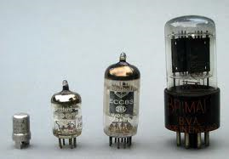
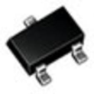

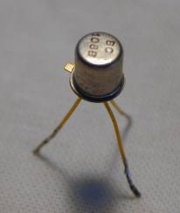

An Idea of NF Over The Years
1940-1960: Tubes, Nuvistor, BJT: > 3dB
1960-1980: BJT, FET, MOSFET: 1dB-3dB
1980-2000: GaAs FET: 0.5dB-1dB
2000-...: HEMPT, pHEMPT: < 0.2 dB
VE2ZAZ

Slide 9
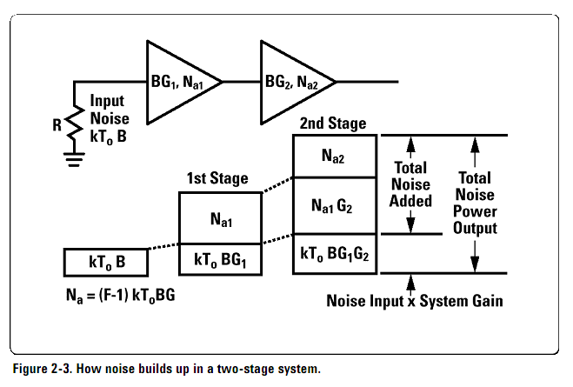
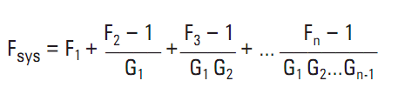
NF in Multi-Stage Systems?
If G₁ (gain of first stage) is sufficiently large, System NF is mostly dominated by first stage NF.
This is why Preamp NF is so important in low noise Rx applications (VHF/UHF/uWave)
VE2ZAZ

Slide 10
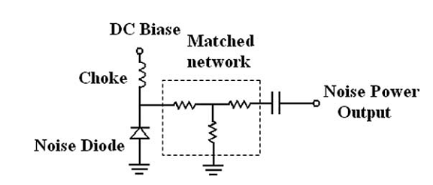
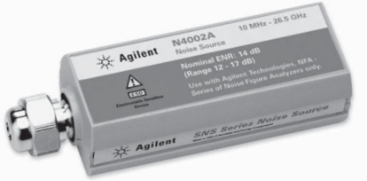
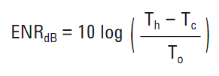
How to Measure NF ?
Easiest way to measure NF involves the use of a calibrated Noise Source
  Usually made of a stable noise diode
  and attenuator.
  Calibration data provides Excess Noise Ratio (ENR) expressed in dB.
    ENR is the difference in Noise Power (N) between “ON” and “OFF” source conditions.
    Sources typically come with ENR of 5dB or 15dB.
    Expressed vs. Frequency (tabular).
T_{h}: T of active source
T_{c}: T of inactive source
T_{o}: 290º Kelvin
VE2ZAZ

Slide 11
How to Measure NF ?
What techniques used?
  Y Factor Method: The most used, accurate, repetitive.
    Noise Figure Meter: The simplest and fastest.
    Spectrum Analyzer: More tedious and labor-intensive. Requires modern S.A. Not quite as accurate.
  Signal Generator Twice-Power Method: OK for high NF
  Direct Noise Measurement Method: OK for high NF
What instruments required?
  Noise Figure Meter: Best but more expensive -> dedicated.
  Spectrum analyzer: More common but less accurate
  Known bandwidth receiver: Much cheaper...
  Build your own? See reference at end of presentation.
VE2ZAZ

Slide 12


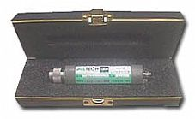
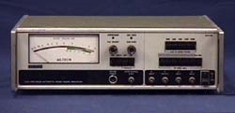
Y-Factor NF Measurement Method
Used by most NF meters and Spectrum Analyzers
Can be automated or performed manually,
Calibrated Noise Source required,
DUT gain not required,
Accurate, repetitive.
VE2ZAZ

Slide 13
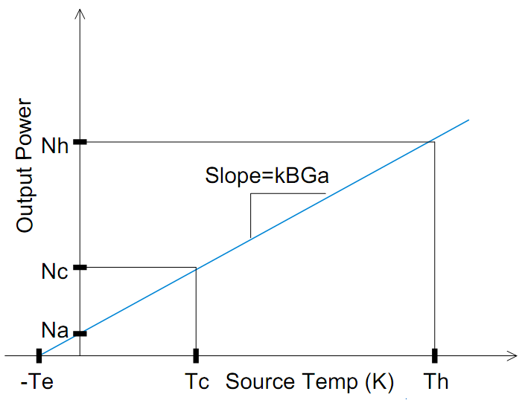
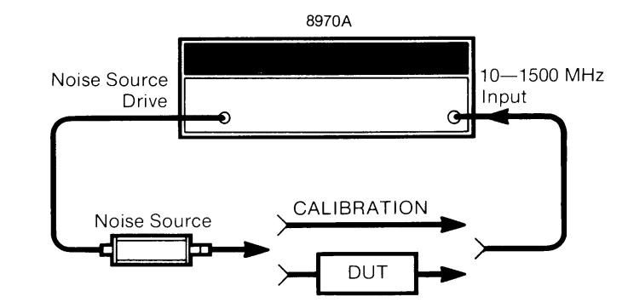
Y-Factor NF Measurement Method
Two-Step Method
  Calibration: Necessary to correct for the noise contribution of the test system and take temperature into account. Includes the input of the ENR data into the meter. Doing a “zero” by measuring Nh and Nc.
  Measurement: Introduces the DUT. Again, measuring Nh and Nc. Yields NF and Gain.
Y = Nh / Nc = Th / Tc
F = ENR
Y-1
VE2ZAZ
Notes:
Knowing the ENR data of the noise source and the current ambient temperature, the instrument makes noise measurements with the noise source in on and then in off state. With the measured noise power, it can extrapolate the curve and compute the equivalent noise temperature of the DUT, thus its NF.
Linear Gain can be easily calculated as a ratio:
(Noise source on - Noise source off) / (Noise source on - Noise source off)
The numerator is with DUT and the denom with the noise source alone.
One must know the Linear Gain to compute the true noise temp and NF of DUT.

Slide 14
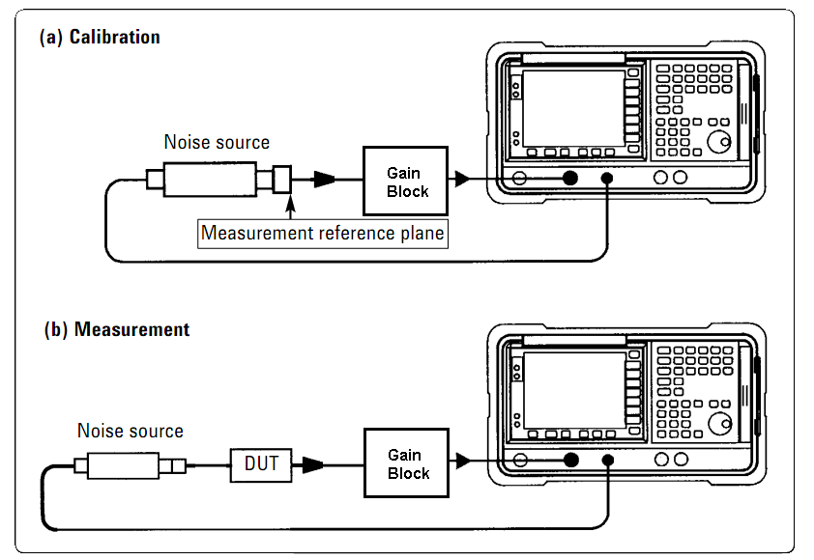
Y-Factor NF Measurement Method
...Using a Spectrum Analyzer
  Requires modern S.A that computes Noise Spectral Density dB/Hz of plotted spectrum (computerized S.A.).
  Four measurements must be made.
  Requires a calibrated noise head...
  Requires the 1-3MHz Resolution Bandwidth option to pick up enough noise for a meaningful measurement.
  Needs at least 30-40dB of low noise gain block ahead of the S.A. to compensate for its poor input noise figure.
  Will work for NF values as low as a 1-2 dB. But likely not accurate/stable/linear enough for sub-dB NF measurements.
VE2ZAZ
  See VE2AZX reference.
Notes:
Preamp is included in some newer SA. There should be enough gain to overcome the SA noise figure.
To check SA noise figure: Remove all attenuation in front of the mixer, terminate input and read the residual noise in dBm/Hz. Ex: a reading of -144 dBm/Hz indicates a 30 dB NF. Adding a preamp should reduce the SA noise figure to 2 - 5 dB.

Slide 15
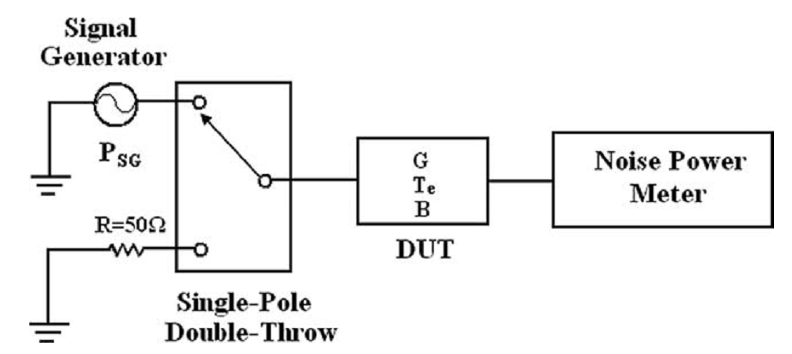

Other NF measurement Methods
Signal Generator Twice-Power Method
  Does not require a Noise Source,
  Useful for High NF devices,
  Need to know Rx Bandwidth,
  Two step Method
    Measure output power of terminated input DUT @ ~290K.
    Attach Signal Generator to input and adjust it to produce a 3dB increase in output power. The signal generator output power is equal to the total output noise power divided by the gain of DUT. Use formula below:
Or Spectrum Analyzer
VE2ZAZ

Slide 16
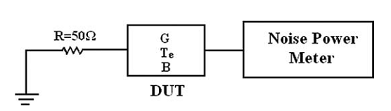

Other NF measurement Methods
Direct Measurement Method
  Does not require a Noise Source.
  Useful for High NF devices
  Need to know DUT Gain, Rx Bandwidth
  One step Method
    Measure output power of terminated input DUT @ ~290K. Use formula below:
Or Spectrum Analyzer
VE2ZAZ

Slide 17
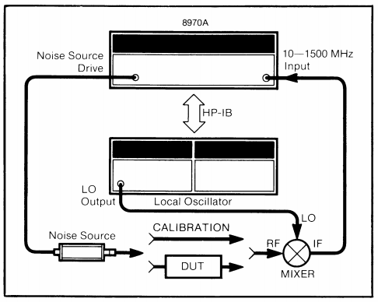
Measuring NF in the Microwaves?
Use an external Microwave Signal Generator
Add a Double-Balanced Mixer
VE2ZAZ
Notes:
If you can measure a noise power difference when inserting the DUT, then it is a good sign...
You can make DSB measurements for broadband DUTs,
SSB measurements on narrowband DUTs
You can do
fixed LO frequency, meter sweep
LO sweep, fixed meter frequency
Modern instruments support many different modes you can pick based on what you are trying to measure.

Slide 18
Measurement Uncertainties?
One must understand the potential measurement uncertainties.
  Actual temperature at measurement time
  Uncertainties increase as gain of DUT decreases
  Uncertainties increase as NF of DUT increases
  Externally induced noise (Lights, Power supplies, RF sources, noisy LO...)
  Impedance mismatch between source and DUT.
  Be careful with coaxial adapters and cables introduced or removed after calibration.
VE2ZAZ

Slide 19
NF Meas. Recommendations
Minimize the noise figure of the test system (especially when measuring low gain DUTs).
Reduce the magnitude of all mismatches by using isolators or pads. See Agilent Calculation spreasheet.
Minimize the number of adapters, and take good care of them.
Avoid DUT non-linearities. Avoid S.A. non-linearities.
Use Averaging to Avoid Display Jitter.
Choose the Appropriate Bandwidth.
Calibrate Noise Source ENR values regularly and use good pedigree calibration... (easier said than done!)
VE2ZAZ

Slide 20
The Challenges in Designing for Best NF
Stability: Be Careful!
  Watch for excessive out-of-band gain, usually at the low end.
  Scale back on gain to improve stability.
Narrowband vs.Broadband
  Best NF is usually not at a device input impedance of 50 Ohms.
    Narrowband: Input/Output matching optimization for best NF “relatively” straightforward.
    Broadband: Compromise on NF, Gain, S-Parameters, Stability...
Keep Input Losses to Minimum
  Every bit of attenuation is a direct hit on overall NF.
VE2ZAZ

Slide 21
References
Agilent, AN 57-1 Fundamentals of RF and Microwave Noise Figure Measurements
  http://cp.literature.agilent.com/litweb/pdf/5952-8255E.pdf
Agilent, AN 57-2 Noise Figure Measurement Accuracy – The Y-Factor Method
  http://cp.literature.agilent.com/litweb/pdf/5952-3706E.pdf
Agilent, Noise Figure Basics Presentation,Feb 24, 2009
  http://www.ieee.li/pdf/viewgraphs/noise_figure_measurements.pdf
Agilent, Spectrum and Signal Analyzer Measurements and Noise
  http://cp.literature.agilent.com/litweb/pdf/5966-4008E.pdf
Agilent, Online Noise Figure Uncertainty Calculator.
  http://sa.tm.agilent.com/noisefigure/NFUcalc.html
VE2AZX, Noise Figure Testing using a Spectrum Analyzer (spreadsheet)
  http://ve2azx.net/technical/NoiseFigMeasure.xls
VE2ZAZ, Amateur Radio and Electronics Website
  http://ve2zaz.net
VE5FP, An automatic Noise Figure Meter, Jim Koehler, QEX May/June 2007
VE2ZAZ

Slide 22
Measurement Time!
The HP 8970A
  10 MHz to 1500/1600 MHz, 1MHz increments,
  Temperature compensated,
  Calculates NF (0dB to +30dB)
  Calculates Gain (-20dB to +40dB).
  Accommodates typical Noise Sources on the market.
  Rapidly turns on/off the noise source to perform calculations
Hands on!
VE2ZAZ

Slide 23
Thanks!
VE2ZAZ
Notes:
Two Resonances typical of a crystal
A Series resonance (C1, L1) on marker 1 . Impedance minimum (lowest attenuation typical of series resonance. Phase shift = 0 degrees at resonance.
A Parallel resonance(C0,C1, L1) on marker 2. Called Anti-Resonance. Impedance maximum (highest attenuation typical of parallel resonance. Again, phase shift = 0 degrees at resonance.
Definition
motional capacitance Cl
motional inductance L1
series resistance R1,
shunt capacitance C0

