Slide 1
“Nowcasting” with DX Toolbox™
Doug Leach – VE3XK

Slide 2
Nowcasting with DX Toolbox™
There are several point-to-point propagation prediction programs, but DX Toolbox™ stands out by also providing realtime maps of projected signal strength from your QTH to the cursor location.
Includes dozens of windows with radio, solar and geomagnetic conditions for the DX operator.
Includes an HF Propagation tutorial.
Available for Mac OS9, Mac OSX, Windows 98/NT/2000/XP/Vista/System 7, iPhone, iPad, & iPod Touch
Free trial download. Registration US $24.99

Slide 3
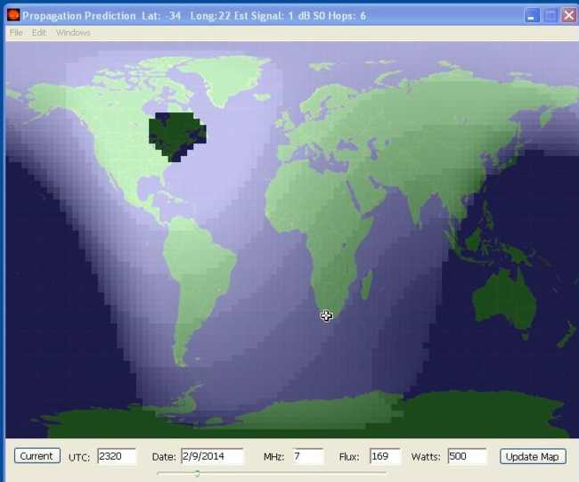
Nowcasting with DX Toolbox™
This screen sets DX Toolbox apart from other propagation software that merely predicts path loss. 40M CW signal from VE3XK at ZS will be just 1 dB over noise floor at 23:20 on 2/9/14 even with 500W.

Slide 4
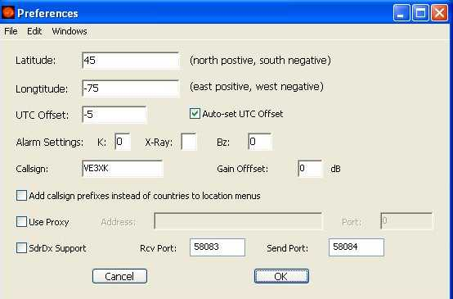
Nowcasting with DX Toolbox™
Everything starts with the Preferences screen.

Slide 5
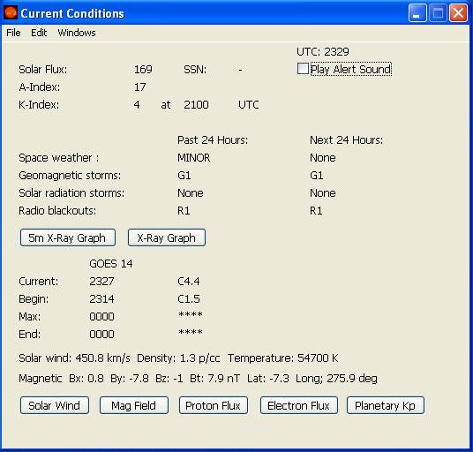
Nowcasting with DX Toolbox™
This screen shows current conditions for current date/time. Data is obtained from the internet. The buttons provide access to various related graphs.
This is the basic screen.

Slide 6
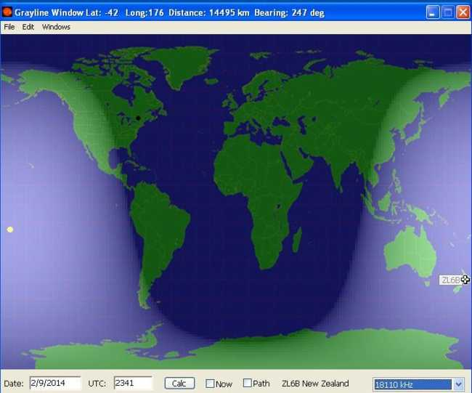
Nowcasting with DX Toolbox™
Conventional grayline map for 23:41UTC on Feb 9, 2014. At the moment this screen was grabbed, the ZL6B 17M IARU Beacon was transmitting. The distance from VE3XK to the beacon is 14,495 km at 247°

Slide 7
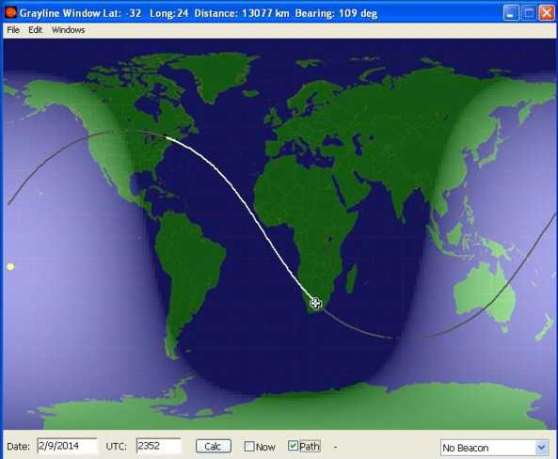
Nowcasting with DX Toolbox™
Screen shows the transmission path from VE3XK to South Africa. If the map was Azimuthal Projection instead of Mercator Projection, the transmission path would be a straight line and the grayline circular, showing the sunlight footprint.

Slide 8
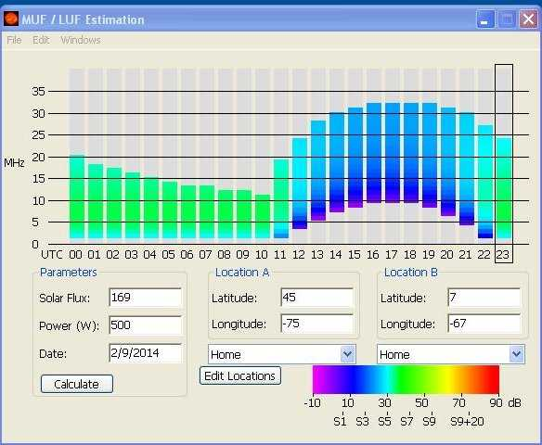
Nowcasting with DX Toolbox™
Screen shows the MUF (Maximum Useable Frequency) and LUF between VE3XK and Trinidad over the 24 hour period 2/9/14. You can see at a glance why the north-south path is so good when 10M is open. Sig S5 at 18:00UTC

Slide 9
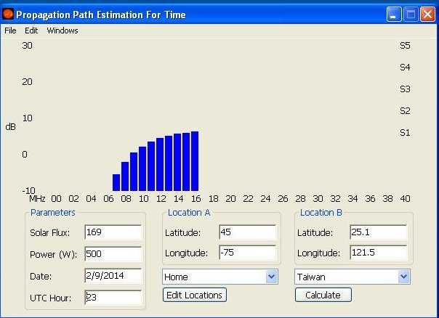
Nowcasting with DX Toolbox™
This screen shows the best frequency (20M) to work Taiwan on 2/9/14 at 23:00 UTC.With 500 watts to a vertical and projected S1 at the far end you can’t expect to crack a pileup.

Slide 10
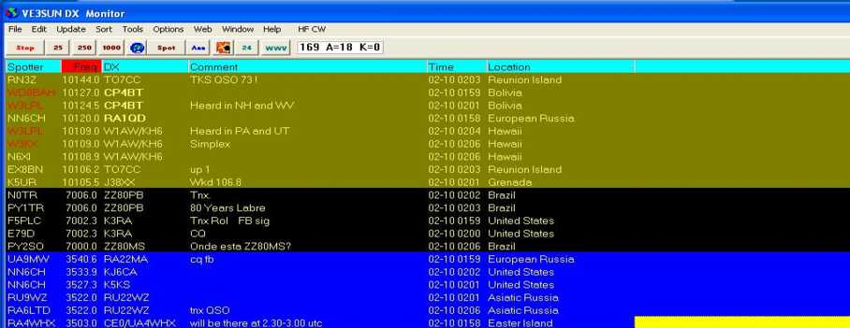
An Enhanced Spotting Program
Screen shot shows the VE3SUN DX Monitor™ program displaying DX CW spots on 30, 40 and 80M, sorted by mode, band and frequency. Stations using Logbook of The World are shown in bold typeface. Spots by “local” stations (selectable distance) are shown in red. Very useful aide.

Slide 11
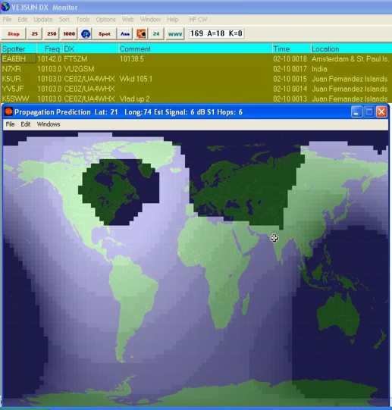

Putting It All Together
This screen is where DX Toolbox pays off. DX Monitor at top shows the CW spots on 30M. I want to work VU2GSM as I need India on 30M, so I call with no reply. A glance at the DX Toolbox Propagation Prediction screen shows that it would take 6 hops and signal strength at VU2GSM would be only 6 dB over his noise floor – a real long shot.

Slide 12
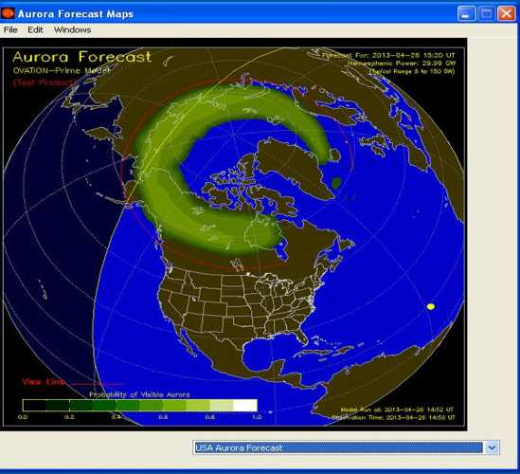

Aurora on DX Toolbox™
Among the many additional images included in DX Toolbox are the next two.
1. North America Aurora Forecast Map (Azimuthal) for date/time shown.

Slide 13
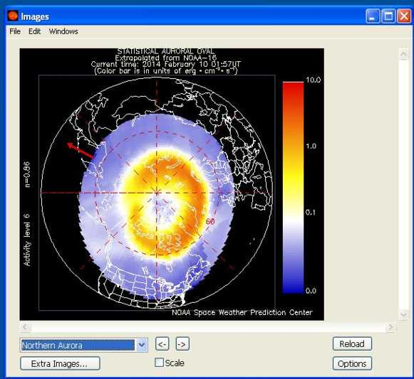
More Aurora on DX Toolbox™
2. Northern Aurora Map (also Azimuthal) at date/time shown. Note the intensity scale at right.

Slide 14
Other Features of DX Toolbox™
Realtime Displays of:
Reports and Forecasts :
Solar Flux
A-Index
K-Index
Solar Flux Index
Sun Spot Number
Solar Wind
Earth’s Magnetic Field
Proton and Electron Flux Levels
Blackout and Storm Condx
NCDXF/IARU Beacons
WWV Geophysical Alert
27 Day Space Outlook
45 Day AP Forecast
Geomagnetic Data
Particle Data
Solar Data
Magnetometer Analysis
Predicted SSN and SFI
Space Weather Predictions
and much more

Slide 15
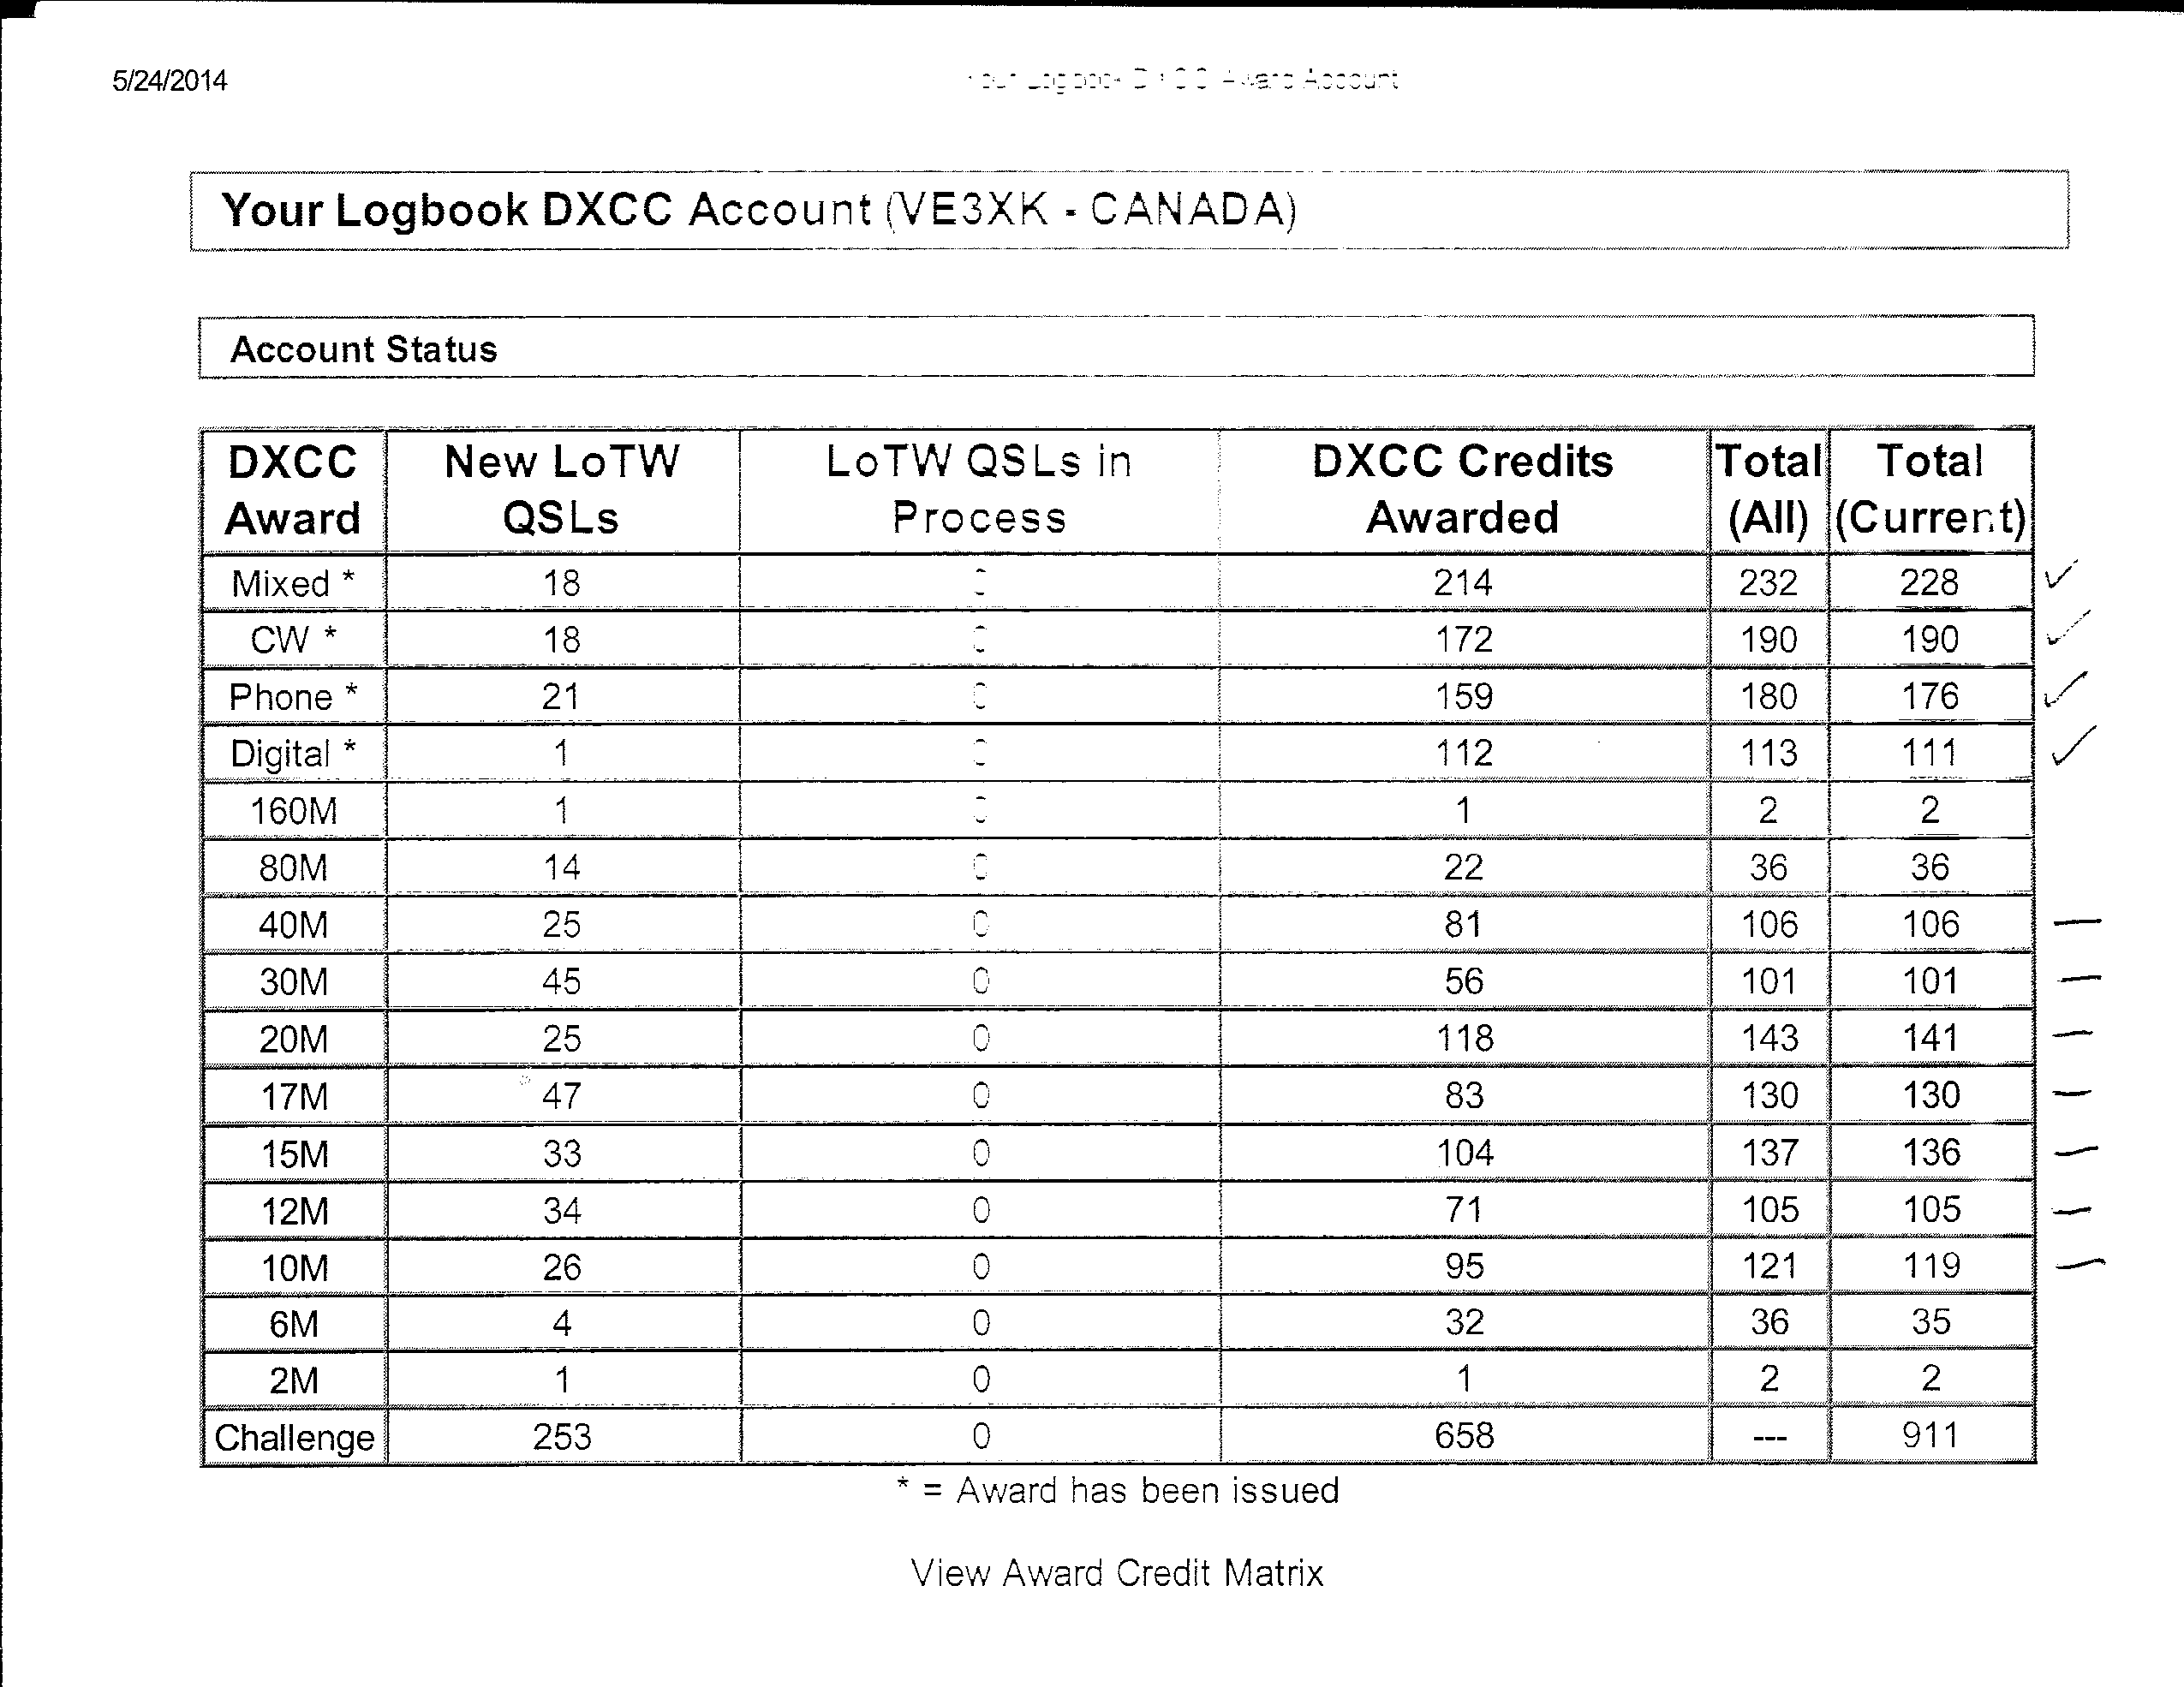
Does All This Work for Me?

Slide 16
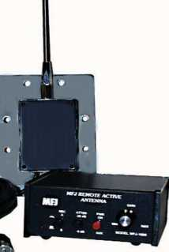
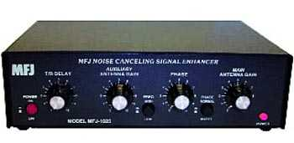
Yes it works but ….
The previous awards list confirms DX Toolbox™ works but it would be better to be able to enhance the signal or subtract noise from signal.
I am now experimenting with the MFJ-1024 Active antenna (top) in my attic and the MFJ-1025 Noise Canceling Signal Enhancer (bottom).
MFJ-1025 uses phasing of my 43 ft vertical and the MFJ-1024 to rotate the pattern and to add or subtract the signals.

Slide 17
Nowcasting with DX Toolbox™
Questions?
Thank You
de VE3XK

