Slide 1
Spectrum Analyzers
And
Network Analyzers
The Whats, Whys and Hows...
Bertrand Zauhar, VE2ZAZ
ve2zaz@amsat.org
June 2010

Slide 2
Today's Program
Definitions of Spectrum and Network Analyzers,
Differences between SNA and VNA,
Inner guts of both types of Analyzers,
What you get with them,
Calibration Kits,
Buying one?
Example measurements,
Measurement of your devices?

Slide 3
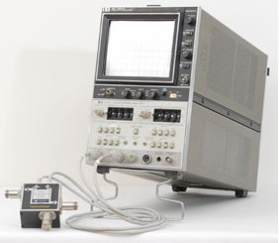
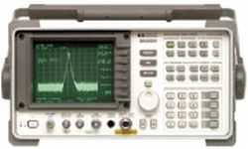
Spectrum and Network Analyzers
Look somewhat similar
  CRT, Knobs, buttons, span, filters, RF input...
Both work in the Frequency Domain
  Sweep narrow to wide parts of frequency spectrum
  Detect amplitudes and/or phase
  Have similar displaying capabilities
HP 8560A SA
HP 8755A SNA
Notes:
Oscilloscopes display amplitudes as a function of time.
Spectrum and Network Analyzers display amplitudes as a function of frequency.

Slide 4
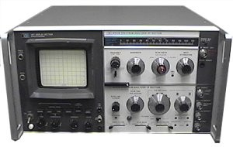
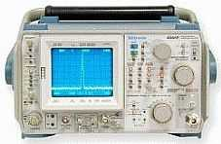
RF Spectrum Analyzer – Definition
An RF spectrum analyzer is a device used to examine the spectral composition of some electrical waveform. It may also measure the power spectrum. Wikipedia
Translation: It is a fast-sweeping tuned radio receiver that displays signal amplitudes at various frequencies.
HP 141T SA
HP 494AP SA

Slide 5
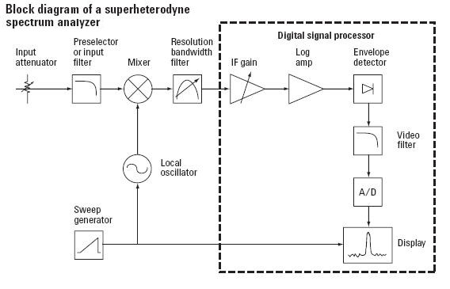
Spectrum Analyzer – Block Diagram
Notes:
Sweeping Ramp Controls
Horiz deflection
Frequency sweep Linear
Sweeping Ramp Can be synchronous to AC mains
Useful for QRN source detection
Prescaler reduces image spurrs by limiting bandwidth of incoming signal
Relationship between:
sweep speed
Resolution Bandwidth
Video bandwidth
Digital Signal Processor is all analog one older SA's
No A/D required

Slide 6
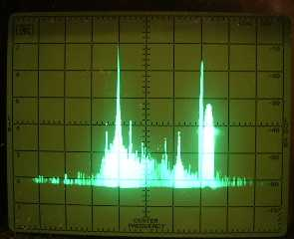
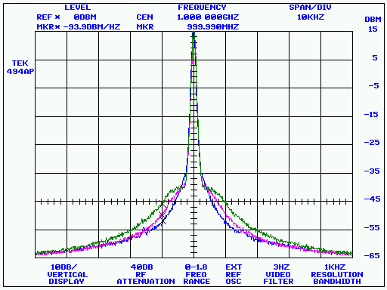
Spectrum Analyzer – What you get
Analog / Storage CRT
Synthesized with u-processor
Notes:
CRT/Trace Storage allows to see a broader span, otherwise sweep s to slow for the CRT and the eyes to get a complete picture
The broader the sweep, the better it is to have storage capability.

Slide 7
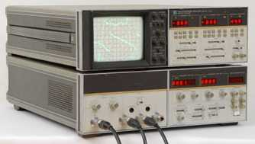
Network Analyzer - Definition
An instrument used to analyze the properties of electrical networks, especially those properties associated with the reflection and transmission of electrical signals known as scattering parameters (S-parameters). Wikipedia
Translation: It is a fast-sweeping tuned or wideband radio receiver that displays relative signal amplitudes (and optionally phases) when compared to a reference at various frequencies.
HP 8505A VNA

Slide 8

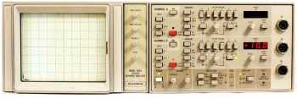
Network Analyzer – Two Types
Scalar Network Analyzer (SNA)
  Measures amplitude properties only. Simpler design ($)‏
  Usually requires an external sweeping RF source
  May have external RF detectors
Vector Network Analyzer (VNA)
  Measures both amplitude and phase properties with greater dynamic range and accuracy. Complex unit ($$$)‏
  Has built-in sweeping RF source (generally)‏
  Has built-in Tuned RF receiver
Wiltron 560 SNA
HP 8753C VNA
Notes:
SNA
RF source controlled by SNA's voltage ramp. Adjustments required
Broadband RF detectors
Provide a DC voltage proportional to the magnitude of the incoming signal.
However, ignore any information regarding the phase of the incoming signal
Is broadband, may cause a mis-interpretation especially when looking for small signals (harmonics also get detected)‏
VNA
Accuracy and stability are key to internal RF source
Frequency Resolution typically down to 1Hz
Dynamic Range in excess of 100dB
Phase accuracy down t 0.1 degrees
Require very good interconnecting cables (mechanically stable)‏
Requires calibration before use.

Slide 9
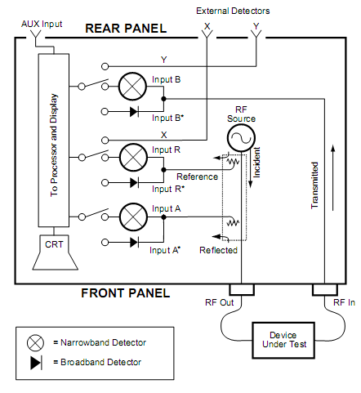
Network Analyzer – Block Diagram
Notes:
Narrowband Detector = Tuned Receiver
This one has built-in source and RF Detectors
Could also be a Wiltron 560 SNA and sweep generator like HP 8620 or 8660 series. Cheaper solution.

Slide 10
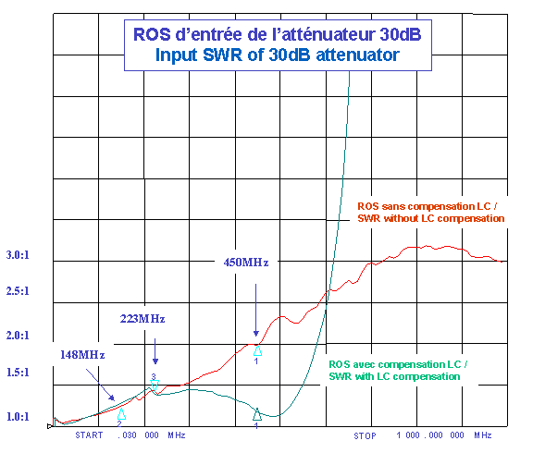
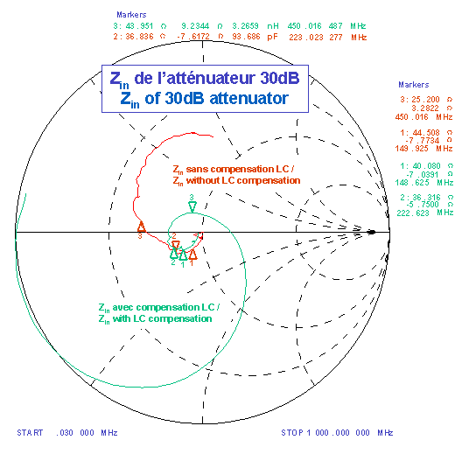
Network Analyzer – What you get
SNA or VNA
VNA
Notes:
Both SNA and VNA
Amplitude plots of Transmission and reflection coefficients in dB, VSWR
Great for displaying filter response, antenna VSWR.
Very useful for tuning filters, duplexers and preamp front-ends !
How to know what to change to improve matching? -> VNA
May have markers to indicate impedance in selected locations
VNA
Amplitude plots of Transmission and Reflection coefficients in dB, VSWR, plus
Phase shift, group delay, complex impedance (Resistance and Reactance)‏
Allows to analyze and perform the matching of passive devices (antennas, filters) by knowing the type and size of reactance seen (capacitive or inductive)‏

Slide 11
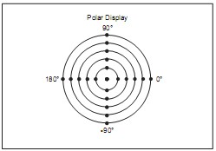
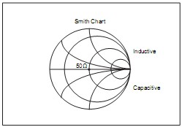
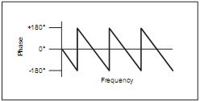
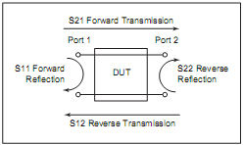
Vector Network Analyzers
Can display data in various forms
Can usually express results in the form of S-parameters directly.
  Completely characterize a
  one-port or two-port linear or
  passive device
Linear Phase with Frequency
Polar Plot
Smith Chart

Slide 12
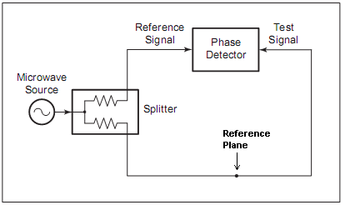
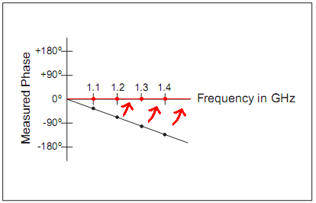
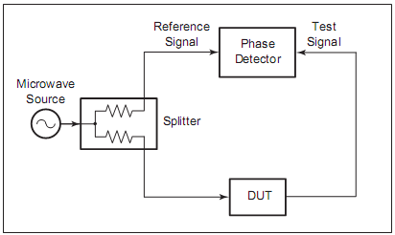
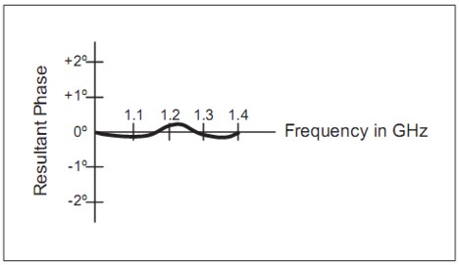
VNA Calibration before measurement
Ampl. &
Phase
Detectors
=
Ampl. &
Phase
Detectors
=

Slide 13
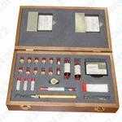
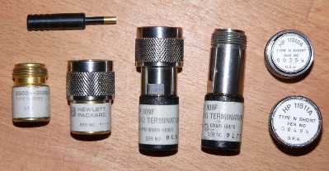
Some Calibration Required...
VNAs require performing a “zero” to bring the reference plane at the Device-Under-Test point.
Cal Kits
  Short, Open, Termination and Thru.
  Expensive!!!
Make your own using good quality connectors, a termination and a bit of imagination...

Slide 14
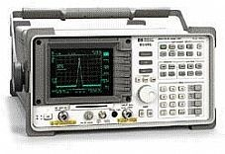
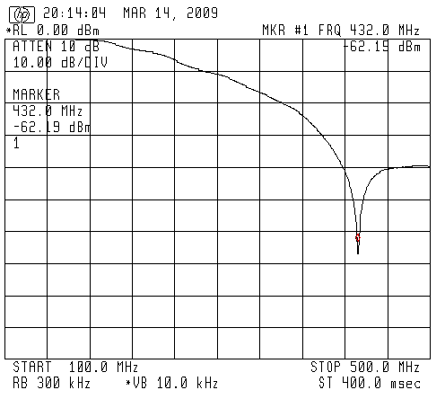
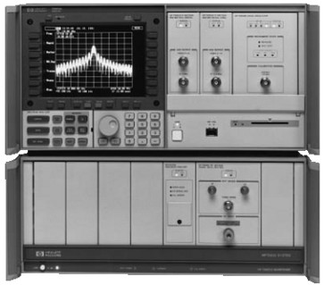
SA can make a good SNA
With addition of Tracking Generator
HP 8594A SA
HP 70000 SA

Slide 15
Buying a Spectrum Analyzer?
  Prices vary from ~ hundreds$ to thousands$.
  Good for general purpose experimenting and test. For example, required for cavity duplexer adjustment.
  CRT Trace Storage capability is a must.
  Addition of Tracking generator is a wise move.
  It is nice to be able to capture the plots. Need 1980's grade (GP-IB bus). Otherwise take screen pictures.
  The HP-141T mainframe SA is good entry point.
  Lab-Grade units keep their value.

Slide 16
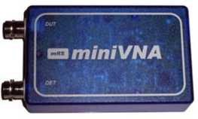
Buying a Network Analyzer?
  Classic VNAs are expensive (min. 1000$). Keep their value.
  SNA....Better off with SA and Tracking Generator.
  Cheaper newer models available (use the computer for display/control). Not as broadband, not as accurate as classic lab-grade VNAs. Require a PC.
    MiniVNA, max. 180MHz
    N2PK Vector Network Analyzer, max. 60MHz, a kit.
    VNA 2180, max. 180MHz
  Antenna Analyzers, a possibility...Limited in frequency and measurement range, accuracy, but are small and can be connected up at the antenna feedpoint.
    MFJ-269, HF, VHF, UHF
    AEA CIA-HF, HF
    Autek RF-1, HF only

Slide 17
Want more?
Spectrum Analyzer tutorial
  http://www.radio-electronics.com/info/t_and_m/spectrum_analyser/rf-analyzer-basics-tutorial.php
  http:///www.home.agilent.com .
    Spectrum Analyzer Basics (AN 150)‏
    Spectrum Analysis Basics: From 1997 Back to Basics Seminar
Network Analyzer tutorial
  http://www.radio-electronics.com/info/t_and_m/rf-network-analyzer/analyser-basics-tutorial.php
  http:///www.home.agilent.com .
    Network Analyzer Basics
    Network Analysis Basics - Architecture Of Network Analyzers (AN 1287-2)‏
Smith Chart Tools (Online Java Applets)‏
  http://www.amanogawa.com/archive/transmissionB.html
  http://www.bessernet.com/jobAids/jSmith/jSmith.html

Slide 18
Today's Measurements on the VNA
Crystal Resonance
1.56GHz Low-Pass Filter
HF Lowpass Filter
2.4GHz Helix antenna
Tektronix termination
Your Device?

Slide 19
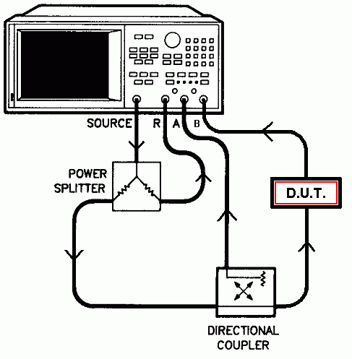
Today's Measurements on the VNA
  Using the HP 8753C VNA (0.5MHz to 3000MHz)‏
The Setup
Not used for VSWR, S₁₁ or reflection loss

Slide 20
Backup Slides

Slide 21
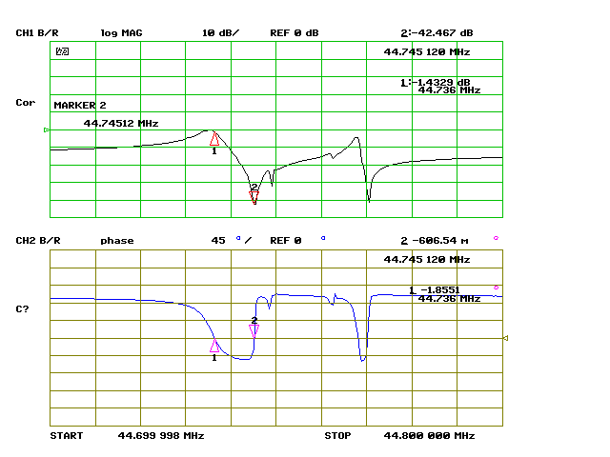
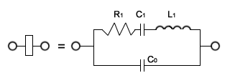
Crystal Resonance
Notes:
Two Resonances typical of a crystal
A Series resonance (C1, L1) on marker 1 . Impedance minimum (lowest attenuation typical of series resonance. Phase shift = 0 degrees at resonance.
A Parallel resonance(C0,C1, L1) on marker 2. Called Anti-Resonance. Impedance maximum (highest attenuation typical of parallel resonance. Again, phase shift = 0 degrees at resonance.
Definition
motional capacitance Cl
motional inductance L1
series resistance R1,
shunt capacitance C0

Slide 22
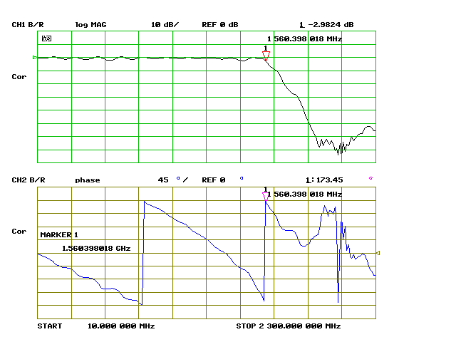
1.56GHz Low-Pass Filter

Slide 23
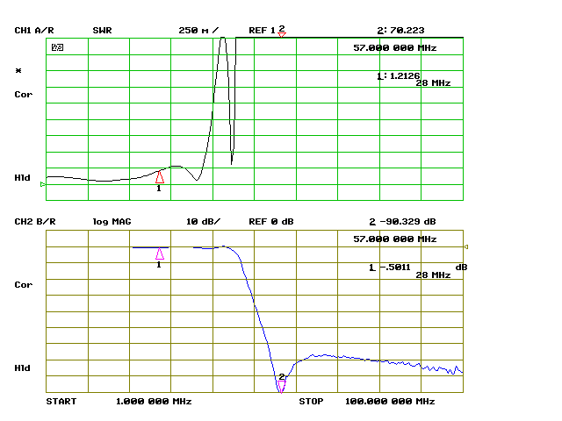
HF Low-Pass Filter

Slide 24
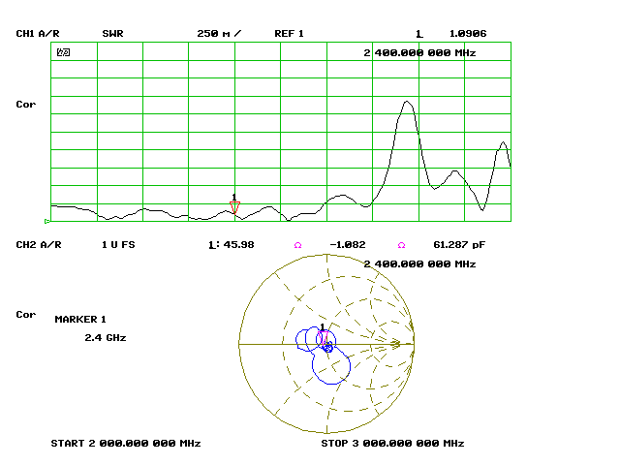
2.4GHz Helix Antenna

Slide 25
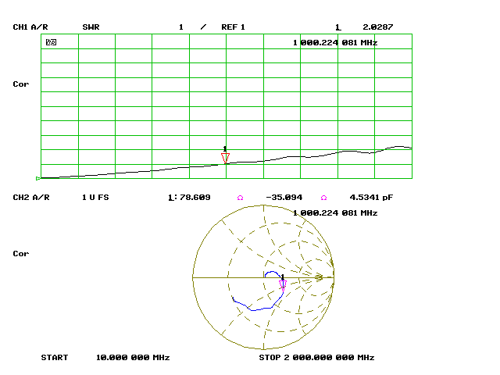
Tektronix 50-Ohm BNC Termination

Slide 26
Two Types of Spectrum Analyzers
Swept
  Traditional Heterodyne design.
  The most popular and least costly
  Has wider frequency coverage (GHz...)‏
  Has limitations in capturing bursty or complex events
  Provides only amplitude information
Real-Time (Fourier Transform)‏
  RF samples are taken by ADC in the time domain
  Fourier Transform and other post-processing (math) is applied to the samples at various frequency bins.
  Is much better in capturing complex or fast changing signals
  Provides both amplitude and phase info, thanks to FFT
  Has frequency range limited by ADC.
  More costly
Notes:
A PC + sound card are a Real-Time (FFT) Spectrum Analyzer

Slide 27
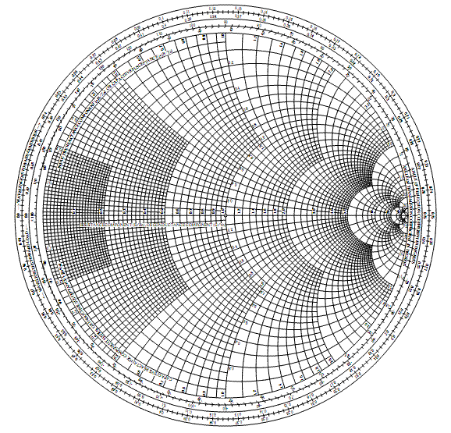
The Smith Chart
Inductive Reactance
Perfect Match
Open
Short
Capacitive Reactance

