Slide 1
D-STAR System VA3ODG
Update – 3 August, 2010
For West Carleton Amateur Radio Club
By Rick Bandla VE3CVG

Slide 2
D-STAR ← --> Internet
D-STAR architecture is highly dependent on a reliable and fast internet connection.
D-STAR system is functional (locally) without internet but strongest features of D-STAR are unavailable.

Slide 3
Problems With The Wi-Fi Internet Connection
No suitable hardwired internet is available at YMCA VA3ODG radio site, so we used a 2.4GHz wi-fi feed from VA3YH to VA3ODG
Internet for computers, blue tooth, entertainment equipment, commercial equipment, all vying for same 2.4GHz ISM channels
Clutter in path from VA3YH to VA3ODG
Strong signal - target for hackers
Net Result: very unstable connection, became frustrating and impossible to trouble shoot the system. Disappointed user group.

Slide 4
Options
Modify the wired internet feed from the YMCA to make it useable for D-STAR – this is not likely
Purchase commercial internet feed – while this is not a closed door, we do not presently have the $30/mnth
Upgrade existing wireless feed – this was the chosen approach

Slide 5
Solution
We acquired specialized 100mw wireless technology for both ends of the internet extension
Supports proprietary TDMA protocol
Covers the ham band outside of the ISM band
May be optioned for point-to-point radio
Supports half channels
Locks to mac
Uses directional 1 foot dish – 23dBi gain. Pole-mount included
No RF cabling - entire unit at each end is located right in the dish feed
Powered by POE (included) i.e. ethernet cable plugs into dish feed
Cost is $90/end

Slide 6
Installation
Hard part done by Dale VE3XZT and company
Internet feed, routing, etc. provided by Ying VA3YH
Support and nagging by Rick VE3CVG
Work done June 23 and 29th
No setup software required, setup is via built-in web pages

Slide 7
Results
Almost worked out of the box, required some conditioning
Basically a transparent pipe
Has been very stable so far
Very good signal quality –54dBm signal with a –96dBm noise floor

Slide 8
Where the Money Went
Received $300 from WCARC
Cost of new gateway computer abt $160
Cost of new wireless equipment abt $180
Installation work and materials donated by Dale VE3XZT
Internet continues to be donated by Ying VA3YH
Thankyou for the financial assistance!!!

Slide 9
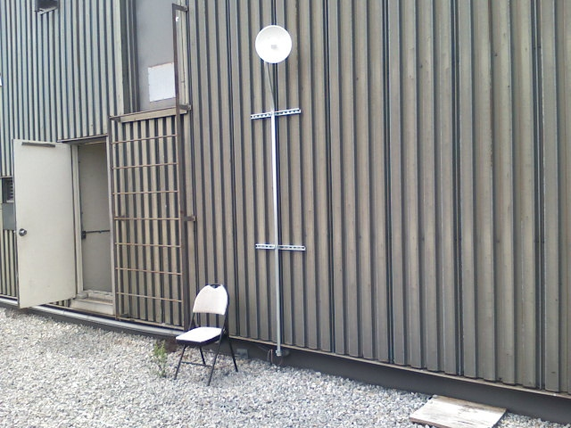
73

