Slide 1
WCARC Beacons
On 33cm & 23cm
By Rick Bandla VE3CVG
October 1, 2013

Slide 2
Why We Have Beacons
Signal Source to test our equipment including antennas
Direction Reference for rovers and rotators
Propagation Indicator for weak signal work
Telemetry (embedded data)
Experimentation

Slide 3
Characteristics of Beacons
On High Ground (to be heard)
Often low RF power output
Reliable
  Robust
  Emergency Powered
Consistent with Other Beacons
Identifiable
  Unique Signature
  Location Indicator
Well Documented

Slide 4
WCARC Beacons
Complete modules with keyer, rf module and filtering, custom made and tested by Bruce Shurtz W7BAS for $130. See http://www.signalblox.com/Synthesizers.html
Keyer code is W7BAS hack of KD7TS work, w/ permission
Programmable 90 Mhz - 1300 Mhz
Excellent Phase Noise
On-Board High Stability TCXO w input for user Ref Osc. 2-26 Mhz (GPS, Rubidium, OXCO etc...)
+5 to +10 dbm output
Low-Pass Filtering on output (nice harmonics if filter removed)
Very small 2" x 2" PCB
Excellent osc replacement for W1GHZ, DEMI Transverters
Phase Noise, Power & Harmonic Plots emailed w every unit
Power requirements 8-20VDC @ 50ma

Slide 5
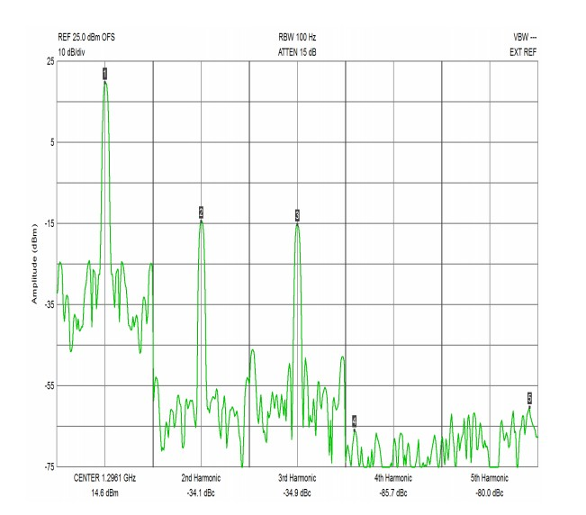
1296.060 Module Harmonics

Slide 6
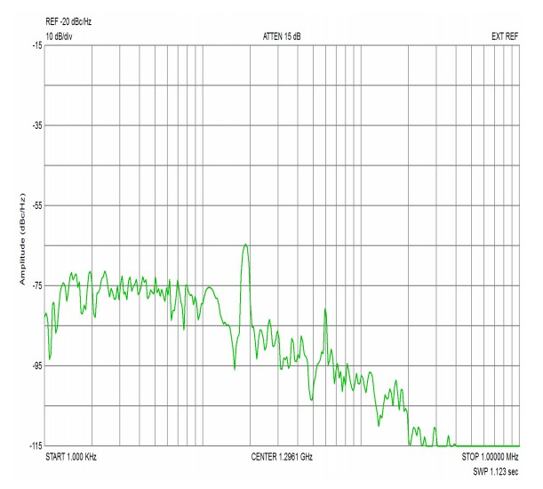
1296.060 Module Phase Noise

Slide 7
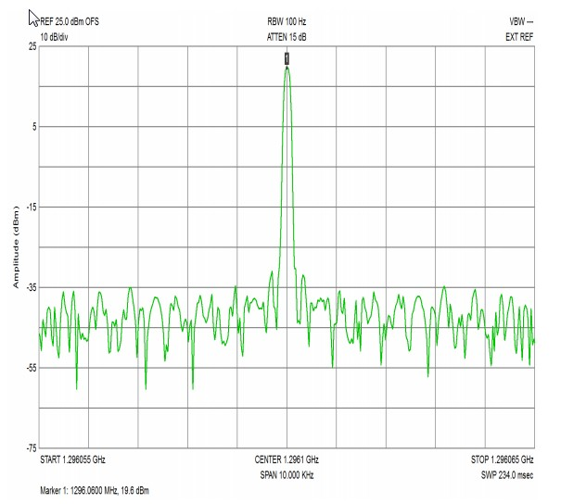
1296.060 Module Power Out

Slide 8
Big Wheel Antennas
Called the Big Wheel, or clover leaf antenna because of its shape
Consists of 3 full wave loops fed in parallel. A single big wheel has a gain of roughly 2-3dBd. Phasing 2 big wheels mounted one above the other will result in a gain (in the horizontal plane) of about 5dBd. This is similar to a small Yagi, but in a full 360 degree pattern.
See Roger Lapthorn’s (G3XBM) QRP site at https://sites.google.com/site/g3xbmqrp3/antennas/bigwheel

Slide 9
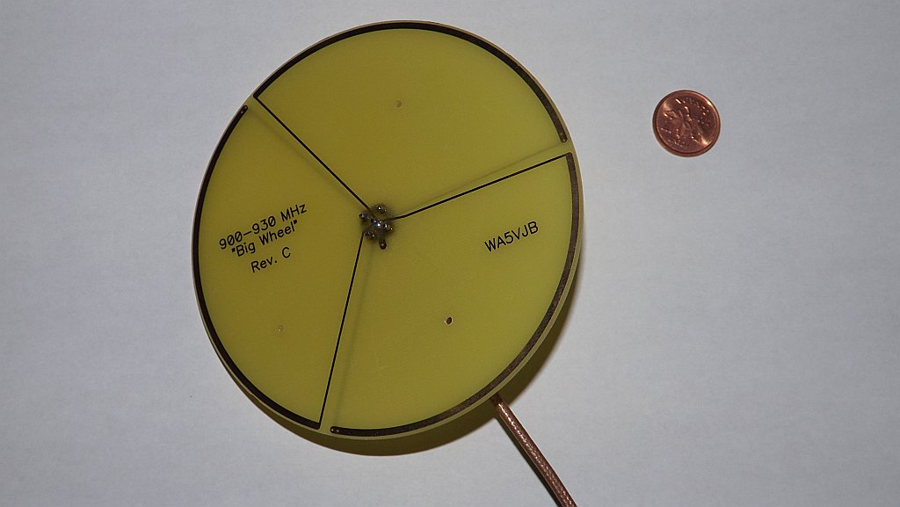
Beacon Antenna t – 903MHz

Slide 10
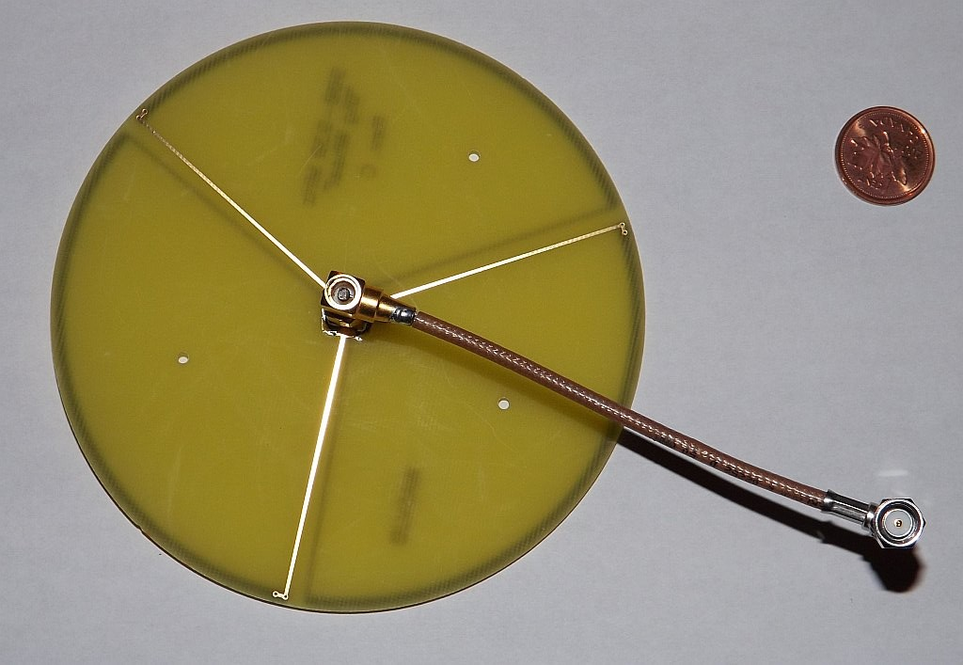
Beacon Antenna b – 903MHz

Slide 11
33cm or 903MHz Beacon
Frequency is 903.360MHz
Power is 100mw
Elevation is approximately 170’ AGL
Transmission Mode is CW:VVV DE VE3WCC IN FN25DJ
Antenna is a horizontally polarized miniature Big Wheel plated circuit board antenna by Kent Britain (WA5VJB) see http://www.wa5vjb.com/
Antenna gain is about 2 dBd horizontal omni
Activated March 2013

Slide 12
23cm or 1296MHz Beacon
Frequency is 1296.060MHz
Power is 100mw
Elevation is approximately 170’ AGL
Transmission Mode is CW:VVV DE VE3WCC IN FN25DJ
Antenna is a horizontally polarized miniature Big Wheel plated circuit board antenna by Kent Britain (WA5VJB) see http://www.wa5vjb.com/
Antenna gain is about 2 dBd horizontal omni
Activated March 2013

Slide 13
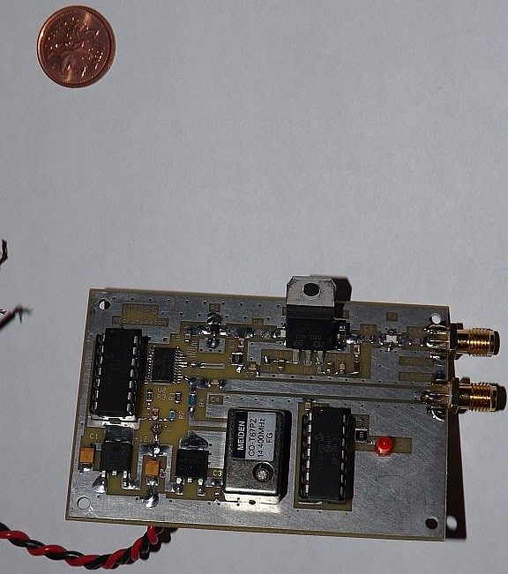
Beacon Module t

Slide 14
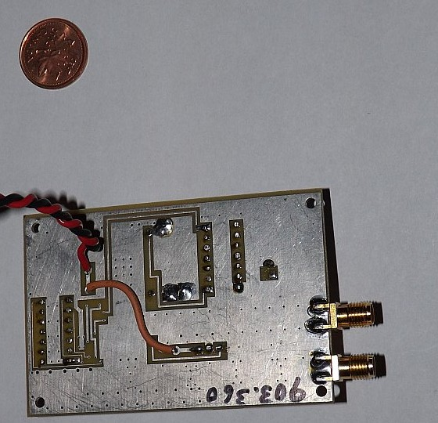
Beacon Module b

Slide 15
More Info
Both the 903 and 1296 MHz beacons are self contained (except for remote power feed). There is no RF feedline or external antenna.
Antenna, transmitter and CW encoder are encapsulated in PVC drain pipe
Suspended on cross-arm attached to D-STAR antenna mast

Slide 16
How Much Power is Enough?
These modules are only 100mw. Small solid state PA modules can be added to the package. This adds complexity, filtering requirements and cost.
I can hear them adequately at my QTH in Cumberland (FN25hm)
No other reports received to date.
No official requests for increased power.
Low activity level on these bands (unfortunately)

Slide 17

Beacon Encapsulation 1

Slide 18
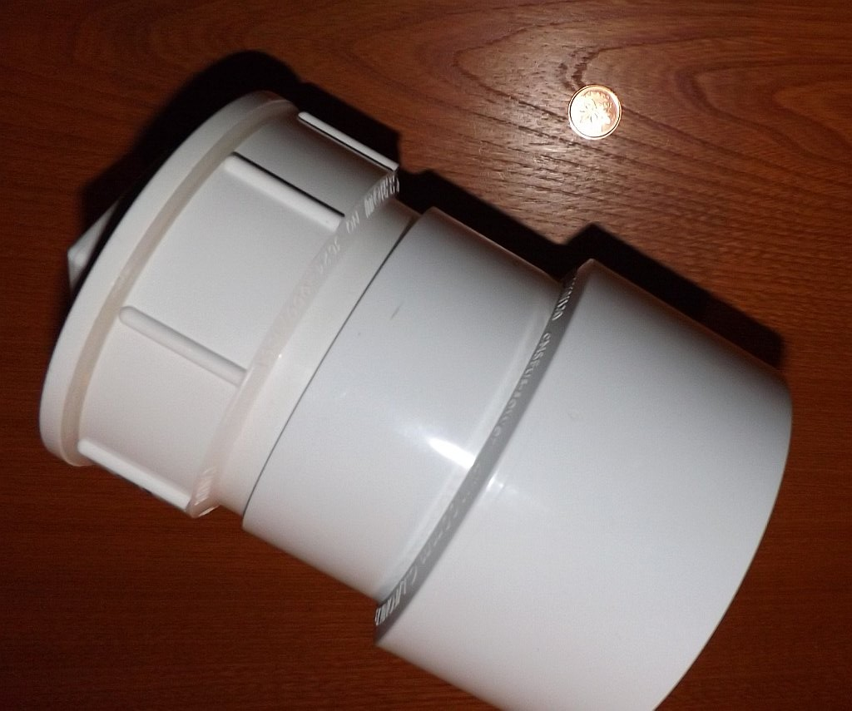
Beacon Encapsulation 2

Slide 19
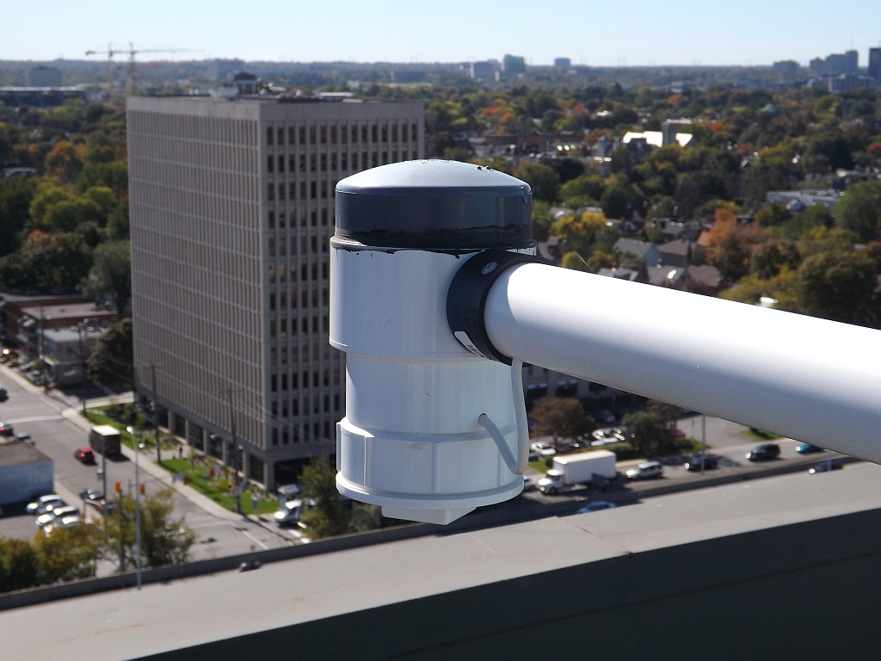
Beacon Encapsulation 3

Slide 20
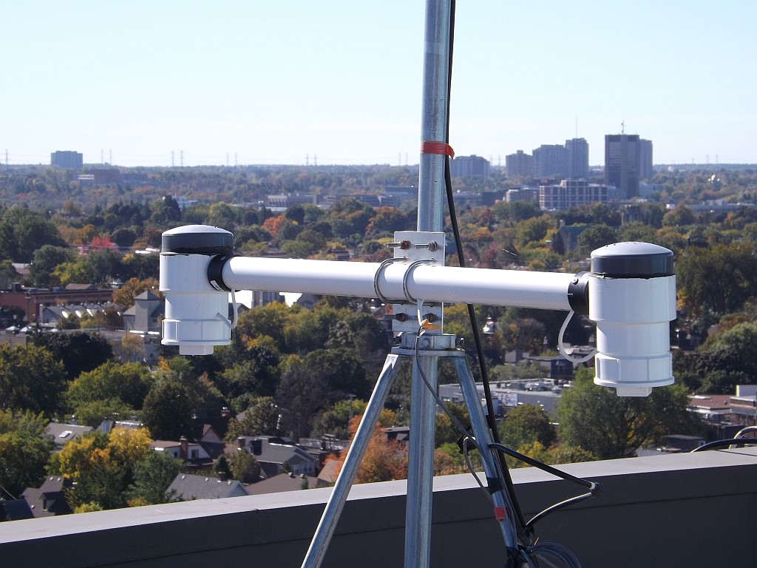
Beacon Cross Arm 1

Slide 21
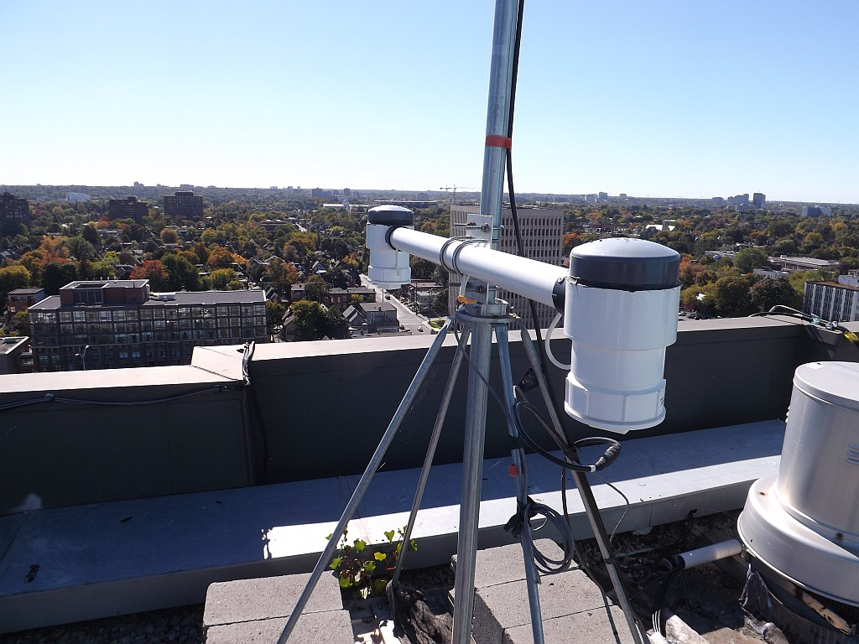
Beacon Cross Arm 2

Slide 22

The View From the Y

Slide 23
73 de
Rick (VE3CVG)

