Slide 1
Apache ANAN-10 SDR
By
Rick Bandla (VE3CVG)
October 1, 2013
For WCARC

Slide 2
Apache ANAN-10
This is a digital-down-conversion (DDC) and digital-up-conversion (DUC) Software Defined HF transceiver
Does not require a sound card, DSP, Firewire, or USB intf.
Based on open source Hermes Board which includes Mercury (RX + Alex filters) + Metis (Ethernet) + Penelope (TX) TAPR boards + 15W Apollo PA
Recommended: i3 2GHz CPU and 4GB RAM
1000mbs (Gigabit) capable ethernet full duplex
13.8vdc @7A
firmware upgradeable
S/W - Suggest HPSDR/OpenHDR – Unlike Flex 6000 series, it is FREE & upgraded regularly
Cost: under $1500 - surpasses Flex 5000 performance

Slide 3
The Key is FPGA
Field Programmable Gate Arrays
These are large sets of gates in a reconfigure-able array.
Chips can be reprogrammed by code.
These are fast!

Slide 4
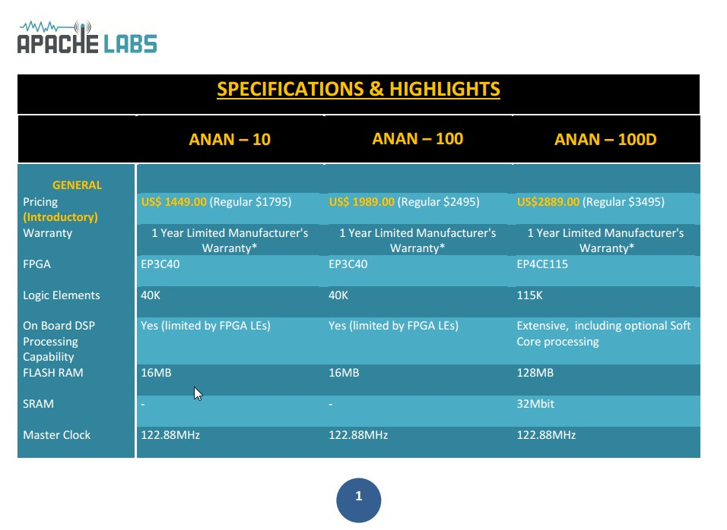
ANAN-10 Specs 1

Slide 5
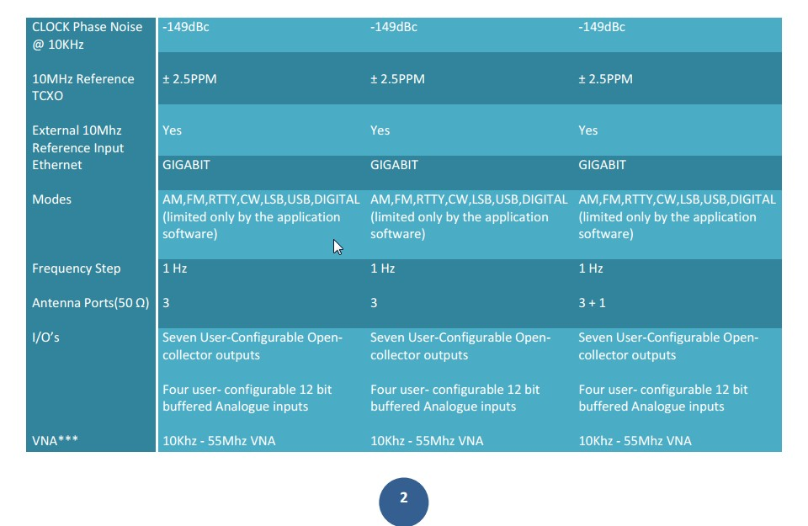
ANAN-10 Specs 2

Slide 6
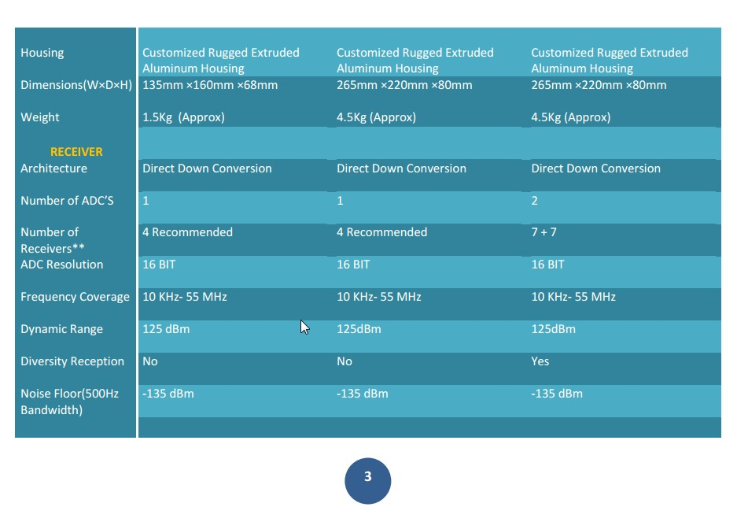
ANAN-10 Specs 3

Slide 7
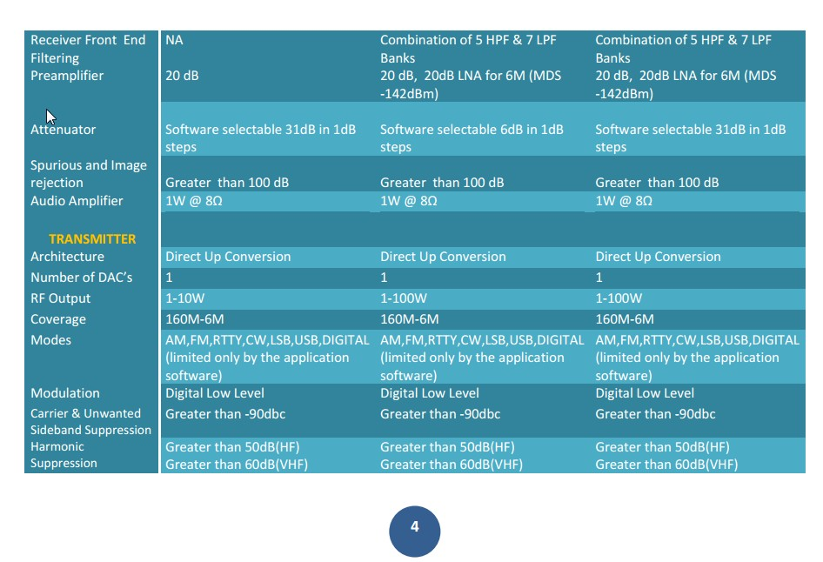
ANAN-10 Specs 4

Slide 8
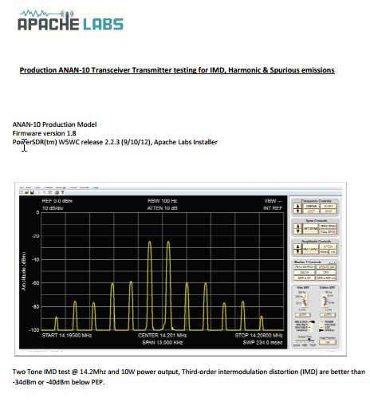
Specs: 2-Tone IMD

Slide 9
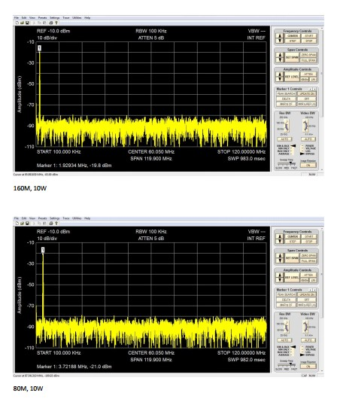
Specs: Spurious 160m & 80m

Slide 10
My Comments
I am still learning!
So far, It is an incredible radio which surpasses everything else that I have worked with, both commercial and Amateur
Every report has praised my signal & audio
Much fewer ghosts than Flex series, so far
I have not found anything that I do not like. Perhaps get the 100W version if you prefer higher power but not necessary, in my opinion.

Slide 11
73 from VE3CVG

