Slide 1
WCARC VHF/UHF Repeaters
VE3WCC
Franktown Tower Site

Slide 2
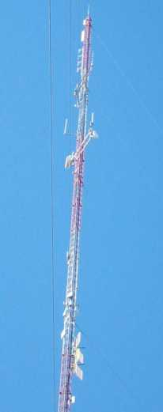
Franktown Tower
The commercial tower, located southeast of Franktown is now owned by Barrett Xplornet.
The VHF 4-bay Folded Dipole Array at 375 ft above ground is shared with other VHF users by VE3WCC 2M through a common multicoupler cavity filter assembly
The UHF 4-bay Folded Dipole Array at 360 ft above ground is shared with other UHF users by VE3WCC 70 CM through a common multicoupler cavity filter assembly

Slide 3
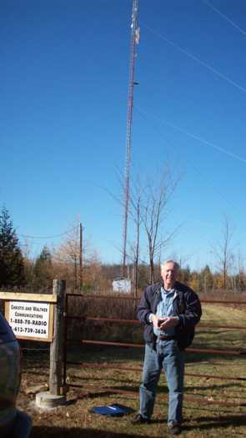
Franktown Tower
The tower location is on swampy land.
One major advantage of the site is that it has not lost AC power since the ice storm in 1998.
The WCARC repeaters are located in the equipment building at the base of the tower
Their sign should show the new Xplornet ownership.

Slide 4
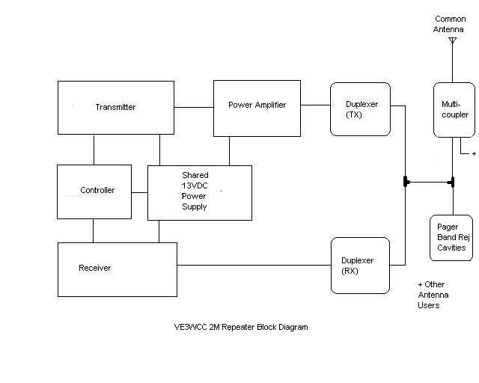
VE3WCC 2M Repeater

Slide 5
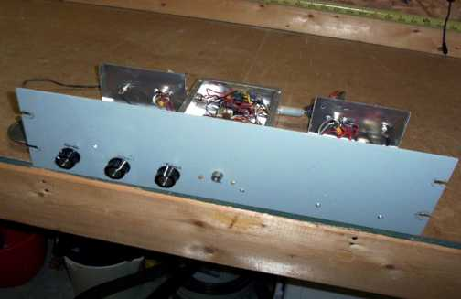
VE3WCC 2M Repeater
2M Repeater was home-brewed by WCARC member Manfred Kahle VA3WK, using Hamtronics modules
Receiver compartment (L), Controller compartment(M) and Transmitter compartment(R).

Slide 6
VE3WCC 2M Repeater
Receiver Compartment
Hamtronics Model R301 Synthesized VHF FM Receiver
Controller Compartment
Hamtronics Model COR-4 Repeater Controller Module
Ramsey Model QT1 Quick Tone CTCSS Tone Encoder/Decoder – Qty 2 (one for each function)
Transmitter Compartment
Hamtronics Model T301 Synthesized VHF FM Exciter

Slide 7
VE3WCC 2M Repeater
External to 2M Repeater Cabinet
Homebrew 40 Watt Power Amplifier
Duplex Cavity Filters 4 BPF / 4 BRF Sinclair Q2220E
Band Reject Filter Cavities for Pager Freq Sinclair C2037
12 VDC Power Supply – Daiwa RS300 13VDC /30A/6A/6A (shared with 70CM Repeater)
Not shown on the lists or photos are the multicoupler cavity filter assemblies shared by the site VHF users.
Shared 4-Bay Folded Dipole Colinear Array at 375 ft AGL

Slide 8
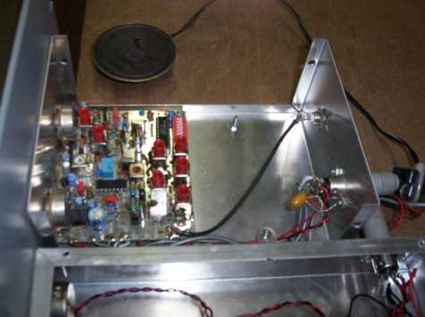
VE3WCC 2M Repeater
Receiver compartment showing Hamtronics R301 Synthesized Receiver Module

Slide 9
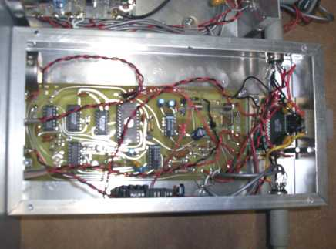
VE3WCC 2M Repeater
Controller compartment showing Hamtronics COR-4 Repeater Controller Module. EPROM chip contains CW ID.
Ramsey QT1 CTCSS Tone Encode and Decode modules are mounted on the right and the front side of this photo.

Slide 10
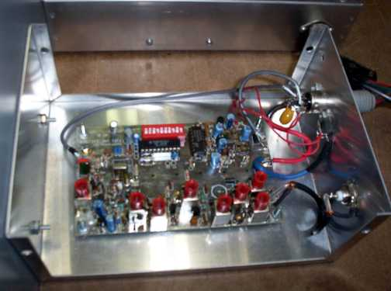
VE3WCC 2M Repeater
Transmitter compartment shows Hamtronics T301 3W Exciter module

Slide 11
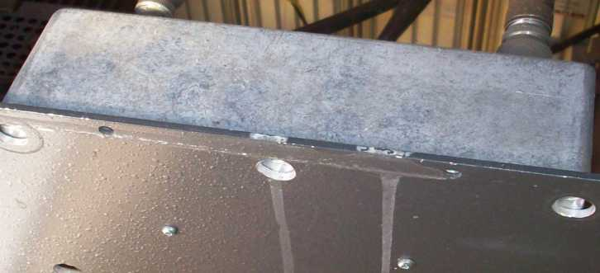
VE3WCC 2M Repeater
External 40W RF Power Amplifier is mounted below the repeater rack panel.

Slide 12
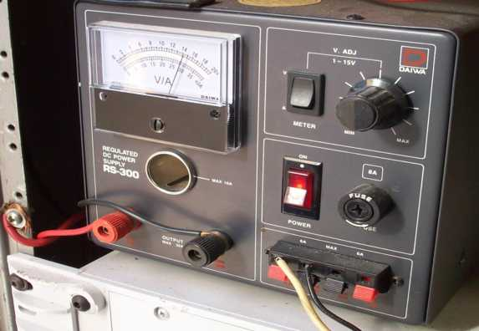
VE3WCC 2M Repeater
Daiwa RS-300 13VDC Power Supply provides power to both 2M and 70CM repeaters and amplifier

Slide 13
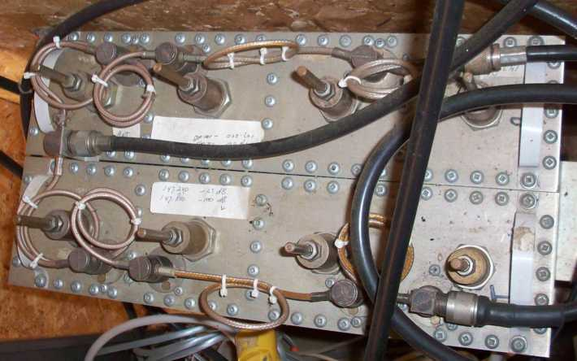
VE3WCC 2M Repeater
Sinclair Duplexer cavity filter provides isolation between transmit and receive frequencies.

Slide 14
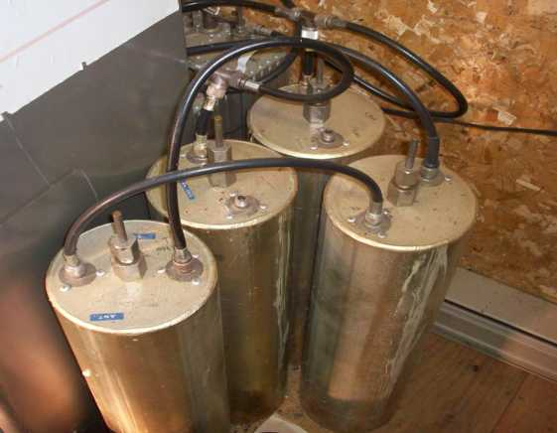
VE3WCC 2M Repeater
Sinclair multicoupler tuned cavities provides pager frequency rejection to prevent intermodulation.

Slide 15
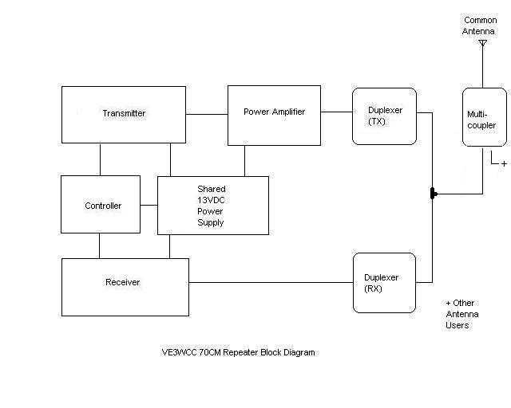
VE3WCC 70CM Repeater

Slide 16
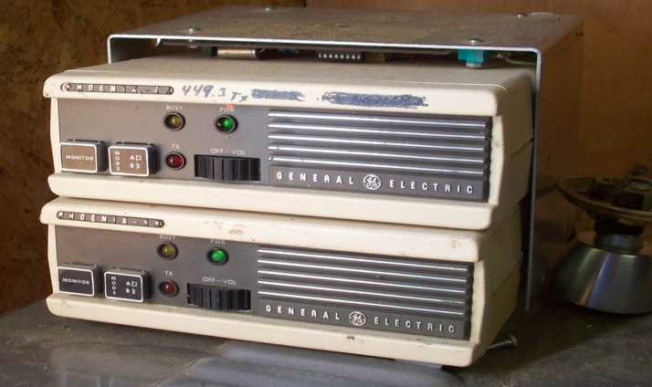
VE3WCC 70CM Repeater
UHF Repeater comprises two GE Phoenix SX UHF radios
Transmitter is the top unit. Power output is 25W FM.

Slide 17
VE3WCC 70CM Repeater
Receiver and Transmitter
GE Phoenix SX UHF Radios Model N5RR2W25BB
Controller
Repeater Control Card - Western Radio Model RCL-54A
External
Duplex Cavity Filters 2 BPF / 2 BRF Sinclair Series Q3220E
Daiwa RS300 Power Supply 13VDC (shared with 2M Rptr)
Not shown on the lists or photos are the multicoupler cavity filter assemblies shared by the site UHF users.
Shared 4-Bay Folded Dipole Colinear Array at 350 ft AGL

Slide 18
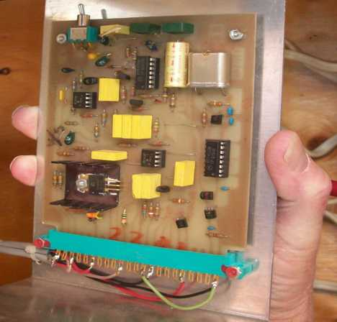
VE3WCC 70CM Repeater
70CM Repeater Control Card - Western Radio RCL-54A

Slide 19
VE3WCC 70CM Repeater
The 70CM Repeater was assembled by Sean Huntley - VE3HXP using the two GE Phoenix SX UHF radios and Western Radio RCL-54A Control Card.
No instruction manual for the GE radios was provided. WCARC can order a photocopy of a GE Phoenix SX radio installation and service manual for $25
However, in the event of a fault in one of the radios it would make more sense to contact Sean as he is very familiar with those radios and has proper test equipment.
Sean and Wayne Getchell - VE3CZO have suitable test gear for aligning the cavity filters, should that be required.

Slide 20
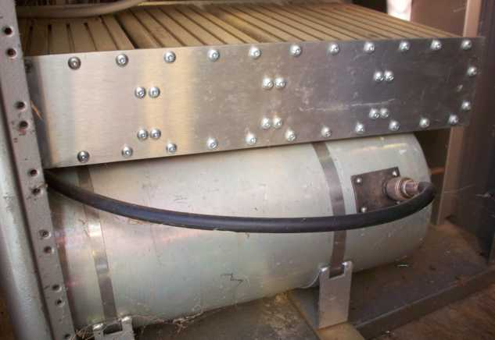
VE3WCC 70CM Repeater
UHF Duplexer Filter cavities rack panel (top).

Slide 21
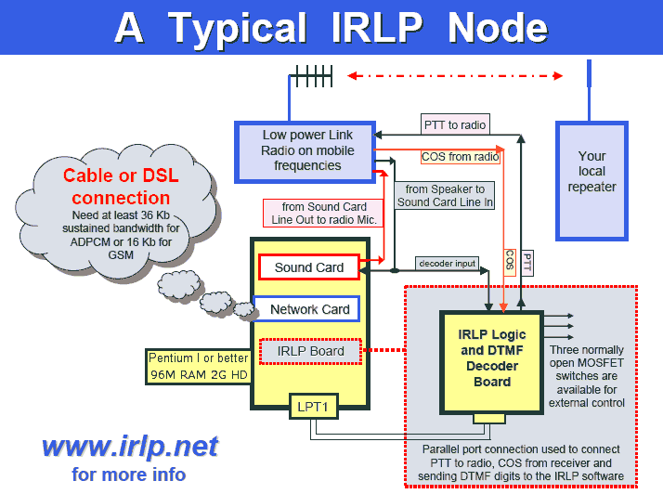
VE3WCC IRLP Node 2220

Slide 22
VE3WCC IRLP Node 2220
The VE3WCC Internet Radio Linking Project Node provides connection through the internet to other repeater nodes world-wide. It is remotely located at the Almonte home of WCARC member John - VE3IAO
The Node is connected to the VE3WCC 70CM Repeater through a 70CM link radio at VE3IAO.
The node provides Voice Identification to the 70CM repeater in place of the CW ID used for the 2M repeater.

Slide 23
VE3WCC IRLP Node 2220
Operation
Remember you are dealing with your local repeater and the distant repeater and the delays of the internet.
All IRLP users should understand the IRLP network practices and procedures so they don’t cause chaos.
See http://www.kwarc.org/irlp/ for “Suggested IRLP Guidelines” that should be read and followed.

Slide 24
VE3WCC Repeaters
The repeater hardware, including electronics, power supply, tuned cavity filters, IRLP Node personal computer, IRLP logic and DTMF decoder board, software and link radio, were donated to WCARC by Manfred Kahle VA3WK.
WCARC is forever indebted to Manfred for this generous donation. It is difficult to place a value on this gift but it is well over $5000. A club as small as WCARC would never have been able to purchase repeater equipment out of membership fees.

Slide 25
VE3WCC Repeaters
We must ensure that the WCARC repeaters and IRLP Node are maintained in good working order, as a public service to the amateur community.
At the January 6 meeting the purchase of a suitable plaque was approved.
WCARC is pleased to award the plaque to Manfred Kahle - VA3WK, in recognition for his contribution to WCARC of the 2M and 70CM repeater systems and IRLP Node UHF radio, computer equipment and software.

Slide 26
VE3WCC Repeater Useage
The 70CM repeater gets regular use from the Almonte / Carleton Place hams. It is also a good backup for ARES.
The 2M repeater is only lightly used though it has good coverage: east to the Civic Hospital, west to Perth and south to Hwy 401.
How do we develop more activity on the 2M repeater?
  Weekly Net?
  MCW Code Practice?
  IRLP Node - separate or transferred from 70CM?
  Networked with second (east-end) repeater?
  Other ideas?

