Slide 1
The VA3KS Tower Work Party
Kieran Shepherd VA3KS generously donated most of his gear to WCARC conditional on the two towers and antennas plus two C-Band TV dishes and two Ku Band TV dishes, actuators, receivers and cabling being removed from the property by Sept 1
My urgent e-mail got a very good response.
The weather forecast was marginal but it improved until the day before our event - a 60% POP, with a thunderstorm in the afternoon.
It only rained a bit as we finished loading the trailer. No thunderstorm. Whew!

Slide 2
The VA3KS Tower Work Party
The August 22 Work Party comprised: Al Penny VO1NO, Dale Hennigar VE3XZT, Ken Asmus VA3KA, Stan Madore VA3SMM, Bernie Madore VA3BMZ, Andy Hart VE3NVK, Glen McDonell VE3XAR, Peter Jago VA3PJ and Doug Leach VE3XK. Our benefactor Kieran Shepherd VA3KS provided a lot of help in addition to guidance on what went with what, etc.
The objective today was to take down both towers and transport the sections and antennas.
The C-Band dishes were taken off their mounts for later disassembly and transport by new owner Bert VE2ZAZ.

Slide 3
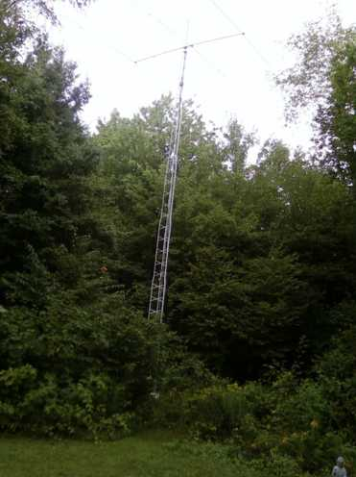
The VA3KS Tower Work Party
Kieran’s 48 ft Delhi tower with Cushcraft A4S and
Diamond 2/70 Colinear vertical

Slide 4
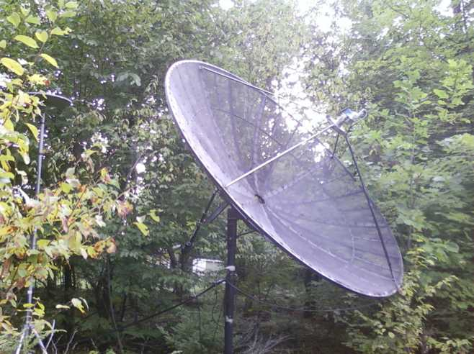
The VA3KS Tower Work Party
The 10 ft Dish, with a remote TV off-air antenna

Slide 5
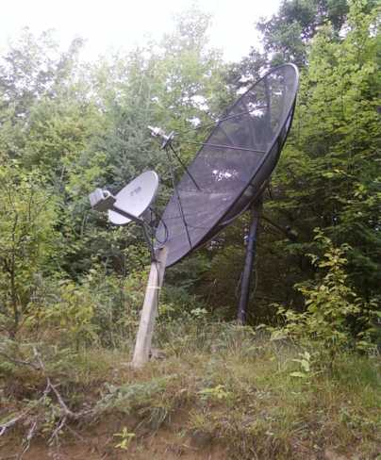
The VA3KS Tower Work Party
The 8 ft Dish with one of the Ka Band Sat-TV dishes

Slide 6
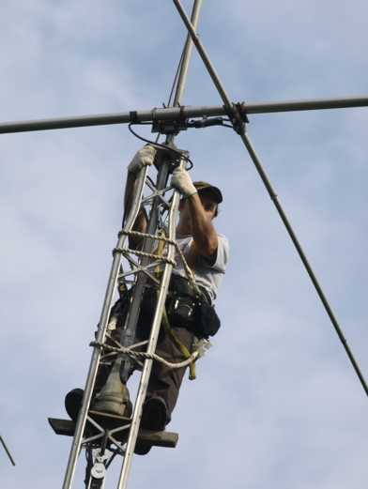
The VA3KS Tower Work Party
Dale VE3XZT on the
48 ft tower
The short 2X4 was essential for comfort.

Slide 7
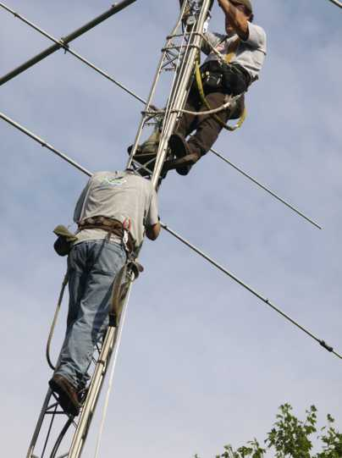
The VA3KS Tower Work Party
Tools arrive by courier (VE3XK) but no room for two to work at the top.

Slide 8
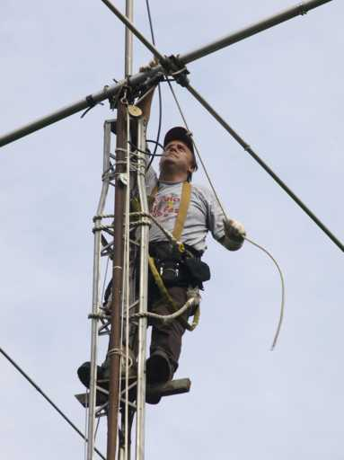
The VA3KS Tower Work Party
The line through the gin pole pulley ready to take the weight of the beam and Dale starts lowering it

Slide 9
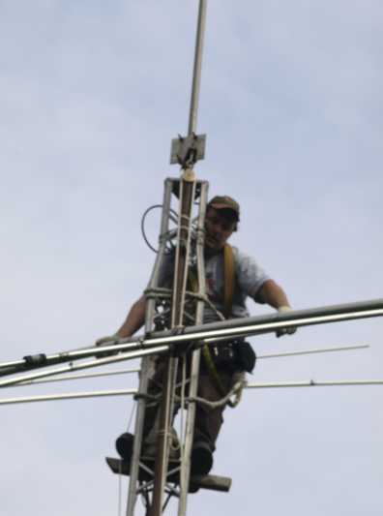
The VA3KS Tower Work Party
…and down she goes. The boom mounting plate is still in place on the mast.

Slide 10
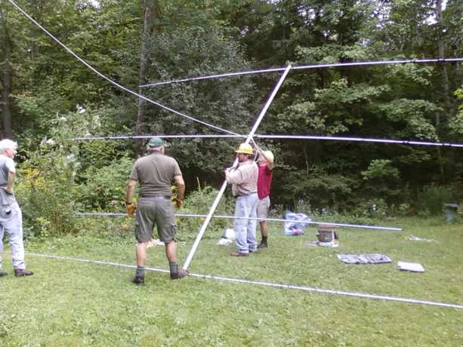
The VA3KS Tower Work Party
The A4S beam arrives safely on the ground

Slide 11
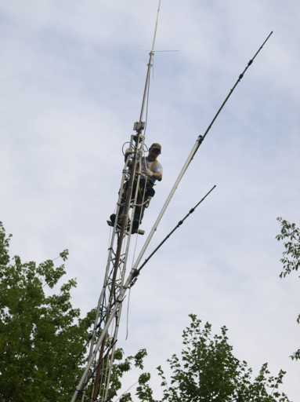
The VA3KS Tower Work Party
Part way down and angled to get through the new foliage that had grown since the beam was installed over 15 years ago.

Slide 12
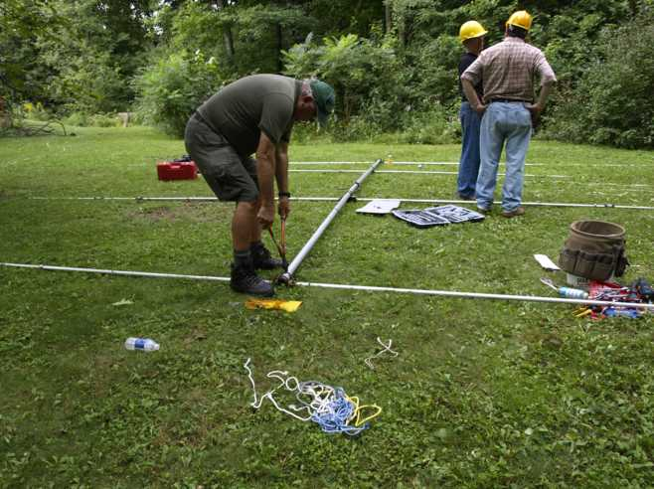
The VA3KS Tower Work Party
More work taking beam apart for transport. The bolt cutter made short work of the rusted U-bolts

Slide 13
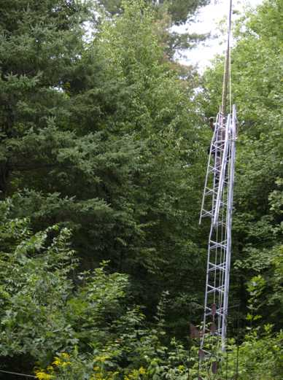
The VA3KS Tower Work Party
The Gin Pole, repositioned to the top of the second section, allows the top section to be lowered, and so on until only the bottom section is left to be unbolted from the stubs.

Slide 14
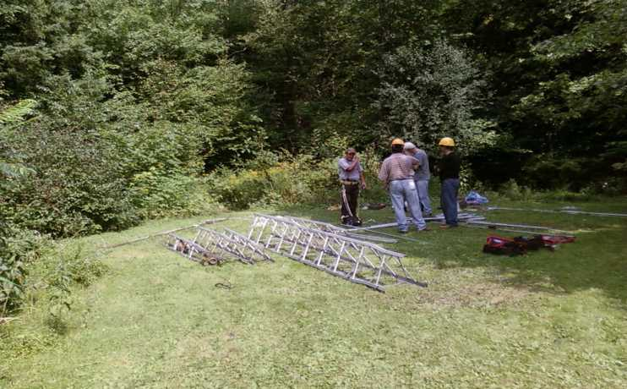
The VA3KS Tower Work Party
Tower and disassembled beam on the ground for transport.

Slide 15
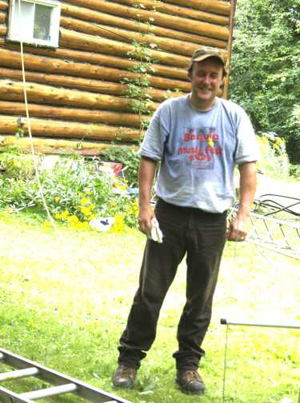
The VA3KS Tower Work Party
Our hero, Dale VE3XZT, back on the ground, safe and sound.

Slide 16
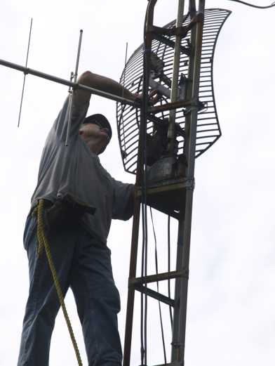
The VA3KS Tower Work Party
Attempt to remove the antennas from the second tower were not successful, so it was decided to lower the tower intact.

Slide 17
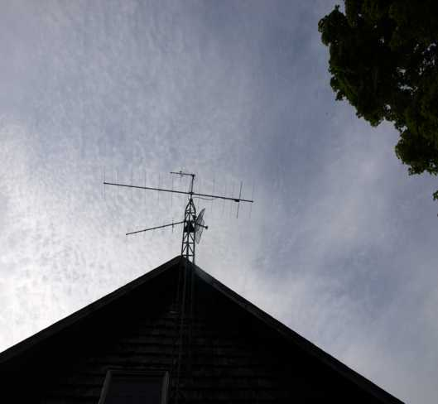
The VA3KS Tower Work Party
The VHF/UHF antennas on the 36 ft Radio Shack tower attached to the eave. Kieran’s Sawzall tool cut the bottom 3 ft of the tower at ground level so it could be let down gently with the antennas in place using rope over the top of the roof.

Slide 18
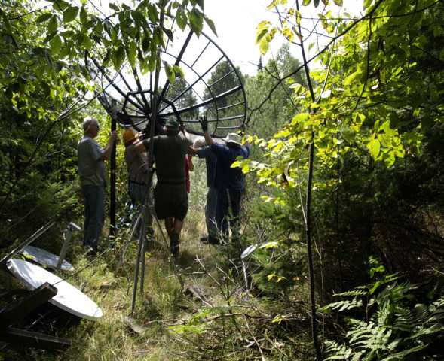
The VA3KS Tower Work Party
Many hands make light work of lifting the dish off its mount and onto the ground for disassembly and transport next weekend

Slide 19
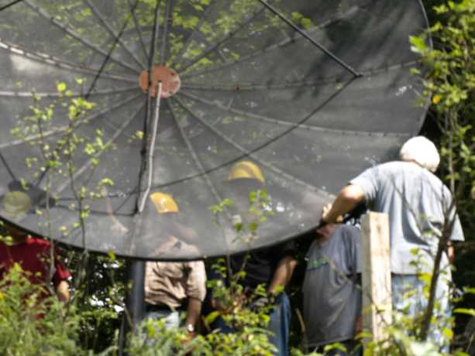
The VA3KS Tower Work Party
With a little more effort, even the ten ft dish lifted up and onto the ground for disassembly and transport next weekend

Slide 20
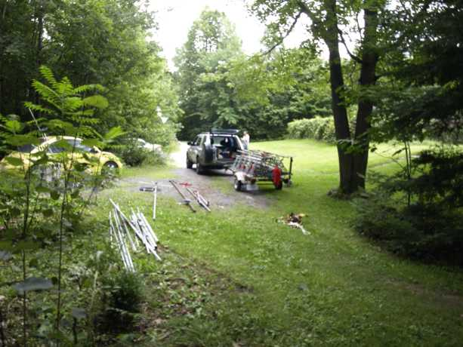
The VA3KS Tower Work Party
Loading half complete when the rain started.

Slide 21
The VA3KS Tower Work Party
The August 29 Work Party comprised: Bert Zahaur VE2ZAZ and Doug Leach VE3XK
The objective was to disassemble the dishes so the “leaves” would fit into Bert’s borrowed trailer.
The various actuators, receivers and cabling were packed up and loaded into Bert’s trailer for transport.
This day was all rain - all the time, and both of us got really soaked. No photos. An added complication was a wasp nest in one of the actuators and a good crop of poison ivy around where the cables had been piled.
In spite of these difficulties we were loaded by 11:15AM

Slide 22
The VA3KS Tower Work Party
Acknowledgments
To Dale Hennigar VE3XZT - who climbed the 48 ft tower and got the big beam and tower down to the ground. His Sawzall cut the bottom off the small tower. Without him the event would not have been possible.
To Peter Jago VA3PJ - for the loan of his Gin Pole and to Dean VA3CDD who lent a second Gin Pole as a backup
To Stan and Bernie Madore for the use of their trailer and SUV to transport the towers and antennas
To all the crew who gave up their Saturdays for the substantial benefit of the club.

Slide 23
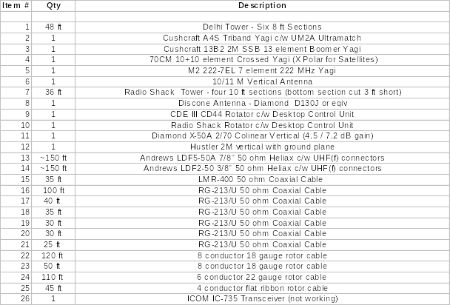
The VA3KS Donation List
List does not include the C & Ku Band Satellite TV dishes, receivers and cable bought by Bert VE2ZAZ

Slide 24
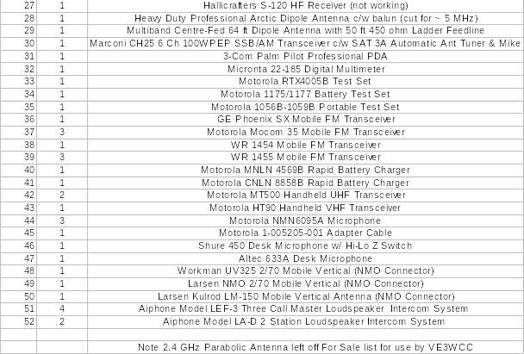
The VA3KS Donation List

