Slide 1
West Carleton Club
Grid Expedition
ARRL VHF QSO Party
14/15 June 2008

Slide 2
Contest Information
Starts 1400 Local, Sat 14 June
Ends 2300 Local Sun 15 June
6 Meters to Daylight
Exchange is 4-figure Grid Square

Slide 3
WCARC Grid Expedition
A group of WCARC members will activate FN04xa during the contest
Site is just north of Grafton
Elevation 730 feet ASL
High and clear
Location very popular with Rovers!
Owner has very positive impression of Amateur Radio

Slide 4
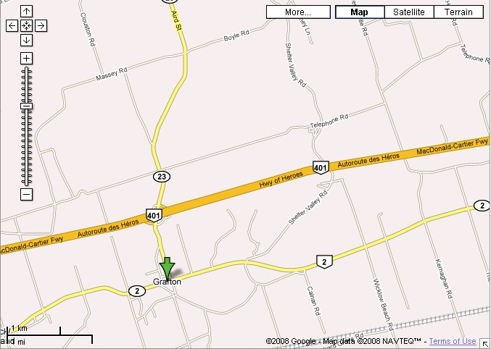
VE3WCC
Exit 487

Slide 5
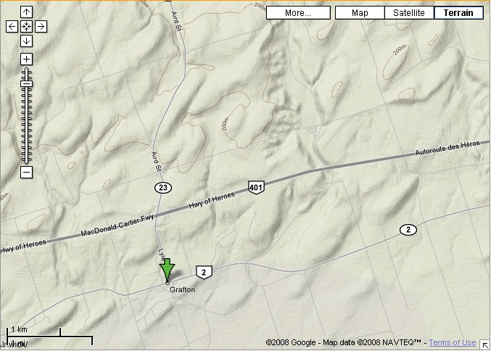
VE3WCC

Slide 6
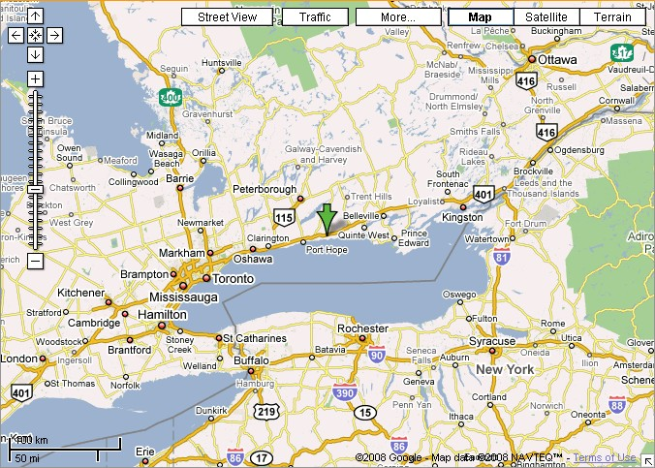

Slide 7
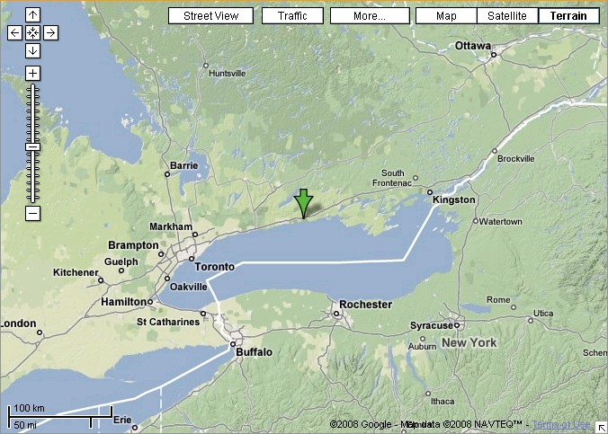

Slide 8
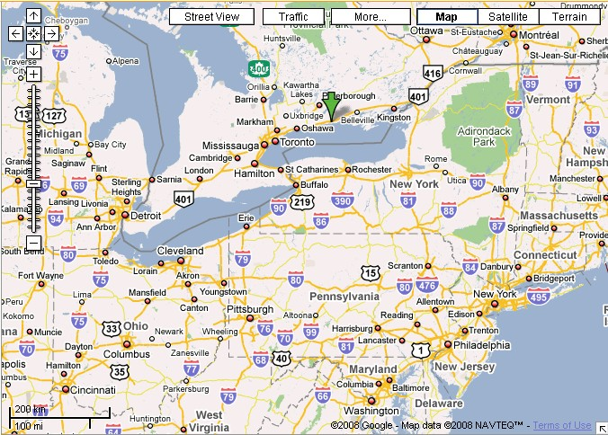

Slide 9
Stations
6 Meters
  FT-736R with Brick, 160 watts
2 Meters
  FT-736R with Brick, 150 watts
222 MHz, 70 cm, 903 MHz, 1296 MHz
  FT-736R, Bricks for 222 MHz and 70 cm
  FT-726 with Transverter for 903 MHz
10 GHz
  Courtesy of Ray VE3FN

Slide 10
Station Organization
6 M
2 M
Other
Bands

Slide 11
Station Notes
Three logging computers networked using N3FJP software
Laptops at eye level, separate keyboards
WSJT for 6 Meters and 2 Meters
Bricks have individual cooling fans
Humans have individual cooling fans also!
3 Towers (24, 30 and 30 feet), with rotators

Slide 12
Antennas
6 Meters – 6 element Yagi, 21 foot boom
2 Meters (SSB) – 13 element Yagi
2 Meters (FM) – 4 element Yagi
222 MHz – 16 element Yagi
432 MHz – 40 element Yagi (circ. polarity)
903 MHz – 35 element Looper
1296 MHz – 35 element Yagi
10 GHz – Parabolic Dish

Slide 13
Mess Tent
Screen Tent
Will have:
  Propane Stove
  Propane BBQ
  Microwave
  Coffee Maker
  Electric Cooler
To Hell with roughing it!!

Slide 14
Accommodations
Most people will bring tent / sleeping bag
Room rented in nearby Cobourg
  2 beds
  Toilet
  Shower
  Fridge
  Microwave

Slide 15
Miscellaneous Notes
Location very popular with Rovers
  Expect several to drop by for coffee, & eyeball
Skeds being arranged
  Voice, Meteor Scatter and JT65

Slide 16
Summary
This event WILL happen!
This is not a typical Field Day operation thrown together at the last minute!
This is a serious operation, but trust me, we WILL have lots of fun!
This is an outstanding learning opportunity!
This will be the WCARC “Event of the Year”
BUT…..

Slide 17
WE NEED OPERATORS!!
Please come out to support your club!

