Slide 1
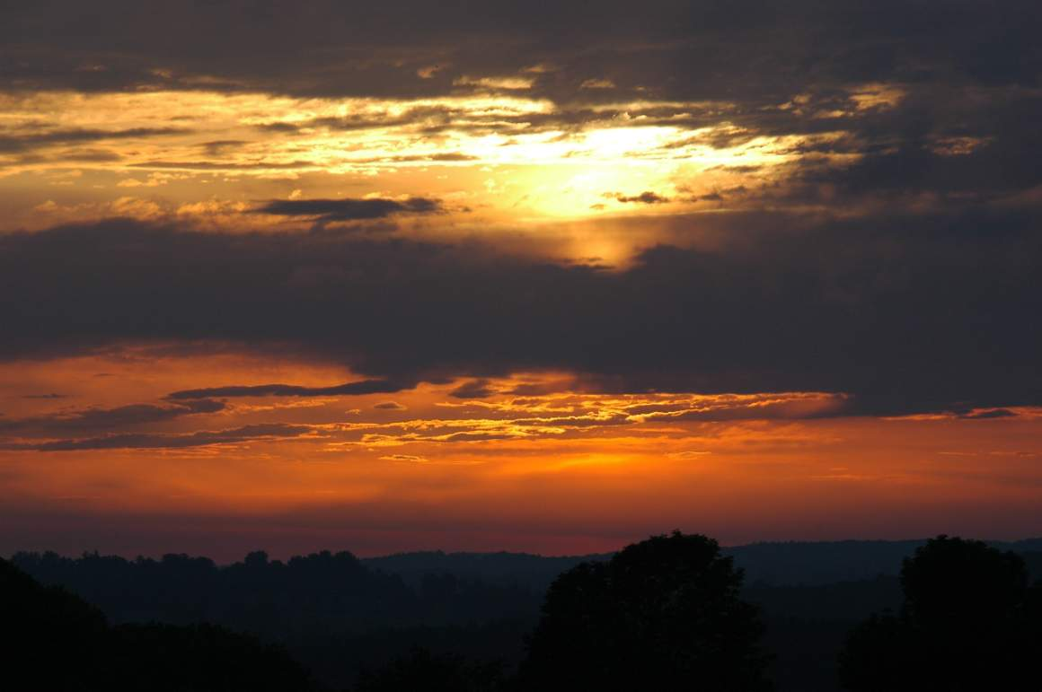
West Carleton Club
Grid Expedition
ARRL VHF QSO Party
12-13 June 2010

Slide 2
West Carleton Club
Grid Expedition
ARRL VHF QSO Party
12/13 June 2010

Slide 3
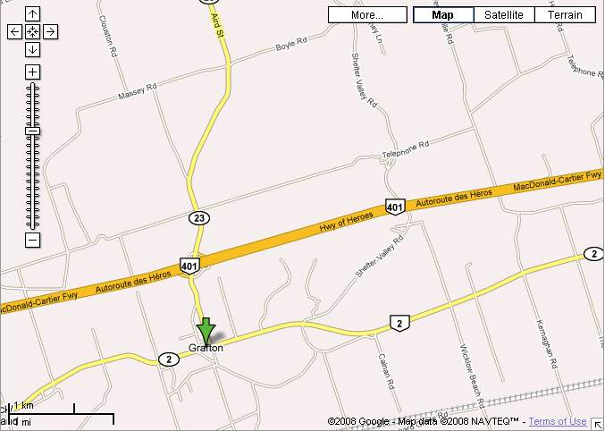
VE3WCC
Exit 487

Slide 4
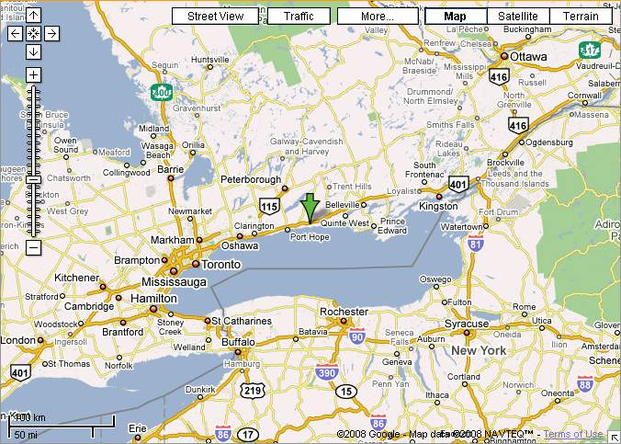

Slide 5
Stations
6 Meters
  FT-736R with Brick, 160 watts
2 Meters
  FT-736R with Henry amp, 800 watts
222 MHz, 70 cm, 903 MHz, 1296 MHz
  FT-736R, Bricks for 222 MHz and 70 cm
  FT-726 with Transverter for 903 MHz
10 GHz
  Tellurometers
5.6 GHz
  Cordless Telephones
Laser
  Ramsey kits

Slide 6
Station Organization
Big Amp!
2 M
Other
VHF/UHF
bands
6 M in tent

Slide 7
Accommodations
Most people will bring a tent / sleeping bag
Room rented in nearby Cobourg for everyone’s use:
  2 beds
  Toilet
  Shower
  Fridge
  Microwave

Slide 8
Antennas
6 Meters – 6 element Yagi, 21 foot boom
2 Meters (SSB) – 13 element Yagi
2 Meters (FM) – 4 element Yagi
222 MHz – 16 element Yagi
432 MHz – 22 element Yagi
903 MHz – 15 element Looper
1296 MHz – 35 element Yagi
10 GHz – Tellurometer

Slide 9
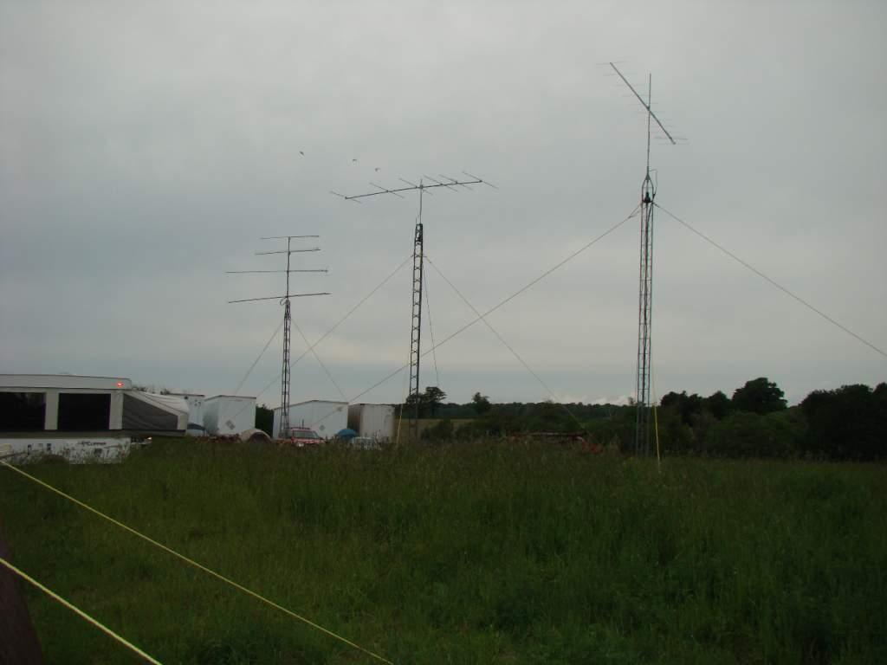

Slide 10
Station Notes
Three logging computers networked using N3FJP software
Laptops at eye level, separate keyboards
WSJT for 6 Meters and 2 Meters
Bricks have individual cooling fans
Humans have individual cooling fans also!
3 Towers (24, 30 and 30 feet) and one 24 foot mast, all with rotators

Slide 11
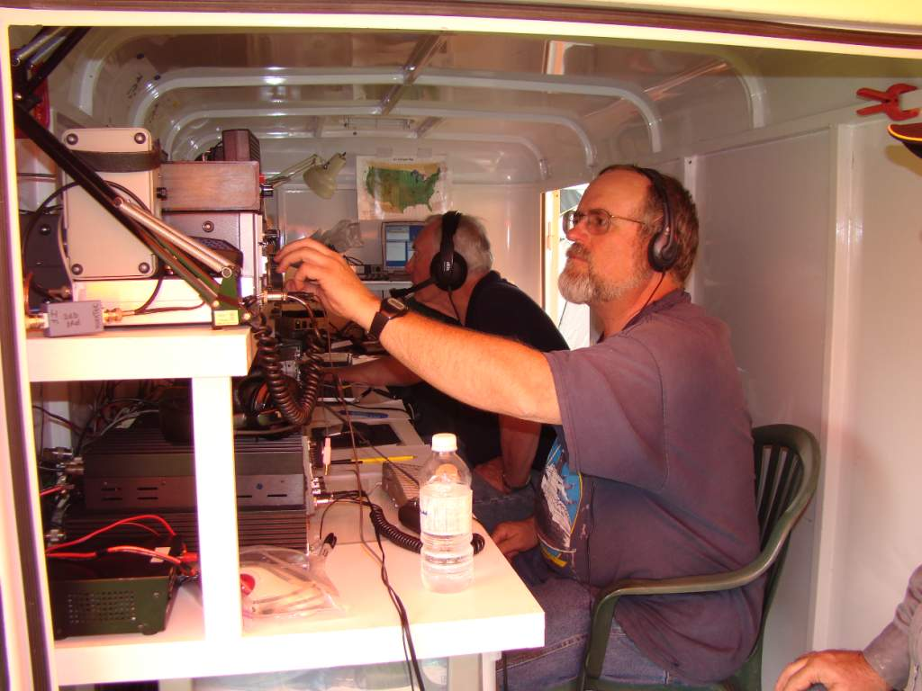

Slide 12
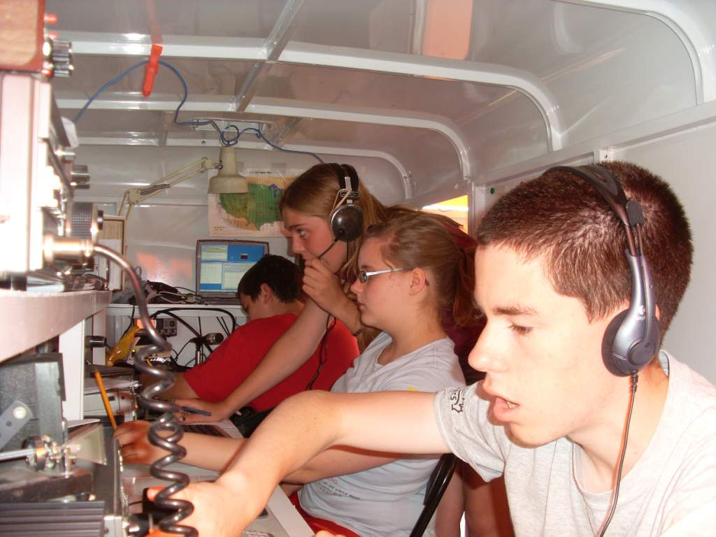

Slide 13
Band QSOs Mults
-------------------
6: 207 58
2: 119 31
222: 43 17
432: 42 17
903: 10 7
1.2: 19 9
2.3:
3.4:
5.7:
10G: 7 2
24G:
-------------------
Total: 447 141 Total Score = 86,151
Results from 2008

Slide 14
Band QSOs Mults
-------------------
6: 249 94
2: 114 31
222: 48 19
432: 56 20
903: 11 7
1.2: 21 11
2.3:
3.4:
5.7: 1 1
10G: 38 3
24G:
-------------------
Total: 538 186 Total Claimed Score = 153,078
Results from 2009

Slide 15
This Year’s Contest!
Starts 1800Z, Saturday 12 June
Ends 0300Z, Sunday 13 June
We depart Ottawa Friday morning
We return Monday after teardown
Details much the same as last year’s contest

Slide 16
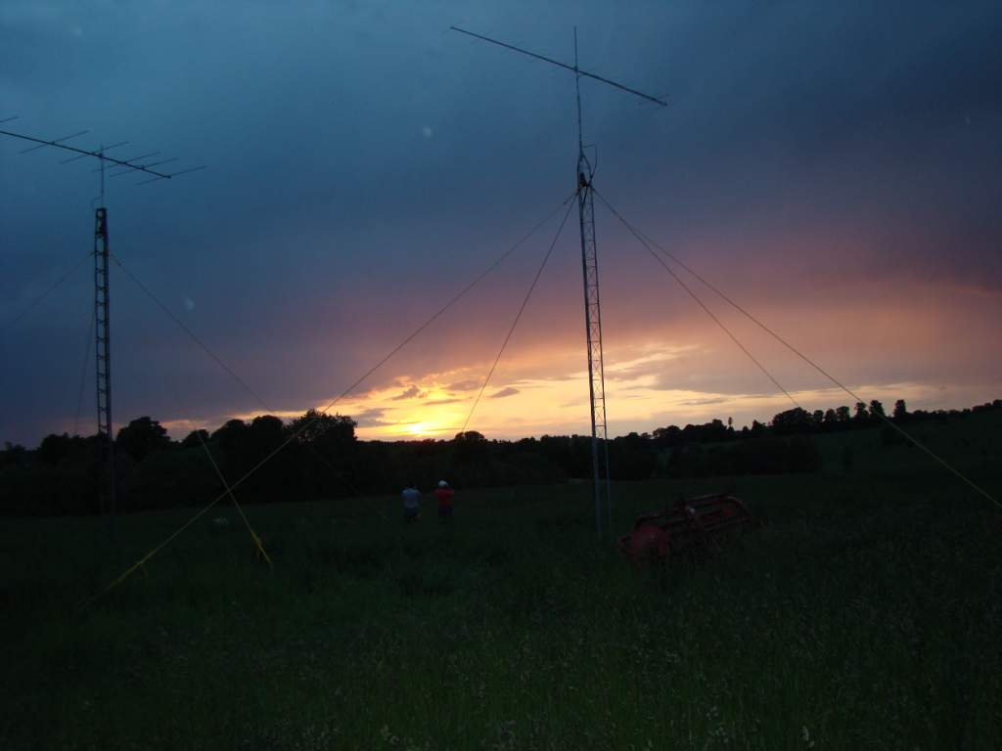
73 from FN04xa

