Slide 1
Lab2

Slide 2
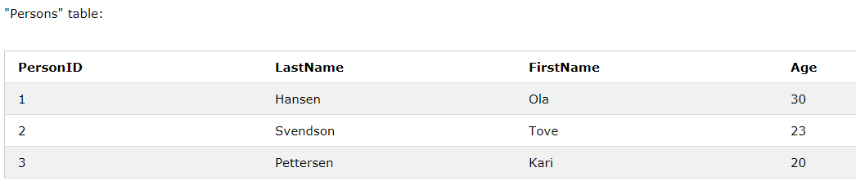
Primary Key
-The PRIMARY KEY constraint uniquely identifies each record in a database table.
-Primary keys must contain UNIQUE values, and cannot contain NULL values.
-A table can have only one primary key, which may consist of single or multiple fields.
Primary Key

Slide 3
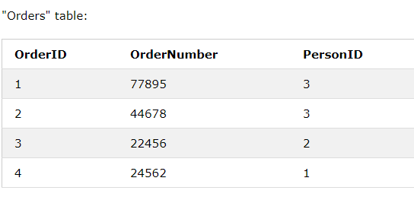
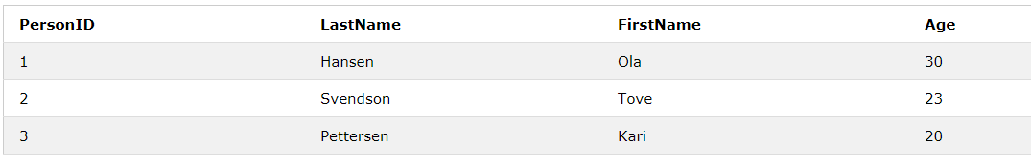
Foreign Key
-A FOREIGN KEY is a key used to link two tables together.
-A FOREIGN KEY is a field in one table that refers to the PRIMARY KEY in another table.
Primary Key
Primary Key
Foreign Key

Slide 4
JOIN
A JOIN clause is used to combine two or more tables, based on a related column between them.
JOIN:
SELECT table_column1, table_column2...
FROM table_name1
JOIN table_name2
ON table_name1.column_name=table_name2.column_name

Slide 5
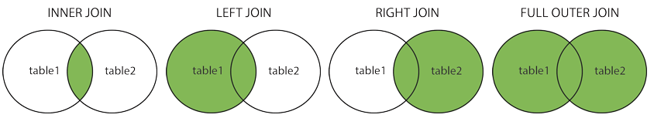
Different Types of SQL JOINs

Slide 6
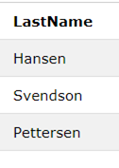
[OrderID,OrderNumber,LastName]
SELECT OrderID, OrderNumber, LastName
FROM Orders
INNER JOIN Persons
ON Orders.PersonID=Persons.PersonID

Slide 7
5
87878
4
SELECT OrderID, OrderNumber, LastName
FROM Orders
LEFT JOIN Persons
ON Orders.PersonID=Persons.PersonID
5
87878

Slide 8
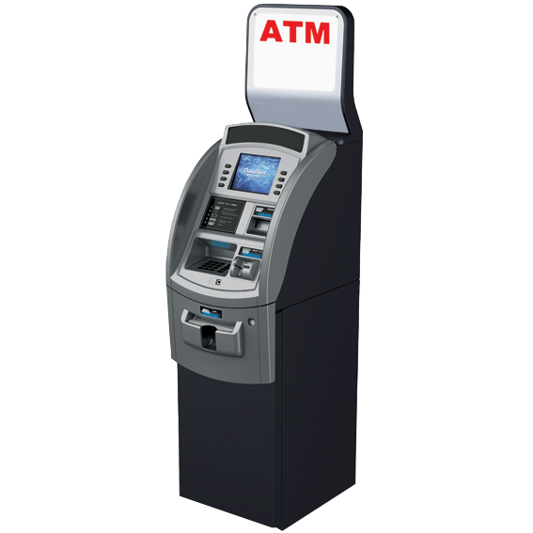
Transactions
A transaction is a unit of work that is performed against a database.
-100
?
?
+100
------------------------------------------------>

Slide 9
Transactions
Transaction:一連串的SQL指令
Commit: 一個transaction裡面SQL全部執行成功 然後將執行結果提交給資料庫
Rollback: 只要SQL中有任何執行失敗 就會還原到執行前狀態
https://www.tutorialspoint.com/sql/sql-transactions.htm
https://dev.mysql.com/doc/refman/5.7/en/commit.html

Slide 10
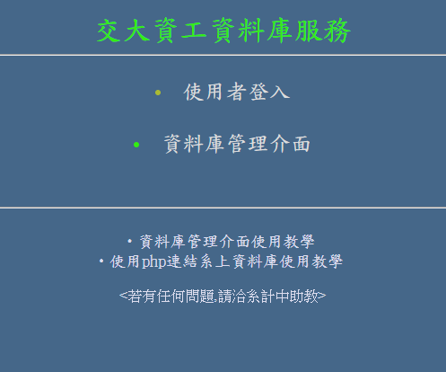
phpMyAdmin(系計中)
帳號:系計中帳號

Slide 11
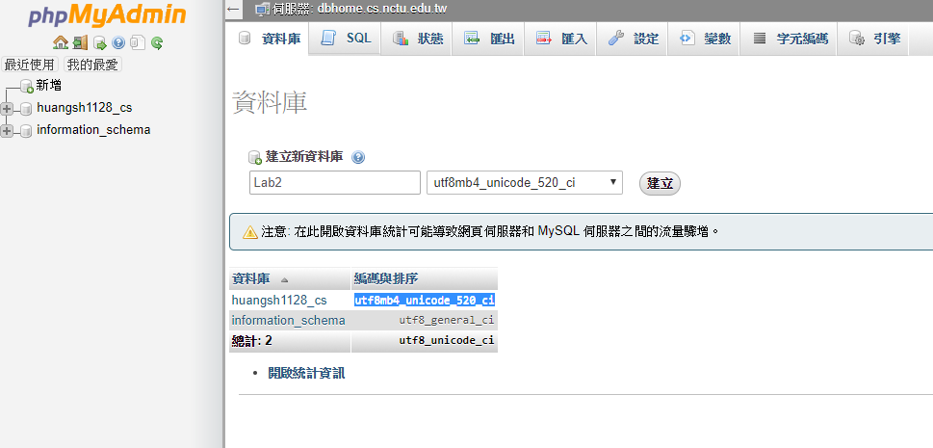
新增資料庫
資料庫->建立新資料庫
編碼:utf8mb4_unicode_ci

Slide 12
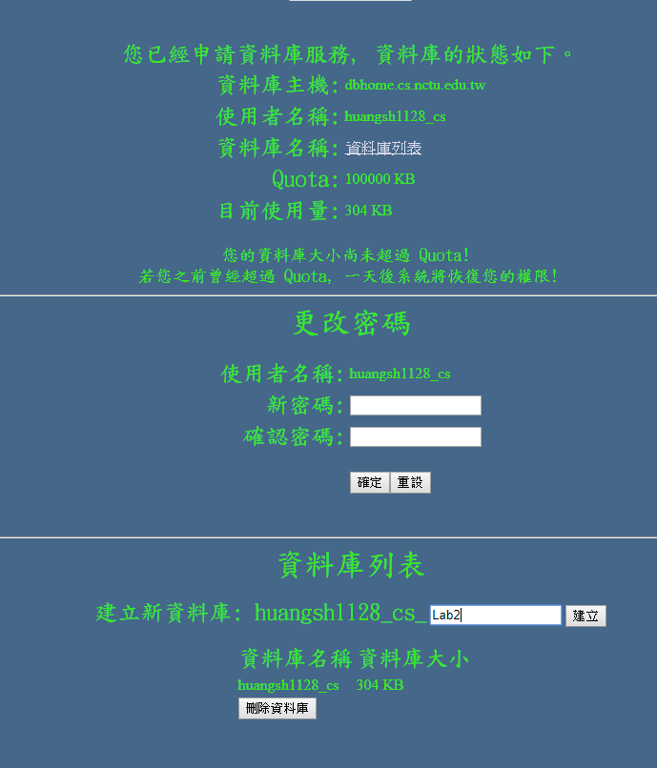
新增資料庫(系計中)
建立新資料庫

Slide 13
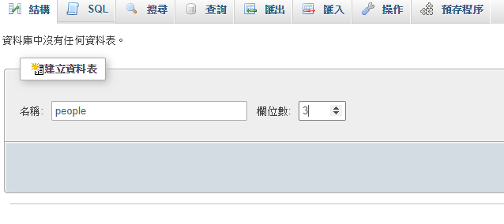
建立資料表(Table)
建立新資料表於資料庫XXX
輸入名稱與欄位數

Slide 14
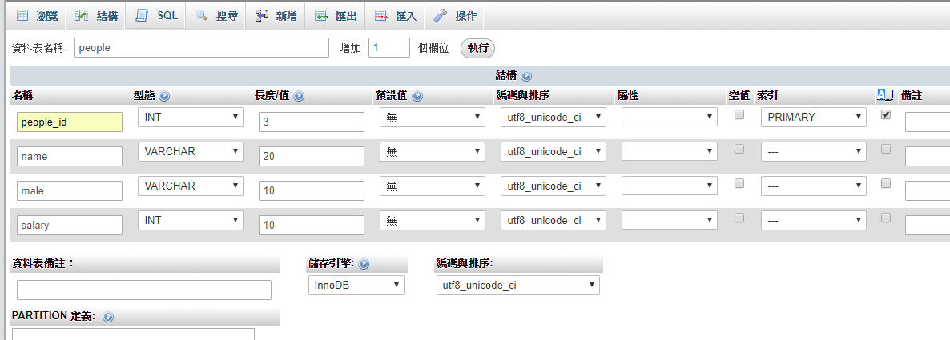
設定欄位屬性
欄位:欄位名稱
型態:INT、VARCHAR、TEXT、DATE
長度/值:英文1單位，中文2單位
索引:僅選Primary的，其他的就不必選，每張資料表只會有一個主鍵值(Primary Key)
A_I:自動增值
id
gender

Slide 15
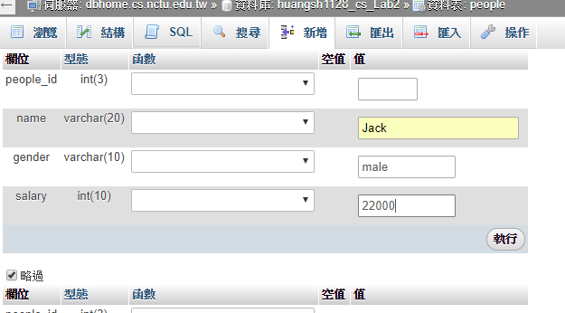
新增欄位
新增->輸入資訊
id

Slide 16
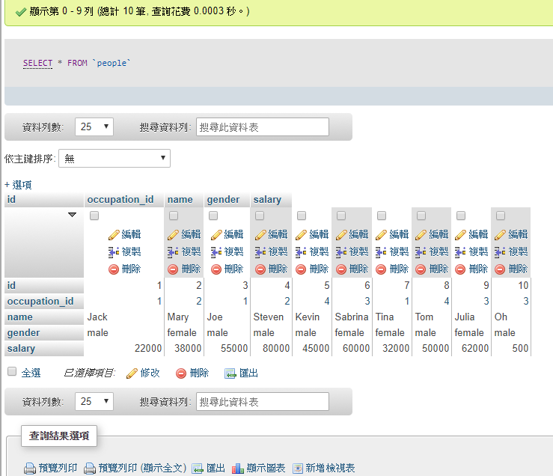
瀏覽欄位
SQL
Auto_Increment

Slide 17
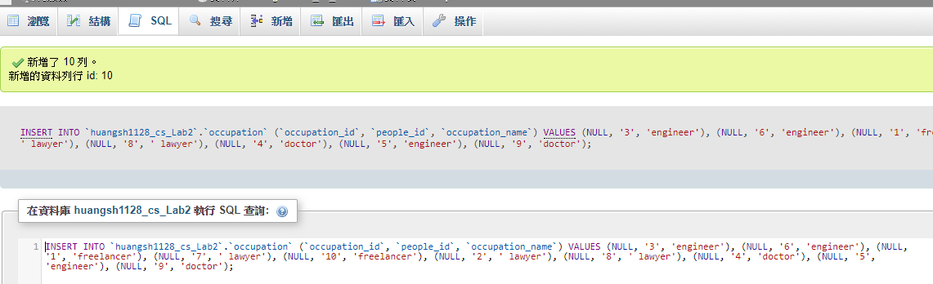
SQL

Slide 18
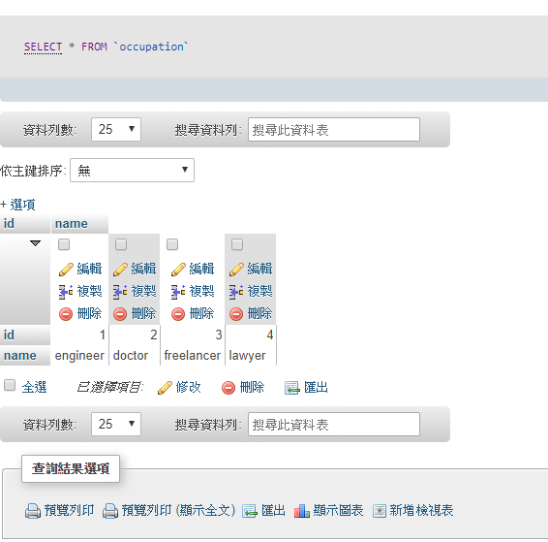
新增Occupation

Slide 19
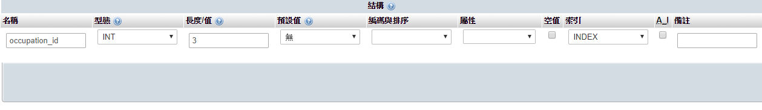
在people新增 occupation_id

Slide 20
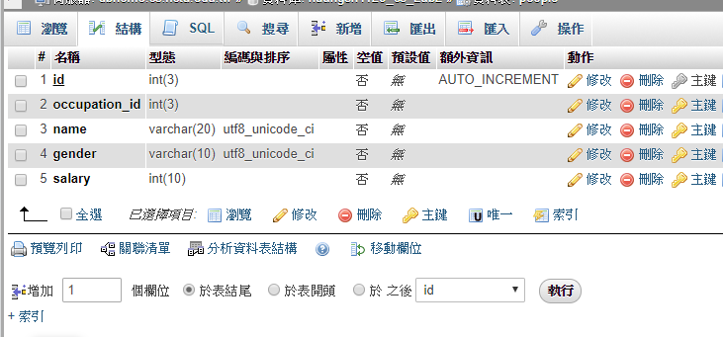
設定foreign key
結構->關聯清單
O

Slide 21
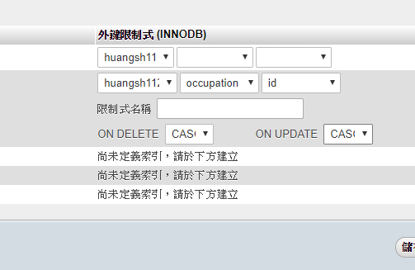
設定foreign key
對應另一個table的Primary key
ON DELETE/ON UPDATE:主鍵刪除或更新後，foreign key的行為

Slide 22
增加occupation

Slide 23
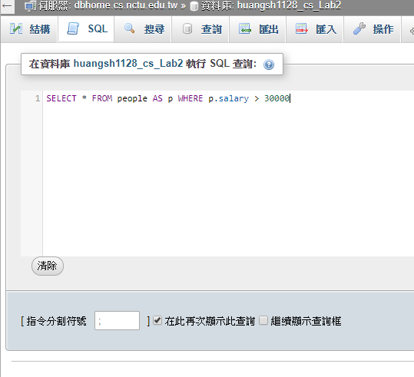
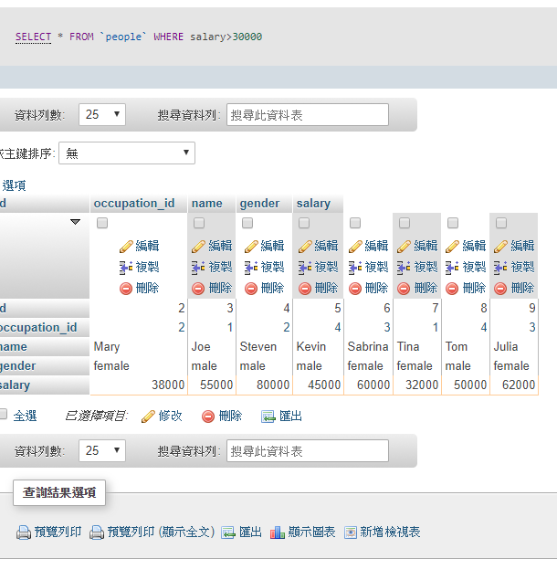
用SQL操作欄位

Slide 24
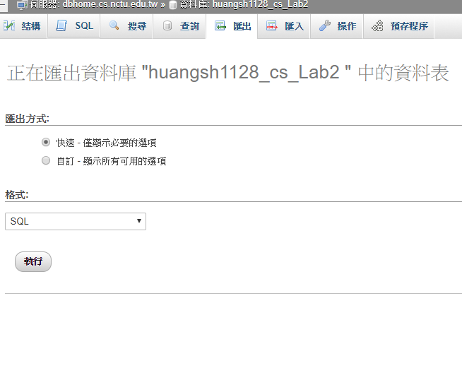
匯出Table

Slide 25
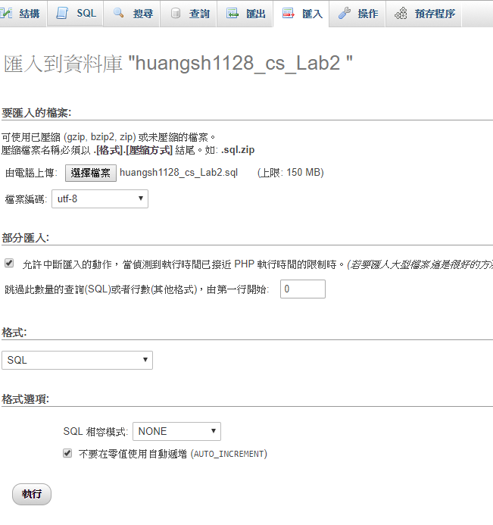
匯入Table

Slide 26
SQL Practice
1.Who is both male and a freelancer?
2.Output “Name ,Occupation ,Salary”.
3.Count how many people whose salary is higher than 30000.
Reference: https://www.w3schools.com/sql/default.asp

Slide 27

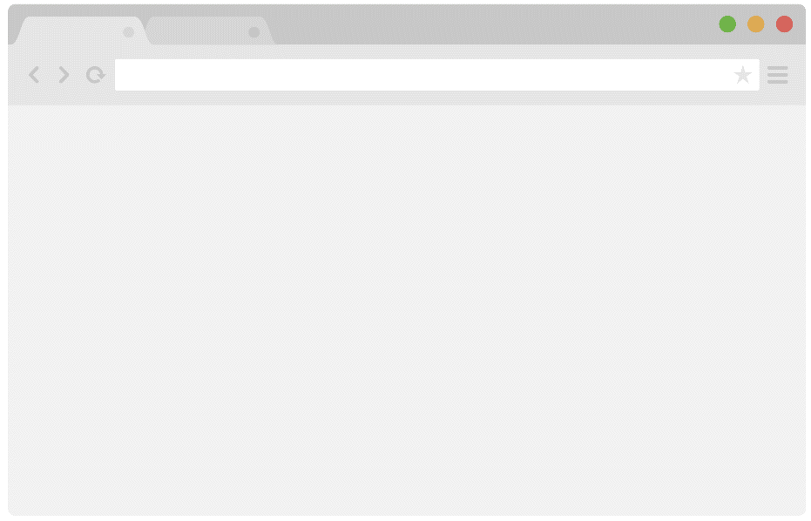

SQL + PHP
Web Server
POST/GET
SQL
PHP
Browser
資料庫 Server
HTML

Slide 28
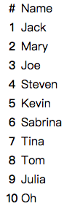
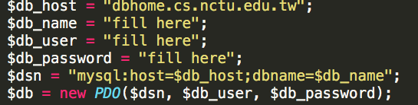
Step
1. Move db2.php file to your public_html directory.
2. Fill your database information.
3. Open the following url then you could see the table in the database like the right hand side picture.
(http://people.cs.nctu.edu.tw/~your_account/db2.php)

Slide 29
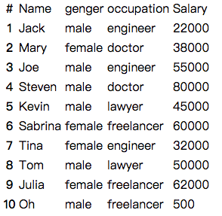
Practice
Show all the columns in the member table as the following screenshot.
(HINT: when encountering same column names,you could use `AS` to rename it.)

