Slide 1
ξ
1
0
1
η

Slide 2
ζ
1
0
1
η
1
-1
ξ

Slide 3
T∞
T_{C}
T_{B}
T_{F}
T₀
Coolant
Clad
Bond
Fuel
q'''
R_{C}
R_{B}
R_{F}
r=0

Slide 4
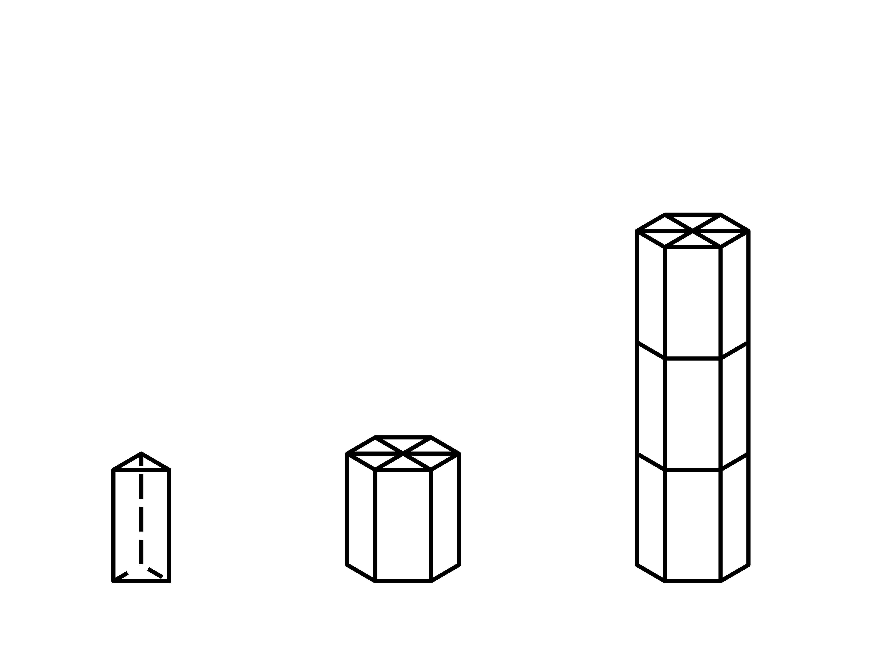
z

Slide 5
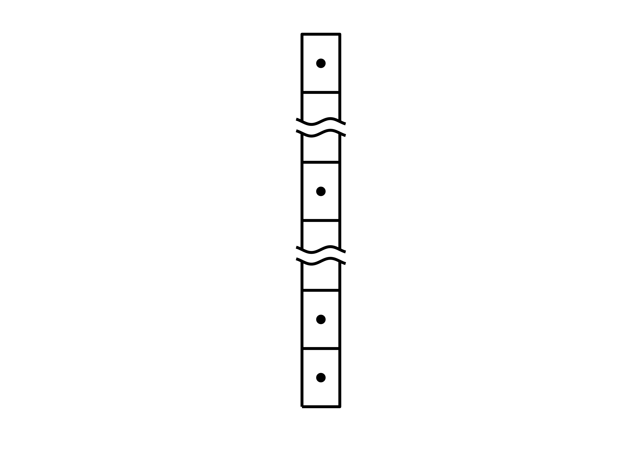
h_{Nz+1/2}
h_{Nz}
h_{Nz-1/2}
h_{k+1/2}
h_{k}
h_{k-1/2}
h₂
h_{3/2}
h₁
h_{1/2}

Slide 6
D_{wrap}
R_{Clad}
R_{Bond}
R_{Fuel}

Slide 7
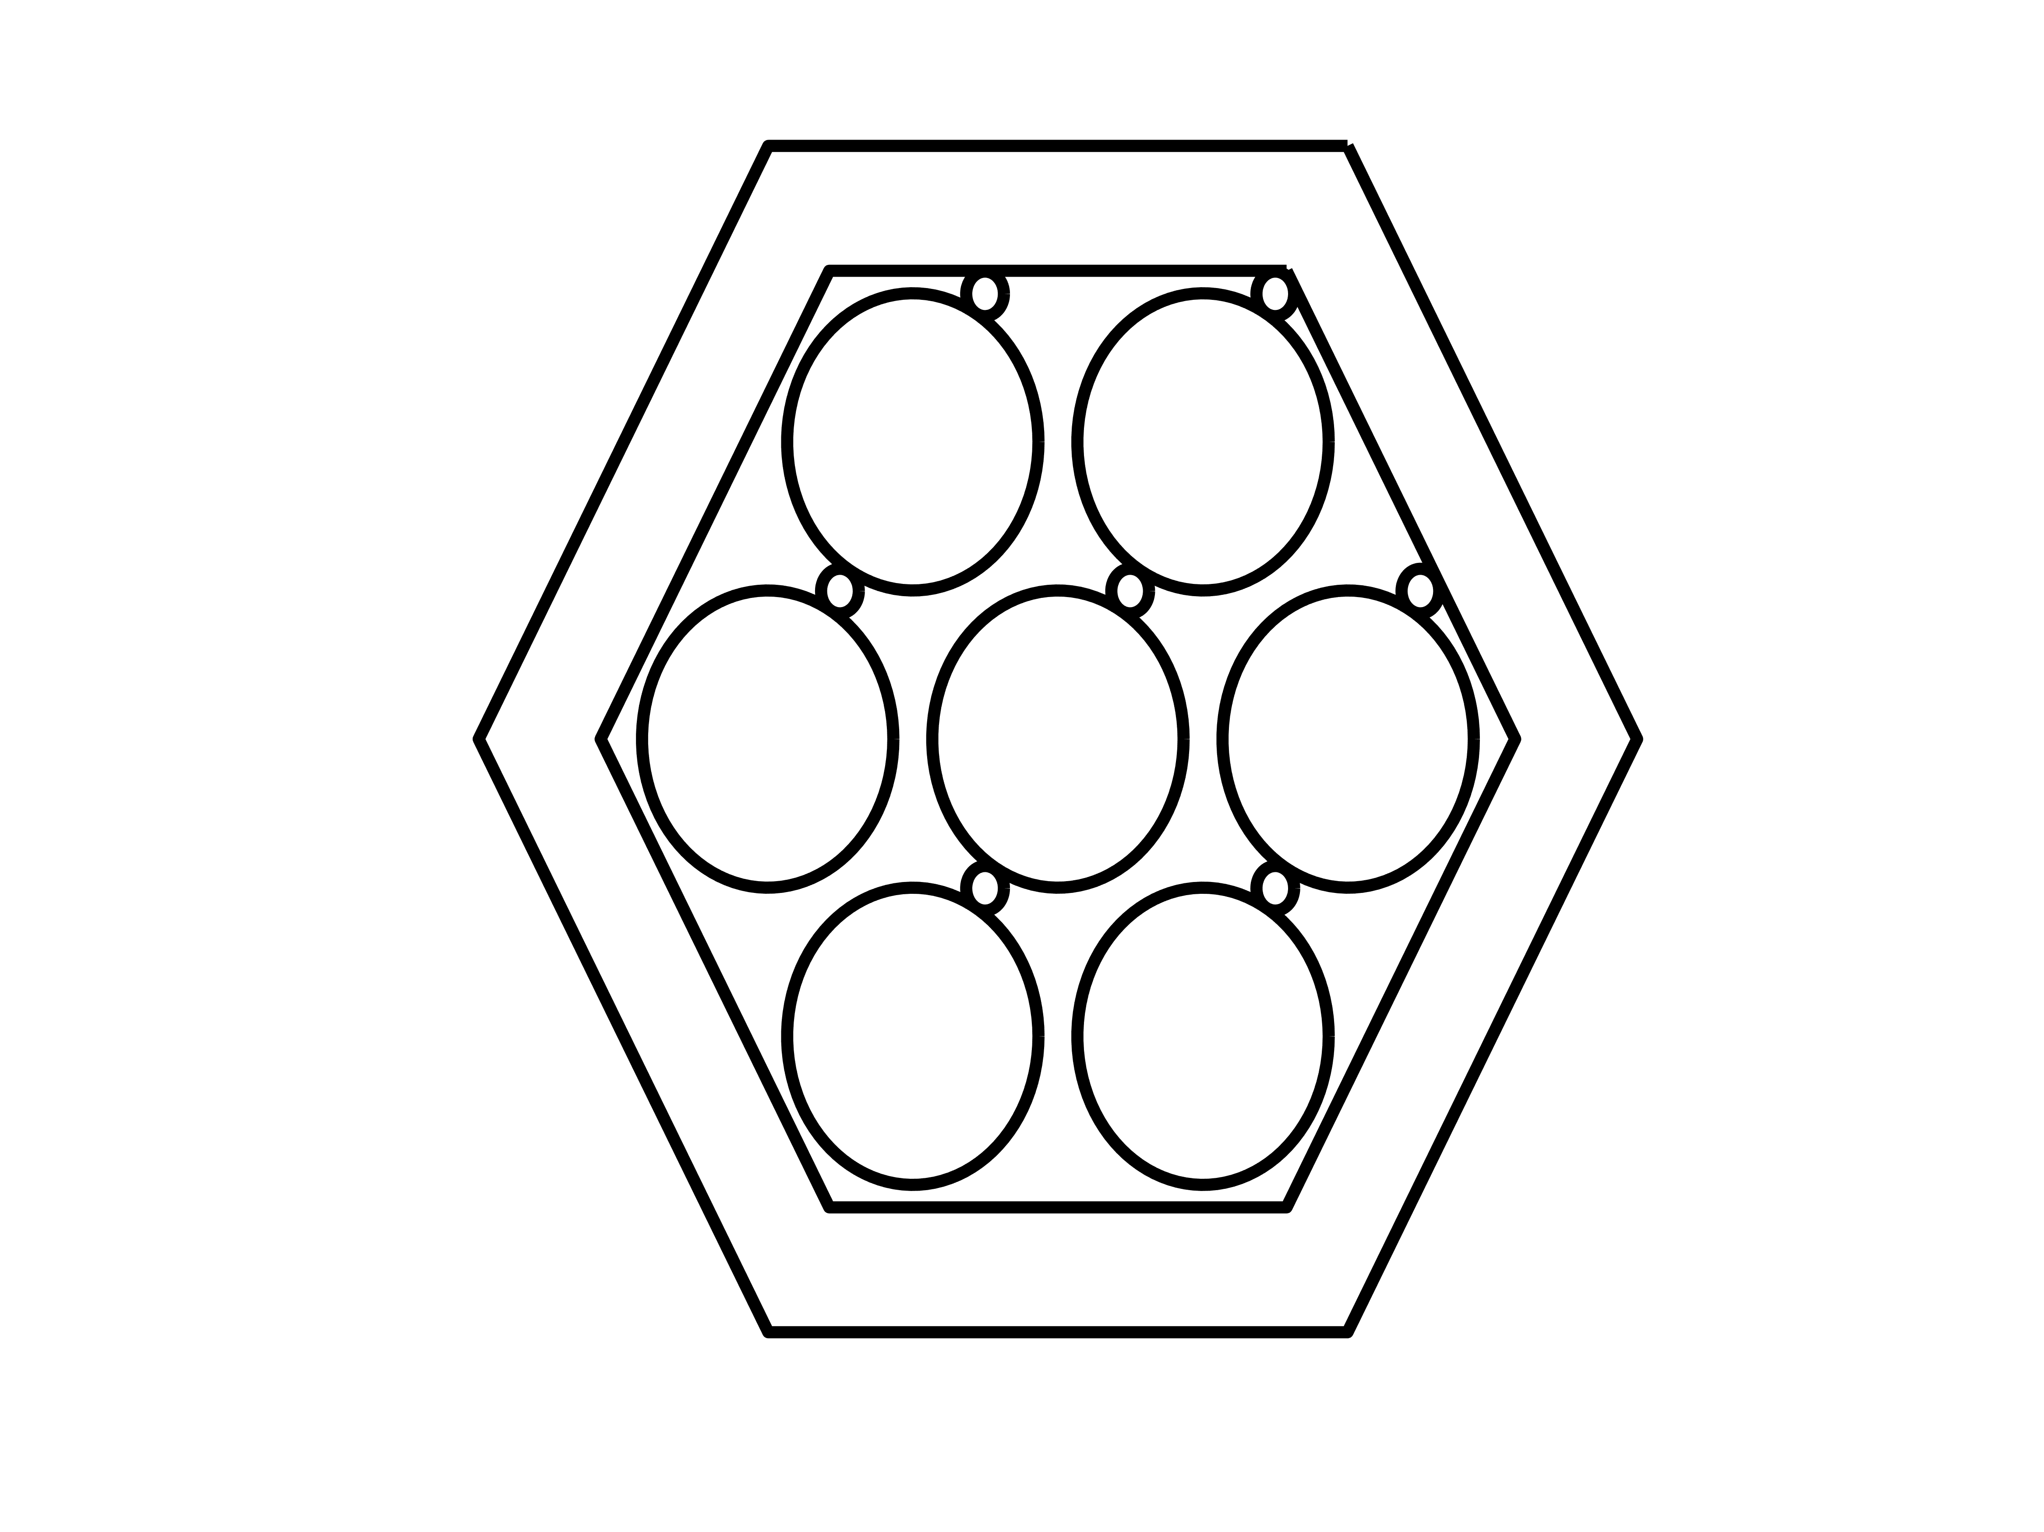
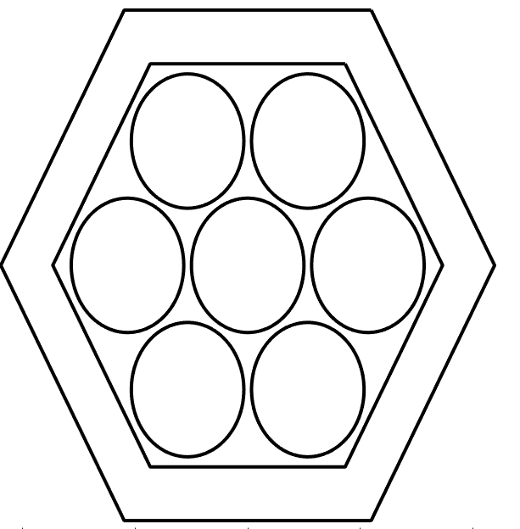
F2F
Th_{Box}
Pitch

