Slide 1
2-part models

Slide 3
Adults, aged 21-64, 1997 (nominal dollars)

Slide 4
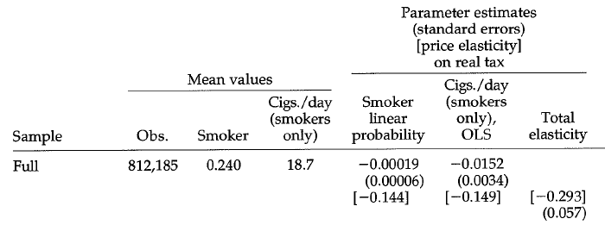

Slide 5
RAND HIE
Field experiment designed to identify the impact of cost-sharing on demand for medical care
Enrollment 11/74 – 2/77; non-aged
6 cities
Dayton; Seattle; Bitchburg, MA; Franklin county, MA; Charleston, Georgetown Co, KY
One of 14 plans or a prepaid group plan

Slide 6
Cost sharing
Coinsurance: 0, 25, 50, 95%
Stop loss: 5, 10, 15% of family income, up to a max of $1000
Coverage: all medical expenses
95% coinsirance plan had $450 stop/loss for family ($150/person) – inpatient services were free

Slide 7
70% enrolled for 3 years, rest for 5 years
1st rule of RACT: do no harm
Had to pay people to participate in plan
Hope that income effect from payments is small
Varied icome effect midway through experiment to see whethe this is true

Slide 8
Funded by HHS (the HEW)
Enrollment
5800 in FFS
1800 in manged care
Costs of $136 million in 1984 dollars ($265 in today’s dollars)

Slide 10
Monotonic declines
In use measures

Slide 11
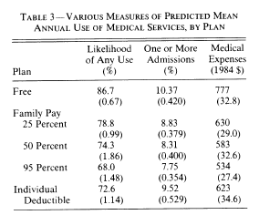
Big change in
The probability
Of use, 21%
decline
31% reduction
In costs
25% reduction
In hospitalization

Slide 12
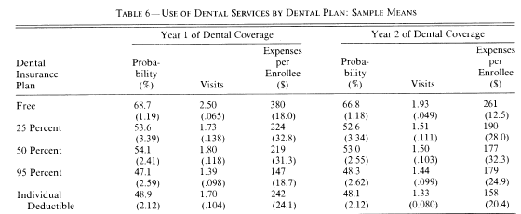
61% reduction
In expenditures
31% reduction
In Prob of use

