Slide 1
IV/2SLS models

Slide 2
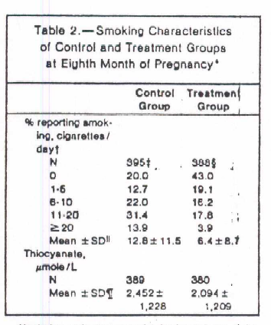
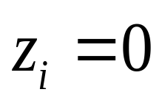
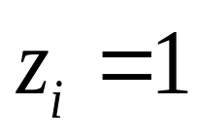
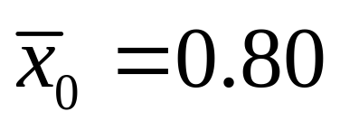
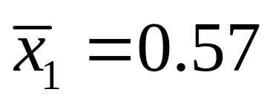

Slide 3
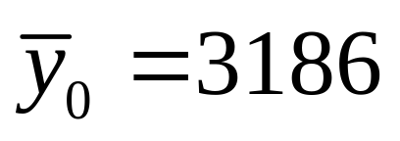
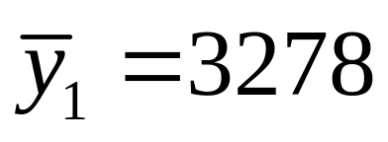
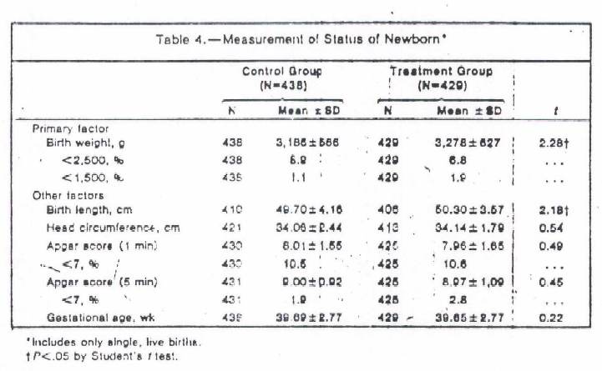
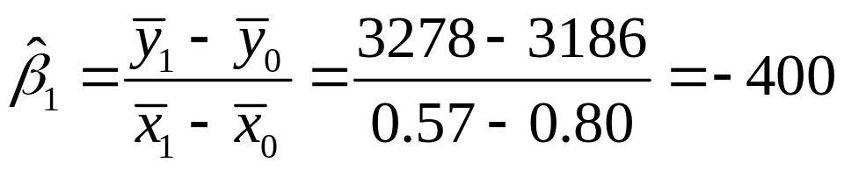

Slide 4
Vietnam era service
Defined as 1964-1975
Estimated 8.7 million served during era
3.4 million were in SE Asia
2.6 million served in Vietnam
1.6 million saw combat
203K wounded in action, 153K hospitalized
58,000 deaths
http://www.history.navy.mil/library/online/american%20war%20casualty.htm#t7

Slide 5
Vietnam Era Draft
1st part of war, operated liked WWII and Korean War
At age 18 men report to local draft boards
Could receive deferment for variety of reasons (kids, attending school)
If available for service, pre-induction physical and tests
Military needs determined those drafted

Slide 6
Everyone drafted went to the Army
Local draft boards filled army.
Priorities
  Delinquents, volunteers, non-vol. 19-25
  For non-vol., determined by age
College enrollment powerful way to avoid service
  Men w. college degree 1/3 less likely to serve

Slide 7
Draft Lottery
Proposed by Nixon
Passed in Nov 1969, 1st lottery Dec 1, 1969
1st lottery for men age 19-26 on 1/1/70
  Men born 1944-1950.
Randomly assigned number 1-365, Draft Lottery number (DLN)
Military estimates needs, sets threshold T
If DLN<=T, drafted

Slide 8
Questions?
What are the research questions?
Why can we NOT obtain estimates from observational data?

Slide 9
If volunteer, could get better assignment
Thresholds for service
Draft Year of Birth Threshold
1970 1946-50 195
1971 1951 125
1972 1952 95
Draft suspended in 1973

Slide 10


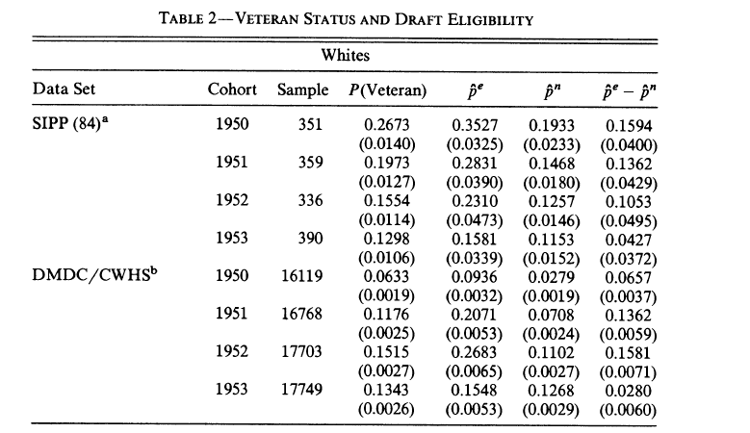

Slide 11
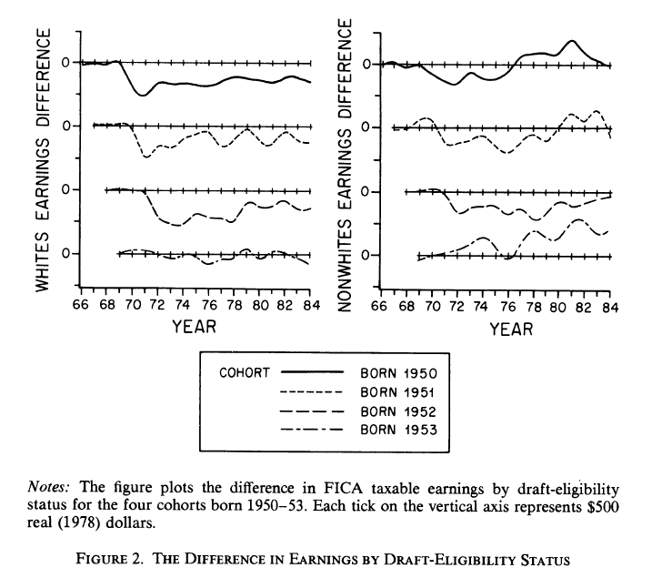

Slide 12
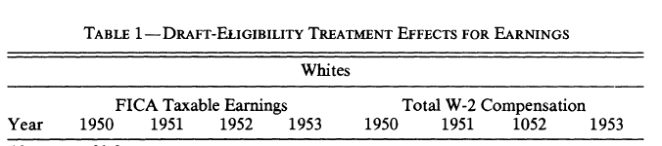
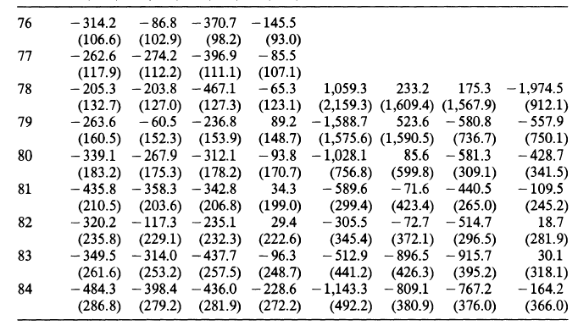

Slide 13
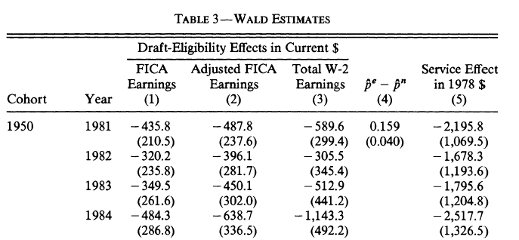
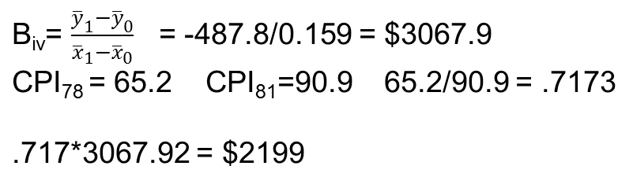

Slide 14
Angrist/Evans

Slide 15
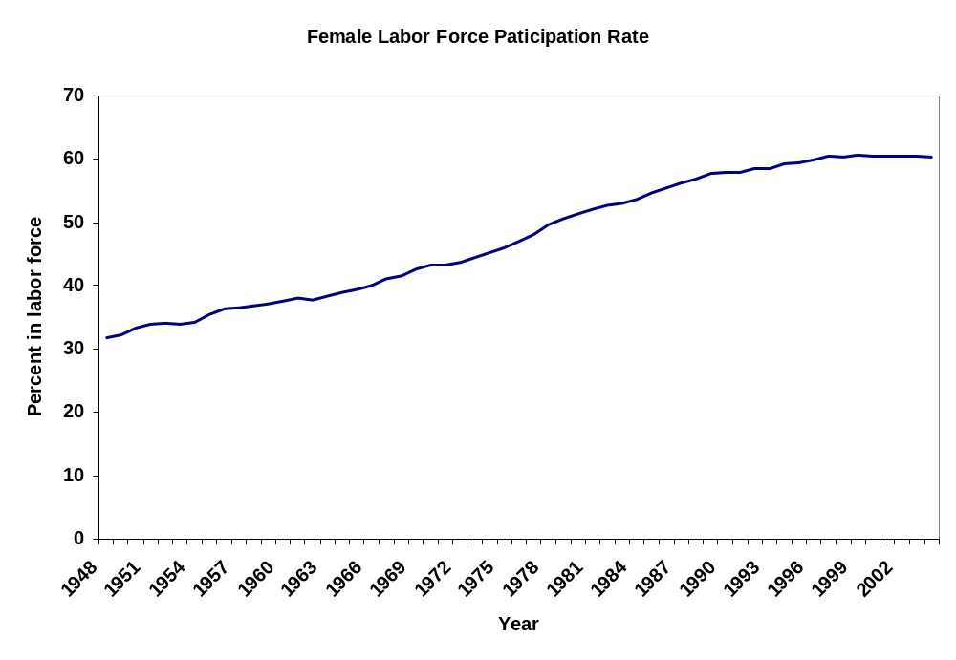

Slide 16
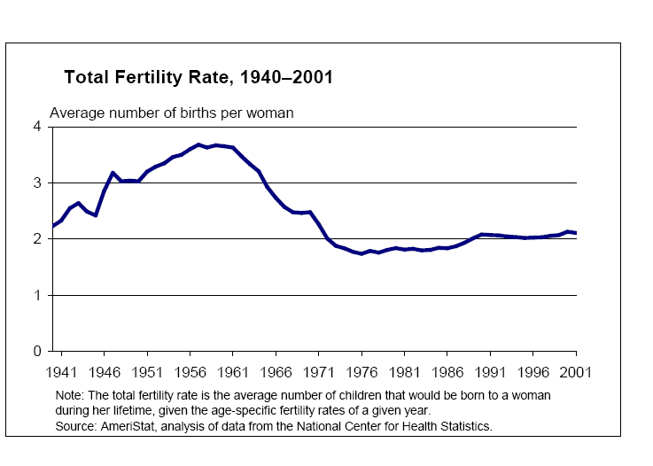

Slide 17
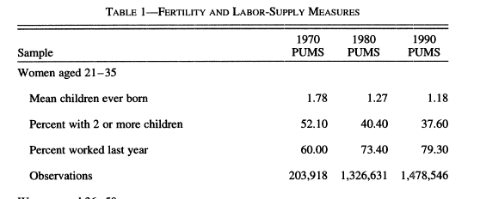

Slide 18
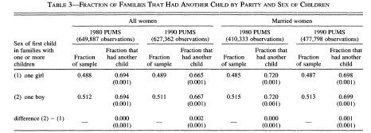

Slide 19
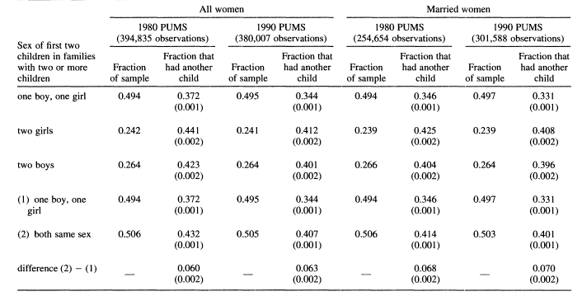

Slide 20
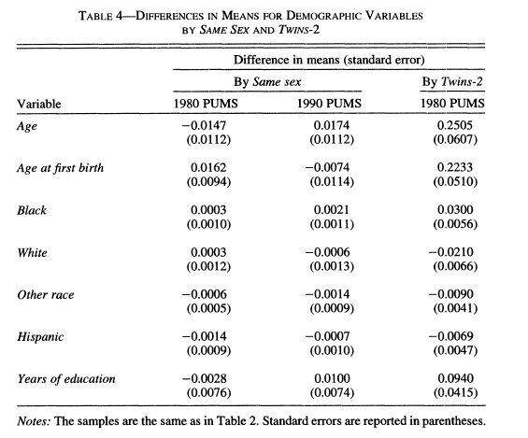

Slide 21
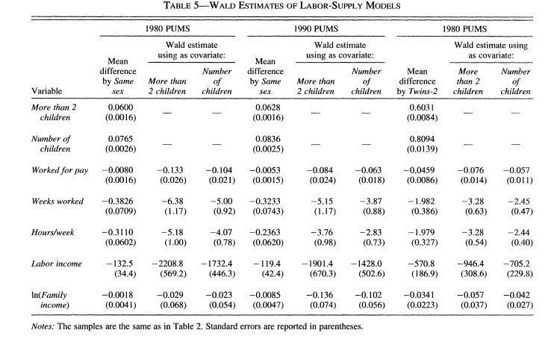

Slide 22
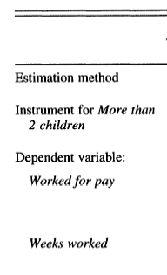
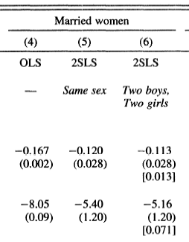

Slide 23
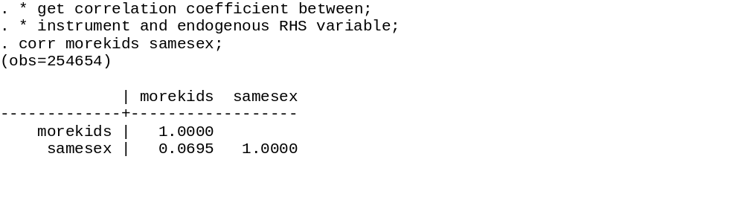
Correlation coefficient

Slide 24
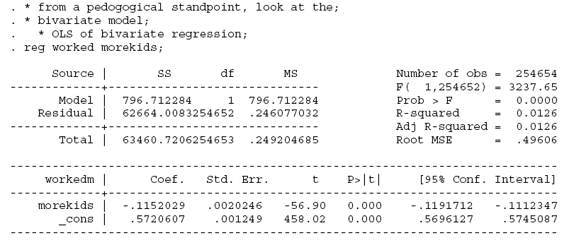
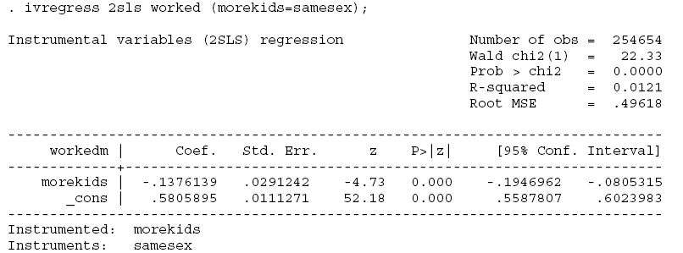
Ratio of variances = (0.0020246/0.0291242)^2 = 0.004832484

Slide 25
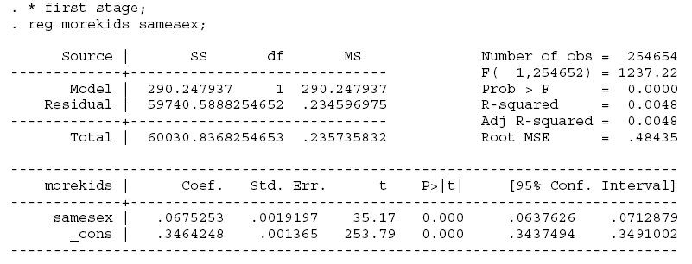
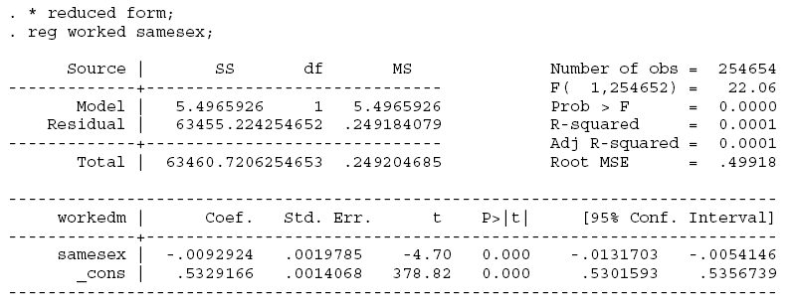
R² = 290.247937/60030.836855 = 0.004832
βiv = -0.0092924/0.0675253= -0.137631

Slide 26
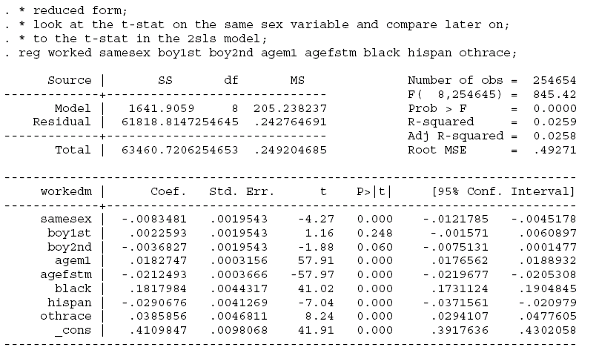
Reduced form, just identified model

Slide 27
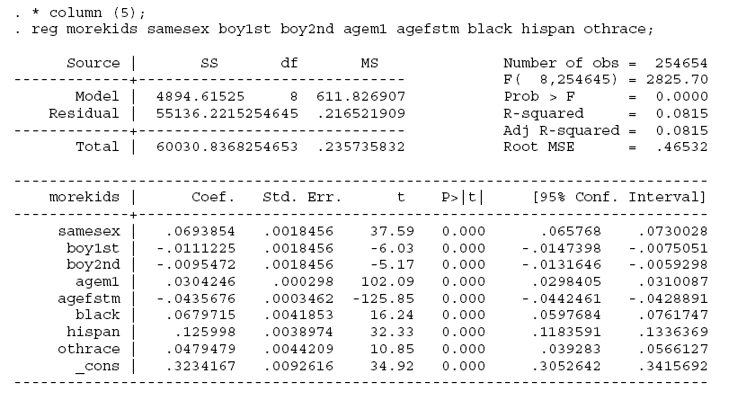
First stage, just identified model

Slide 28
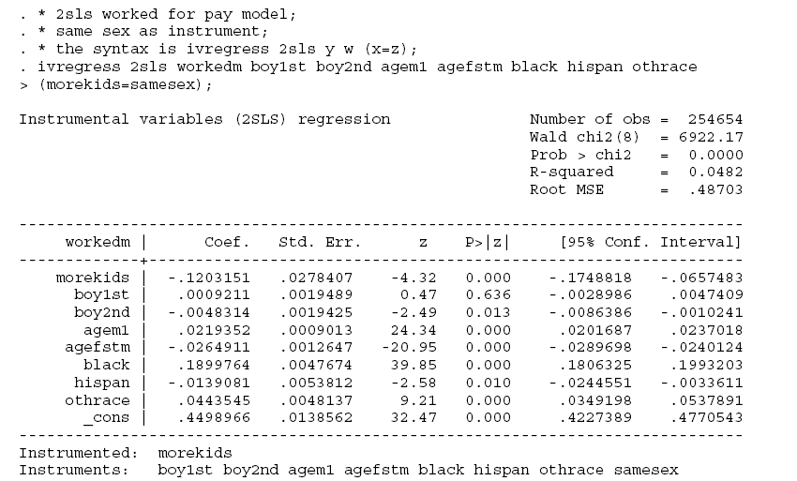
2SLS, just identified model
Β_{iv}= -0.0083481/0.0693854 = -0.120315

Slide 29
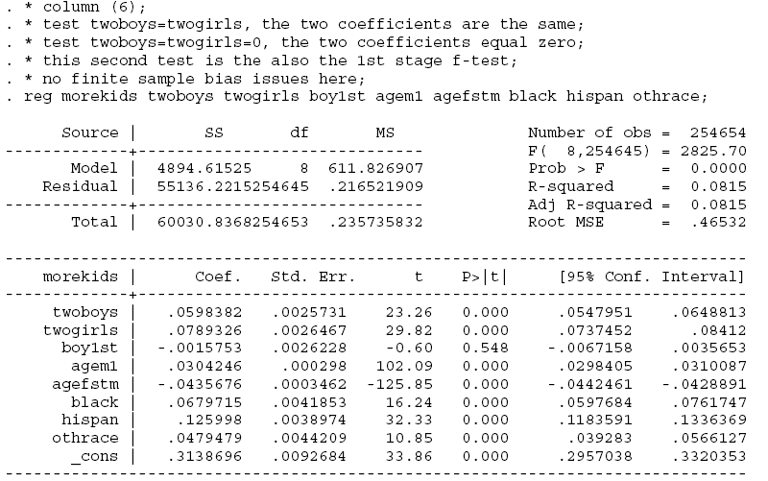
1st stage over identified model

Slide 30
ivreg2
Download from www
Within stata, type
ssc install ivreg2, replace
and hit return
Does all the tests seemlessly

Slide 31
Outcome of interest
W’s (exogenous covariates)
* the syntax is ivreg2 y w (x=z), first endog(x);
* the first command asks stata to report the 1st stage, and;
* endog(x) asks stata to do the hausman-wu test of endogeneity;
ivreg2 workedm boy1st boy2nd agem1 agefstm black hispan othrace
(morekids=samesex), first endog(morekids);
Test for endogeneity
of morekids in model
Endogenous variable
And instruments
Ask for 1st stage

Slide 32
IV (2SLS) estimation
--------------------
Estimates efficient for homoskedasticity only
Statistics consistent for homoskedasticity only
Number of obs = 254654
F( 8,254645) = 865.24
Prob > F = 0.0000
Total (centered) SS = 63460.72056 Centered R2 = 0.0482
Total (uncentered) SS = 134513 Uncentered R2 = 0.5510
Residual SS = 60402.67924 Root MSE = .487
------------------------------------------------------------------------------
workedm | Coef. Std. Err. z P>|z| [95% Conf. Interval]
-------------+----------------------------------------------------------------
morekids | -.1203151 .0278407 -4.32 0.000 -.1748818 -.0657483
boy1st | .0009211 .0019489 0.47 0.636 -.0028986 .0047409
boy2nd | -.0048314 .0019425 -2.49 0.013 -.0086386 -.0010241
agem1 | .0219352 .0009013 24.34 0.000 .0201687 .0237018
agefstm | -.0264911 .0012647 -20.95 0.000 -.0289698 -.0240124
black | .1899764 .0047674 39.85 0.000 .1806325 .1993203
hispan | -.0139081 .0053812 -2.58 0.010 -.0244551 -.0033611
othrace | .0443545 .0048137 9.21 0.000 .0349198 .0537891
_cons | .4498966 .0138562 32.47 0.000 .4227389 .4770543
------------------------------------------------------------------------------
Underidentification test (Anderson canon. corr. LM statistic): 1405.578
Chi-sq(1) P-val = 0.0000
------------------------------------------------------------------------------
Weak identification test (Cragg-Donald Wald F statistic): 1413.330
Stock-Yogo weak ID test critical values: 10% maximal IV size 16.38
15% maximal IV size 8.96
20% maximal IV size 6.66
25% maximal IV size 5.53
Source: Stock-Yogo (2005). Reproduced by permission.
------------------------------------------------------------------------------
Sargan statistic (overidentification test of all instruments): 0.000

Slide 33
OLS estimation
--------------
Estimates efficient for homoskedasticity only
Statistics consistent for homoskedasticity only
Number of obs = 254654
F( 8,254645) = 2825.70
Prob > F = 0.0000
Total (centered) SS = 60030.83676 Centered R2 = 0.0815
Total (uncentered) SS = 96912 Uncentered R2 = 0.4311
Residual SS = 55136.2215 Root MSE = .4653
------------------------------------------------------------------------------
morekids | Coef. Std. Err. t P>|t| [95% Conf. Interval]
-------------+----------------------------------------------------------------
boy1st | -.0015753 .0026228 -0.60 0.548 -.0067158 .0035653
agem1 | .0304246 .000298 102.09 0.000 .0298405 .0310087
agefstm | -.0435676 .0003462 -125.85 0.000 -.0442461 -.0428891
black | .0679715 .0041853 16.24 0.000 .0597684 .0761747
hispan | .125998 .0038974 32.33 0.000 .1183591 .1336369
othrace | .0479479 .0044209 10.85 0.000 .039283 .0566127
twoboys | .0598382 .0025731 23.26 0.000 .0547951 .0648813
twogirls | .0789326 .0026467 29.82 0.000 .0737452 .08412
_cons | .3138696 .0092684 33.86 0.000 .2957038 .3320353
------------------------------------------------------------------------------
Included instruments: boy1st agem1 agefstm black hispan othrace twoboys twogirl
> s
------------------------------------------------------------------------------
F test of excluded instruments:
F( 2,254645) = 715.13
Prob > F = 0.0000
Angrist-Pischke multivariate F test of excluded instruments:
F( 2,254645) = 715.13
Prob > F = 0.0000
1st stage F

Slide 34
Summary results for first-stage regressions
-------------------------------------------
(Underid) (Weak id)
Variable | F( 2,254645) P-val | AP Chi-sq( 2) P-val | AP F( 2,254645)
morekids | 715.13 0.0000 | 1430.31 0.0000 | 715.13

Slide 35
IV (2SLS) estimation
--------------------
Estimates efficient for homoskedasticity only
Statistics consistent for homoskedasticity only
Number of obs = 254654
F( 7,254646) = 987.26
Prob > F = 0.0000
Total (centered) SS = 63460.72056 Centered R2 = 0.0475
Total (uncentered) SS = 134513 Uncentered R2 = 0.5506
Residual SS = 60445.97117 Root MSE = .4872
------------------------------------------------------------------------------
workedm | Coef. Std. Err. z P>|z| [95% Conf. Interval]
-------------+----------------------------------------------------------------
morekids | -.1127816 .0276854 -4.07 0.000 -.167044 -.0585193
boy1st | .0009424 .0019496 0.48 0.629 -.0028786 .0047635
agem1 | .0217057 .0008969 24.20 0.000 .0199478 .0234635
agefstm | -.0261649 .0012583 -20.79 0.000 -.0286312 -.0236987
black | .1895035 .0047653 39.77 0.000 .1801637 .1988433
hispan | -.014818 .0053707 -2.76 0.006 -.0253444 -.0042916
othrace | .0439784 .004813 9.14 0.000 .034545 .0534118
_cons | .4448388 .0137111 32.44 0.000 .4179656 .4717121
------------------------------------------------------------------------------
Underidentification test (Anderson canon. corr. LM statistic): 1422.320
Chi-sq(2) P-val = 0.0000
------------------------------------------------------------------------------
Weak identification test (Cragg-Donald Wald F statistic): 715.129
Stock-Yogo weak ID test critical values: 10% maximal IV size 19.93
15% maximal IV size 11.59
20% maximal IV size 8.75
25% maximal IV size 7.25
Source: Stock-Yogo (2005). Reproduced by permission.
------------------------------------------------------------------------------
Sargan statistic (overidentification test of all instruments): 6.182
Chi-sq(1) P-val = 0.0129
Test of over id.
-endog- option:
Endogeneity test of endogenous regressors: 3.809
Chi-sq(1) P-val = 0.0510
Regressors tested: morekids
------------------------------------------------------------------------------
Instrumented: morekids
Included instruments: boy1st agem1 agefstm black hispan othrace
Excluded instruments: twoboys twogirls
------------------------------------------------------------------------------
Hausman endo test

Slide 36
. * output residuals and do the tests of overid;
. * and hausman test by brute force;
. predict res_2sls_worked, res;
. * test of overid;
. reg res_2sls_worked twoboys twogirls boy1st agem1 agefstm black hispan othr
> ace;
Source | SS df MS Number of obs = 254654
-------------+------------------------------ F( 8,254645) = 0.77
Model | 1.46731447 8 .183414308 Prob > F = 0.6269
Residual | 60444.5039254645 .237367723 R-squared = 0.0000
-------------+------------------------------ Adj R-squared = -0.0000
Total | 60445.9712254653 .237366028 Root MSE = .4872
------------------------------------------------------------------------------
res_2sls_w~d | Coef. Std. Err. t P>|t| [95% Conf. Interval]
-------------+----------------------------------------------------------------
twoboys | -.0052822 .0026941 -1.96 0.050 -.0105625 -1.83e-06
twogirls | .0042367 .0027711 1.53 0.126 -.0011946 .0096681
boy1st | .004822 .0027461 1.76 0.079 -.0005603 .0102043
agem1 | 3.72e-07 .000312 0.00 0.999 -.0006112 .000612
agefstm | 2.07e-06 .0003625 0.01 0.995 -.0007084 .0007125
black | -.0000392 .0043822 -0.01 0.993 -.0086282 .0085498
hispan | -.0000393 .0040807 -0.01 0.992 -.0080375 .0079588
othrace | .0000149 .0046288 0.00 0.997 -.0090575 .0090872
_cons | -.0021381 .0097043 -0.22 0.826 -.0211583 .016882
------------------------------------------------------------------------------

Slide 37
SSM = 1.467
SST = 600444.50
R2 = SSM/SST = 2.43E-5
N = 254654
NR² = 6.18
Dist as χ²(1)
P-value of 6.18 is 0.0129

Slide 38
Do Hausman test brute force
. * Run Hausmans test of endogeneity, two instrument case;
. * add residual from 1st stage regression to OLS of structural model;
. reg workedm morekids boy1st agem1 agefstm black hispan othrace res_1st_2zs;
Source | SS df MS Number of obs = 254654
-------------+------------------------------ F( 8,254645) = 1677.06
Model | 3176.20362 8 397.025453 Prob > F = 0.0000
Residual | 60284.5169254645 .236739449 R-squared = 0.0500
-------------+------------------------------ Adj R-squared = 0.0500
Total | 63460.7206254653 .249204685 Root MSE = .48656
------------------------------------------------------------------------------
workedm | Coef. Std. Err. t P>|t| [95% Conf. Interval]
-------------+----------------------------------------------------------------
morekids | -.1127816 .0276489 -4.08 0.000 -.1669726 -.0585906
boy1st | .0009424 .001947 0.48 0.628 -.0028736 .0047585
agem1 | .0217057 .0008957 24.23 0.000 .0199501 .0234612
agefstm | -.0261649 .0012566 -20.82 0.000 -.0286279 -.0237019
black | .1895035 .004759 39.82 0.000 .180176 .1988311
hispan | -.014818 .0053636 -2.76 0.006 -.0253305 -.0043054
othrace | .0439784 .0048067 9.15 0.000 .0345574 .0533994
res_1st_2zs | -.0541136 .0277264 -1.95 0.051 -.1084566 .0002294
_cons | .4448388 .013693 32.49 0.000 .4180009 .4716768
------------------------------------------------------------------------------
. * notice that OLS of this model generates 2SLS estimates of the other;
. * variables in the model (morekids, boy1st, etc.);
. test res_1st_2zs;
( 1) res_1st_2zs = 0
F( 1,254645) = 3.81
Prob > F = 0.0510

Slide 39
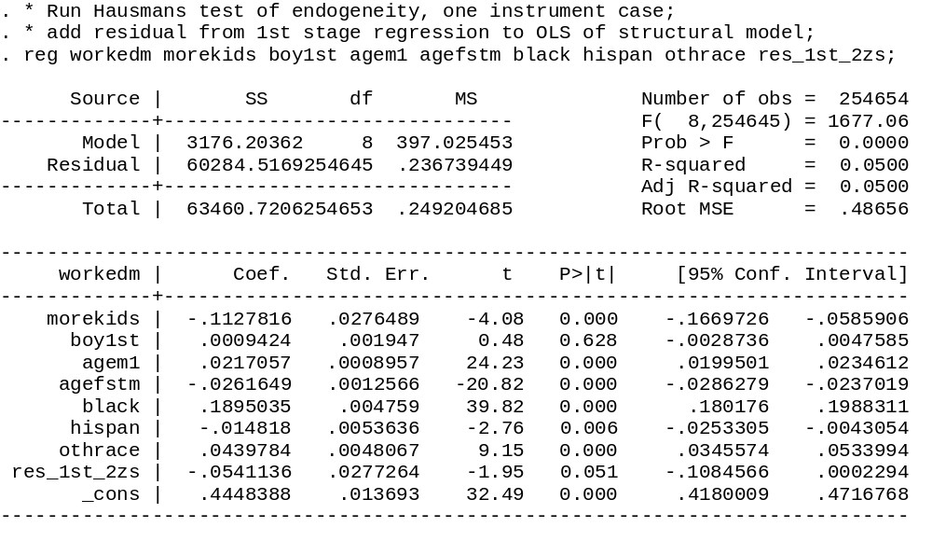
Can reject at 5.1 percent the null the coefficients are
The same

Slide 40
Angrist/Krueger

Slide 41
Example
Suppose a school district requires that a child turn 6 by October 31 in the 1st grade
Has compulsory education until age 18
Consider two kids
One born Oct 1, 1960
Another born Nov 1,1960

Slide 42
Oct 1, 1960
  Starts school in 1966 (age 5)
  Turns 6 a few months into school
  Starts senior year in 1977 (age 16)
  Does not turn 18 until after HS school is over
Nov 1, 1960
  Start school in 1967 (age 6)
  Turns 7 a few months into school
  Starts senior year in 1978 (age 17)
  Turns 18 midway through senior year

Slide 43
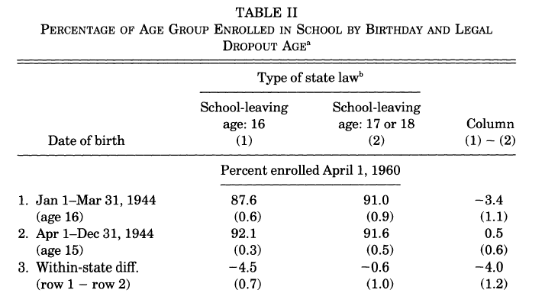

Slide 44
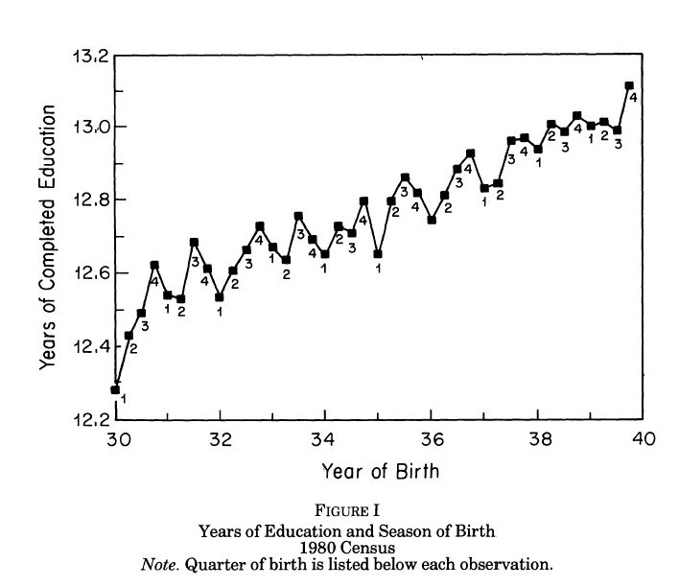

Slide 45
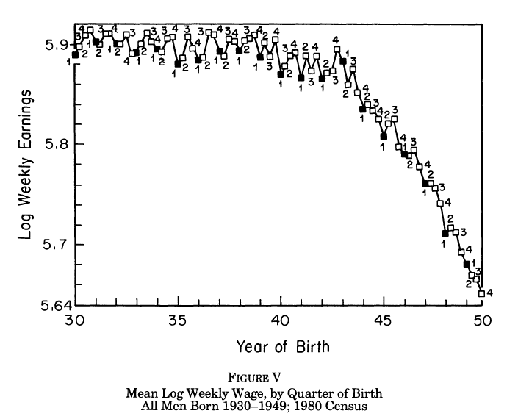

Slide 46
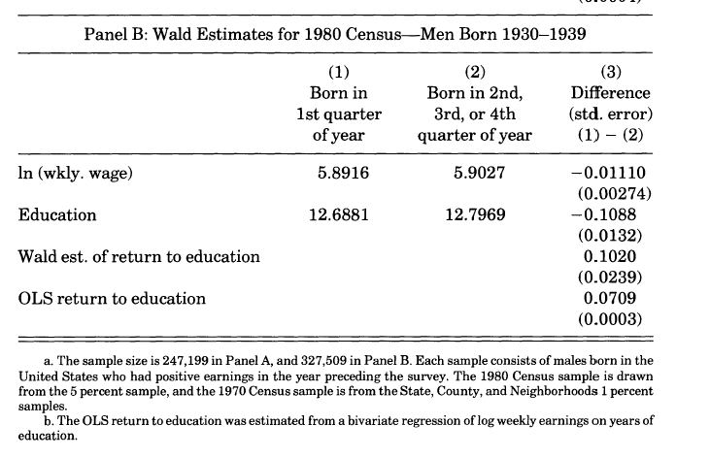

Slide 47
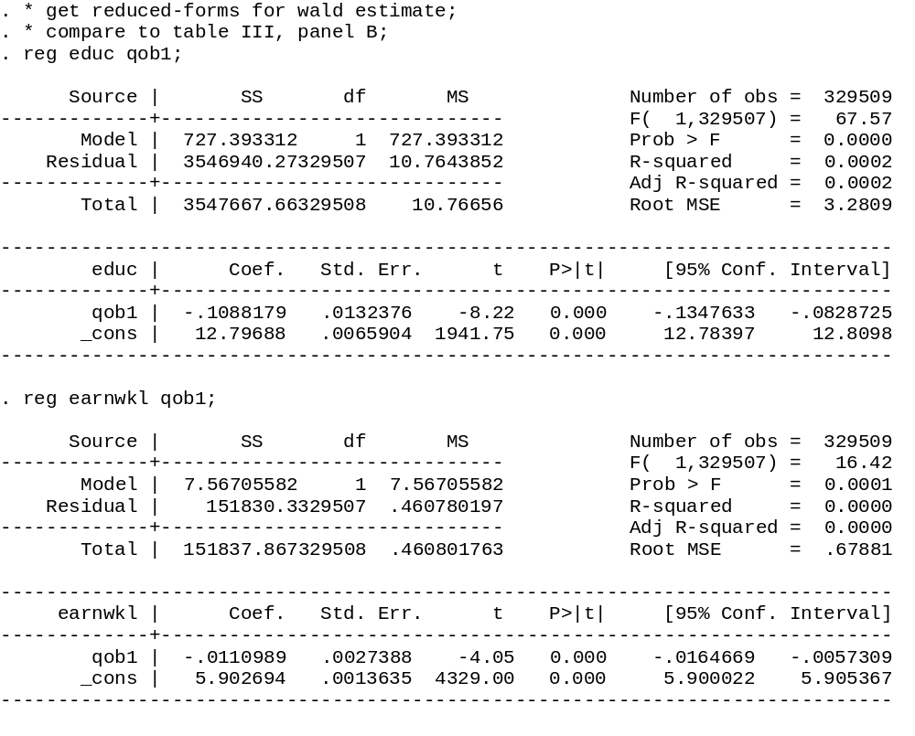
β_{iv=}=-0.0110989/-0.1088179=-0.10199
1st stage
Reduced-form

Slide 48
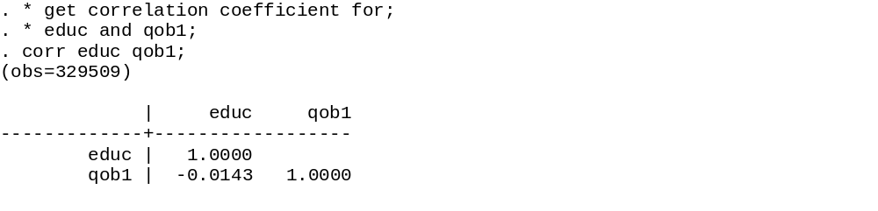
Correlation coefficient: z and x

Slide 49
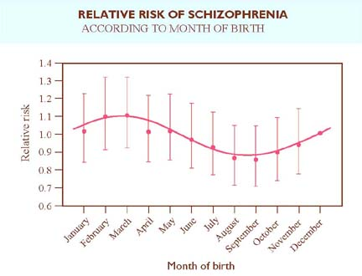

Slide 50
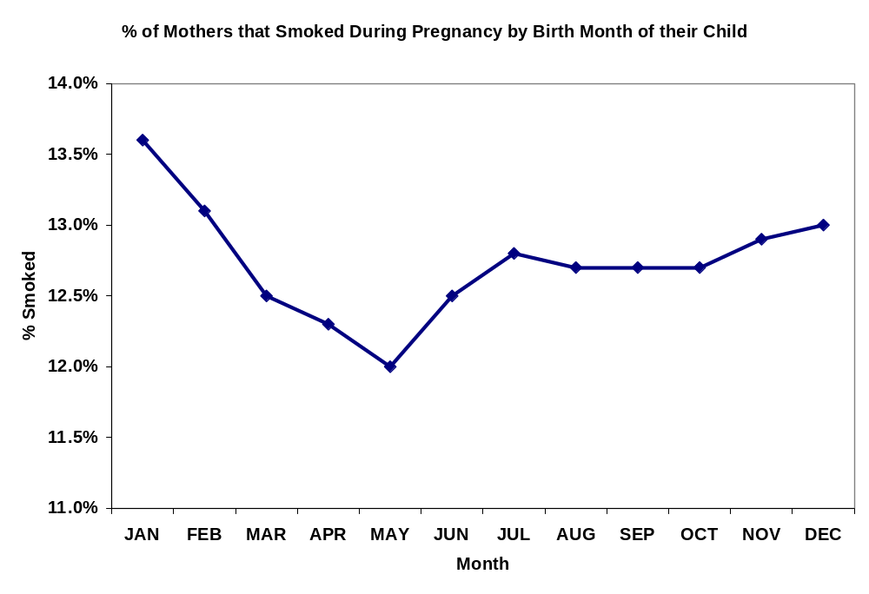

Slide 51
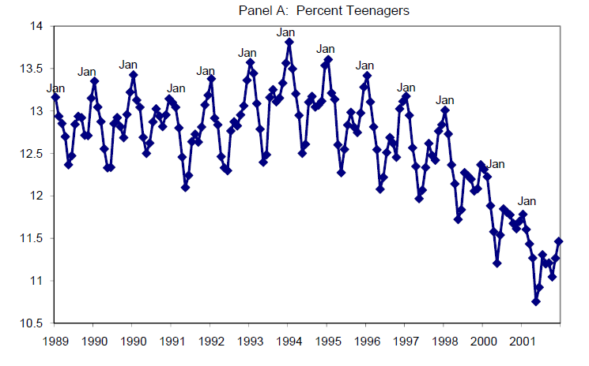

Slide 52
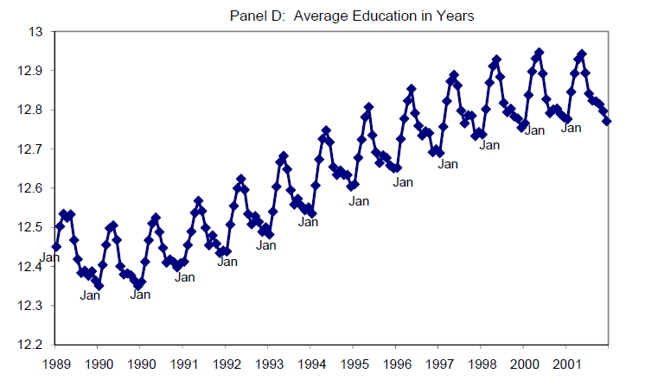

Slide 53
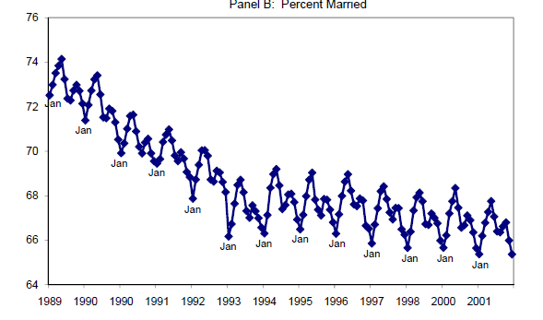

Slide 54
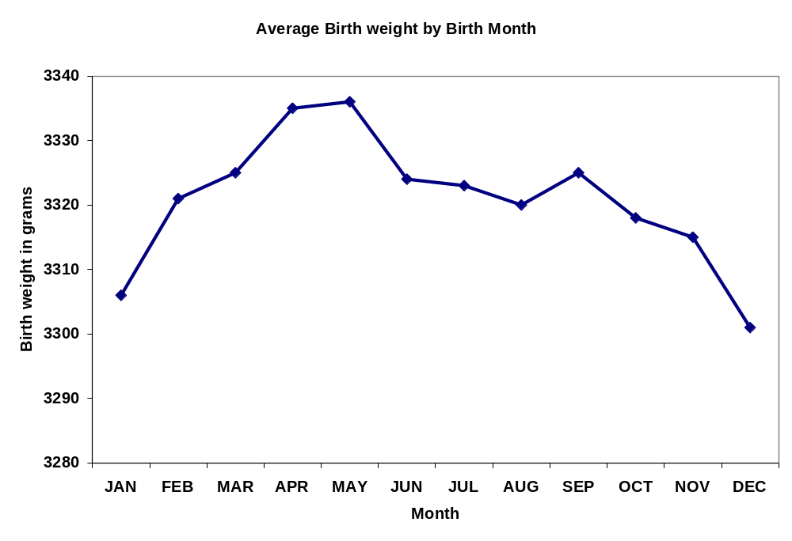

Slide 55
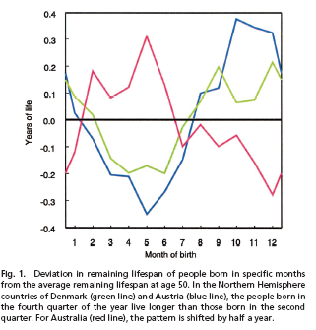

Slide 56
Overidentified model
10 years of birth
3 quarters of birth
30 instruments

Slide 57
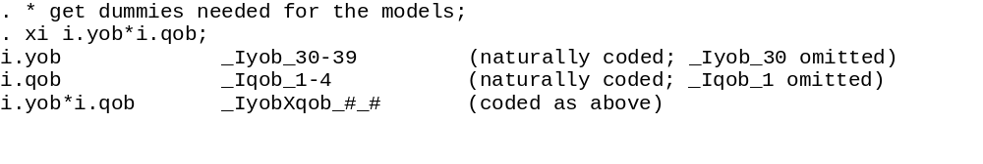
The xi command i.m*i.n takes and generates dummies for
i.m, i.n then all the unique interactions of m and n

Slide 58
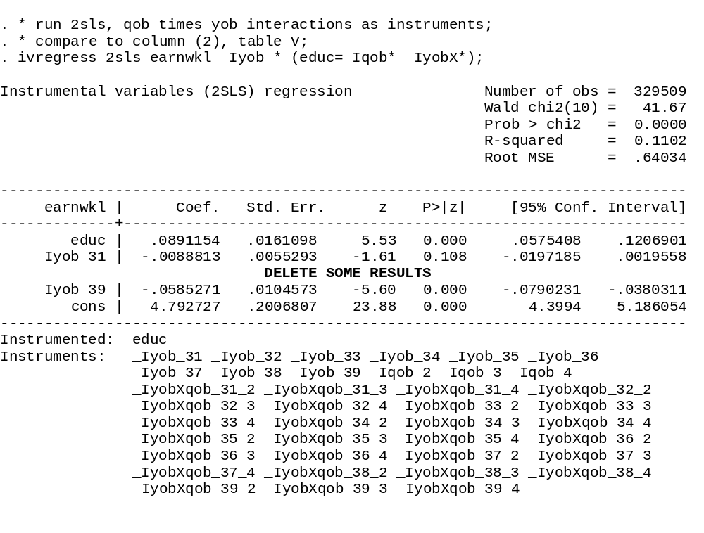
YOB effects
QOB main effects and qob x yob interactions as
instruments

Slide 59
. estat overid;
Tests of overidentifying restrictions:
Sargan (score) chi2(29)= 25.4394 (p = 0.6553)
Basmann chi2(29) = 25.4383 (p = 0.6553)

Slide 60
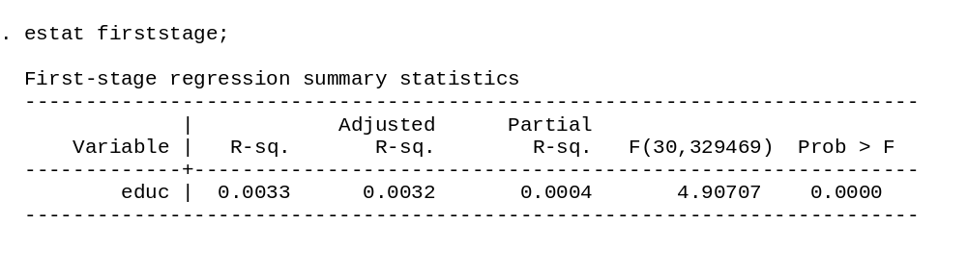
1st stage F – lots of concerns about finite sample bias

Slide 61

In columns (4) and (8), age and agesq reduce information contained
in instrument. 1st stage F falls to 1.6. Compare 2sls to IV in these cases.
In this instance, low F – poor 1st stage fit – results collapse to OLS

Slide 62

Notice how close the 2SLS and OLS are
Generate instruments by interacting
3 QOB x 10 YOB dummies (30)
3 QOB x 50 YOB dummies (147)
177 instruments, 176 DOF in NR² test

Slide 63


