Slide 1
Multi-Choice
Models

Slide 2
Introduction
In this section, we examine models with more than 2 possible choices
Examples
  How to get to work (bus, car, subway, walk)
  How you treat a particular condition (bypass, heart cath., drugs, nothing)
  Living arrangement (single, married, living with someone)

Slide 3
In these examples, the choices reflect tradeoffs the consumer must face
  Transportation: More flexibility usually requires more cost
  Health: more invasive procedures may be more effective
In contrast to ordered probit, no natural ordering of choices

Slide 4
Modeling choices
Model is designed to estimate what cofactors predict choice of 1 from the other J-1 alternatives
Motivated from the same decision/theoretic perspective used in logit/probit modes
  Just have expanded the choice set

Slide 5
Some model specifics
j indexes choices (J of them)
  No need to assume equal choices
i indexes people (N of them)
Y_{ij}=1 if person i selects option j, =0 otherwise
U_{ij} is the utility or net benefit of person ”i” if they select option “j”
Suppose they select option 1

Slide 6
Then there are a set of (J-1) inequalities that must be true
  U_{i1}>U_{i2}
  U_{i1}>U_{i3}…..
U_{i1}>U_{iJ}
Choice 1 dominates the other
We will use the (J-1) inequality to help build the model

Slide 7
Two different but similar models
Multinomial logit
  Utility varies only by “i” characteristics
  People of different incomes more likely to pick one mode of transportation
Conditional logit
  Utility varies only by the characteristics of the option
  Each mode of transportation has different costs/time
Mixed logit – combined the two

Slide 8
Multinomial Logit
Utility is determined by two parts: observed and unobserved characteristics (just like logit)
However, measured components only vary at the individual level
Therefore, the model measures what characteristics predict choice
  Are people of different income levels more/less likely to take one mode of transportation to work

Slide 9
U_{ij} = X_{i}β_{j} + ε_{ij}
ε_{ij} is assumed to be a type 1 extreme value distribution
  f(ε_{ij}) = exp(- ε_{ij})exp(-exp(-ε_{ij}))
  F(a) = exp(-exp(-a))
Choice of 1 implies utility from 1 exceeds that of options 2 (and 3 and 4….)

Slide 10
Focus on choice of option 1 first
U_{i1}>U_{i2} implies that
X_{i}β₁ + ε_{i1} > X_{i}β₂ + ε_{i2}
    OR
ε_{i2} < X_{i}β₁ - X_{i}β₂ + ε_{i1}

Slide 11
There are J-1 of these inequalities
ε_{i2} < X_{i}β₁ - X_{i}β₂ + ε_{i1}
ε_{i3} < X_{i}β₁ – X_{i}β₃ + ε_{i1}
ε_{iJ} < X_{i}β₁ - X_{i}β_{j} + ε_{i1}
Probability we observe option 1 selected is therefore
[Prob(ε_{i2} < X_{i}β₁ - X_{i}β₂ + ε_{i1} ∩ ε_{i3} < X_{i}β₁ – X_{i}β₃ + ε_{i1 ….} ∩ ε_{iJ} < X_{i}β₁ - X_{i}β_{j} + ε_{i1})]

Slide 12
Recall: if a, b and c are independent
Pr(A ∩ B ∩ C) = Pr(A)Pr(B)Pr(C)
And since ε₁ ε₂ ε₃ … ε_{k} are independent
The term in brackets equals
Pr(X_{i}β₁ - X_{i}β₂ + ε_{i1})Pr(X_{i}β₁ – X_{i}β₃ + ε_{i1})…
But since ε₁ is a random variable, must integrate this value out

Slide 13
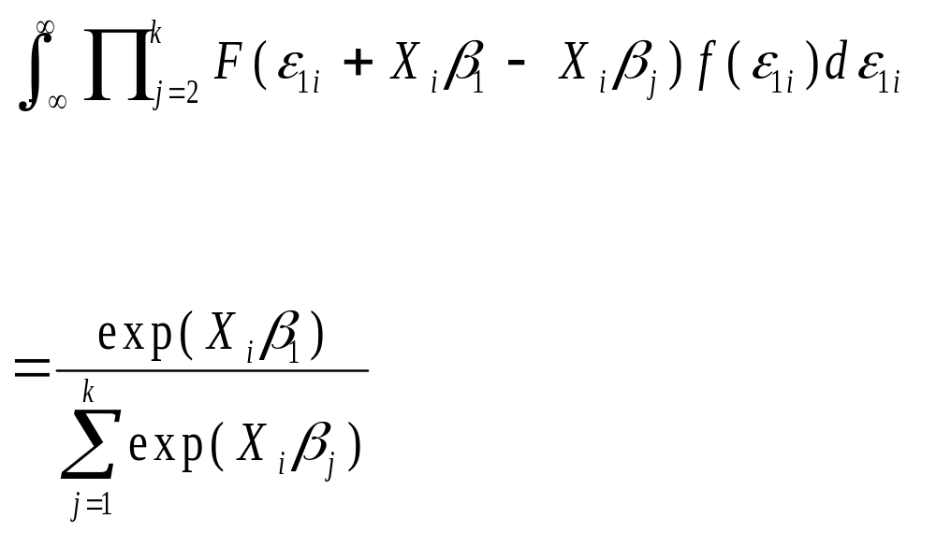

Slide 14
General Result
The probability you choose option j is
Prob(Y_{ij}=1 | X_{i}) = exp(X_{i}β_{j})/Σ_{k}[exp(X_{ik}β_{k})]
Each option j has a different vector β_{j}

Slide 15
To identify the model, must pick one option (m) as the “base” or “reference” option and set β_{m}=0
Therefore, the coefficients for β_{j} represent the impact of a personal characteristic on the option they will select j relative to m.
If J=2, model collapses to logit

Slide 16
Log likelihood function
Y_{ij}=1 of person I chose option j
0 otherwise
Prob(Y_{ij}=1) is the estimated probability option j will be picked
L = Σ_{i} Σ_{j} Y_{ij} ln[Prob(Y_{ij})]

Slide 17
Estimating in STATA
Estimation is trivial so long as data is constructed properly
Suppose individuals are making the decision. There is one observation per person
The observation must identify
  the X’s
  the options selected
Example:Job_training_example.dta

Slide 18
1500 adult females who were part of a job training program
They enrolled in one of 4 job training programs
Choice identifies what option was picked
  1=classroom training
  2=on the job training
  3= job search assistance
  4=other

Slide 19
* get frequency of choice variable;
. tab choice;
choice | Freq. Percent Cum.
------------+-----------------------------------
1 | 642 42.80 42.80
2 | 225 15.00 57.80
3 | 331 22.07 79.87
4 | 302 20.13 100.00
------------+-----------------------------------
Total | 1,500 100.00

Slide 20
Syntax of mlogit procedure. Identical to logit but, must list as an option the choice to be used as the reference (base) option
Mlogit dep.var ind.var, base(#)
Example from program
mlogit choice age black hisp nvrwrk lths hsgrad, base(4)

Slide 21
Three sets of characteristics are used to explain what option was picked
  Age
  Race/ethnicity
  Education
  Whether respondent worked in the past
1500 obs. in the data set

Slide 22
Multinomial logistic regression Number of obs = 1500
LR chi2(18) = 135.19
Prob > chi2 = 0.0000
Log likelihood = -1888.2957 Pseudo R2 = 0.0346
------------------------------------------------------------------------------
choice | Coef. Std. Err. z P>|z| [95% Conf. Interval]
-------------+----------------------------------------------------------------
1 |
age | .0071385 .0081098 0.88 0.379 -.0087564 .0230334
black | 1.219628 .1833561 6.65 0.000 .8602566 1.578999
hisp | .0372041 .2238755 0.17 0.868 -.4015838 .475992
nvrwrk | .0747461 .190311 0.39 0.694 -.2982567 .4477489
lths | -.0084065 .2065292 -0.04 0.968 -.4131964 .3963833
hsgrad | .3780081 .2079569 1.82 0.069 -.0295799 .785596
_cons | .0295614 .3287135 0.09 0.928 -.6147052 .6738279
-------------+----------------------------------------------------------------

Slide 23
-------------+----------------------------------------------------------------
2 |
age | .008348 .0099828 0.84 0.403 -.011218 .0279139
black | .5236467 .2263064 2.31 0.021 .0800942 .9671992
hisp | -.8671109 .3589538 -2.42 0.016 -1.570647 -.1635743
nvrwrk | -.704571 .2840205 -2.48 0.013 -1.261241 -.1479011
lths | -.3472458 .2454952 -1.41 0.157 -.8284075 .1339159
hsgrad | -.0812244 .2454501 -0.33 0.741 -.5622979 .399849
_cons | -.3362433 .3981894 -0.84 0.398 -1.11668 .4441936
-------------+----------------------------------------------------------------
3 |
age | .030957 .0087291 3.55 0.000 .0138483 .0480657
black | .835996 .2102365 3.98 0.000 .4239399 1.248052
hisp | .5933104 .2372465 2.50 0.012 .1283157 1.058305
nvrwrk | -.6829221 .2432276 -2.81 0.005 -1.159639 -.2062047
lths | -.4399217 .2281054 -1.93 0.054 -.887 .0071566
hsgrad | .1041374 .2248972 0.46 0.643 -.3366529 .5449278
_cons | -.9863286 .3613369 -2.73 0.006 -1.694536 -.2781213
------------------------------------------------------------------------------

Slide 24
Notice there is a separate constant for each alternative
Represents that, given X’s, some options are more popular than others
Constants measure in reference to the base alternative

Slide 25
How to interpret parameters
Parameters in and of themselves not that informative
We want to know how the probabilities of picking one option will change if we change X
Two types of X’s
  Continuous
  dichotomous

Slide 26
Probability of choosing option j
Prob(Y_{ij}=1 |X_{i}) = exp(X_{i}β_{j})/Σ_{k}[exp(X_{i}β_{k})]
X_{i}=(X_{i1}, X_{i2}, …..X_{ik})
Suppose X_{i1} is continuous
dProb(Y_{ij}=1 | X_{i})/dX_{i1} = ?

Slide 27
Suppose X_{i1} is continuous
Calculate the marginal effect
dProb(Y_{ij}=1 | X_{i})/dX_{i1}
  where X_{i} is evaluated at the sample means
Can show that
dProb(Y_{ij} =1 | X_{i})/dX_{i1} = P_{j}[β_{1j}-b]
Where b=P₁β₁₁ + P₂β₁₂ + …. P_{k}β_{1k}

Slide 28
The marginal effect is the difference in the parameter for option 1 and a weighted average of all the parameters on the 1st variable
Weights are the initial probabilities of picking the option
Notice that the ‘sign’ of beta does not inform you about the sign of the ME

Slide 29
Suppose X_{i2} is Dichotomous
Calculate change in probabilities
P₁= Prob(Y_{ij}=1 | X_{i1}, X_{i2} =1 ….. X_{ik})
P₀ = Prob(Y_{ij}=1 | X_{i1}, X_{i2} =0 ….. X_{ik})
ATE = P₁ – P₀
Stata uses sample means for the X’s

Slide 30
How to estimate
mfx compute, predict(outcome(#));
Where # is the option you want the probabilities for
Report results for option #1 (classroom training)

Slide 31
. mfx compute, predict(outcome(1));
Marginal effects after mlogit
y = Pr(choice==1) (predict, outcome(1))
= .43659091
------------------------------------------------------------------------------
variable | dy/dx Std. Err. z P>|z| [ 95% C.I. ] X
---------+--------------------------------------------------------------------
age | -.0017587 .00146 -1.21 0.228 -.004618 .001101 32.904
black*| .179935 .03034 5.93 0.000 .120472 .239398 .296
hisp*| -.0204535 .04343 -0.47 0.638 -.105568 .064661 .111333
nvrwrk*| .1209001 .03702 3.27 0.001 .048352 .193448 .153333
lths*| .0615804 .03864 1.59 0.111 -.014162 .137323 .380667
hsgrad*| .0881309 .03679 2.40 0.017 .016015 .160247 .439333
------------------------------------------------------------------------------
(*) dy/dx is for discrete change of dummy variable from 0 to 1

Slide 32
An additional year of age will increase probability of classroom training by .17 percentage points
  10 years will increase probability by 1.7 percentage pts
Those who have never worked are 12 percentage pts more likely to ask for classroom training

Slide 33
β and Marginal Effects
 | Option 1 |  | Option 2 |  | Option 3
 | β | ME | β | ME | β | ME
Age | 0.007 | -0.002 | 0.008 | -0.001 | 0.031 | 0.004
Black | 1.219 | 0.179 | 0.524 | -0.042 | 0.836 | 0.001
Hisp | 0.037 | -0.020 | -0.867 | -0.100 | 0.593 | 0.136
Nvrwk | 0.075 | 0.121 | -0.704 | -0.065 | -0.682 | -0.093
LTHS | -0.008 | 0.065 | -0.347 | -0.029 | -0.449 | -0.062
HS | 0.378 | 0.088 | -0.336 | -0.038 | 0.104 | -0.016

Slide 34
Notice that there is not a direct correspondence between sign of β and the sign of the marginal effect
Really need to calculate the ME’s to know what is going on

Slide 35
Problem: IIA
Independent of Irrelevant alternatives or ‘red bus/blue bus’ problem
Suppose two options to get to work
  Car (option c)
  Blue bus (option b)
What are the odds of choosing option c over b?

Slide 36
Since numerator is the same in all probabilities
Pr(Y_{ic}=1|X_{i})/Pr(Y_{ib}=1|X_{i})
=exp(X_{i}β_{c})/exp(X_{i}β_{b})
Note two thing: Odds are
  independent of the number of alternatives
  Independent of characteristics of alt.
  Not appealing

Slide 37
Example
Pr(Car) + Pr(Bus) = 1 (by definition)
Originally, lets assume
  Pr(Car) = 0.75
  Pr(Blue Bus) = 0.25,
So odds of picking the car is 3/1.

Slide 38
Suppose that the local govt. introduces a new bus.
Identical in every way to old bus but it is now red (option r)
Choice set has expanded but not improved
  Commuters should not be any more likely to ride a bus because it is red
  Should not decrease the chance you take the car

Slide 39
In reality, red bus should just cut into the blue bus business
  Pr(Car) = 0.75
  Pr(Red Bus) = 0.125 = Pr(Blue Bus)
  Odds of taking car/blue bus = 6

Slide 40
What does model suggest
Since red/blue bus are identical β_{b} =β_{r}
Therefore,
Pr(Y_{ib}=1|X_{i})/Pr(Y_{ir}=1|X_{i})
=exp(X_{i}β_{b})/exp(X_{i}β_{r}) = 1
But, because the odds are independent of other alternatives
Pr(Y_{ic}=1|X_{i})/Pr(Y_{ib}=1|X_{i})
=exp(X_{i}β_{c})/exp(X_{i}β_{b}) = 3 still

Slide 41
With these new odds, then
  Pr(Car) = 0.6
  Pr(Blue) = 0.2
  Pr(Red) = 0.2
Note the model predicts a large decline in car traffic – even though the person has not been made better off by the introduction of the new option

Slide 42
Poorly labeled – really independence of relevant alternatives
Implication? When you use these models to simulate what will happen if a new alternative is added, will predict much larger changes than will happen
How to test for whether IIA is a problem?

Slide 43
Hausman Test
Suppose you have two ways to estimate a parameter vector β (k x 1)
β₁ and β₂ are both consistent but 1 is more efficient (lower variance) than 2
Let Var(β₁) =Σ₁ and Var(β₂) =Σ₂
H_{o}: β₁ = β₂
q = (β₂ – β₁)`[Σ₂ - Σ₁]⁻¹(β₂ – β₁)
If null is correct, q ~ chi-squared with k d.o.f.

Slide 44
Operationalize in this context
Suppose there are J alternatives and reference 1 is the base
If IIA is NOT a problem, then deleting one of the options should NOT change the parameter values
However, deleting an option should reduce the efficiency of the estimates – not using all the data

Slide 45
β₁ as more efficient (and consistent) unrestricted model
β₂ as inefficient (and consistent) restricted model
Conducting a Hausman test
Mlogtest, hausman
Null is that IIA is not a problem, so, will reject null if the test stat. is ‘large’

Slide 46
Results
Ho: Odds(Outcome-J vs Outcome-K) are independent of other alternatives.
Omitted | chi2 df P>chi2 evidence
---------+------------------------------------
1 | -5.283 14 1.000 for Ho
2 | 0.353 14 1.000 for Ho
3 | 2.041 14 1.000 for Ho
----------------------------------------------

Slide 47
Not happy with this subroutine
Notice p-values are all 1 – wrong from the start
The 1st test statistic is negative. Can be the case and is often the case, but, problematic.

Slide 48
How to get around IIA?
Conditional probit models.
  Allow for correlation in errors
  Very complicated.
  Not pre-programmed into any statistical package
Nested logit
  Group choices into similar categories
  IIA within category and between category

Slide 49
Example: Model of car choice
  4 options: Sedan, minivan, SUV, pickup truck
Could ‘nest the decision
First decide whether you want something on a car or truck platform
Then pick with the group
  Car: sedan or minivan
  Truck: pickup or SUV

Slide 50
IIA is imposed
  within a nest:
    Cars/minivans
    Pickup and SUV
  Between 1st level decision
    Truck and car platform

Slide 51
Conditional Logit
Devised by McFadden and similar to logit
Allows characteristics to vary across alternatives
U_{ij} = Z_{ij}γ + ε_{ij}
ε_{ij} is again assumed to be a type 1 extreme value distribution

Slide 52
Choice of 1 over 2,3,…J generates J-1 inequalities
Reduces to similar probability as before
Probability of choosing option j
Prob(Y_{ij}=1 | Z_{ij}) = exp(Z_{ij}γ)/Σ_{k}[exp(Z_{ik} γ)]

Slide 53
Mixed models
Most frequent type of multiple unordered choice
Z’s that vary by option
X’s that vary by person
U_{ij} = X_{i}β_{j} + Z_{ij}γ + ε_{ij}
Prob(Y_{ij}=1 |X_{i} Z_{ij})
= exp(X_{i}β_{j} + Z_{ij}γ)/Σ_{k}[exp(X_{i}β_{k} + Z_{ik} γ)]

Slide 54
How must data be structured?
There must be J observations (one for each alternative) for each person (N) in the data set
  NJ observations in total
Must be an ID variable that identifies what observations go together
A dummy variable that equals 1 identifies the observation from the J alternatives that is selected

Slide 55
Example
  Travel_choice_example.dta
210 families had one of four ways to travel to another city in Australia
  Fly (mode=1)
  Train (=2)
  Bus (=3)
  Car (=4)
Two variables that vary by option/person
  Costs and travel time
One family-specific characteristic -- Income

Slide 56
Index of
Options
Actual
Choice
Travel time
In minutes
Household
Index
Travel cost
In $
1005 | 1 | 0 | 208 | 82 | 45 | 2
1005 | 2 | 0 | 448 | 93 | 45 | 2
1005 | 3 | 0 | 502 | 94 | 45 | 2
1005 | 4 | 1 | 600 | 99 | 45 | 2
1006 | 1 | 0 | 169 | 70 | 20 | 1
1006 | 2 | 1 | 385 | 57 | 20 | 1
1006 | 3 | 0 | 452 | 58 | 20 | 1
1006 | 4 | 0 | 284 | 43 | 20 | 1
Household income
X 1000
Size of group
traveling

Slide 57
Preparing the data for estimation
There are 4 choices. Some more likely than others.
Need to reflect this by having J-1 dummy variables
  Construct dummies for air, bus, train choices
gen air=mode==1;
gen train=mode==2;
gen bus=mode==3;

Slide 58
For each family-specific characteristic, need to interact with a option dummy variable
* interact hhinc with choice dummies;
gen hhinc_air=air*hhinc;
gen hhinc_train=train*hhinc;
gen hhinc_bus=bus*hhinc;

Slide 59
Costs are a little complicated –
  If by car, costs are costs.
  If by air/bus/train, costs are groupsize*costs (need to buy a ticket for all travelers)
gen group_costs=car*costs
+(1-car)*groupsize*costs;

Slide 60
1=air, |
2=train, | =1 if choice, =0
3=bus, | otherwise
4=car | 0 1 | Total
-----------+----------------------+----------
1 | 152 58 | 210
2 | 147 63 | 210
3 | 180 30 | 210
4 | 151 59 | 210
-----------+----------------------+----------
Total | 630 210 | 840

Slide 61
Means of Variables
 |  | % Selecting | Costs | Travel time
Plane |  | 27.6% | $174 | 194
Train |  | 30.0% | $237 | 583
Bus |  | 14.3% | $212 | 671
Car |  | 28.1% | $95 | 573

Slide 62
Run two models. One with only variables that vary by option (conditional logit)
clogit choice air train bus time totalcosts, group(hhid);
Run another with family characteristics
clogit choice air train bus time totalcosts hhinc_*, group(hhid);

Slide 63
Results from Second Model
Conditional (fixed-effects) logistic regression Number of obs = 840
LR chi2(8) = 102.15
Prob > chi2 = 0.0000
Log likelihood = -240.04567 Pseudo R2 = 0.1754
------------------------------------------------------------------------------
choice | Coef. Std. Err. z P>|z| [95% Conf. Interval]
-------------+----------------------------------------------------------------
air | -1.393948 .6314865 -2.21 0.027 -2.631639 -.1562576
train | 2.371822 .4460489 5.32 0.000 1.497582 3.246062
bus | 1.147733 .5159572 2.22 0.026 .1364751 2.15899
time | -.0036407 .0007603 -4.79 0.000 -.0051308 -.0021506
group_costs | -.0036817 .0013058 -2.82 0.005 -.0062411 -.0011224
hhinc_air | .0058589 .0106655 0.55 0.583 -.0150451 .026763
hhinc_train | -.0492424 .0119151 -4.13 0.000 -.0725956 -.0258892
hhinc_bus | -.0290673 .0131363 -2.21 0.027 -.0548141 -.0033206
------------------------------------------------------------------------------

Slide 64
Problem
The post-estimation subrountines like MFX have not been written for CLOGIT
Need to brute force the outcomes
On next slide, some code to estimate change in probabilities if travel time by car increases by 30 minutes

Slide 65
predict pred0;
replace time=time+30 if mode==4;
predict pred30;
gen change_p=pred30-pred0;
sum change_p if mode==1;
sum change_p if mode==2;
sum change_p if mode==3;
sum change_p if mode==4;

Slide 66
Results
Change in probabilities
  Air 0.0083
  Train 0.0067
  Bus 0.0037
  Car -0.0187
0.0187

Slide 67
clogit (N=840): Factor Change in Odds
Odds of: 1 vs 0
--------------------------------------------------
choice | b z P>|z| e^b
-------------+------------------------------------
air | -1.39395 -2.207 0.027 0.2481
train | 2.37182 5.317 0.000 10.7169
bus | 1.14773 2.224 0.026 3.1510
time | -0.00364 -4.789 0.000 0.9964
group_costs | -0.00368 -2.820 0.005 0.9963
hhinc_air | 0.00586 0.549 0.583 1.0059
hhinc_train | -0.04924 -4.133 0.000 0.9520
hhinc_bus | -0.02907 -2.213 0.027 0.9714
--------------------------------------------------

Slide 68
Gupta et al.
33,000 sites across US with hazardous waste
Contaminants Leak into soil, ground H₂O
Cost nearly $300 Billion to clean them up (1990 estimates)
Decision of how to clean them up is made by the EPA
Comprehensive Emergency Response, Compensation Liability Act (CERCLA)

Slide 69
Hazardous waste sites scored on 0-100 score, ascending in risk
Hazard Ranking Score
If HRS>28.5, put on National Priority List
1,100 on NPL
Once on list, EPA conducts Remedial investigation/feasibility study

Slide 70
EPS must decide
  Size of area to be treated
  How to treat
In first decision, must protect health of residents
In second, can tradeoff costs of remediation vs. permanence of solution

Slide 71
Example
3 potential decisions
  Cap the soil
  Treat the soil (in situ)
  Truck the dirt away for processing
    Landfill somewhere else
    Treat offsite
More permanent solutions are more expensive
Question for paper: How does EPA tradeoff permanence/cost

Slide 72
Collect data from 100 “Records of decision”
  Ignore decision about the size of the site
  Outlines alternatives
  Explains decision
Two types of sites
  Wood preservatives
  PCB

Slide 73
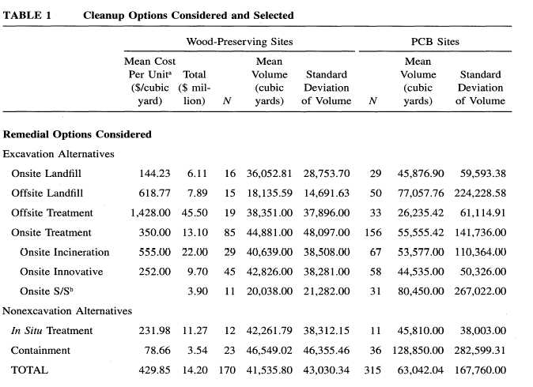
Most permanent/most costly
Least permanent/least costly

Slide 74
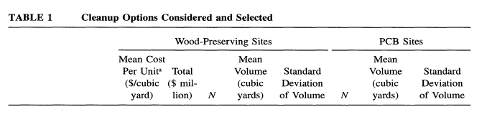
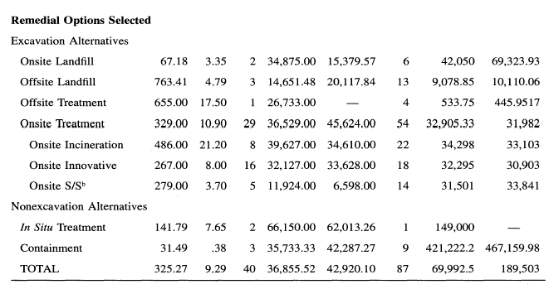

Slide 75
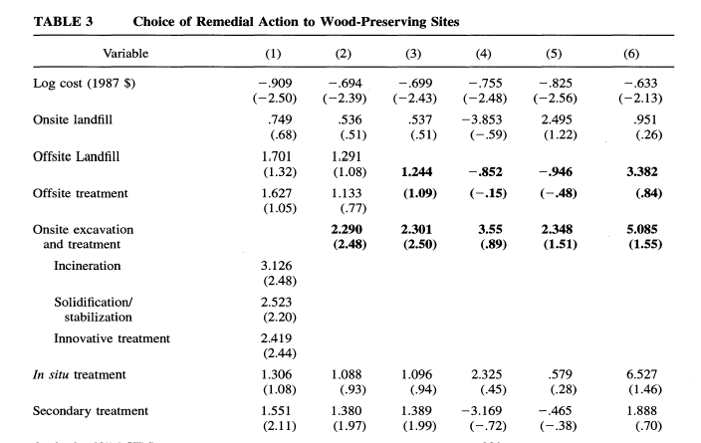
Option/specific variable
Option Dummies, the low-cost “cap” option is the reference group

Slide 76
EPA’s revealed value of permanence
U_{k} = V_{k}+ε_{k}
Consider only the observed portion of utility
V_{k} = COST_{k}β + v_{k}
  Where v_{k} is the option-specific dummy variable
For the low cost option CAP, v_{k}=0 and assume COST = $400K
Compare CAP vs. other alternatives

Slide 77
V_{cap} =V_{k}
Ln(COST_{cap})β = ln(COST_{k}) β + v_{k}
What they are willing to pay for the more permanent alternative k
COST_{k} = exp[ln(COST_{cap} )β – v_{k}]/β]

