Slide 1
Two-way fixed effects
Balanced panels
i=1,2,3….N groups
t=1,2,3….T observations/group
Easiest to think of data as varying across states/time
Write model as single observation
Y_{it}=α + X_{it}β + u_{i} + v_{t} +ε_{it}
X_{it} is (1 x k) vector

Slide 2
Three-part error structure
u_{i} – group fixed-effects. Control for permanent differences between groups
v_{t} – time fixed effects. Impacts common to all groups but vary by year
ε_{it} -- idiosyncratic error

Slide 3
Capture state and year effects with sets of dummy variables
d_{i} = 1 if obs from panel i (N dummies)
w_{t} =1 if obs from time period t (T-1 dum.)
Sort data by group, year
  1st t obs from group 1
  2nd t obs from group 2, etc

Slide 4
Drop constant since we have complete set of group effects
Matrix notation
Y = Xβ + Dα + Wλ + ε
D (NT x N) matrix of group dummies
W(NT x T-1) Matrix of time dummies

Slide 5
D looks like the matrix from one-way fixed-effects model (check your notes)
D = I_{n}  i_{t}
  I_{n} is N x N
  i_{t} is T x 1
  D is therefore NT x N

Slide 6
W is tricky
  1st obs period 1, group 1
  2nd obs period 2, group 2
  Same for all blocks i
  Only t-1 dummies, but t obs
Let W_{t} be partitioned matrix [ I_{t-1} / 0_{t-1}’ ]
W_{t} is (T x (T-1))
1st T-1 rows are a I_{t-1}
Final row 0_{t-1}’ is a vector of 0’s

Slide 7
W_{t} is repeated for all N blocks of data
W = i_{n}  W_{t}
i_{n} is (n x1), W_{t} is (T x (T-1))
W is NT x (T-1)

Slide 8
Y = Xβ + Dα + Wλ + ε
D = I_{n}  i_{t}
W = i_{n}  W_{t}
Let H =[D | W] = [I_{n}  i_{t} | i_{n}  W_{t}]
Let Γ = [α / λ] [( N + T – 1) x 1] vector
Y = Xβ + H Γ + ε

Slide 9
By partitioned inverses (b is est of β)
b=[X’MX]⁻¹[X’MY]
M_{h} = I_{nt} – H(H’H)⁻¹H’
Can show that

Slide 10
M_{h}=
I_{nt} - I_{n}(1/t)i_{t}i_{t}’ - (1/n)i_{n}i_{n}’  I_{t} + (1/nt)i_{nt}i_{nt}’
I_{nt} - I_{n}(1/t)i_{t}i_{t}’ creates within panel deviations in means
I_{nt} - (1/n)i_{n}i_{n}’  I_{t} creates within year deviations in means
(1/nt)i_{nt}i_{nt}’ adds back sample mean

Slide 11
Sample within panel means of y are 0
Sample within year means of y are 0
Therefore, need to add back the sample mean to return the mean of the transformed y=0

Slide 12
Y_{it} = β₀ + X_{1it}β₁ + … X_{kit} β_{k} + u_{i} + v_{t} + ε_{it}
Y*_{it} = Y_{it} - ¥_{i} - ¥_{t} - ¥
¥_{i} = (1/t)Σ_{t} Y_{it}
¥_{t} = (1/n)Σ_{i} Y_{it}
¥ = [1/(nt)] Σ_{t}Σ_{i} Y_{it}
X*_{1it} ….. X*_{kit} defined the same way

Slide 13
Estimate the model
Y*_{it} = X*_{1it}β₁ + … X*_{kit} β_{k} + ε_{it}
DOF in model are NT – K – N – (T-1)

Slide 14
Caution
In balanced panel, two-way fixed-effects equivalent to subtracting
  Within group means
  Within time means
  Adding sample mean
Only true in balanced panels
If unbalanced, need to do the following

Slide 15
Can subtract off means on one dimension (i or t)
But need to add the dummies for the other dimension

Slide 16
Difference in difference models
Maybe the most popular identification strategy in applied work today
Attempts to mimic random assignment with treatment and “comparison” sample
Application of two-way fixed effects model

Slide 17
Problem set up
Cross-sectional and time series data
One group is ‘treated’ with intervention
Have pre-post data for group receiving intervention
Can examine time-series changes but, unsure how much of the change is due to secular changes

Slide 18
Y
True effect = Y_{t2}-Y_{t1}
Estimated effect = Y_{b}-Y_{a}
Y_{t1}
Y_{a}
Y_{b}
Y_{t2}
t₁
t_{i}
t₂
time

Slide 19
Intervention occurs at time period t₁
True effect of law
  Y_{a} – Y_{b}
Only have data at t₁ and t₂
  If using time series, estimate Y_{t1} – Y_{t2}
Solution?

Slide 20
Difference in difference models
Basic two-way fixed effects model
  Cross section and time fixed effects
Use time series of untreated group to establish what would have occurred in the absence of the intervention
Key concept: can control for the fact that the intervention is more likely in some types of states

Slide 21
Three different presentations
Tabular
Graphical
Regression equation

Slide 22
Difference in Difference
 | Before Change | After Change | Difference
Group 1 (Treat) | Y_{t1} | Y_{t2} | ΔY_{t} = Y_{t2}-Y_{t1}
Group 2 (Control) | Y_{c1} | Y_{c2} | ΔY_{c} =Y_{c2}-Y_{c1}
Difference |  |  | ΔΔY ΔY_{t} – ΔY_{c}

Slide 23
Y
Treatment effect=
(Y_{t2}-Y_{t1}) – (Y_{c2}-Y_{c1})
Y_{c1}
Y_{t1}
Y_{c2}
Y_{t2}
control
treatment
t₁
t₂
time

Slide 24
Key Assumption
Control group identifies the time path of outcomes that would have happened in the absence of the treatment
In this example, Y falls by Y_{c2}-Y_{c1} even without the intervention
Note that underlying ‘levels’ of outcomes are not important (return to this in the regression equation)

Slide 25
Y
Y_{c1}
Treatment effect=
(Y_{t2}-Y_{t1}) – (Y_{c2}-Y_{c1})
Y_{c2}
Y_{t1}
control
Y_{t2}
Treatment
Effect
treatment
t₁
t₂
time

Slide 26
In contrast, what is key is that the time trends in the absence of the intervention are the same in both groups
If the intervention occurs in an area with a different trend, will under/over state the treatment effect
In this example, suppose intervention occurs in area with faster falling Y

Slide 27
Y
Estimated treatment
Y_{c1}
Y_{t1}
Y_{c2}
True treatment effect
control
Y_{t2}
True
Treatment
Effect
treatment
t₁
t₂
time

Slide 28
Basic Econometric Model
Data varies by
  state (i)
  time (t)
  Outcome is Y_{it}
Only two periods
Intervention will occur in a group of observations (e.g. states, firms, etc.)

Slide 29
Three key variables
  T_{it} =1 if obs i belongs in the state that will eventually be treated
  A_{it} =1 in the periods when treatment occurs
  T_{it}A_{it} -- interaction term, treatment states after the intervention
Y_{it} = β₀ + β₁T_{it} + β₂A_{it} + β₃T_{it}A_{it} + ε_{it}

Slide 30
Y_{it} = β₀ + β₁T_{it} + β₂A_{it} + β₃T_{it}A_{it} + ε_{it}
 | Before Change | After Change | Difference
Group 1 (Treat) | β₀+ β₁ | β₀+ β₁+ β₂+ β₃ | ΔY_{t} = β₂+ β₃
Group 2 (Control) | β₀ | β₀+ β₂ | ΔY_{c} = β₂
Difference |  |  | ΔΔY = β₃

Slide 31
More general model
Data varies by
  state (i)
  time (t)
  Outcome is Y_{it}
Many periods
Intervention will occur in a group of states but at a variety of times

Slide 32
u_{i} is a state effect
v_{t} is a complete set of year (time) effects
Analysis of covariance model
Y_{it} = β₀ + β₃ T_{it}A_{it} + u_{i} + v_{t} + ε_{it}

Slide 33
What is nice about the model
Suppose interventions are not random but systematic
  Occur in states with higher or lower average Y
  Occur in time periods with different Y’s
This is captured by the inclusion of the state/time effects – allows covariance between
  u_{i} and T_{it}A_{it}
  v_{t} and T_{it}A_{it}

Slide 34
Group effects
  Capture differences across groups that are constant over time
Year effects
  Capture differences over time that are common to all groups

Slide 35
Meyer et al.
Workers’ compensation
  State run insurance program
  Compensate workers for medical expenses and lost work due to on the job accident
Premiums
  Paid by firms
  Function of previous claims and wages paid
Benefits -- % of income w/ cap

Slide 36
Typical benefits schedule
  Min( pY,C)
  P=percent replacement
  Y = earnings
  C = cap
  e.g., 65% of earnings up to $400/month

Slide 37
Concern:
  Moral hazard. Benefits will discourage return to work
Empirical question: duration/benefits gradient
Previous estimates
  Regress duration (y) on replaced wages (x)
Problem:
  given progressive nature of benefits, replaced wages reveal a lot about the workers
  Replacement rates higher in higher wage states

Slide 38
Y_{i} = X_{i}β + αR_{i} + ε_{i}
Y (duration)
R (replacement rate)
Expect α > 0
Expect Cov(R_{i}, ε_{i})
  Higher wage workers have lower R and higher duration (understate)
  Higher wage states have longer duration and longer R (overstate)

Slide 39
Solution
Quasi experiment in KY and MI
Increased the earnings cap
  Increased benefit for high-wage workers
    (Treatment)
  Did nothing to those already below original cap (comparison)
Compare change in duration of spell before and after change for these two groups

Slide 40
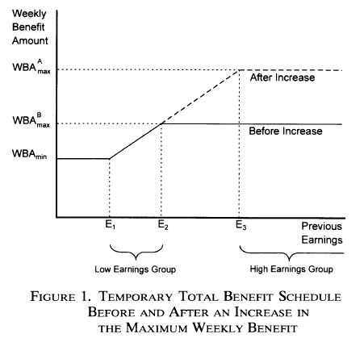

Slide 41
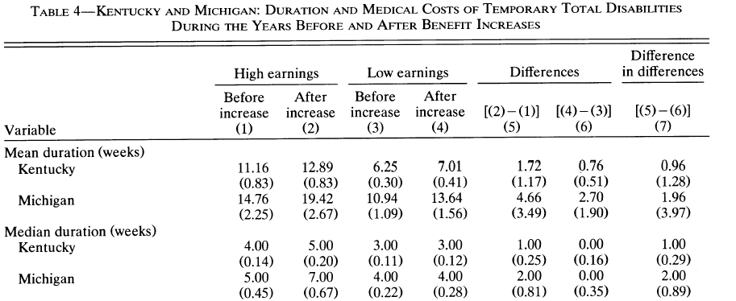

Slide 42
Model
Y_{it} = duration of spell on WC
A_{it} = period after benefits hike
H_{it} = high earnings group (Income>E₃)
Y_{it} = β₀ + β₁H_{it} + β₂A_{it} + β₃A_{it}H_{it} + β₄X_{it}’ + ε_{it}
Diff-in-diff estimate is β₃

Slide 43
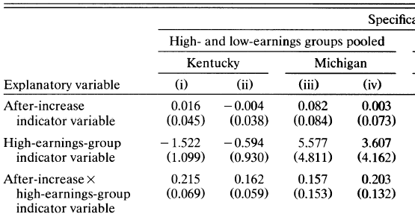

Slide 44
Questions to ask?
What parameter is identified by the quasi-experiment? Is this an economically meaningful parameter?
What assumptions must be true in order for the model to provide and unbiased estimate of β₃?
Do the authors provide any evidence supporting these assumptions?

Slide 45
Almond et al.
Babies born w/ low birth weight(< 2500 grams) are more prone to
  Die early in life
  Have health problems later in life
  Educational difficulties
generated from cross-sectional regressions
6% of babies in US are low weight
Highest rate in the developed world

Slide 46
Let Y_{it} be outcome for baby t from mother I
e.g., mortality
Y_{it} = α + bw_{it} β + X_{i} γ + α_{i} + ε_{it}
bw is birth weight (grams)
X_{i} observed characteristics of moms
α_{i} unobserved characteristics of moms

Slide 47
Terms
Neonatal mortality, dies in first 28 days
Infant mortality, died in first year

Slide 48
Many observed factors that might explain health (Y) of an infant
  Prenatal care, substance abuse, smoking, weight gain (of lack of it)
Some unobserved as well
  Quality of diet, exercise, generic predisposition
α_{i} not included in model

Slide 49
Cross sectional model is of the form
Y_{it} = α + bw_{it} β + X_{i} γ + u_{it}
where u_{it} =α_{i} + ε_{it}
Cov(bw_{it},u_{it}) < 0
Same factors that lead to poor health lead to a marker of poor health (birth weight)

Slide 50
Solution: Twins
Possess same mother, same environmental characterisitics
Y_{i1} = α + bw_{i1} β + X_{i} γ + α_{i} + ε_{i1}
Y_{i2} = α + bw_{i2} β + X_{i} γ + α_{i} + ε_{i2}
ΔY = Y_{i2}-Y_{i1} = (bw_{i2}-bw_{i1}) β + (ε_{i2}- ε_{i1})

Slide 51
Questions to consider?
What are the conditions under which this will generate unbiased estimate of β?
What impact (treatment effect) does the model identify?

Slide 52
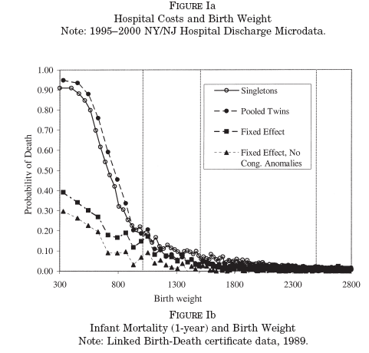

Slide 53
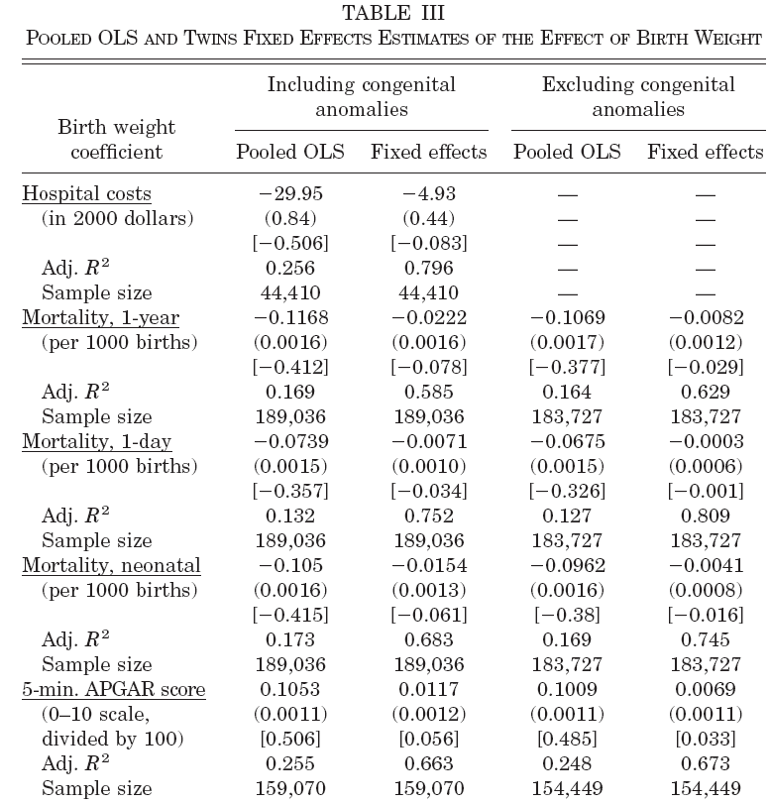

Slide 54
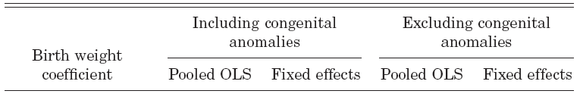
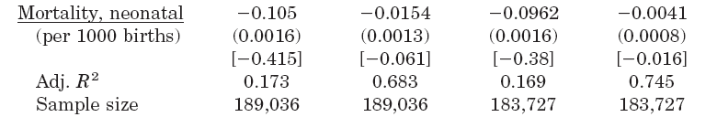
Big Drop in
Coefficient on
Birth weight
Large change
In R2

Slide 55
More general model
Many within group estimators that do not have the nice discrete treatments outlined above are also called difference in difference models
Cook and Tauchen. Examine impact of alcohol taxes on heavy drinking
States tax alcohol
Examine impact on consumption and results of heavy consumption death due to liver cirrhosis

Slide 56
Y_{it} = β₀ + β₁ INC_{it} + β₂ INC_{it-1}
+ β₁ TAX_{it} + β₂ TAX_{it-1} + u_{i} + v_{t} + ε_{it}
i is state, t is year
Y_{it} is per capita alcohol consumption
INC is per capita income
TAX is tax paid per gallon of alcohol

Slide 57
Some Keys
Model requires that untreated groups provide estimate of baseline trend would have been in the absence of intervention
Key – find adequate comparisons
If trends are not aligned, cov(T_{it}A_{it},ε_{it}) ≠0
  Omitted variables bias
How do you know you have adequate comparison sample?

Slide 58
Do the pre-treatment samples look similar
  Tricky. D-in-D model does not require means match – only trends.
  If means match, no guarantee trends will
  However, if means differ, aren’t you suspicious that trends will as well?

Slide 59
Develop tests that can falsify model
Y_{it} = β₀ + β₃ T_{it}A_{it} + u_{i} + v_{t} + ε_{it}
Will provide unbiased estimate so long as cov(T_{it}A_{it}, ε_{it})=0
Concern: suppose that the intervention is more likely in a state with a different trend
If true, coefficient may ‘show up’ prior to the intervention

Slide 60
Add “leads” to the model for the treatment
Intervention should not change outcomes before it appears
If it does, then suspicious that covariance between trends and intervention

Slide 61
Y_{it} = β₀ + β₃ T_{it}A_{it} + α₁T_{it}A_{it-1} + α₂ T_{it}A_{it-2} + α₃T_{it}A_{it-3} + u_{i} + v_{t} + ε_{it}
Three “leads”
Test null: H_{o}: α₁=α₂=α₃=0

Slide 62
Pick control groups that have similar pre-treatment trends
Most studies pick all untreated data as controls
  Example: Some states raise cigarette taxes. Use states that do not change taxes as controls
  Example: Some states adopt welfare reform prior to TANF. Use all non-reform states as controls
Intuitive but not likely correct

Slide 63
Can use econometric procedure to pick controls
Appealing if interventions are discrete and few in number
Easy to identify pre-post

Slide 64
Card and Sullivan
Examine the impact of job training
Some men are treated with job skills, others are not
Most are low skill men, high unemployment, frequent movement in and out of work
Eight quarters of pre-treatment data for treatment and controls

Slide 65
Let Y_{it} =1 if “i” worked in time t
There is then an eight digit sequence of outcomes
“11110000” or “10100111”
Men with same 8 digit pre-treatment sequence will form control for the treated
People with same pre-treatment time series are ‘matched’

Slide 66
Intuitively appealing and simple procedure
Does not guarantee that post treatment trends would be the same but, this is the best you have.

Slide 67
More systematic model
Data varies by individual (i), state (s), time
Intervention is in a particular state
Y_{ist} = β₀ + X_{ist} β₂+ β₃ T_{st}A_{st} + u_{i} + v_{t} + ε_{it}
Many states available to be controls
How do you pick them?

Slide 68
Restrict sample to pre-treatment period
State 1 is the treated state
State k is a potential control
Run data with only these two states
Estimate separate year effects for the treatment state
If you cannot reject null that the year effects are the same, use as control

Slide 69
Unrestricted model
Pretreatment years so T_{st}A_{st} not in model
M pre-treatment years
Let W_{t}=1 if obs from year t
Y_{ist} = α₀ + X_{ist} α₂+ Σ_{t=2}γ_{t}W_{t} + Σ_{t=2} λ_{t} T_{i}Wt + u_{i} + v_{t} + ε_{it}
H_{o}: λ₂= λ₃=… λ_{m}=0

Slide 70
Tyler et al.
Impact of GED on wages
General education development degree
Earn a HS degree by passing an exam
Exam pass rates vary by state
Introduced in 1942 as a way for veterans to earn a HS degree
Has expanded to the general public

Slide 71
In 1996, 760K dropouts attempted the exam
Little human capital generated by studying for the exam
Really measures stock of knowledge
However, passing may ‘signal’ something about ability

Slide 72
Identification strategy
Use variation across states in pass rates to identify benefit of a GED
High scoring people would have passed the exam regardless of what state they lived in
Low scoring people are similar across states, but on is granted a GED and the other is not

Slide 73
NY
CT
A
B
Passing score NY
Increasing scores
C
D
Passing Scores CT
E
F

Slide 74
Groups A and B pass in either state
Group D passes in CT but not in NY
Group C looks similar to D except it does not pass

Slide 75
What is impact of passing the GED
Y_{is}=earnings of person i in state s
L_{is} = earned a low score
CT_{is} = 1 if live in a state with a generous passing score
Y_{is} = β₀ + L_{is}β₁ + CTβ₂ + L_{is}CT_{is} β₃ + ε_{is}

Slide 76
Difference in Difference
 | CT | NY | Difference
Test score is low | D | C | (D-C)
Test score is high | B | A | (B-A)
Difference |  |  | (D-C) – (B-A)

Slide 77
How do you get the data
From ETS (testing agency) get social security numbers (SSN) of test takes, some demographic data, state, and test score
Give Social Security Admin. a list of SSNs by group (low score in CT, high score in NY)
SSN gives you back mean, std.dev. # obs
per cell

Slide 78

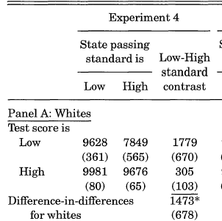

Slide 79
