Slide 1
Duration models
Bill Evans

Slide 2
Flow sample
t₀ initial period
t₂ followup period
i
h
g
f
e
d
c
b
a
t₀
t₂
time

Slide 3
Stock sample
t₀ initial period
t₁ people sampled
t₂ followup period
i
h
g
f
e
d
c
b
a
t₀
t₁
t₂
time

Slide 4
Interpreting Coefficients
This is the same for both Weibull, Exponential, and any other proportional hazard model
For Weibull, λ(t_{i} ) = ργ_{i}t^{ρ-1}
γ_{i} = exp(β₀ + β₁ + x_{2i} β₂ …. x_{ki} β_{k})

Slide 5
Suppose x_{1i} is a dummy variable
When x_{i1}=1, then
γ_{i1} = exp(β₀ + β₁ + x_{2i} β₂ …. x_{ki} β_{k})
When x_{i1}=0, then
γ_{i0} = exp(β₀ + β₁ + x_{2i} β₂ …. x_{ki} β_{k})

Slide 6
Let λ_{i1} be hazard when x_{1i}=1 and λ_{i0} when x_{i1}=0
Percentage change in hazard (λ_{i1} – λ_{i0})/ λ_{i0}
(ργ_{i1} t^{ρ-1} – ργ_{i0} t^{ρ-1} ) /ργ_{i0} t^{ρ-1} = exp(β₁) -1
Percentage change in the hazard when x_{1i} turns from 0 to 1.
STATA prints out exp(β₁), just subtract 1

Slide 7
Suppose x_{2i} is continuous
Suppose we increase x_{2i} by 1 unit
γ_{i1} = exp(β₀ + β₁x_{1i} + x_{2i} β₂ …. x_{ki} β_{k})
γ_{i2} = exp(β₀ + β₁ x_{1i}+ (x_{2i} +1)β₂ …. x_{ki} β_{k})
Can show that (λ_{i1} – λ_{i0})/ λ_{i0} =
(ργ_{i2} t^{ρ-1} – ργ_{i1} t^{ρ-1} ) / ργ_{i1} t^{ρ-1} = exp(β₂) – 1
Percentage change in the hazard for 1 unit increase in x

Slide 8
NLMS
National longitudinal mortality survey
Match of monthly CPS data sets to National Death Index
Public Use version
  Five monthly CPS data sets from 1979-1981
  637,162 people
  Each followed for 9 years (3288 days)
Our sample
  Males, 50-70, who were married at the time of the survey
  Used to examine bereavement effect

Slide 9
Key Variables
followh -- days of followup for husband (max is 3288)
Deathh =1 if husband dies during followup
Note if deathh=0, then followh=3288
Deathh identifies whether the data is censored.

Slide 10
Variable | Obs Mean Std. Dev. Min Max
-------------+--------------------------------------------------------
followh | 40715 3005.135 723.6469 2 3288
followw | 40715 3173.552 469.8656 8 3288
age | 40715 59.16623 5.807821 50 70
educ | 40715 2.808817 1.335242 1 5
income | 40715 4.313717 1.72004 1 7
-------------+--------------------------------------------------------
raceh1 | 40715 .9188997 .2729925 0 1
raceh2 | 40715 .0611323 .2395757 0 1
deathh | 40715 .1818494 .3857251 0 1
deathw | 40715 .0795776 .2706414 0 1
hhid | 40715 125273.2 72259.65 7 249994

Slide 11
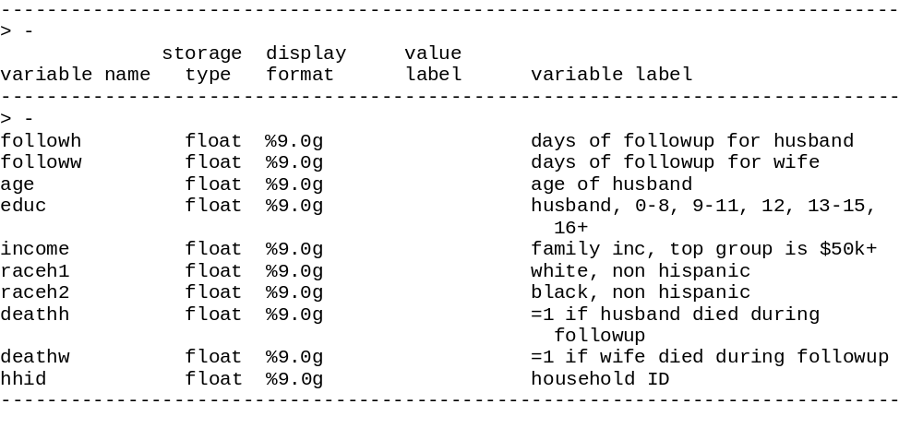

Slide 12
educh
  =1 if <8 years
  =2 if 9-11 years
  =3 if 12 years
  =4 if 13-15 years
  =5 if 16+ years

Slide 13
income (Family income)
  1 <$5K
  2 ≥ $5K, < $10K
  3 ≥ $10K, < $15K
  4 ≥ $15K, < $20K
  5 ≥ $20K, < $25K
  6 ≥ $25K, < $50K
  7 ≥ $50K

Slide 14
Duration Data in STATA
Need to identify variable that measures duration
stset length, failure(failvar)
    Length=duration variable
    Failvar=1 when durations end in failure, =0 for censored values
If all data is uncensored, omit failure(failvar)
In our case
stset followh, failure(deathh)

Slide 15
Kaplan-Meier Curves
Graph of raw data
What fraction of people exit the sample in each period
“Risk set” includes people who make it to the next period

Slide 16
Getting Kaplan-Meier Curves
Tabular presentation of results
sts list
Graphical presentation
sts graph
Results by subgroup
sts graph, by(educ)
Graph hazard functions
  Sts graph, hazard

Slide 17
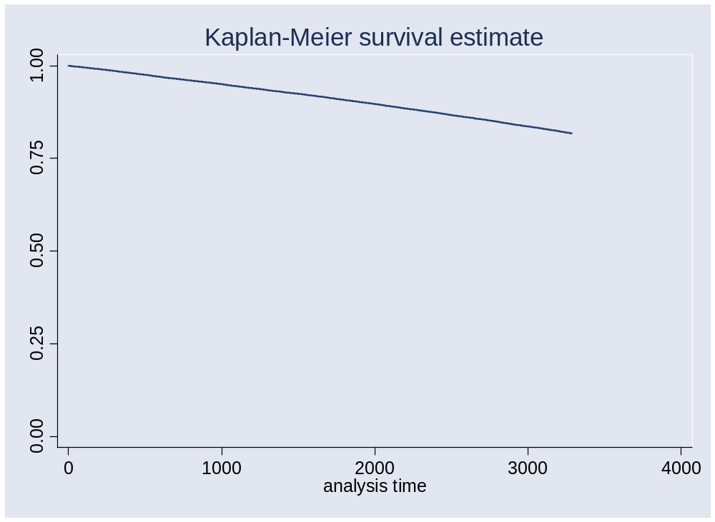

Slide 18
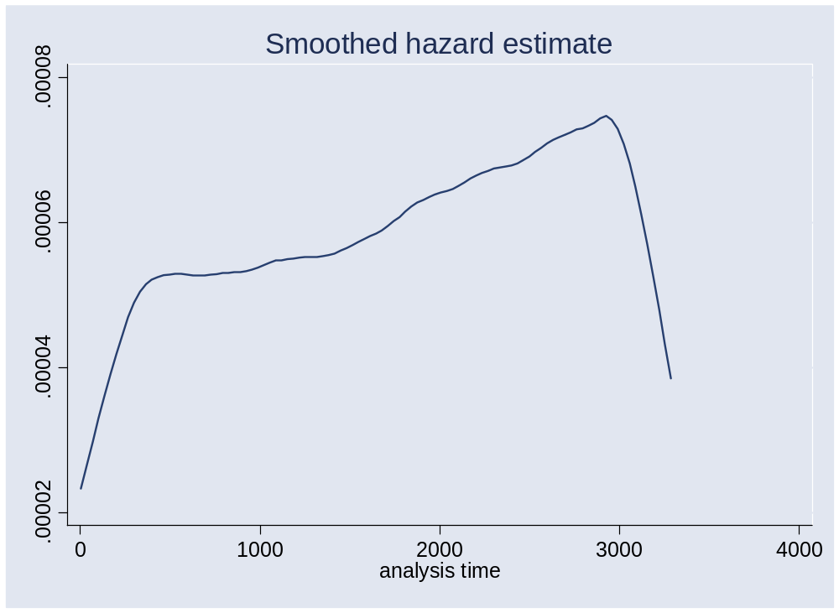

Slide 19
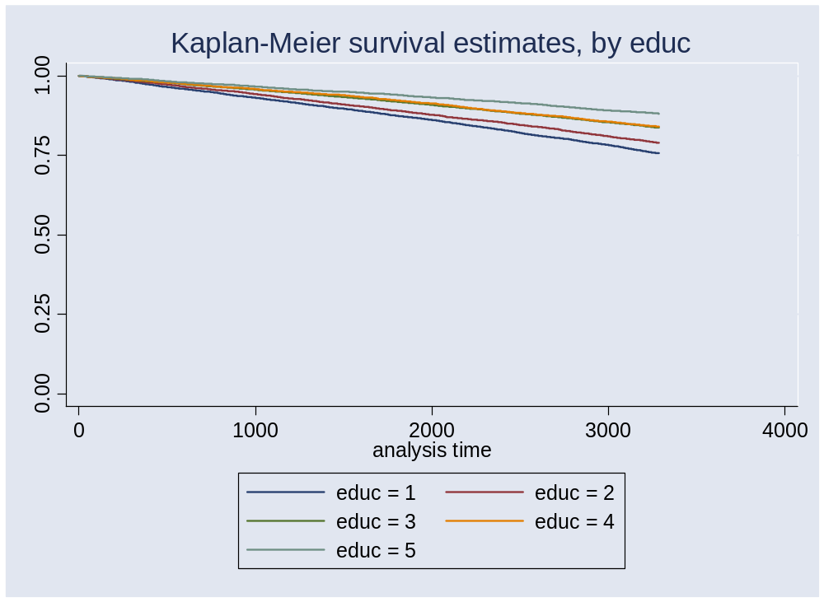

Slide 20
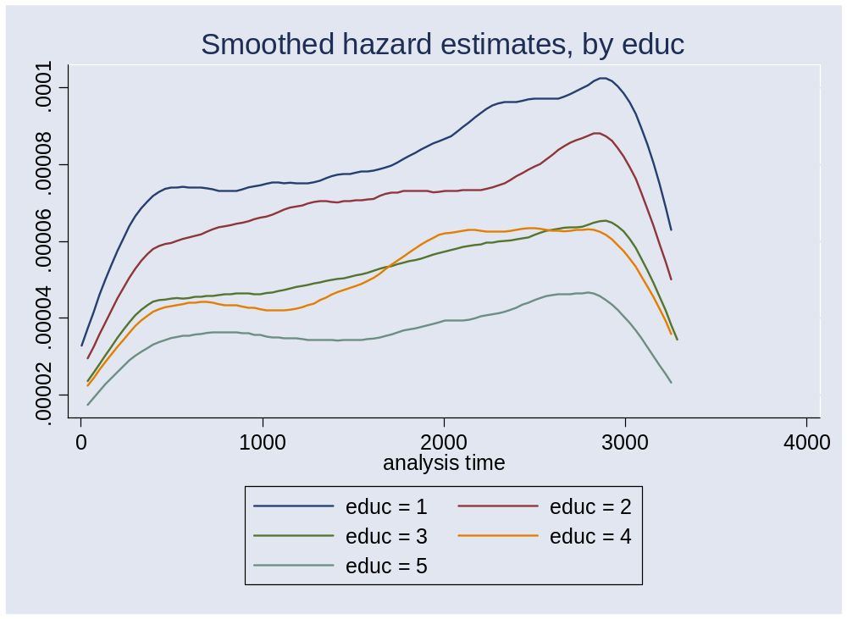

Slide 21
MLE of duration model with Covariates
Basic syntax
streg covariates, d(distribution)
streg age raceh1 raceh2 _Ie* _Ii*, d(weibull) nohr;
In this model, STATA will print out exp(β)
If you want the coefficients, add ‘nohr’ option (no hazard ratio)

Slide 22
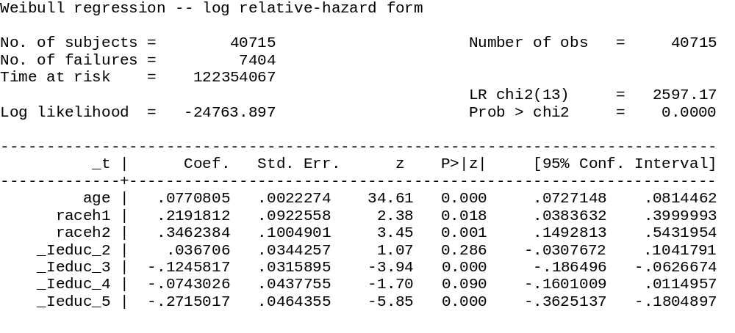
Mortality falling
In education but
It is not
monotonic
Whites have higher mortality than hispanics –
Hispanic “paradox”

Slide 23
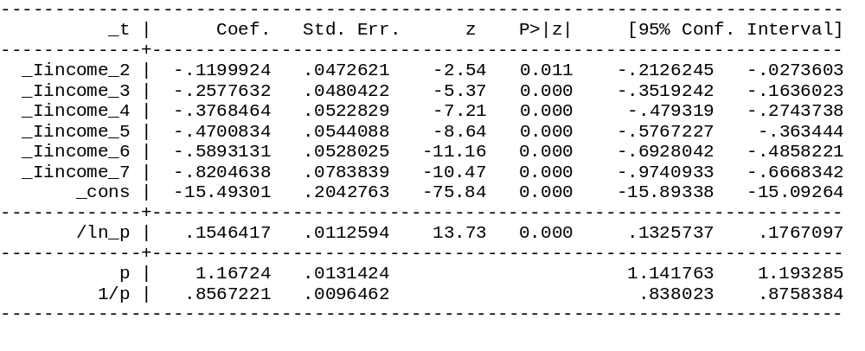
Mortality is monotonic in
income
Weibull parameter, hazard
Is increasing in duration

Slide 24
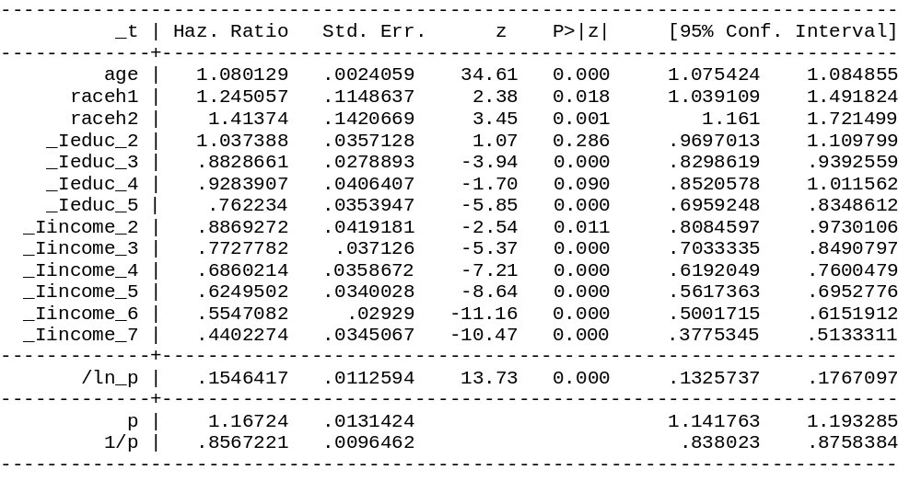

Slide 25
The magnitude (> or < 1) of the parameters is informative
  Hazard increasing in age
  Whites, Blacks have higher mortality rates
  Hazard decreases with income and age
  P-value is for the test that parameter = 1
The Weibull parameter ρ = 1.167.
  Check 95% confidence interval (1.14, 1.19). Can reject null p=1 (exponential)
  Low probability P<1
  Hazard is increasing over time

Slide 26
Interpret coefficients
Age: every year of age hazard increases by 8%
Black, non-Hispanics: have 41% greater hazard than Hispanics
White, non-Hispanics: 24.5% greater hazard than Hispanics
Notice results are
  Monotonic in income
  Nearly monotonic in education

Slide 27
Educ 5: those with college degree.762 – 1 = -0.328 or a 32.8% lower hazard than those with <9 years of school
Income 5, those with >$50K in income have a 0.44 – 1 = -0.54 or a 54% lower hazard than those with income <$5K

Slide 28
To run an exponential – just change the distrbution
. streg age raceh1 raceh2 _Ie* _Ii*, d(exp);
Exponential regression -- log relative-hazard form
No. of subjects = 40715 Number of obs = 40715
No. of failures = 7404
Time at risk = 122354067
LR chi2(13) = 2557.23
Log likelihood = -24853.379 Prob > chi2 = 0.0000
------------------------------------------------------------------------------
_t | Haz. Ratio Std. Err. z P>|z| [95% Conf. Interval]
-------------+----------------------------------------------------------------
age | 1.079425 .0024034 34.33 0.000 1.074725 1.084146
raceh1 | 1.241462 .1145318 2.34 0.019 1.036108 1.487515
raceh2 | 1.407746 .1414651 3.40 0.001 1.156077 1.714202
_Ieduc_2 | 1.037157 .0357046 1.06 0.289 .9694863 1.109552
_Ieduc_3 | .884399 .0279394 -3.89 0.000 .8312995 .9408902
_Ieduc_4 | .9295894 .0406939 -1.67 0.095 .8531566 1.01287
_Ieduc_5 | .7642151 .0354907 -5.79 0.000 .6977265 .8370397
_Iincome_2 | .8887569 .0420042 -2.50 0.013 .8101282 .9750171
_Iincome_3 | .7758393 .0372727 -5.28 0.000 .7061201 .8524422
_Iincome_4 | .6893931 .0360434 -7.11 0.000 .6222483 .7637833
_Iincome_5 | .6284558 .034194 -8.54 0.000 .5648866 .6991787
_Iincome_6 | .5580047 .0294658 -11.05 0.000 .5031409 .618851
_Iincome_7 | .443217 .0347429 -10.38 0.000 .3800953 .5168212
------------------------------------------------------------------------------

Slide 29
Cox models
. stcox age raceh1 raceh2 _Ie* _Ii*;

Slide 30
. * run cox proportional hazards model;
. stcox age raceh1 raceh2 _Ie* _Ii*;
failure _d: deathh
analysis time _t: followh
id: hhid
Cox regression -- Breslow method for ties
No. of subjects = 40715 Number of obs = 40715
No. of failures = 7404
Time at risk = 122354067
LR chi2(13) = 2608.19
Log likelihood = -76566.71 Prob > chi2 = 0.0000
------------------------------------------------------------------------------
_t | Haz. Ratio Std. Err. z P>|z| [95% Conf. Interval]
-------------+----------------------------------------------------------------
age | 1.080333 .0024067 34.69 0.000 1.075627 1.085061
raceh1 | 1.245519 .1149061 2.38 0.017 1.039494 1.492376
raceh2 | 1.414956 .1421888 3.45 0.001 1.161999 1.722979
_Ieduc_2 | 1.037417 .0357138 1.07 0.286 .9697289 1.109831
_Ieduc_3 | .8823358 .0278711 -3.96 0.000 .829366 .9386886
_Ieduc_4 | .9281931 .0406331 -1.70 0.089 .8518745 1.011349
_Ieduc_5 | .7615854 .0353637 -5.87 0.000 .6953344 .8341488
_Iincome_2 | .8866648 .0419057 -2.55 0.011 .8082206 .9727227
_Iincome_3 | .7722259 .0370996 -5.38 0.000 .7028304 .8484732
_Iincome_4 | .685404 .0358353 -7.22 0.000 .618647 .7593647
_Iincome_5 | .6242297 .0339635 -8.66 0.000 .5610889 .6944759
_Iincome_6 | .5540265 .0292542 -11.18 0.000 .4995565 .6144358
_Iincome_7 | .439497 .0344497 -10.49 0.000 .3769077 .5124798
------------------------------------------------------------------------------

Slide 31
Comparing Hazard Ratios
 | Expon. | Weibull | Cox
Age | 1.079 (0.0024) | 1.080 (0.0024) | 1.080 (0.0024)
Raceh1 | 1.241 (0.1145) | 1.245 (0.1148) | 1.246 (0.1149)
Raceh2 | 1.4078 (0.141) | 1.4137 (0.142) | 1.415 (0.142)

Slide 32
Comparing Hazard Ratios
 | Expon. | Weibull | Cox
Educ2 | 1.037 (0.0357) | 1.037 (0.0357) | 1.037 (0.0357)
Educ3 | 0.8843 (0.0279) | 0.8829 (0.0280) | 0.8823 (0.0279)
Educ4 | 0.9296 (0.0407) | 0.9284 (0.0419) | 0.9282 (0.0419)
Educ5 | 0.7642 (0.0355) | 0.7622 (0.0359) | 0.7616 (0.0354)

Slide 33
Comparing Hazard Ratios
 | Expon. | Weibull | Cox
Income5 | 0.6284 (0.0342) | 0.6249 (0.0359) | 0.6242 (0.0340)
Income6 | 0.5580 (0.0294) | 0.5547 (0.0293) | 0.5540 (0.0293)
Income7 | 0.4432 (0.0347) | 0.4402 (0.0345) | 0.4395 (0.0344)

Slide 34
Time vary covariates
The example so far have examines the impact of time invariant covariates on outcomes
Can be the case that time varying covariates matter as well
  What happens to jobless spell when UI benefits run out?

Slide 35
Example: Bereavement Effect
Heightened mortality after the death of a spouse
Especially pronounced in the 2 years after spouse’s death
Measure many possible
Time-varying covariate – the dummy variable turns on the day your spouse dies ahead of you

Slide 36
followh is the husband’s duration measure
followw is the wife’s
If followw<followh, wife dies before the husband

Slide 37
. stsplit bereavement, after(time=followw) at(0);
(2771 observations (episodes) created)
. recode bereavement -1=0 0=1;
(bereavement: 43486 changes made)
. stcox age raceh1 raceh2 _Ie* _Ii* bereavement;

Slide 38
. stcox age raceh1 raceh2 _Ie* _Ii* bereavement;
Cox regression -- Breslow method for ties
No. of subjects = 40715 Number of obs = 43486
No. of failures = 7404
Time at risk = 122354067
LR chi2(14) = 2635.84
Log likelihood = -76552.883 Prob > chi2 = 0.0000
------------------------------------------------------------------------------
_t | Haz. Ratio Std. Err. z P>|z| [95% Conf. Interval]
-------------+----------------------------------------------------------------
age | 1.079492 .0024106 34.25 0.000 1.074778 1.084227
raceh1 | 1.240377 .1144358 2.33 0.020 1.035196 1.486225
raceh2 | 1.403174 .1410254 3.37 0.001 1.15229 1.708681
_Ieduc_2 | 1.038709 .0357596 1.10 0.270 .9709336 1.111215
_Ieduc_3 | .8835838 .0279117 -3.92 0.000 .8305371 .9400187
_Ieduc_4 | .9275845 .040601 -1.72 0.086 .8513257 1.010674
_Ieduc_5 | .7632188 .0354458 -5.82 0.000 .6968144 .8359514
_Iincome_2 | .8860515 .041878 -2.56 0.010 .8076592 .9720527
_Iincome_3 | .7732764 .0371528 -5.35 0.000 .7037818 .8496333
_Iincome_4 | .6885298 .0360055 -7.14 0.000 .6214563 .7628426
_Iincome_5 | .6270364 .034122 -8.58 0.000 .5636016 .697611
_Iincome_6 | .5570053 .0294192 -11.08 0.000 .5022289 .617756
_Iincome_7 | .4420974 .0346619 -10.41 0.000 .3791237 .5155313
bereavement | 1.318605 .066781 5.46 0.000 1.194004 1.45621
------------------------------------------------------------------------------

