Slide 1
Logit/Probit Models

Slide 2
Making sense of the decision rule
Suppose we have a kid with great scores, great grades, etc.
For this kid, x_{i} β is large.
What will prevent admission? Only a large negative ε_{i}
What is the probability of observing a large negative ε_{i} ? Very small.
Most likely admitted. We estimate a large probability

Slide 3
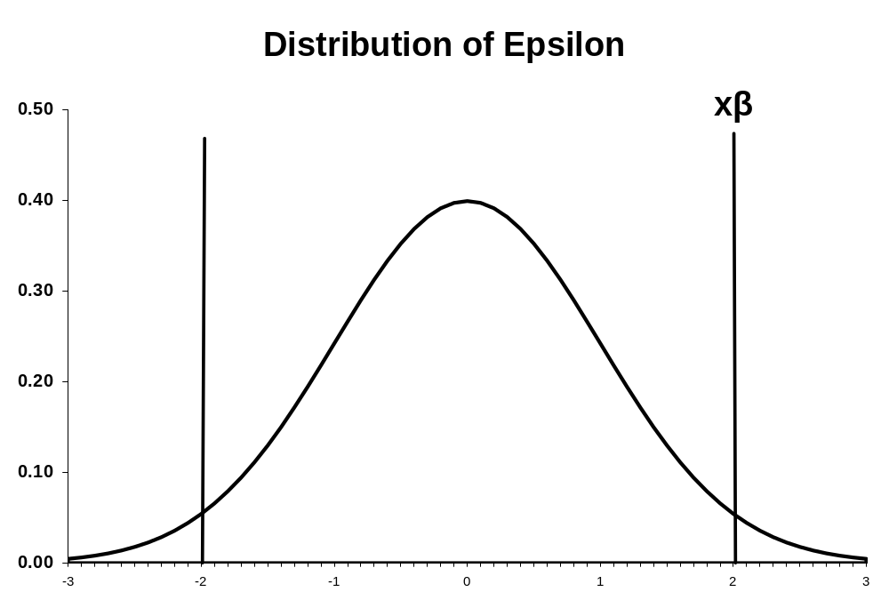
Values of ε that would allow admission
Values of ε
That will prevent admission

Slide 4
Another example
Suppose we have a kid with bad scores.
For this kid, x_{i} β is small (even negative).
What will allow admission? Only a large positive ε_{i}
What is the probability of observing a large positive ε_{i} ? Very small.
Most likely, not admitted, so, we estimate a small probability

Slide 5
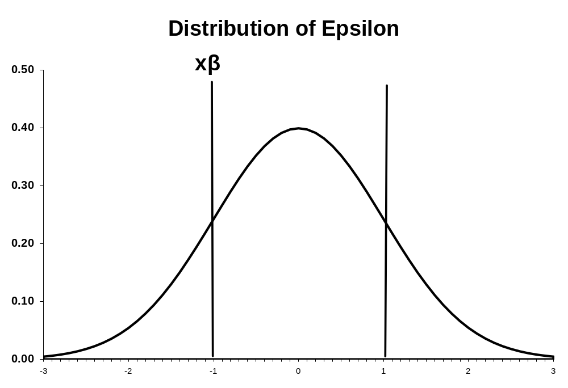
Values of ε
that would
allow
admission
Values of
ε that would
prevent
admission

Slide 6
Normal (probit) Model
ε is distributed as a standard normal
  Mean zero
  Variance 1
Evaluate probability (y=1)
  Pr(y_{i}=1) = Pr(ε_{i} > - x_{i} β) = 1 – Ф(-x_{i} β)
  Given symmetry: 1 – Ф(-x_{i} β) = Ф(x_{i} β)
Evaluate probability (y=0)
  Pr(y_{i}=0) = Pr(ε_{i} ≤ - x_{i} β) = Ф(-x_{i} β)
  Given symmetry: Ф(-x_{i} β) = 1 - Ф(x_{i} β)

Slide 7
Summary
  Pr(y_{i}=1) = Ф(x_{i} β)
  Pr(y_{i}=0) = 1 -Ф(x_{i} β)
Notice that Ф(a) is increasing a. Therefore, if the x’s increases the probability of observing y, we would expect the coefficient on that variable to be (+)

Slide 8
The standard normal assumption (variance=1) is not critical
In practice, the variance may be not equal to 1, but given the math of the problem, we cannot separately identify the variance.

Slide 9
Logit
PDF: f(x) = exp(x)/[1+exp(x)]²
CDF: F(a) = exp(a)/[1+exp(a)]
  Symmetric, unimodal distribution
  Looks a lot like the normal
  Incredibly easy to evaluate the CDF and PDF
  Mean of zero, variance > 1 (more variance than normal)

Slide 10
Evaluate probability (y=1)
  Pr(y_{i}=1) = Pr(ε_{i} > - x_{i} β) = 1 – F(-x_{i} β)
  Given symmetry: 1 – F(-x_{i} β) = F(x_{i} β)
  F(x_{i} β) = exp(x_{i} β)/(1+exp(x_{i} β))

Slide 11
Evaluate probability (y=0)
  Pr(y_{i}=0) = Pr(ε_{i} ≤ - x_{i} β) = F(-x_{i} β)
  Given symmetry: F(-x_{i} β) = 1 - F(x_{i} β)
  1 - F(x_{i} β) = 1 /(1+exp(x_{i} β))
In summary, when ε_{i} is a logistic distribution
  Pr(y_{i} =1) = exp(x_{i} β)/(1+exp(x_{i} β))
  Pr(y_{i}=0) = 1/(1+exp(x_{i} β))

Slide 12
STATA Resources
Discrete Outcomes
“Regression Models for Categorical Dependent Variables Using STATA”
  J. Scott Long and Jeremy Freese
Available for sale from STATA website for $52 (www.stata.com)
Post-estimation subroutines that translate results
  Do not need to buy the book to use the subroutines

Slide 13
In STATA command line type
    net search spost
Will give you a list of available programs to download
One is
    Spostado from http://www.indiana.edu/~jslsoc/stata
Click on the link and install the files

Slide 14
Example: Workplace smoking bans
Smoking supplements to 1991 and 1993 National Health Interview Survey
Asked all respondents whether they currently smoke
Asked workers about workplace tobacco policies
Sample: indoor workers
Key variables: current smoking and whether they faced a workplace ban

Slide 15
Data: workplace1.dta
Sample program: workplace1.doc
Results: workplace1.log

Slide 16
Description of variables in data
. desc;
storage display value
variable name type format label variable label
------------------------------------------------------------------------
> -
smoker byte %9.0g is current smoking
worka byte %9.0g has workplace smoking bans
age byte %9.0g age in years
male byte %9.0g male
black byte %9.0g black
hispanic byte %9.0g hispanic
incomel float %9.0g log income
hsgrad byte %9.0g is hs graduate
somecol byte %9.0g has some college
college float %9.0g
-----------------------------------------------------------------------

Slide 17
Summary statistics
sum;
Variable | Obs Mean Std. Dev. Min Max
-------------+--------------------------------------------------------
smoker | 16258 .25163 .433963 0 1
worka | 16258 .6851396 .4644745 0 1
age | 16258 38.54742 11.96189 18 87
male | 16258 .3947595 .488814 0 1
black | 16258 .1119449 .3153083 0 1
-------------+--------------------------------------------------------
hispanic | 16258 .0607086 .2388023 0 1
incomel | 16258 10.42097 .7624525 6.214608 11.22524
hsgrad | 16258 .3355271 .4721889 0 1
somecol | 16258 .2685447 .4432161 0 1
college | 16258 .3293763 .4700012 0 1

Slide 18
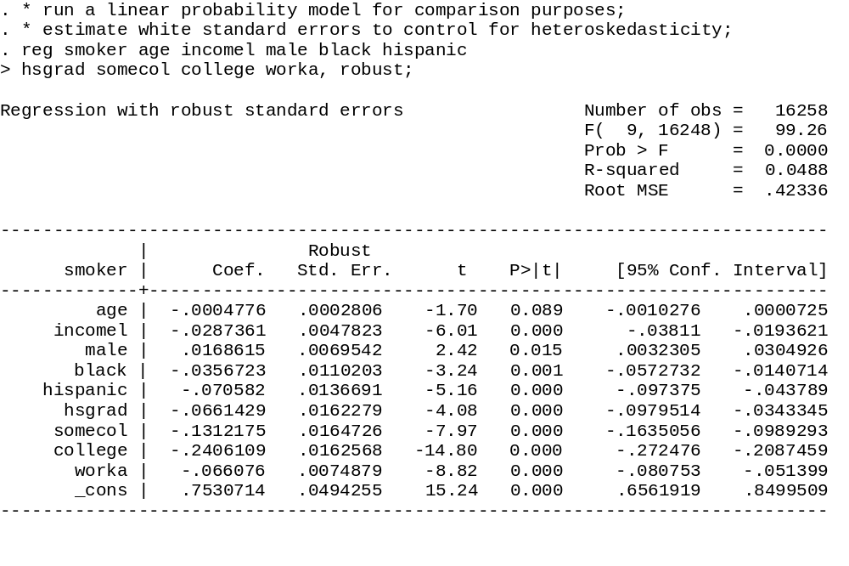
Heteroskedastic consistent
Standard errors
Very low R², typical in LP models
Since OLS
Report t-stats

Slide 19
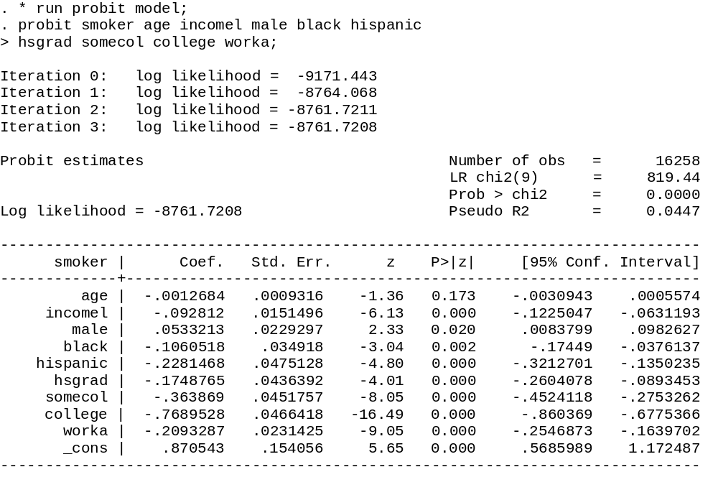
Same syntax as REG but with probit
Converges rapidly for most
problems
Test that all non-constant
Terms are 0
Report z-statistics
Instead of t-stats

Slide 20
. dprobit smoker age incomel male black hispanic
> hsgrad somecol college worka;
Probit regression, reporting marginal effects Number of obs = 16258
LR chi2(9) = 819.44
Prob > chi2 = 0.0000
Log likelihood = -8761.7208 Pseudo R2 = 0.0447
------------------------------------------------------------------------------
smoker | dF/dx Std. Err. z P>|z| x-bar [ 95% C.I. ]
---------+--------------------------------------------------------------------
age | -.0003951 .0002902 -1.36 0.173 38.5474 -.000964 .000174
incomel | -.0289139 .0047173 -6.13 0.000 10.421 -.03816 -.019668
male*| .0166757 .0071979 2.33 0.020 .39476 .002568 .030783
black*| -.0320621 .0102295 -3.04 0.002 .111945 -.052111 -.012013
hispanic*| -.0658551 .0125926 -4.80 0.000 .060709 -.090536 -.041174
hsgrad*| -.053335 .013018 -4.01 0.000 .335527 -.07885 -.02782
somecol*| -.1062358 .0122819 -8.05 0.000 .268545 -.130308 -.082164
college*| -.2149199 .0114584 -16.49 0.000 .329376 -.237378 -.192462
worka*| -.0668959 .0075634 -9.05 0.000 .68514 -.08172 -.052072
---------+--------------------------------------------------------------------
obs. P | .25163
pred. P | .2409344 (at x-bar)
------------------------------------------------------------------------------
(*) dF/dx is for discrete change of dummy variable from 0 to 1
z and P>|z| correspond to the test of the underlying coefficient being 0

Slide 21
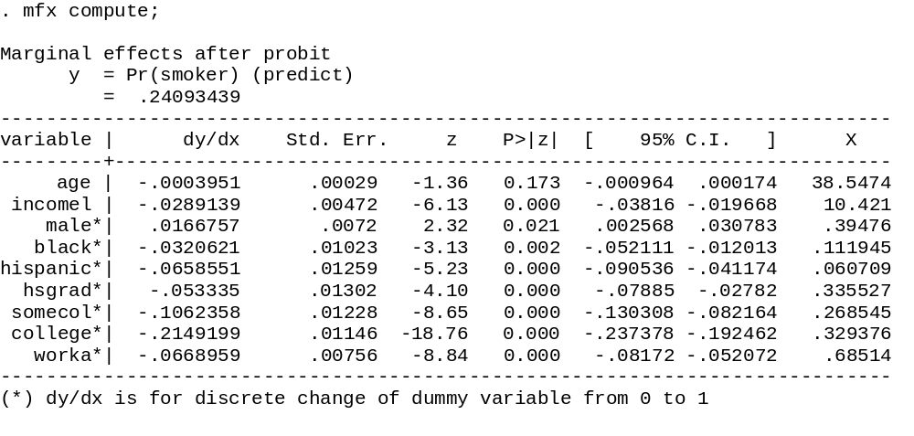
Males are 1.7 percentage points more likely to smoke
Those w/ college degree 21.5 % points
Less likely to smoke
10 years of age reduces smoking rates by
4 tenths of a percentage point
10 percent increase in income will reduce smoking
By .29 percentage points

Slide 22
. * get marginal effect/treatment effects for specific person;
. * male, age 40, college educ, white, without workplace smoking ban;
. * if a variable is not specified, its value is assumed to be;
. * the sample mean. in this case, the only variable i am not;
. * listing is mean log income;
. prchange, x(male=1 age=40 black=0 hispanic=0 hsgrad=0 somecol=0 worka=0);
probit: Changes in Predicted Probabilities for smoker
min->max 0->1 -+1/2 -+sd/2 MargEfct
age -0.0327 -0.0005 -0.0005 -0.0057 -0.0005
incomel -0.1807 -0.0314 -0.0348 -0.0266 -0.0349
male 0.0198 0.0198 0.0200 0.0098 0.0200
black -0.0390 -0.0390 -0.0398 -0.0126 -0.0398
hispanic -0.0817 -0.0817 -0.0855 -0.0205 -0.0857
hsgrad -0.0634 -0.0634 -0.0656 -0.0310 -0.0657
somecol -0.1257 -0.1257 -0.1360 -0.0605 -0.1367
college -0.2685 -0.2685 -0.2827 -0.1351 -0.2888
worka -0.0753 -0.0753 -0.0785 -0.0365 -0.0786

Slide 23
Min->Max: change in predicted probability as x changes from its minimum to its maximum
0->1: change in pred. prob. as x changes from 0 to 1
-+1/2: change in predicted probability as x changes from 1/2 unit below base value to 1/2 unit above
-+sd/2: change in predicted probability as x changes from 1/2 standard dev below base to 1/2 standard dev above
MargEfct: the partial derivative of the predicted probability/rate with respect to a given independent variable

Slide 24
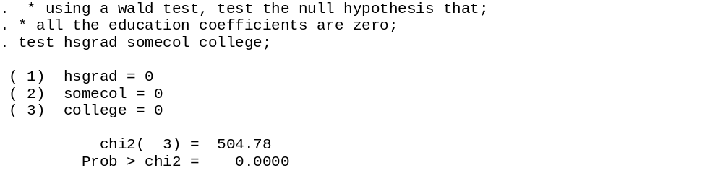

Slide 25
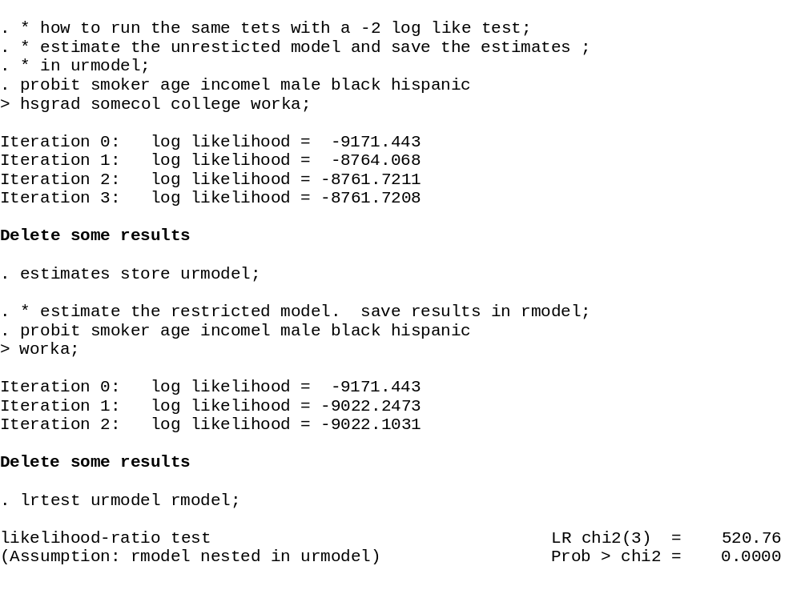

Slide 26
Comparing Marginal Effects
Variable | LP | Probit | Logit
age | -0.00040 | -0.00048 | -0.00048
incomel | -0.0289 | -0.0287 | -0.0276
male | 0.0167 | 0.0168 | 0.0172
Black | -0.0321 | -0.0357 | -0.0342
hispanic | -0.0658 | -0.0706 | -0.0602
hsgrad | -0.0533 | -0.0661 | -0.0514
college | -0.2149 | -0.2406 | -0.2121
worka | -0.0669 | -0.0661 | -0.0658

Slide 27
When will results differ?
Normal and logit PDF/CDF look:
  Similar in the mid point of the distribution
  Different in the tails
You obtain more observations in the tails of the distribution when
  Samples sizes are large
   approaches 1 or 0
These situations will more likely produce differences in estimates

Slide 28
probit smoker worka age incomel male black hispanic hsgrad somecol college;
matrix betat=e(b); * get beta from probit (1 x k);
matrix beta=betat';
matrix covp=e(V); * get v/c matric from probit (k x k);
* get means of x -- call it xbar (k x 1);
* must be the same order as in the probit statement;
matrix accum zz = worka age incomel male black hispanic hsgrad somecol college, means(xbart);
matrix xbar=xbart'; * transpose beta;
matrix xbeta=beta'*xbar; * get xbeta (scalar);
matrix pdf=normalden(xbeta[1,1]); * evaluate std normal pdf at xbarbeta;
matrix k=rowsof(beta); * get number of covariates;
matrix Ik=I(k[1,1]); * construct I(k);
matrix G=Ik-xbeta*beta*xbar'; * construct G;
matrix v_c=(pdf*pdf)*G*covp*G'; * get v-c matrix of marginal effects;
matrix me= beta*pdf; * get marginal effects;
matrix se_me1=cholesky(diag(vecdiag(v_c))); * get square root of main diag;
matrix se_me=vecdiag(se_me1)'; *take diagonal values;
matrix z_score=vecdiag(diag(me)*inv(diag(se_me)))'; * get z score;
matrix results=me,se_me,z_score; * construct results matrix;
matrix colnames results=marg_eff std_err z_score; * define column names;
matrix list results; * list results;

Slide 29
results[10,3]
marg_eff std_err z_score
worka -.06521255 .00720374 -9.0525984
age -.00039515 .00029023 -1.3615156
incomel -.02891389 .00471728 -6.129356
male .01661127 .00714305 2.3255154
black -.03303852 .0108782 -3.0371321
hispanic -.07107496 .01479806 -4.8029926
hsgrad -.05447959 .01359844 -4.0063111
somecol -.11335675 .01408096 -8.0503576
college -.23955322 .0144803 -16.543383
_cons .2712018 .04808183 5.6404217
------------------------------------------------------------------------------
smoker | dF/dx Std. Err. z P>|z| x-bar [ 95% C.I. ]
---------+--------------------------------------------------------------------
age | -.0003951 .0002902 -1.36 0.173 38.5474 -.000964 .000174
incomel | -.0289139 .0047173 -6.13 0.000 10.421 -.03816 -.019668
male*| .0166757 .0071979 2.33 0.020 .39476 .002568 .030783
black*| -.0320621 .0102295 -3.04 0.002 .111945 -.052111 -.012013
hispanic*| -.0658551 .0125926 -4.80 0.000 .060709 -.090536 -.041174
hsgrad*| -.053335 .013018 -4.01 0.000 .335527 -.07885 -.02782
somecol*| -.1062358 .0122819 -8.05 0.000 .268545 -.130308 -.082164
college*| -.2149199 .0114584 -16.49 0.000 .329376 -.237378 -.192462
worka*| -.0668959 .0075634 -9.05 0.000 .68514 -.08172 -.052072
---------+--------------------------------------------------------------------

Slide 30
* this is an example of a marginal effect for a dichotomous outcome;
* in this case, set the 1st variable worka as 1 or 0;
matrix x1=xbar;
matrix x1[1,1]=1;
matrix x0=xbar;
matrix x0[1,1]=0;
matrix xbeta1=beta'*x1;
matrix xbeta0=beta'*x0;
matrix prob1=normal(xbeta1[1,1]);
matrix prob0=normal(xbeta0[1,1]);
matrix me_1=prob1-prob0;
matrix pdf1=normalden(xbeta1[1,1]);
matrix pdf0=normalden(xbeta0[1,1]);
matrix G1=pdf1*x1 - pdf0*x0;
matrix v_c1=G1'*covp*G1;
matrix se_me_1=sqrt(v_c1[1,1]);
* marginal effect of workplace bans;
matrix list me_1;
* standard error of workplace a;
matrix list se_me_1;

Slide 31
symmetric me_1[1,1]
c1
r1 -.06689591
. * standard error of workplace a;
. matrix list se_me_1;
symmetric se_me_1[1,1]
c1
r1 .00756336
------------------------------------------------------------------------------
smoker | dF/dx Std. Err. z P>|z| x-bar [ 95% C.I. ]
---------+--------------------------------------------------------------------
age | -.0003951 .0002902 -1.36 0.173 38.5474 -.000964 .000174
incomel | -.0289139 .0047173 -6.13 0.000 10.421 -.03816 -.019668
male*| .0166757 .0071979 2.33 0.020 .39476 .002568 .030783
black*| -.0320621 .0102295 -3.04 0.002 .111945 -.052111 -.012013
hispanic*| -.0658551 .0125926 -4.80 0.000 .060709 -.090536 -.041174
hsgrad*| -.053335 .013018 -4.01 0.000 .335527 -.07885 -.02782
somecol*| -.1062358 .0122819 -8.05 0.000 .268545 -.130308 -.082164
college*| -.2149199 .0114584 -16.49 0.000 .329376 -.237378 -.192462
worka*| -.0668959 .0075634 -9.05 0.000 .68514 -.08172 -.052072
---------+--------------------------------------------------------------------

Slide 32
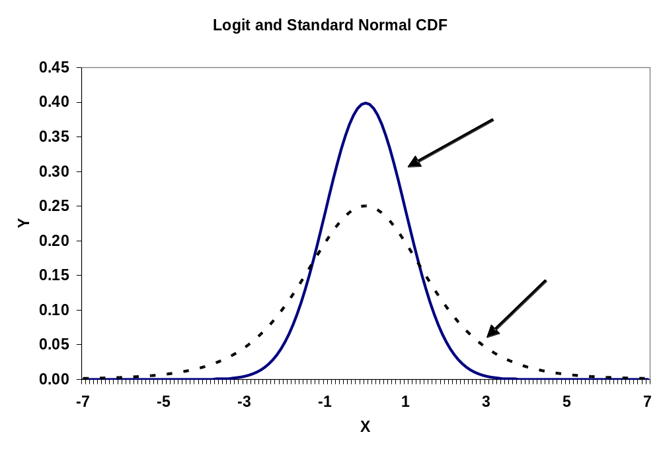

Slide 33
Pseudo R²
LL_{k} log likelihood with all variables
LL₁ log likelihood with only a constant
0 > LL_{k} > LL₁ so | LL_{k} | < |LL₁|
Pseudo R² = 1 - |LL₁/LL_{k}|
Bounded between 0-1
Not anything like an R² from a regression

Slide 34
Predicting Y
Let b be the estimated value of β
For any candidate vector of x_{i} , we can predict probabilities, P_{i}
P_{i} = Ф(x_{i}b)
Once you have P_{i}, pick a threshold value, T, so that you predict
    Y^{p} = 1 if P_{i} > T
    Y^{p} = 0 if P_{i} ≤ T
Then compare, fraction correctly predicted

Slide 35
Question: what value to pick for T?
Can pick .5 – what some textbooks suggest
  Intuitive. More likely to engage in the activity than to not engage in it
  When  is small (large), this criteria does a poor job of predicting Y_{i}=1 (Y_{i}=0)

Slide 36
*predict probability of smoking;
predict pred_prob_smoke;
* get detailed descriptive data about predicted prob;
sum pred_prob, detail;
* predict binary outcome with 50% cutoff;
gen pred_smoke1=pred_prob_smoke>=.5;
label variable pred_smoke1 "predicted smoking, 50% cutoff";
* compare actual values;
tab smoker pred_smoke1, row col cell;

Slide 37
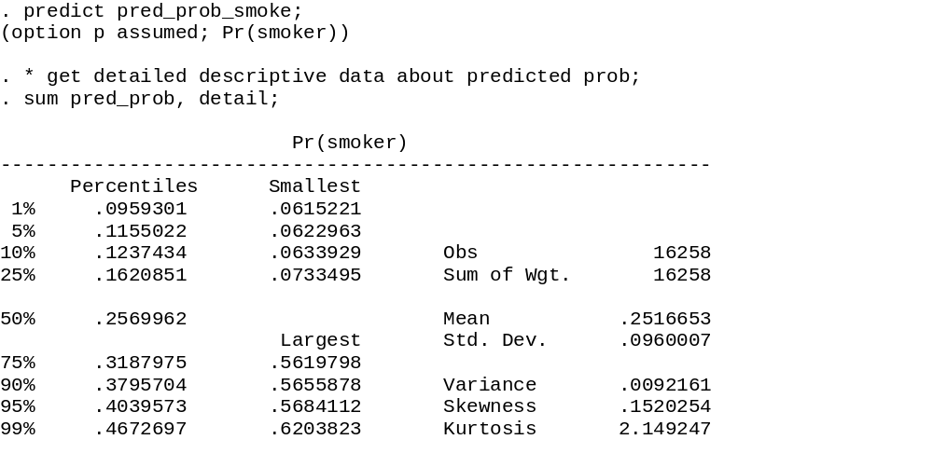
Predicted values close
To sample mean of y
Mean of predicted
Y is always close to actual mean
(0.25163 in this case)
No one predicted to have a
High probability of smoking
Because mean of Y closer to 0

Slide 38
Some nice properties of the Logit
Outcome, y=1 or 0
Treatment, x=1 or 0
Other covariates, x
Context,
  x = whether a baby is born with a low weight birth
  x = whether the mom smoked or not during pregnancy

Slide 39
Risk ratio
  RR = Prob(y=1|x=1)/Prob(y=1|x=0)
  Differences in the probability of an event when x is and is not observed
  How much does smoking elevate the chance your child will be a low weight birth

Slide 40
Let Y_{yx} be the probability y=1 or 0 given x=1 or 0
Think of the risk ratio the following way
    Y₁₁ is the probability Y=1 when X=1
    Y₁₀ is the probability Y=1 when X=0
Y₁₁ = RR*Y₁₀

Slide 41
Odds Ratio
  OR=A/B = [Y₁₁/Y₀₁]/[Y₁₀/Y₀₀]
  A = [Pr(Y=1|X=1)/Pr(Y=0|X=1)]
  = odds of Y occurring if you are a smoker
  B = [Pr(Y=1|X=0)/Pr(Y=0|X=0)]
  = odds of Y happening if you are not a smoker
  What are the relative odds of Y happening if you do or do not experience X

Slide 42
Suppose Pr(Y_{i} =1) = F(β_{o}+ β₁X_{i} + β₂Z) and F is the logistic function
Can show that
OR = exp(β₁) = e ^{β1}
This number is typically reported by most statistical packages

Slide 43
Details
    Y₁₁ = exp(β_{o}+ β₁ + β₂Z) /(1+ exp(β_{o}+ β₁+ β₂Z) )
    Y₁₀ = exp(β_{o}+ β₂Z)/(1+ exp(β_{o}+β₂Z))
    Y₀₁ = 1 /(1+ exp(β_{o}+ β₁ + β₂Z) )
    Y₀₀ = 1/(1+ exp(β_{o}+β₂Z)
    [Y₁₁/Y₀₁] = exp(β_{o}+ β₁ + β₂Z)
    [Y₁₀/Y₀₀] = exp(β_{o}+ β₂Z)
    OR=A/B = [Y₁₁/Y₀₁]/[Y₁₀/Y₀₀]
    = exp(β_{o}+ β₁ + β₂Z)/ exp(β_{o} + β₂Z)
    = exp(β₁)

Slide 44
Suppose Y is rare, mean is close to 0
  Pr(Y=0|X=1) and Pr(Y=0|X=0) are both close to 1, so they cancel
Therefore, when mean is close to 0
  Odds Ratio ≈ Risk Ratio
Why is this nice?

Slide 45
Population Attributable Risk
PAR
Fraction of outcome Y attributed to X
Let x_{s} be the fraction use of x
PAR = (RR – 1)x_{s} /[(1-x_{s}) + RRx_{s}]
Derived on next 2 slides

Slide 46
Population attributable risk
Average outcome in the population
y_{c} = (1-x_{s}) Y₁₀ + x_{s} Y₁₁ = (1- x_{s})Y₁₀ + x_{s} (RR)Y₁₀
Average outcomes are a weighted average of outcomes for X=0 and X=1
What would the average outcome be in the absence of X (e.g., reduce smoking rates to 0)?
Y_{a} = Y₁₀

Slide 47
Therefore
  y_{c} = current outcome
  Y_{a} = Y₁₀ outcome with zero smoking
  PAR = (y_{c} – Y_{a})/y_{c}
  Substitute definition of Y_{a} and y_{c}
  Reduces to (RR – 1)x_{s} /[(1-x_{s}) + RRx_{s}]

Slide 48
Example: Maternal Smoking and Low Weight Births
6% births are low weight
  < 2500 grams
  Average birth is 3300 grams (5.5 lbs)
Maternal smoking during pregnancy has been identified as a key cofactor
  13% of mothers smoke
  This number was falling about 1 percentage point per year during 1980s/90s
  Doubles chance of low weight birth

Slide 49
Natality detail data
Census of all births (4 million/year)
Annual files starting in the 60s
Information about
  Baby (birth weight, length, date, sex, plurality, birth injuries)
  Demographics (age, race, marital, educ of mom)
  Birth (who delivered, method of delivery)
  Health of mom (smoke/drank during preg, weight gain)

Slide 50
Smoking not available from CA or NY
~3 million usable observations
I pulled .5% random sample from 1995
About 12,500 obs
Variables: birthweight (grams), smoked, married, 4-level race, 5 level education, mothers age at birth

Slide 51
Notice a few things
  13.7% of women smoke
  6% have low weight birth
Pr(LBW | Smoke) =10.28%
Pr(LBW |~ Smoke) = 5.36%
RR
= Pr(LBW | Smoke)/ Pr(LBW |~ Smoke)
= 0.1028/0.0536 = 1.92
Raw
Numbers

Slide 52
Asking for odds ratios
Logistic y x1 x2;
In this case
xi: logistic lowbw smoked age married i.educ5 i.race4;

Slide 53
PAR
PAR = (RR – 1) x_{s} /[(1- x_{s}) + RR x_{s}]
x_{s}= 0.137
RR = 1.96
PAR = 0.116
11.6% of low weight births attributed to maternal smoking

Slide 54
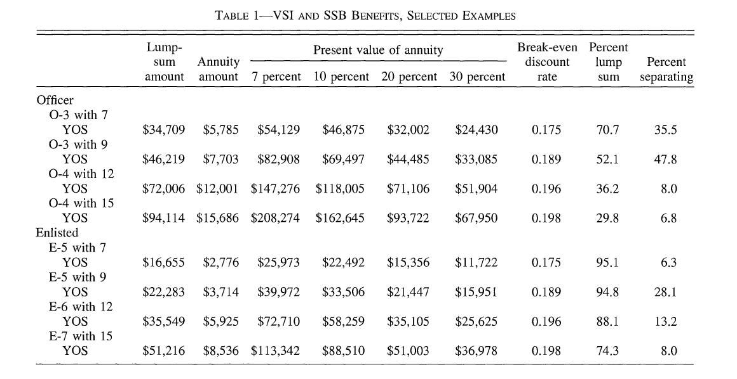

Slide 55
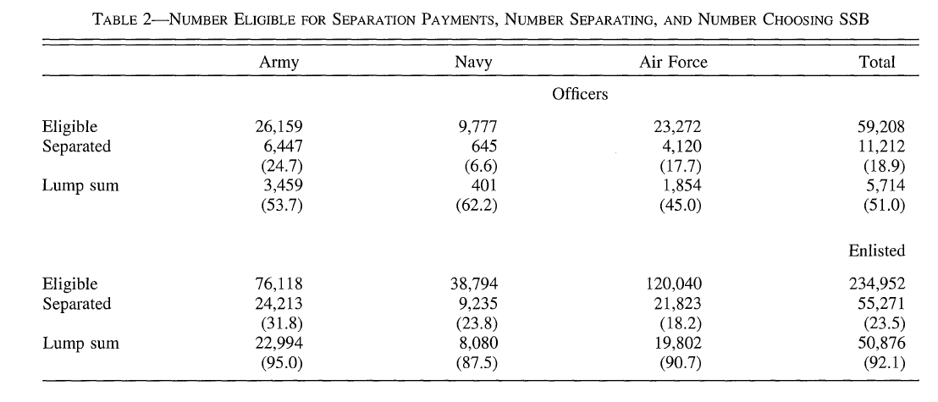

Slide 56
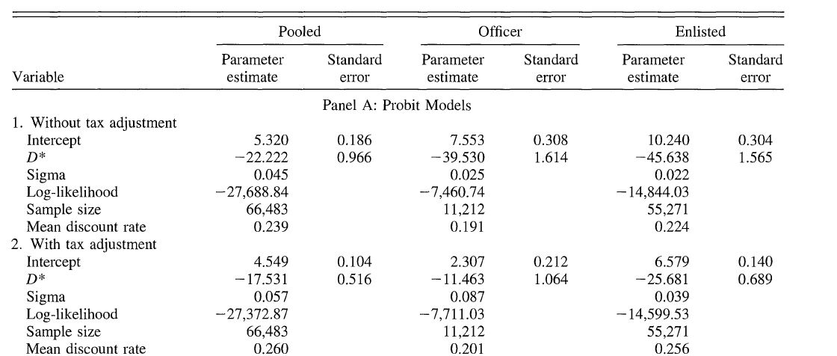
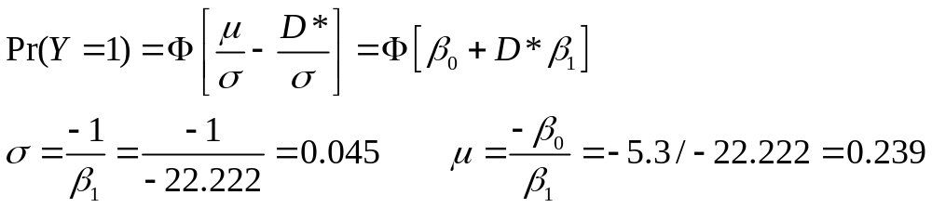

Slide 57
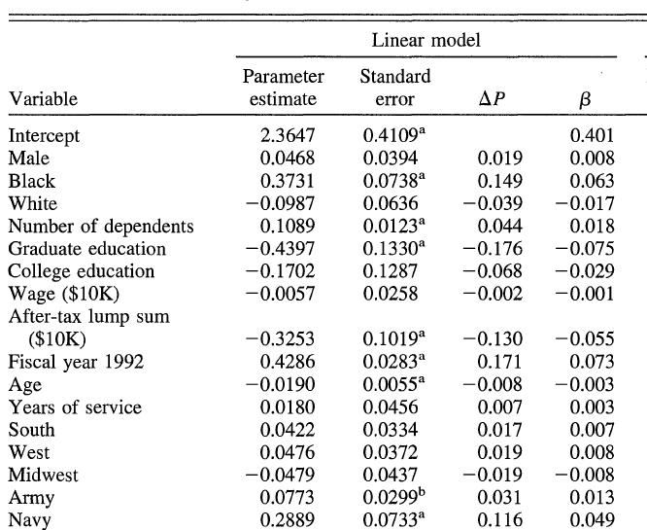

Slide 58
Endowment effect
Ask group to fill out a survey
As a thank you, give them a coffee mug
  Have the mug when they fill out the survey
After the survey, offer them a trade of a candy bar for a mug
Reverse the experiment – offer candy bar, then trade for a mug
Comparison sample – give them a choice of mug/candy after survey is complete

Slide 59
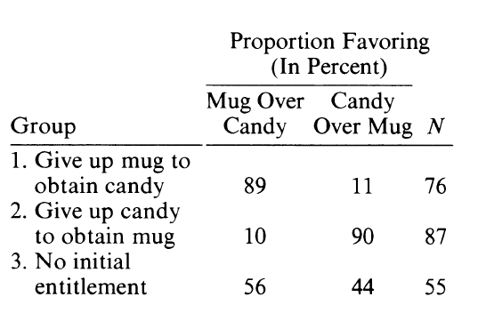

Slide 60
Contrary to simply consumer choice model
Standard util. theory model assume MRS between two good is symmetric
Lack of trading suggests an “endowment” effect
  People value the good more once they own it
  Generates large discrepancies between WTP and WTA

Slide 61
Policy implications
Example:
  A) How much are you willing to pay for clean air?
  B) How much do we have to pay you to allow someone to pollute
  Answer to B) orders of magnitude larger than A)
  Prior – estimate WTP via A and assume equals WTA
Thought of as loss aversion –

Slide 62
Problem
Artificial situations
Inexperienced may not know value of the item
Solution: see how experienced actors behave when they are endowed with something they can easily value
Two experiments: baseball card shows and collectible pins

Slide 63
Baseball cards
Two pieces of memorabilia
  Game stub from game Cal Ripken Jr set the record for consecutive games played (vs. KC, June 14, 1996)
  Certificate commemorating Nolan Ryans’ 300th win
Ask people to fill out a 5 min survey. In return, they receive one of the pieces, then ask for a trade

Slide 64
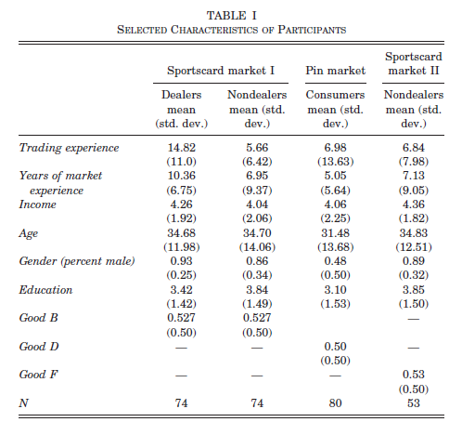

Slide 65
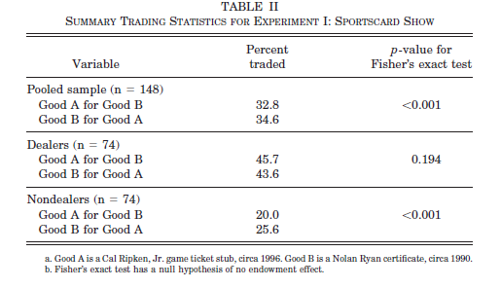

Slide 66
