Slide 1
Results from hsb_subset.do

Slide 2
Example of Kloeck problem
Two-stage sample of high school sophomores
1st school is selected, then students are picked, both at random
This sample,
10 students each from 498 high schools
Y_{is}=β₀ + X_{is}β₁ + Z_{s}γ + v_{is}

Slide 3
Variables in data set
* outcome variable;
* soph_scr;
* variables that vary by school:
* west, south, midwest, cath_sch, urban, rural;
* school id variable;
* schoolid;
* variable that vary across students;
* age, female, siblings, black, hispanic, both_parents;
* parent_ed1-parent_ed4, family_inc1-family_inc6;

Slide 4
. xtreg soph_scr west south midwest urban rural cath_sch, i(schoolid) re;
Random-effects GLS regression Number of obs = 4980
Group variable: schoolid Number of groups = 498
R-sq: within = 0.0000 Obs per group: min = 10
between = 0.1595 avg = 10.0
overall = 0.0407 max = 10
Random effects u_i ~ Gaussian Wald chi2(6) = 93.19
corr(u_i, X) = 0 (assumed) Prob > chi2 = 0.0000
------------------------------------------------------------------------------
soph_scr | Coef. Std. Err. z P>|z| [95% Conf. Interval]
-------------+----------------------------------------------------------------
west | -3.263414 1.088594 -3.00 0.003 -5.397019 -1.129809
south | -6.059277 .919613 -6.59 0.000 -7.861685 -4.256868
midwest | -1.612765 .9379595 -1.72 0.086 -3.451131 .2256022
urban | -3.330204 .8830361 -3.77 0.000 -5.060923 -1.599485
rural | -1.482626 .7745392 -1.91 0.056 -3.000694 .0354435
cath_sch | 2.806002 .9193059 3.05 0.002 1.004195 4.607808
_cons | 29.64833 .8190206 36.20 0.000 28.04308 31.25358
-------------+----------------------------------------------------------------
sigma_u | 5.7411139
sigma_e | 14.223856
rho | .14009098 (fraction of variance due to u_i)
------------------------------------------------------------------------------

Slide 5
In random effects model, ρ=% of total variance explained between-group
ρ = σ²_{u}/(σ²_{u}+ σ²_{e}) = 0.14
Bias of OLS variance is 1+ ρ(T-1)
T=10, so bias = 1+0.14(9) = 2.26
Standard error should be too large by a factor of 2.26^{.5} = 1.50

Slide 6
 |  | OLS | RE | Ratio
X | OLS | Std error | Std err | RE/OLS Std error
west | -3.263 | 0.7233 | 1.08859 | 1.504938
south | -6.059 | 0.6111 | 0.91961 | 1.504938
midwest | -1.613 | 0.6233 | 0.93796 | 1.504938
urban | -3.33 | 0.5868 | 0.88304 | 1.504938
rural | -1.483 | 0.5147 | 0.77454 | 1.504938
cath_sch | 2.806 | 0.6109 | 0.91931 | 1.504938
_cons | 29.65 | 0.5442 | 0.81902 | 1.504938

Slide 7
Now add some covariates
X’s – characteristics that vary across kids and school
Will explain some of the persistent between school difference in outcomes
Therefore ρ = σ²_{u}/(σ²_{u}+ σ²_{e}) should decline

Slide 8
* run ols model of test score on only school characteristics;
* this is a model similar to the one discussed in Kloeck, econometrica, 1981;
reg soph_scr west south midwest urban rural cath_sch;
now run a random effects model to get the estimate of rho;
xtreg soph_scr west south midwest urban rural cath_sch, i(schoolid) re;
* run OLS, Random effect and OLS with clustered standard errors;
* in this case, add in the variables that vary by individual;
*ols;
reg soph_scr age female siblings both_parents parent_ed0-parent_ed3
family_inc0-family_inc6 west south midwest urban rural cath_sch;
*random effects;
xtreg soph_scr age female siblings both_parents parent_ed0-parent_ed3
family_inc0-family_inc6 west south midwest urban rural cath_sch, re i(schoolid);
* ols with standard errros clustered on the school;
reg soph_scr age female siblings both_parents parent_ed0-parent_ed3
family_inc0-family_inc6 west south midwest urban rural cath_sch, cluster(schoolid);

Slide 9
. xtreg soph_scr age female siblings both_parents parent_ed0-parent_ed3
> family_inc0-family_inc6 west south midwest urban rural cath_sch, re i(schoolid);
Random-effects GLS regression Number of obs = 4980
Group variable: schoolid Number of groups = 498
R-sq: within = 0.1288 Obs per group: min = 10
between = 0.4853 avg = 10.0
overall = 0.2116 max = 10
Random effects u_i ~ Gaussian Wald chi2(21) = 1109.65
corr(u_i, X) = 0 (assumed) Prob > chi2 = 0.0000
------------------------------------------------------------------------------
soph_scr | Coef. Std. Err. z P>|z| [95% Conf. Interval]
-------------+----------------------------------------------------------------
age | -4.064159 .3347123 -12.14 0.000 -4.720183 -3.408135
female | -.7981668 .4016643 -1.99 0.047 -1.585414 -.0109193
Delete a bunch of results
urban | -1.648092 .6693946 -2.46 0.014 -2.960081 -.3361027
rural | -.2348173 .5888268 -0.40 0.690 -1.388897 .9192619
cath_sch | 1.081526 .6979434 1.55 0.121 -.2864183 2.449469
_cons | 106.762 5.929101 18.01 0.000 95.1412 118.3829
-------------+----------------------------------------------------------------
sigma_u | 3.4597054
sigma_e | 13.29233
rho | .06344663 (fraction of variance due to u_i)
------------------------------------------------------------------------------
. * ols with standard errros clustered on the school;
. reg soph_scr age female siblings both_parents parent_ed0-parent_ed3
> family_inc0-family_inc6 west south midwest urban rural cath_sch, cluster(schoolid);

Slide 10
ρ = σ²_{u}/(σ²_{u}+ σ²_{e}) = 0.0634
Bias of OLS variance is 1+ ρ(T-1)
T=10, so bias = 1+0.0634(9) = 1.571
Standard error should be too large by a factor of 1.57^{.5} = 1.2534

Slide 11
 |  | OLS |  | RE | Ratio
X | OLS | Std error | RE | Std error | RE/OLS Std errors
age | -4.174 | 0.3371 | -4.0642 | 0.334712 | 0.99299559
female | -0.724 | 0.4015 | -0.7982 | 0.401664 | 1.0003402
siblings | -0.353 | 0.1061 | -0.3653 | 0.106194 | 1.00122756
both_parents | 2.406 | 0.4539 | 2.09878 | 0.449338 | 0.98990222
parent_ed0 | -10.87 | 0.7363 | -10.278 | 0.725593 | 0.98548019
parent_ed1 | -10.81 | 0.7478 | -9.9902 | 0.744871 | 0.99608131
parent_ed2 | -8.21 | 0.6072 | -7.6437 | 0.602842 | 0.99284536
parent_ed3 | -4.183 | 0.6314 | -3.8195 | 0.622386 | 0.98579249
family_inc0 | -4.84 | 0.8744 | -4.3668 | 0.866709 | 0.99116163

Slide 12
 |  | OLS |  | RE | Ratio
X | OLS | Std error | RE | Std error | RE/OLS Std errors
west | -2.881 | 0.659 | -2.9082 | 0.821975 | 1.24730883
south | -4.898 | 0.5593 | -4.9854 | 0.696475 | 1.24533309
midwest | -1.596 | 0.5695 | -1.5684 | 0.709596 | 1.24598822
urban | -1.507 | 0.5378 | -1.6481 | 0.669395 | 1.24477137
rural | -0.141 | 0.4737 | -0.2348 | 0.588827 | 1.24297177
cath_sch | 0.938 | 0.5611 | 1.08153 | 0.697943 | 1.24378773

Slide 13
*ols;
reg soph_scr age female siblings both_parents parent_ed0-parent_ed3
family_inc0-family_inc6 west south midwest urban rural cath_sch;
*random effects;
xtreg soph_scr age female siblings both_parents parent_ed0-parent_ed3
family_inc0-family_inc6 west south midwest urban rural cath_sch, re i(schoolid);
* ols with standard errros clustered on the school;
reg soph_scr age female siblings both_parents parent_ed0-parent_ed3
family_inc0-family_inc6 west south midwest urban rural cath_sch, cluster(schoolid);

Slide 14
 |  | OLS | RE | Huber | Ratio | Ratio
X | OLS | Std error | Std err | Std error | RE/OLS | Hu/OLS
west | -2.881 | 0.6590 | 0.8220 | 0.8338 | 1.2473 | 1.2652
south | -4.898 | 0.5593 | 0.6965 | 0.7529 | 1.2453 | 1.3463
midwest | -1.596 | 0.5695 | 0.7096 | 0.7266 | 1.2460 | 1.2758
urban | -1.507 | 0.5378 | 0.6694 | 0.7550 | 1.2448 | 1.4040
rural | -0.141 | 0.4737 | 0.5888 | 0.5804 | 1.2430 | 1.2252
cath_sch | 0.938 | 0.5611 | 0.6979 | 0.8330 | 1.2438 | 1.4844

Slide 15
 |  | OLS | RE | Huber | Ratio | Ratio
X | OLS | Std error | Std err | Std error | RE/OLS | Hu/OLS
age | -4.174 | 0.3371 | 0.3347 | 0.34145 | 0.9930 | 1.0130
female | -0.724 | 0.4015 | 0.4017 | 0.44817 | 1.0003 | 1.1162
siblings | -0.353 | 0.1061 | 0.1062 | 0.11065 | 1.0012 | 1.0432
both_parents | 2.406 | 0.4539 | 0.4493 | 0.48171 | 0.9899 | 1.0612
parent_ed0 | -10.87 | 0.7363 | 0.7256 | 0.78043 | 0.9855 | 1.0600
parent_ed1 | -10.81 | 0.7478 | 0.7449 | 0.74498 | 0.9961 | 0.9962

Slide 16
Bertrand et al.
Identify high type I error rate in Diff-in-diff models through ‘placebo’ regression
CPS—monthly data of 160K people, 60K households
People in survey same 4 months in a two year period (e.g., April – July 2001 and 2002)

Slide 17
¼ of the households exit the survey either temporarily (month 4) or permanently (month 8)
This outgoing group answers detailed questions about job
  Weekly/hourly earnings
  Usual hours of work
  Union status

Slide 18
Authors take 1979-99 (21 years) worth of data from 4th month
Construct average weekly earnings of women aged 25-50 w/ + earnings by state
51 states x 21 years = 1050 cells
Regress cell avg. wages on state/year effects
Regress residuals on 1st three lags
Autocorrelation coefs are 0.51, 0.44, 0.22

Slide 19
Placebo laws
Draw year at random from 85-95
Select 25 states to receive treatment for all years after that year in previous step
I_{st} =1 if state received treatment in year t
Y_{ist} = I_{st}β + u_{s} + v_{t} + ε_{ist}
Run this experiment couple hundred times
Calculate % Reject H₀: β=0

Slide 20
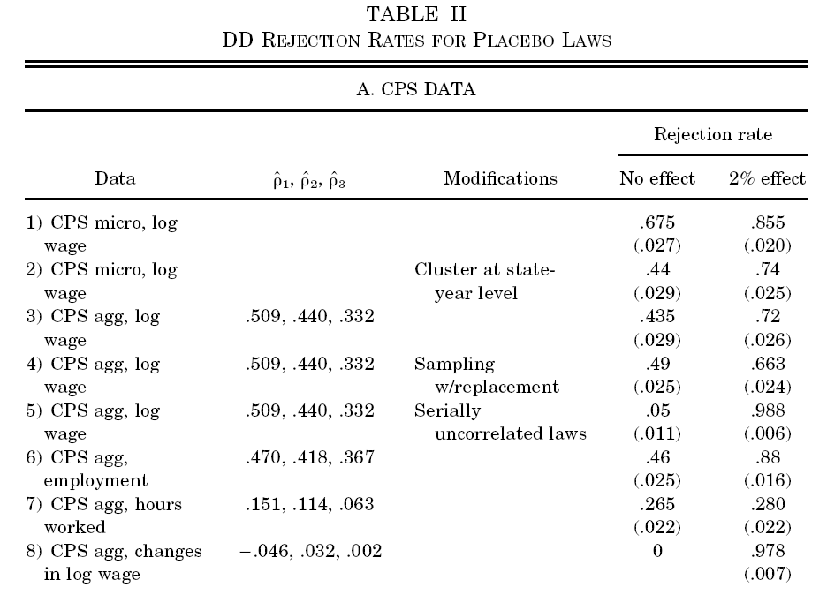
With micro data
reject null hypothesis
67.5% of time
With aggregate data at the state/year cell
Rejection rate falls somewhat but it is still high

Slide 21
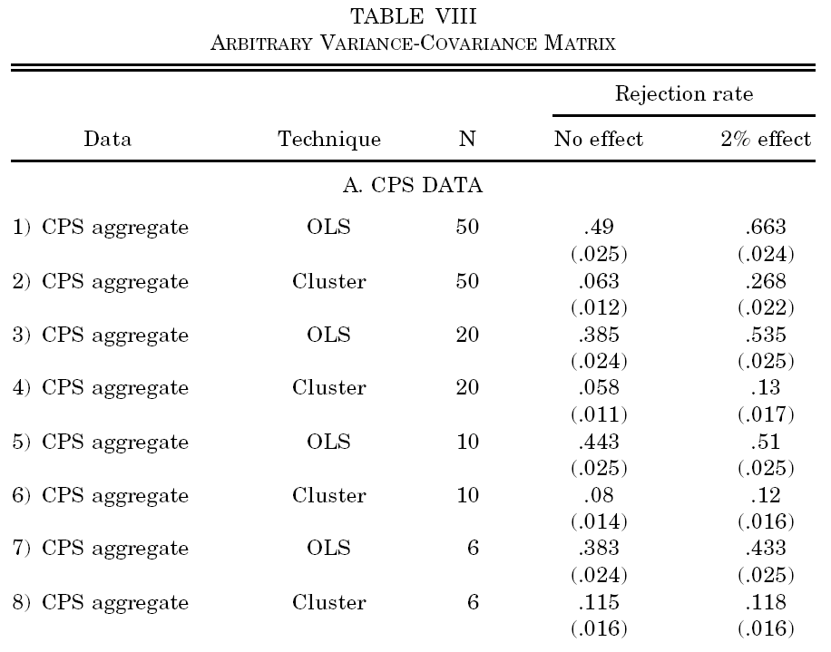
High Type I error rate in standard DnD model
Type I
error
rate ↑
as #
of groups
↓
Type I error falls almost to expected levels
with Huber-type correction

Slide 22
bootstrap_example.do
*run simple regression
reg ln_weekly_earn age age2 years_educ nonwhite union
* now boostrap the data. takes N obs with replacement
* save results in stata file bs-results.dta
bootstrap, saving(bs-results.dta, replace) rep(999) : regress ln_weekly_earn age age2 years_educ union

Slide 23
. *run simple regression
. reg ln_weekly_earn age age2 years_educ nonwhite union
Source | SS df MS Number of obs = 19906
-------------+------------------------------ F( 5, 19900) = 1775.70
Model | 1616.39963 5 323.279927 Prob > F = 0.0000
Residual | 3622.93905 19900 .182057239 R-squared = 0.3085
-------------+------------------------------ Adj R-squared = 0.3083
Total | 5239.33869 19905 .263217216 Root MSE = .42668
------------------------------------------------------------------------------
ln_weekly_~n | Coef. Std. Err. t P>|t| [95% Conf. Interval]
-------------+----------------------------------------------------------------
age | .0679808 .0020033 33.93 0.000 .0640542 .0719075
age2 | -.0006778 .0000245 -27.69 0.000 -.0007258 -.0006299
years_educ | .069219 .0011256 61.50 0.000 .0670127 .0714252
nonwhite | -.1716133 .0089118 -19.26 0.000 -.1890812 -.1541453
union | .1301547 .0072923 17.85 0.000 .1158612 .1444481
_cons | 3.630805 .0394126 92.12 0.000 3.553553 3.708057
------------------------------------------------------------------------------
.
.

Slide 24
.
. * now boostrap the data. takes N obs with replacement
. * save results in stata file bs-results.dta
.
. bootstrap, saving(bs-results.dta, replace) rep(999) :
regress ln_weekly_earn age age2 years_educ union
(running regress on estimation sample)
(note: file bs-results.dta not found)
Bootstrap replications (999)
----+--- 1 ---+--- 2 ---+--- 3 ---+--- 4 ---+--- 5
.................................................. 50
.................................................. 100
.................................................. 150
Delete some results
.................................................. 950
.................................................
Linear regression Number of obs = 19906
Replications = 999
Wald chi2(4) = 8181.87
Prob > chi2 = 0.0000
R-squared = 0.2956
Adj R-squared = 0.2955
Root MSE = 0.4306
------------------------------------------------------------------------------
| Observed Bootstrap Normal-based
ln_weekly_~n | Coef. Std. Err. z P>|z| [95% Conf. Interval]
-------------+----------------------------------------------------------------
age | .0677261 .0020929 32.36 0.000 .0636241 .0718281
age2 | -.000671 .0000256 -26.24 0.000 -.0007211 -.0006209
years_educ | .0737998 .0011444 64.49 0.000 .0715569 .0760427
union | .1275683 .0067367 18.94 0.000 .1143646 .1407721
_cons | 3.545902 .0399948 88.66 0.000 3.467513 3.62429
------------------------------------------------------------------------------

Slide 25
OLS
------------------------------------------------------------------------------
ln_weekly_~n | Coef. Std. Err. t P>|t| [95% Conf. Interval]
-------------+----------------------------------------------------------------
age | .0679808 .0020033 33.93 0.000 .0640542 .0719075
age2 | -.0006778 .0000245 -27.69 0.000 -.0007258 -.0006299
years_educ | .069219 .0011256 61.50 0.000 .0670127 .0714252
nonwhite | -.1716133 .0089118 -19.26 0.000 -.1890812 -.1541453
union | .1301547 .0072923 17.85 0.000 .1158612 .1444481
_cons | 3.630805 .0394126 92.12 0.000 3.553553 3.708057
------------------------------------------------------------------------------
BOOTSTRAP
------------------------------------------------------------------------------
| Observed Bootstrap Normal-based
ln_weekly_~n | Coef. Std. Err. z P>|z| [95% Conf. Interval]
-------------+----------------------------------------------------------------
age | .0677261 .0020929 32.36 0.000 .0636241 .0718281
age2 | -.000671 .0000256 -26.24 0.000 -.0007211 -.0006209
years_educ | .0737998 .0011444 64.49 0.000 .0715569 .0760427
union | .1275683 .0067367 18.94 0.000 .1143646 .1407721
_cons | 3.545902 .0399948 88.66 0.000 3.467513 3.62429
------------------------------------------------------------------------------

Slide 26
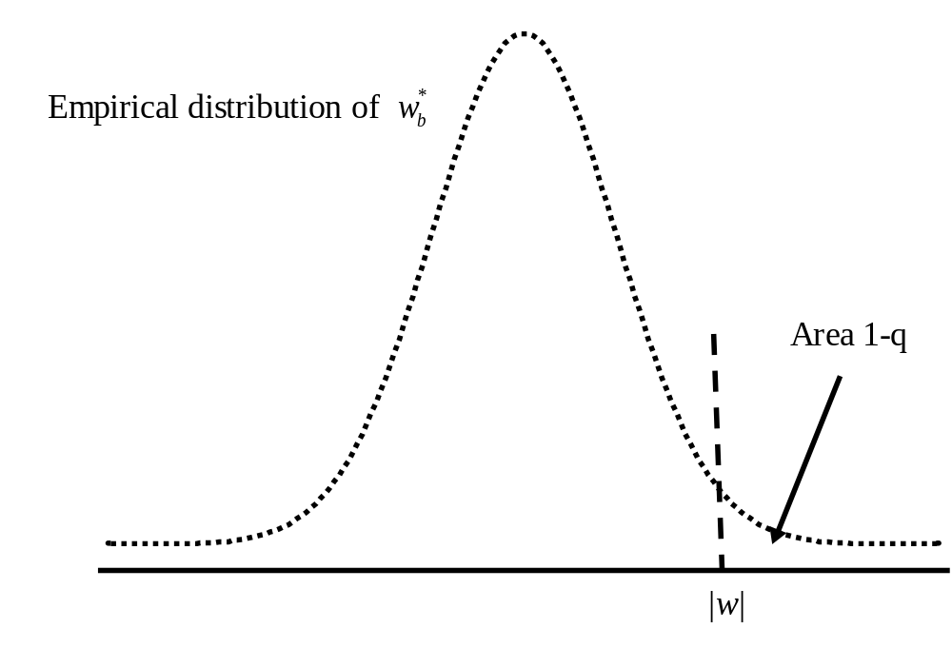

Slide 27
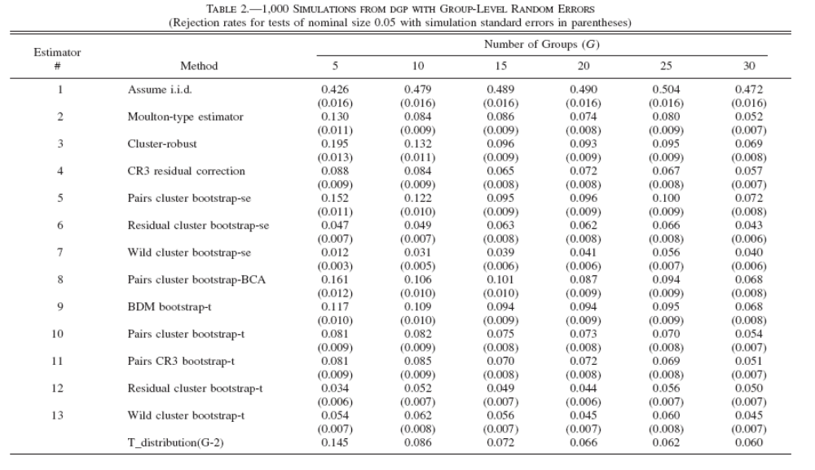

Slide 28
. * run ols without clustered std errors, just for comparison;
. reg carton_market_share _I* real_tax;
Source | SS df MS Number of obs = 1044
-------------+------------------------------ F( 42, 1001) = 1222.46
Model | 30.3895294 42 .723560223 Prob > F = 0.0000
Residual | .592482903 1001 .000591891 R-squared = 0.9809
-------------+------------------------------ Adj R-squared = 0.9801
Total | 30.9820123 1043 .02970471 Root MSE = .02433
------------------------------------------------------------------------------
carton_mar~e | Coef. Std. Err. t P>|t| [95% Conf. Interval]
-------------+----------------------------------------------------------------
_Istate_2 | -.1450251 .0063325 -22.90 0.000 -.1574516 -.1325987
_Istate_3 | -.2283005 .0059946 -38.08 0.000 -.2400639 -.216537
DELETE SOME RESULTS
_Imonth_11 | -.0053518 .0036984 -1.45 0.148 -.0126094 .0019058
_Imonth_12 | .0040418 .0036942 1.09 0.274 -.0032075 .0112911
_Iyear_2005 | -.0046846 .0018602 -2.52 0.012 -.0083349 -.0010343
_Iyear_2006 | -.013917 .0018705 -7.44 0.000 -.0175875 -.0102464
real_tax | -.0201751 .003371 -5.98 0.000 -.0267903 -.01356
_cons | .5595832 .0054096 103.44 0.000 .5489677 .5701988
------------------------------------------------------------------------------

Slide 29
. * now run ols and cluster at the state level;
. reg carton_market_share _I* real_tax, cluster(state);
Linear regression Number of obs = 1044
F( 13, 28) = .
Prob > F = .
R-squared = 0.9809
Root MSE = .02433
(Std. Err. adjusted for 29 clusters in state)
------------------------------------------------------------------------------
| Robust
carton_mar~e | Coef. Std. Err. t P>|t| [95% Conf. Interval]
-------------+----------------------------------------------------------------
_Istate_2 | -.1450251 .0066001 -21.97 0.000 -.1585449 -.1315054
_Istate_3 | -.2283005 .0042925 -53.19 0.000 -.2370932 -.2195078
DELETE SOME RESULTS
_Imonth_11 | -.0053518 .0035491 -1.51 0.143 -.0126217 .0019182
_Imonth_12 | .0040418 .0048803 0.83 0.415 -.005955 .0140387
_Iyear_2005 | -.0046846 .0040704 -1.15 0.260 -.0130224 .0036533
_Iyear_2006 | -.013917 .0070822 -1.97 0.059 -.0284241 .0005901
real_tax | -.0201751 .0082818 -2.44 0.021 -.0371397 -.0032106
_cons | .5595832 .0074706 74.90 0.000 .5442803 .5748862

Slide 30
. di "Number BS reps = $bootreps";
Number BS reps = 999
. di "P-value from clustered standard errors = `p_value_main'";
P-value from clustered standard errors = .0214648522876161
. di "P-value from wild boostrap = `p_value_wild'";
P-value from wild boostrap = .0640640640640641

