Slide 1
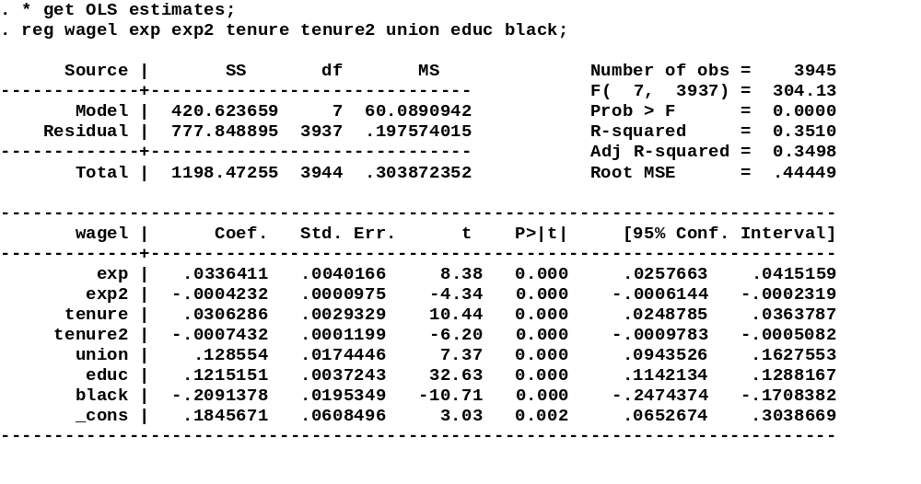
Notice R² and compare to FE
in next regression

Slide 2
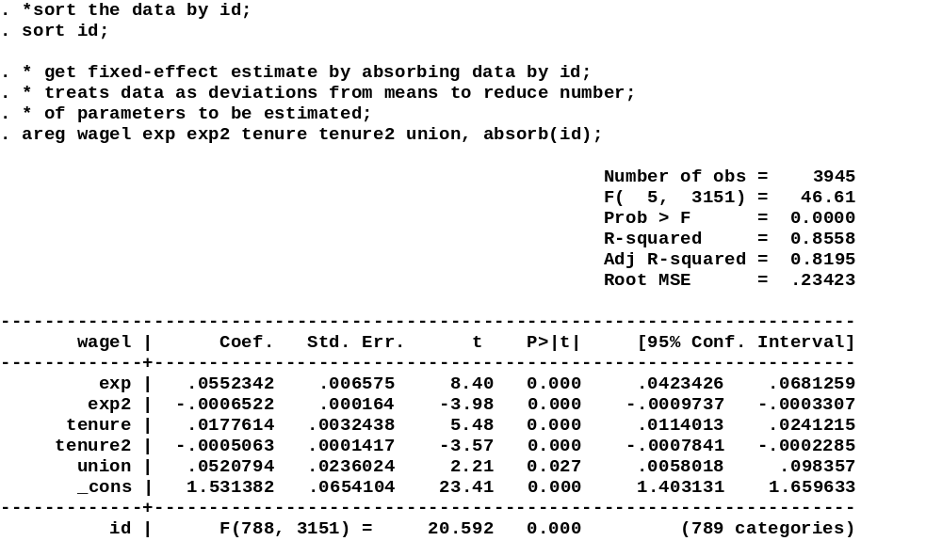
Areg constructs within
Panel means rather than
Estimate LSDV model
Data must
Be sorted by
ID
Big jump in
R²
ID is the variable
That identifies
Groups for Fixed-effects
Number of groups (N in class notation)

Slide 3
To estimate fixed and random effect models,
You must defined the dimension of the daya

Slide 4
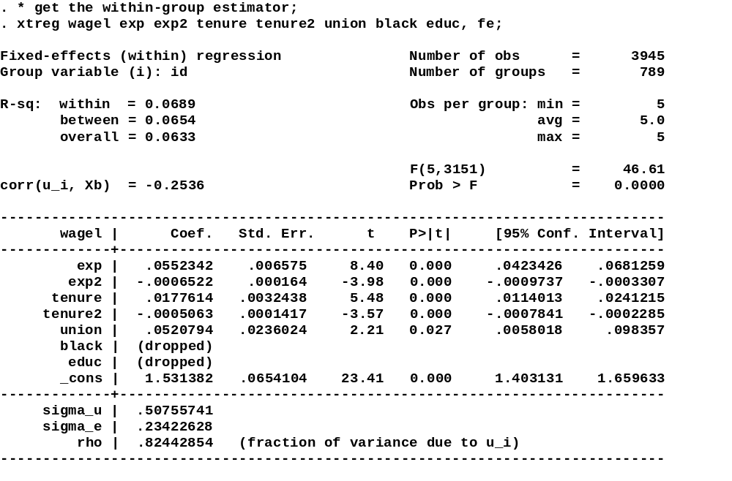
This the R² after within panel
Means have been subtracted
How much variation is left for you
To explain?
Notice the Z’s have been
Dropped from the analysis

Slide 5
Store the fixed-effects estimates to be used in
Construction of the Hausman test

Slide 6
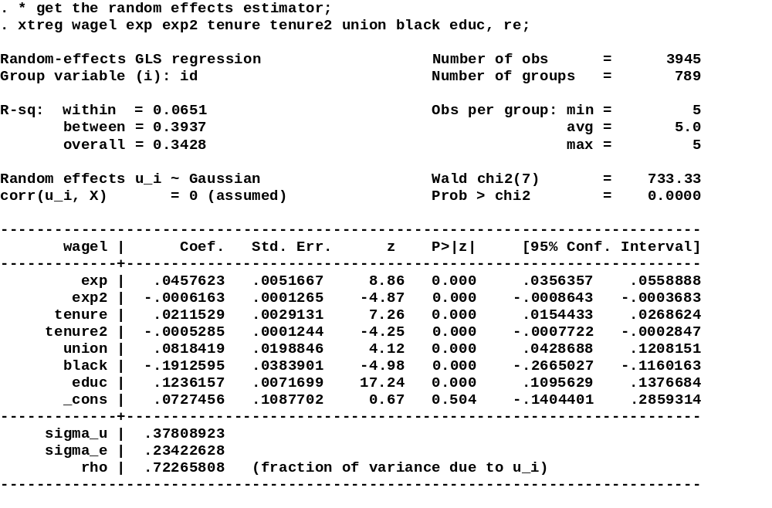
Slightly lower R² than in the
OLS model
Group information
.378²/(.378²+.234²)
Most of the variance is between group, not within

Slide 7
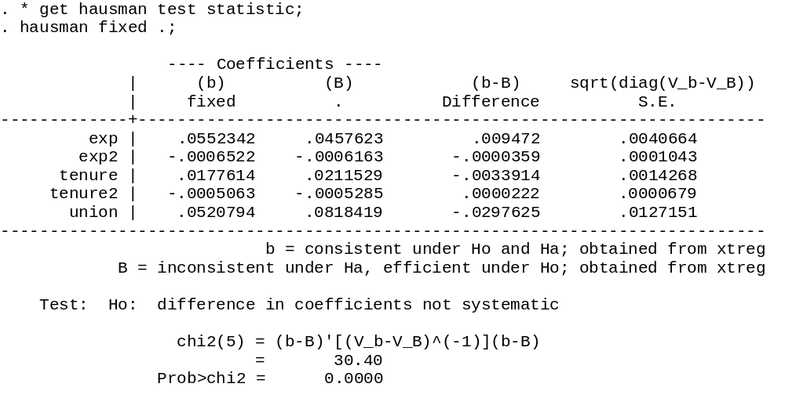
Ask for Hausman test
after the RE model is
estimated
Test statistic
P-value
Easily reject null in this case

Slide 8
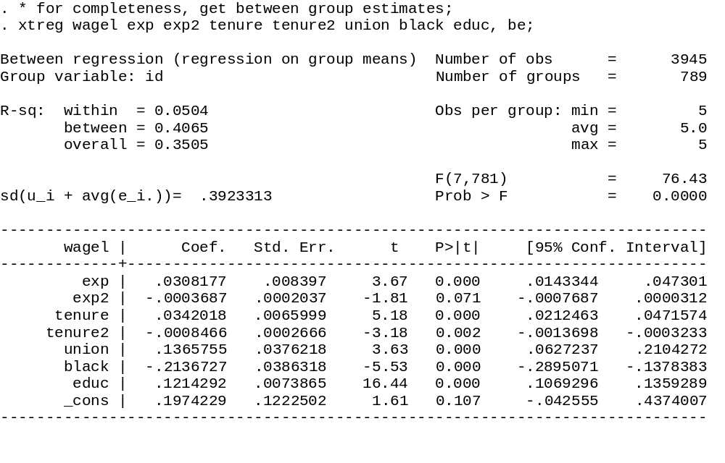
Get between group estimates

Slide 9
Summary of Results (X’s)
Variable | OLS | Fixed | Between | Random
Exp | 0.0336 (0.0040) | 0.055 (0.006) | 0.0308 (0.008) | 0.046 (0.005)
Exp² | -4.2E-4 (1.0E-4) | -6.5E-4 (1.6E-4) | -3.67E-4 (2.0E-4) | -6.2E-4 (1.2E-4)
Tenure | 0.0307 (0.0029) | 0.0178 (0.0032) | 0.034 (0.0066) | 0.021 (0.0029)
Tenure² | -7.5E-4 (1.1E-4) | -5.0E-4 (1.4E-4) | -8.5E-4 (2.7E-4) | -5.3E-4 (1.2E-4)
Union | 0.129 (0.017) | 0.052 (0.024) | 0.137 (0.038) | 0.082 (0.020)

Slide 10
Summary of Results (Z’s)
Variable | OLS | Fixed | Between | Random
EDUC | 0.121 (0.0037) |  | 0.212 (0.0074) | 0.124 (0.0072)
BLACK | -0.209 (0.0195) |  | -0.214 (0.038) | -0.191 (0.038)

Slide 11
Rate of return to tenure
Y_{it} =β₀ + E_{it} β₁ + E_{it\}² β₂ + T_{it} β₃ + T_{it}² β₄ +
Union_{it} β₅ + EDUC_{i} γ₁ + Black_{i} γ₂ + ε_{it}
dY/dT = β₃ + 2 T_{it} β₄
Return to tenure OLS FE RE
5 years 0.0232 0.0128 0.0255
10 years 0.0157 0.0078 0.0170
20 years 0.0007 -0.0022 0.0000

