Slide 1
Regression Discontinuity Design

Slide 2
Pr(X_{i}=1 | z)
1
Fuzzy
Design
Sharp
Design
0
Z₀
Z

Slide 3
E[Y|Z=z]
E[Y₁|Z=z]
E[Y₀|Z=z]
Z₀

Slide 4
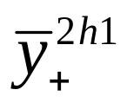
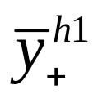
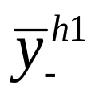
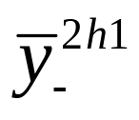
Y
y(z₀)+α
y(z₀)
z₀-2h₁
z₀-h₁
z₀
z₀+h₁
z₀+2h₁
z

Slide 5
Motivating example
Many districts have summer school to help kids improve outcomes between grades
  Enrichment, or
  Assist those lagging
Research question: does summer school improve outcomes
Variables:
  x=1 is summer school after grade g
  y = test score in grade g+1

Slide 6
LUSDINE
To be promoted to the next grade, students need to demonstrate proficiency in math and reading
  Determined by test scores
If the test scores are too low – mandatory summer school
After summer school, re-take tests at the end of summer, if pass, then promoted

Slide 7
Situation
Let Z be test score – Z is scaled such that
    Z≥0 not enrolled in summer school
    Z<0 enrolled in summer school
Consider two kids
    #1: Z=ε
    #2: Z=-ε
    Where ε is small

Slide 8
Intuitive understanding
Participants in SS are very different
However, at the margin, those just at Z=0 are virtually identical
One with z=-ε is assigned to summer school, but z= ε is not
Therefore, we should see two things

Slide 9
There should be a noticeable jump in SS enrollment at z=0.
If SS has an impact on test scores, we should see a jump in test scores at z=0 as well.

Slide 10
Variable Definitions
y_{i} = outcome of interest
x_{i} =1 if NOT in summer school, =1 if in
D_{i} = I(z_{i}≥0) -- I is indicator function that equals 1 when true, =0 otherwise
z_{i} = running variable that determines eligibility for summer school. z is re-scaled so that z_{i}=0 for the lowest value where D_{i}=1
w_{i} are other covariates

Slide 11
Key assumption of RDD models
People right above and below Z₀ are functionally identical
  Random variation puts someone above Z₀ and someone below
  However, this small different generates big differences in treatment (x)
  Therefore any difference in Y right at Z₀ is due to x

Slide 12
Limitation
Treatment is identified for people at the z_{i}=0
Therefore, model identifies the effect for people at that point
Does not say whether outcomes change when the critical value is moved

Slide 13
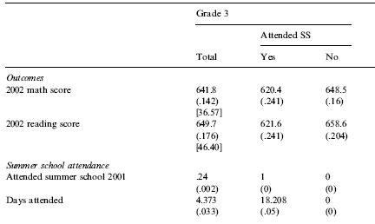
Table 1

Slide 14
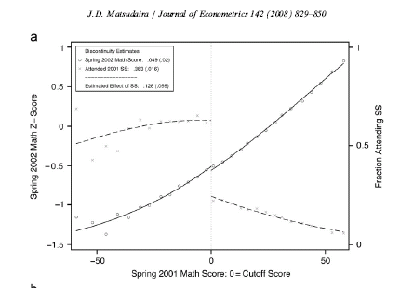

Slide 15
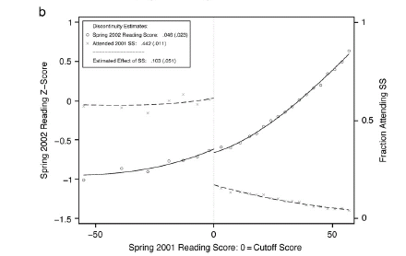

Slide 16
Chay et al.

Slide 17
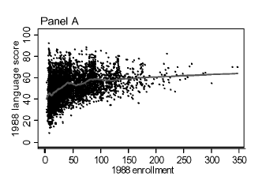

Slide 18
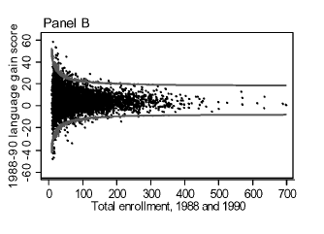

Slide 19
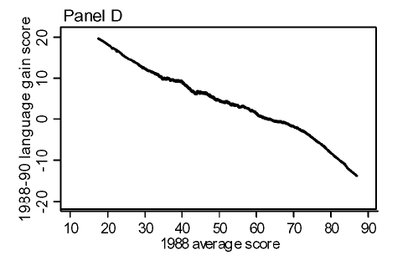

Slide 20
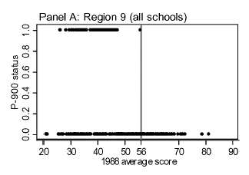

Slide 21
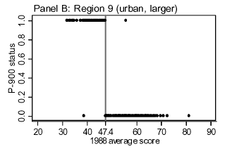

Slide 22
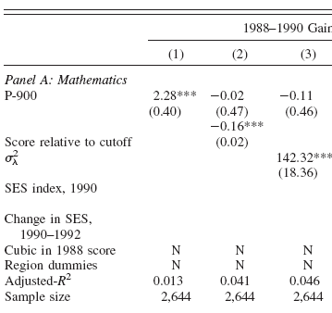
Fixed
Effects
Results
RD
Estimates

Slide 23
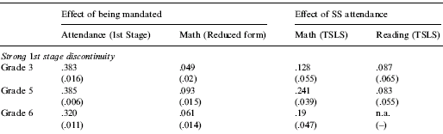
Table 2

Slide 24
Sample Code
Card et al., AER

Slide 25
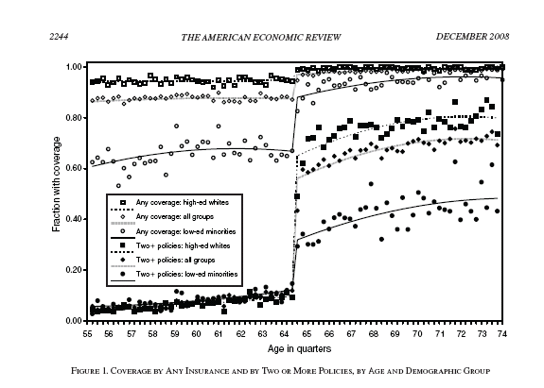

Slide 26
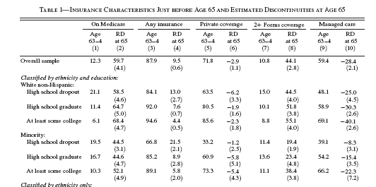

Slide 27
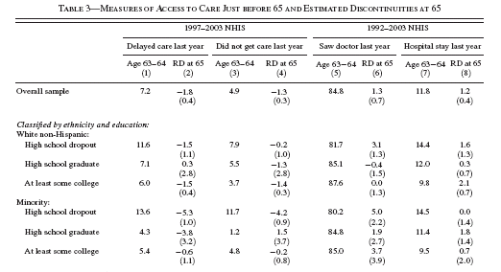

Slide 28
* eligible for Medicare after quarter 259;
gen age65=age_qtr>259;
* scale the age in quarters index so that it equals 0;
* in the month you become eligible for Medicare;
gen index=age_qtr-260;
gen index2=index*index;
gen index3=index*index*index;
gen index4=index2*index2;
gen index_age65=index*age65;
gen index2_age65=index2*age65;
gen index3_age65=index3*age65;
gen index4_age65=index4*age65;
gen index_1minusage65=index*(1-age65);
gen index2_1minusage65=index2*(1-age65);
gen index3_1minusage65=index3*(1-age65);
gen index4_1minusage65=index4*(1-age65);

Slide 29
* 1st stage results. Impact of Medicare on insurance coverage;
* basic results in the paper. cubic in age interacted with age65;
* method 1;
reg insured male white black hispanic _I*
index index2 index3 index_age65 index2_age65 index3_age65 age65,
cluster(index);
* 1st stage results. Impact of Medicare on insurance coverage;
* basic results in the paper. quadratic in age interacted with;
* age65 and 1-age65;
* method 2;
reg insured male white black hispanic _I*
index_1minus index2_1minus index3_1minus
index_age65 index2_age65 index3_age65 age65, cluster(index);

Slide 30
Method 1
Linear regression Number of obs = 46950
F( 21, 79) = 182.44
Prob > F = 0.0000
R-squared = 0.0954
Root MSE = .25993
(Std. Err. adjusted for 80 clusters in index)
------------------------------------------------------------------------------
| Robust
insured | Coef. Std. Err. t P>|t| [95% Conf. Interval]
-------------+----------------------------------------------------------------
male | .0077901 .0026721 2.92 0.005 .0024714 .0131087
white | .0398671 .0074129 5.38 0.000 .0251121 .0546221
delete some results
index | .0006851 .0017412 0.39 0.695 -.0027808 .0041509
index2 | 1.60e-06 .0001067 0.02 0.988 -.0002107 .0002139
index3 | -1.42e-07 1.79e-06 -0.08 0.937 -3.71e-06 3.43e-06
index_age65 | .0036536 .0023731 1.54 0.128 -.0010698 .0083771
index2_age65 | -.0002017 .0001372 -1.47 0.145 -.0004748 .0000714
index3_age65 | 3.10e-06 2.24e-06 1.38 0.171 -1.36e-06 7.57e-06
age65 | .0840021 .0105949 7.93 0.000 .0629134 .1050907
_cons | .6814804 .0167107 40.78 0.000 .6482186 .7147422
------------------------------------------------------------------------------

Slide 31
Method 2
Linear regression Number of obs = 46950
F( 21, 79) = 182.44
Prob > F = 0.0000
R-squared = 0.0954
Root MSE = .25993
(Std. Err. adjusted for 80 clusters in index)
------------------------------------------------------------------------------
| Robust
insured | Coef. Std. Err. t P>|t| [95% Conf. Interval]
-------------+----------------------------------------------------------------
male | .0077901 .0026721 2.92 0.005 .0024714 .0131087
white | .0398671 .0074129 5.38 0.000 .0251121 .0546221
delete some results
index_1mi~65 | .0006851 .0017412 0.39 0.695 -.0027808 .0041509
index2_1m~65 | 1.60e-06 .0001067 0.02 0.988 -.0002107 .0002139
index3_1m~65 | -1.42e-07 1.79e-06 -0.08 0.937 -3.71e-06 3.43e-06
index_age65 | .0043387 .0016075 2.70 0.009 .0011389 .0075384
index2_age65 | -.0002001 .0000865 -2.31 0.023 -.0003723 -.0000279
index3_age65 | 2.96e-06 1.35e-06 2.20 0.031 2.79e-07 5.65e-06
age65 | .0840021 .0105949 7.93 0.000 .0629134 .1050907
_cons | .6814804 .0167107 40.78 0.000 .6482186 .7147422
------------------------------------------------------------------------------

Slide 32
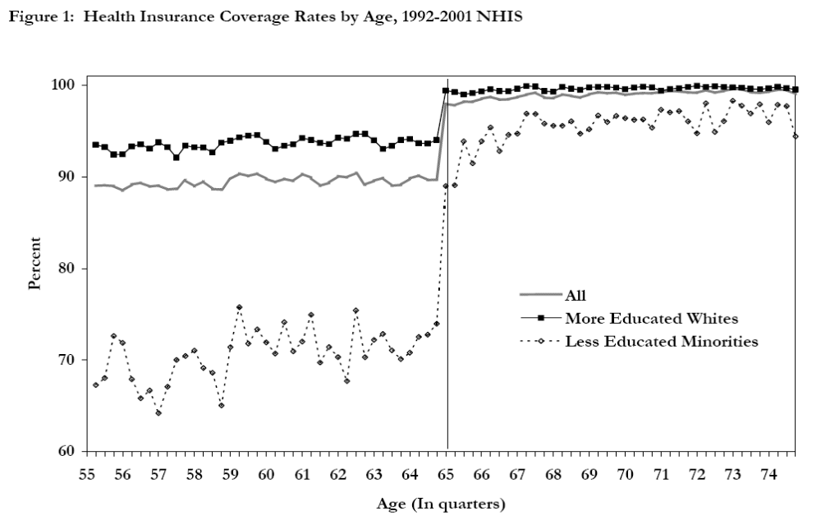

Slide 33
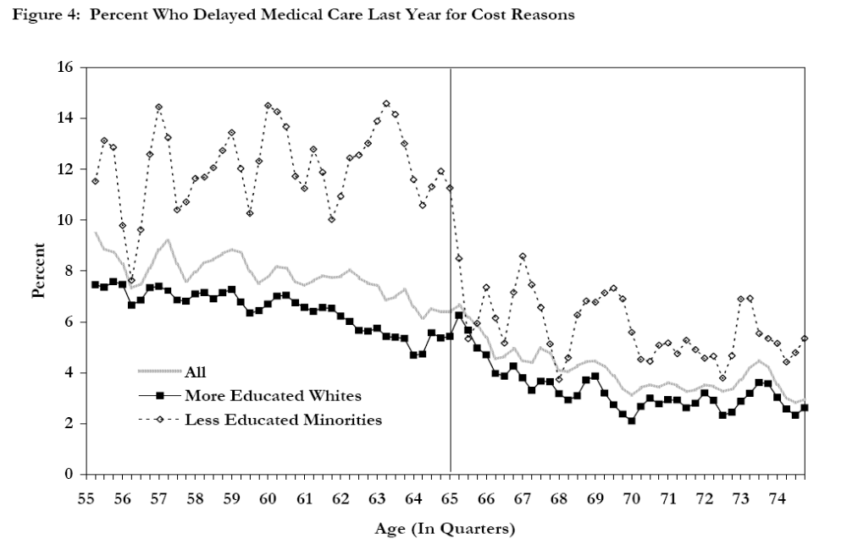

Slide 34
Results for different outcomes
Cubic term in Index
Outcome | Coef (std error) on AGE 65
Have Insurance | 0.084 (0.011)
In good health | -0.0022 (0.0141)
Delayed medical care | -0.0039 (0.0088)
Did not get medical care | 0.0063 (0.0053)
Hosp visits in 12 months | 0.0098 (0.0074)

Slide 35
Sensitivity of results to polynomial
Order | Insured | In good Health | Delayed med care | Hosp. visits
1 | 0.094 (0.008) | 0.0132 (0.0093) | -0.0110 (0.0054) | 0.0238 (0.0084)
2 | 0.091 (0.009) | 0.0070 (0.0102) | -0.0048 (0.0064) | 0.0253 (0.0085)
3 | 0.084 (0.011) | -0.0222 (0.0141) | -0.0039 (0.0088) | 0.0098 (0.0074)
4 | 0.0729 (0.013) | 0.0048 (0.0171) | -0.0120 (0.0101) | 0.0200 (0.0109)
Means age 64 | 0.877 | 0.763 | 0.069 | 0.124

Slide 36
Oreopoulos, AER
Enormous interest in the rate of return to education
Problem:
  OLS subject to OVB
  2SLS are defined for small population (LATE)
    Comp. schooling, distance to college, etc.
    Maybe not representative of group in policy simulations)
Solution: LATE for large group

Slide 37
School reform in GB (1944)
  Raised age of comp. schooling from 14 to 15
  Effective 1947 (England, Scotland, Wales)
  Raised education levels immediately
  Concerted national effort to increase supplies (teachers, buildings, furniture)
Northern Ireland had similar law, 1957

Slide 38
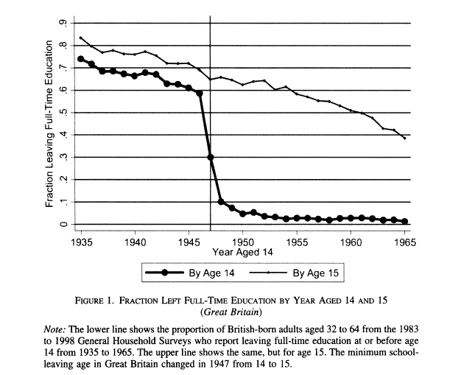

Slide 39
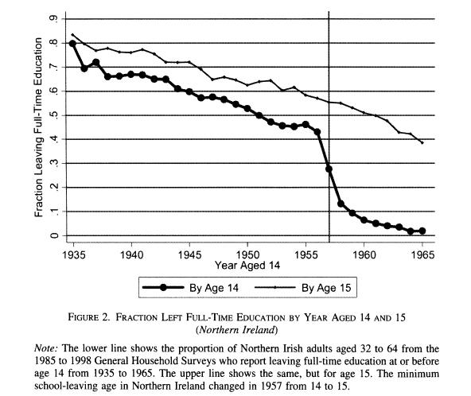

Slide 40
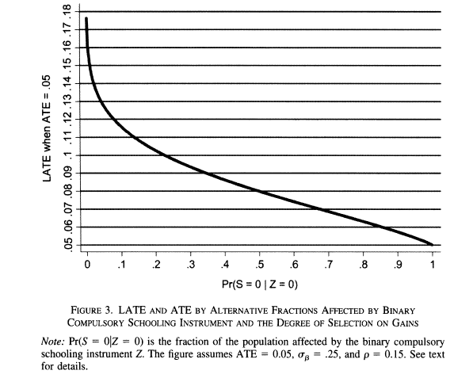

Slide 41
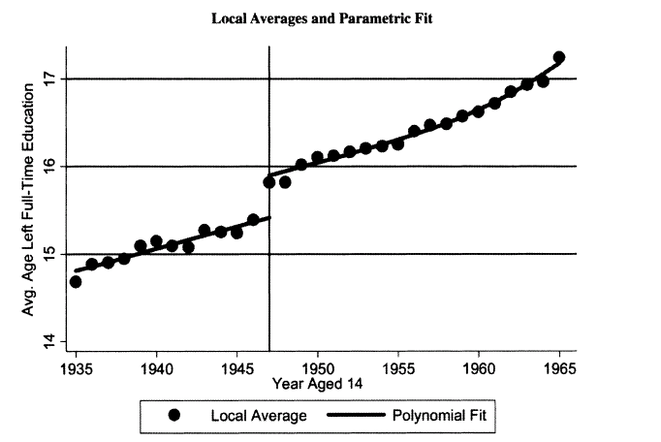

Slide 42
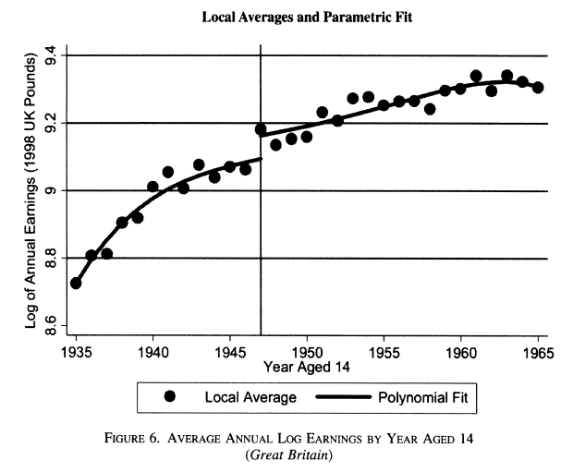

Slide 43
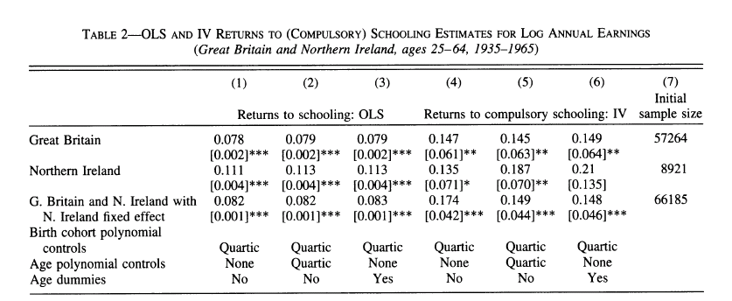

Slide 44
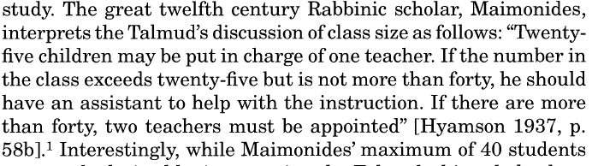
Angrist and Lavy, QJE

Slide 45
1-39 students, one class
40-79 students, 2 classes
80 to 119 students, 3 classes
Addition of one student can generate large changes in average class size

Slide 46
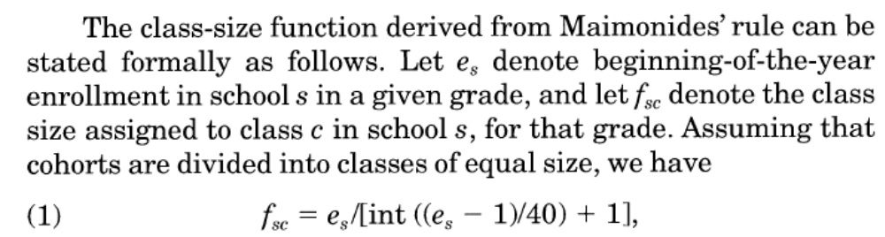
e_{S}= 79, (79-1)/40 = 1.95, int(1.95) =1, 1+1=2, f_{sc}=39.5

Slide 47
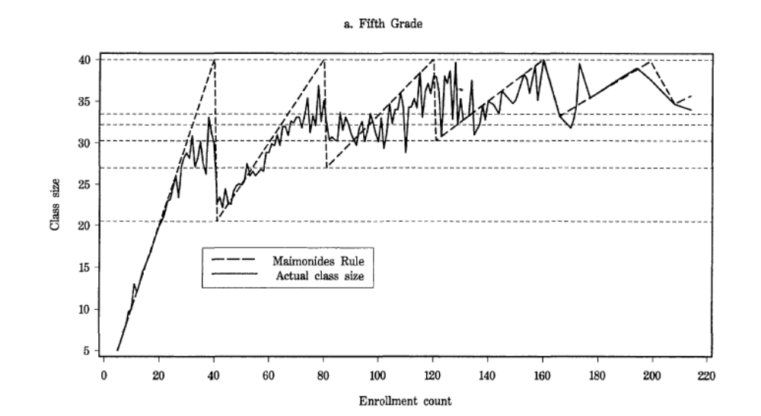

Slide 48
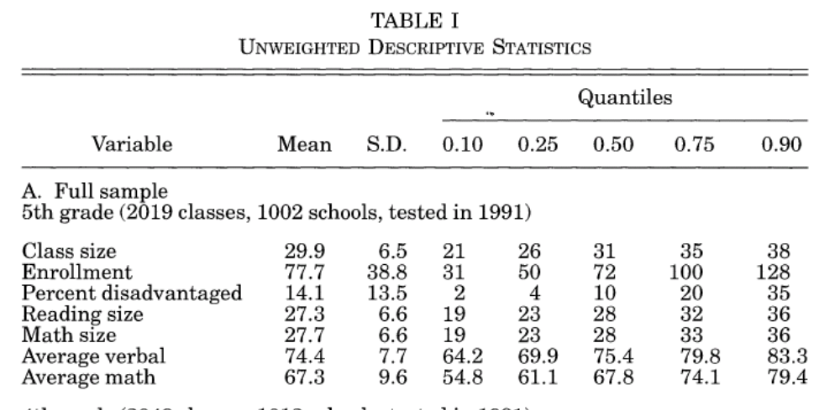

Slide 49
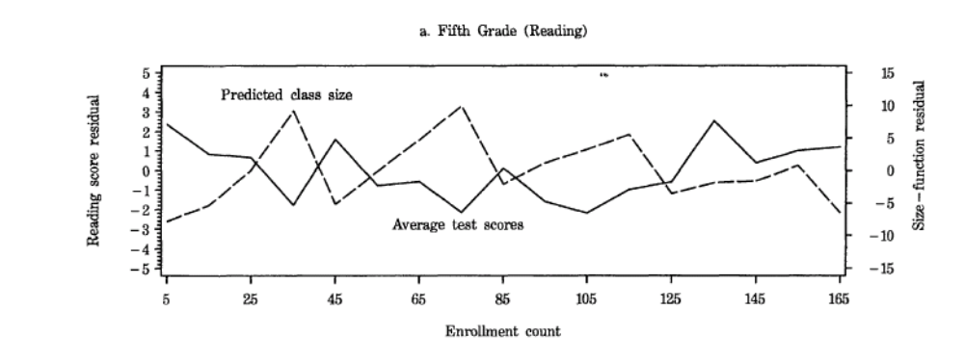
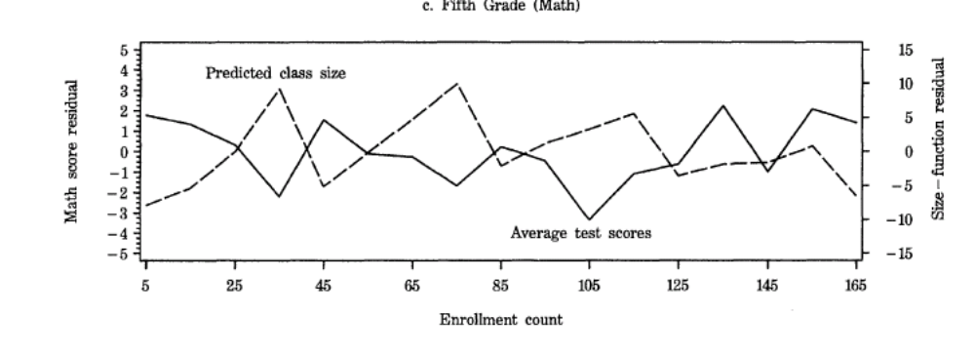

Slide 50
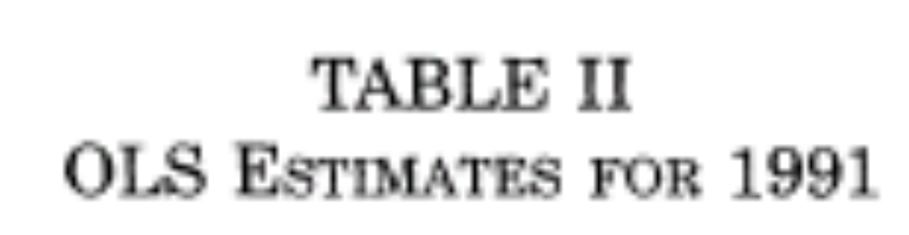
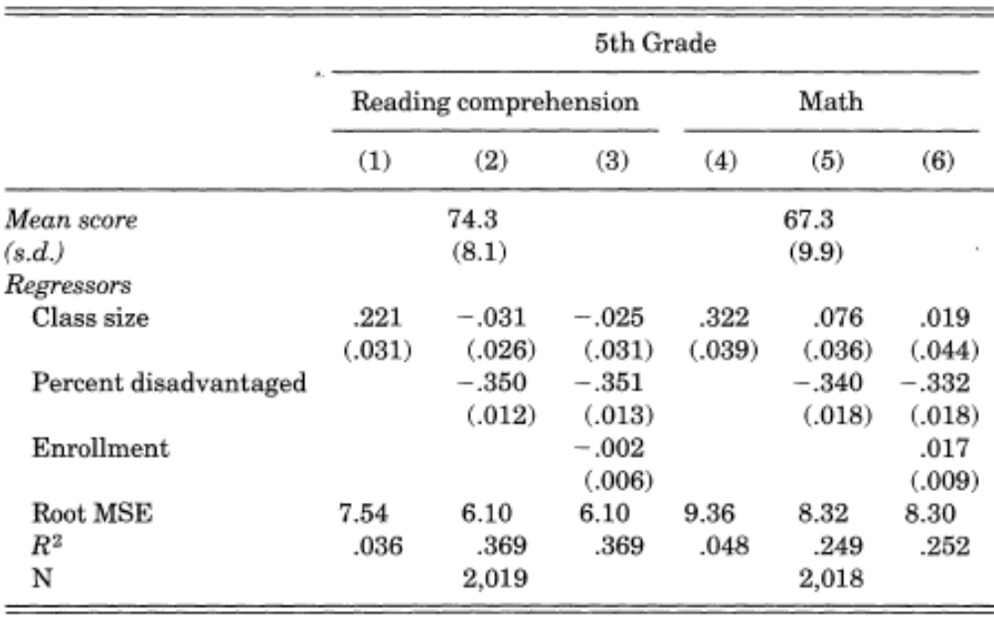

Slide 51
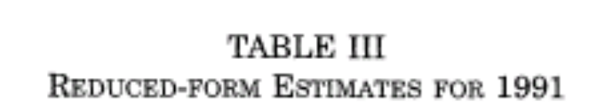
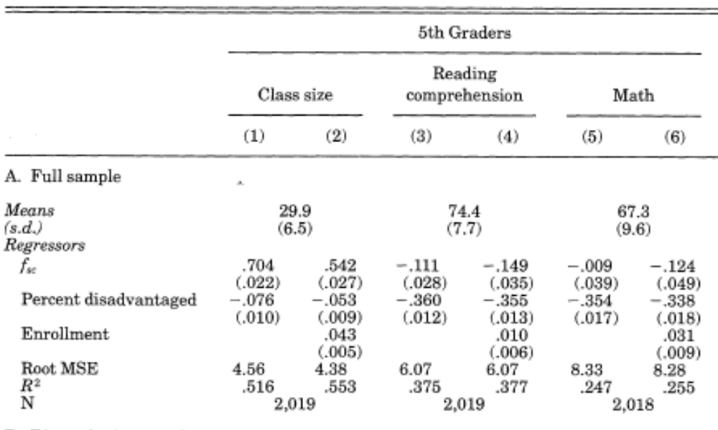
IV estimates reading = -0.111/0.704 = -0.1576
IV estimates math = -0.009/0.704 = -0.01278

Slide 52
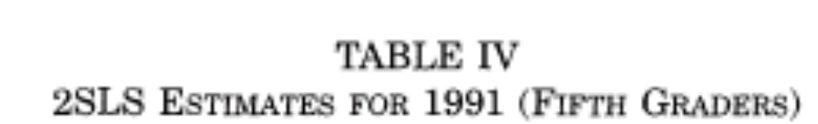
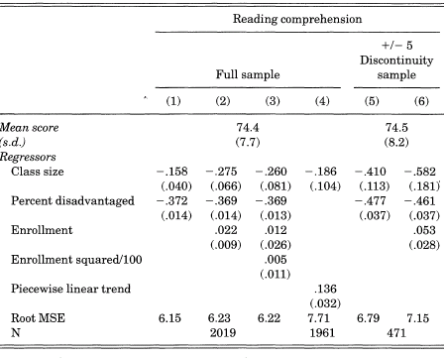

Slide 53
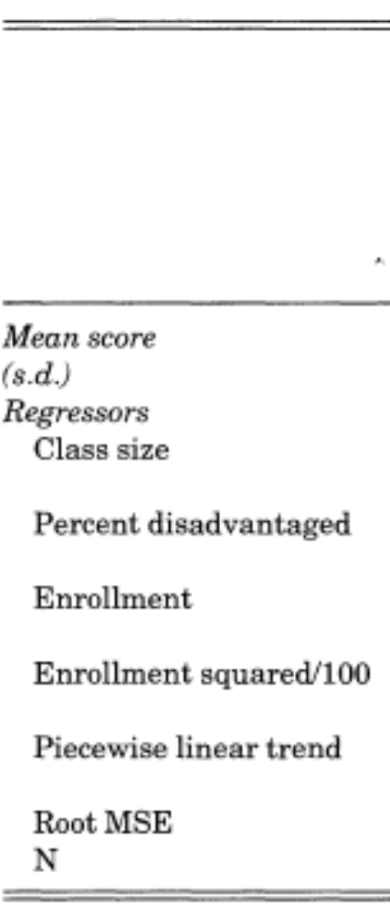
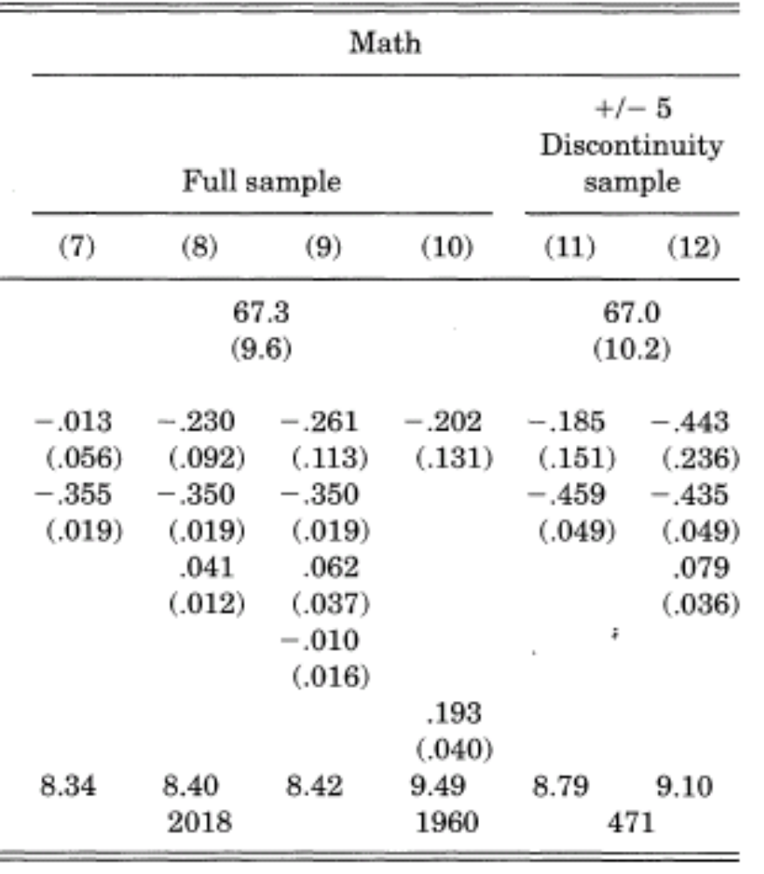

Slide 54
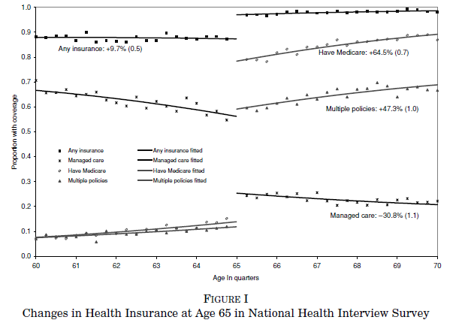
Card et al., QJE

Slide 55
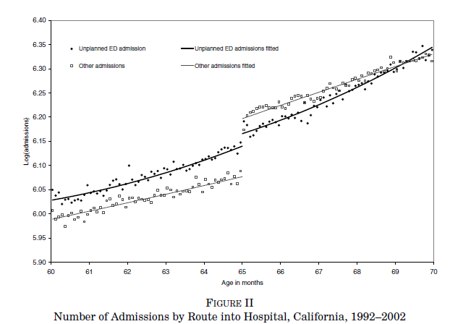

Slide 56
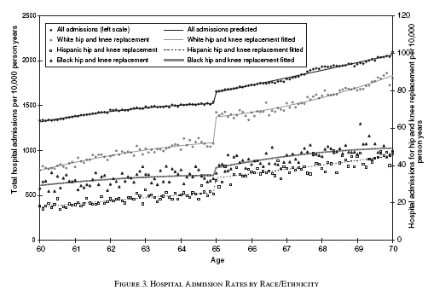

Slide 57
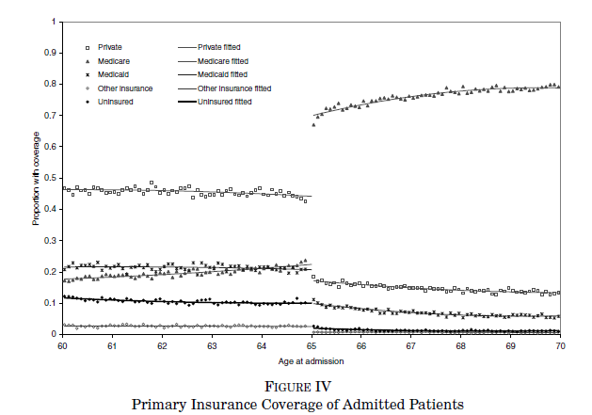

Slide 58
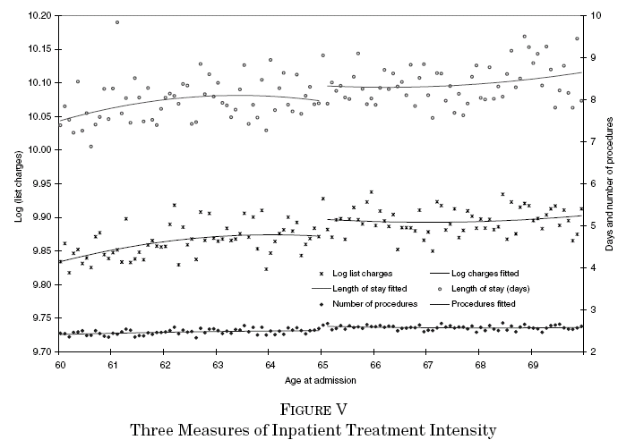

Slide 59
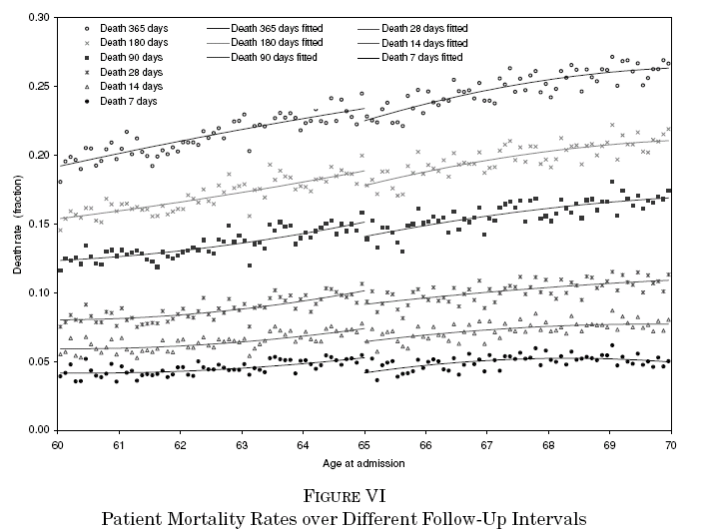

Slide 60
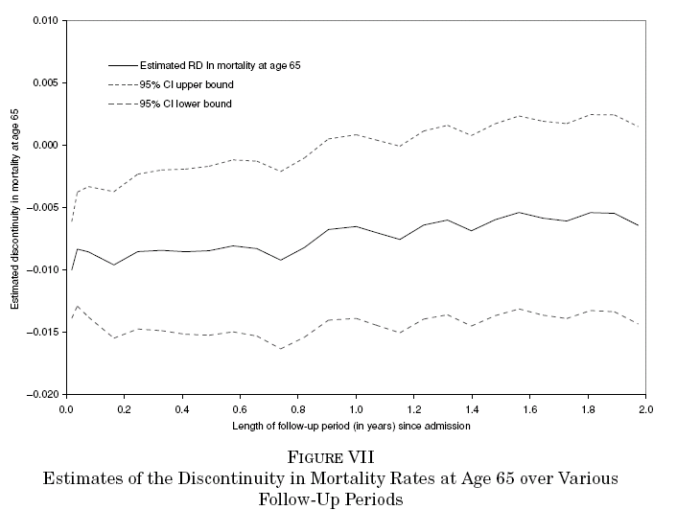

Slide 61
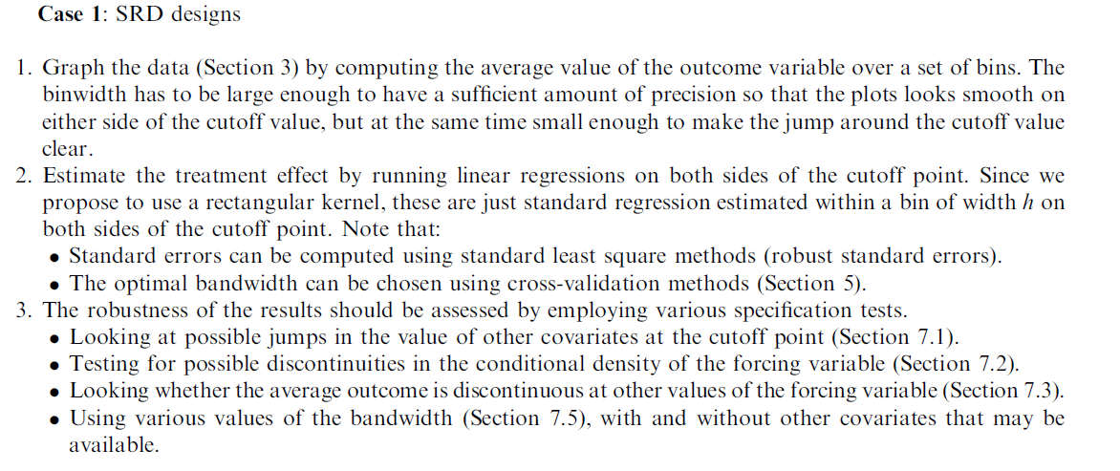

Slide 62
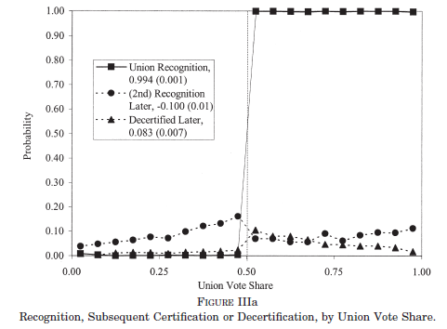
Dinardo and Lee, QJE

Slide 63
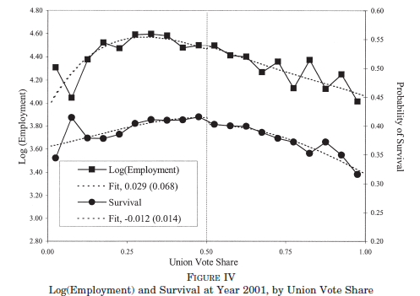

Slide 64
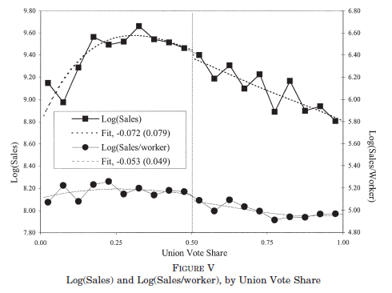

Slide 65


Slide 66

Urquiola and Verhoogen, AER 2009

Slide 67


Slide 68


Slide 69

Camacho and Conover, forthcoming AEJ: Policy

Slide 70


