Slide 1
Sample Selection Example
Bill Evans

Slide 2
Draw 10,000 obs at random
educ uniform over [0,16]
age uniform over [18,64]
wearnl=4.49 + 0.08*educ + 0.012*age + ε
Generate missing data for wearnl

Slide 3
drawn from standard normal [0,1]
d*=-1.5+0.15*educ+0.01*age+0.15*z+v
wearnl missing if d*≤0
wearn reported if d*>0
wearnl_all=wearnl with non-missing obs.

Slide 4
ε_{i} and v_{i} are assumed to be bivariate normal
E(ε_{i}) = E(v_{i}) =0
Var(ε_{i}) = σ²
Var(v_{i}) = 1
Corr(ε_{i},v_{i}) = ρ
Cov(ε_{i},v_{i}) = ρ σ
In this case, ρ=0.25 and σ=0.46

Slide 5
Y_{i} = β₀ + β₁educ_{i} + β₂age_{i} + ε_{i}
E[Y_{i} | SSR] = β₀ + β₁educ_{i} + β₂age_{i} +
E[ε_{i} | SSR]
E[ε_{i} | SSR] = E[ε_{i} | v_{i}>-w_{i}γ]
  = ρ σ φ(w_{i}γ)/Φ(w_{i}γ)

Slide 6
λ_{i} = φ(w_{i}γ)/Φ(w_{i}γ)
w_{i}γ = γ₀+educ γ₁+age γ₂+z γ₃
γ₂ and γ₃ are both constructed to be positive
cov(educ, λ_{i}) < 0 and
cov(age, λ_{i}) < 0

Slide 7
The omitted variable λ_{i} is negatively correlated with what is observed in the model
Therefore, the coefficients on educ and age in the selected sample will be too low

Slide 8
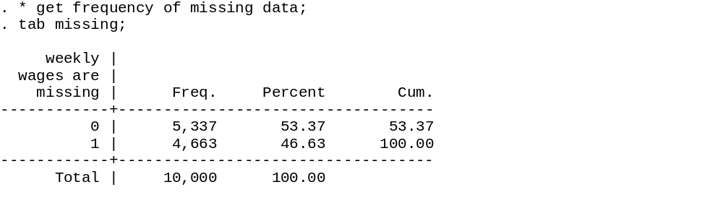
Numbe rof non-missing
observations

Slide 9
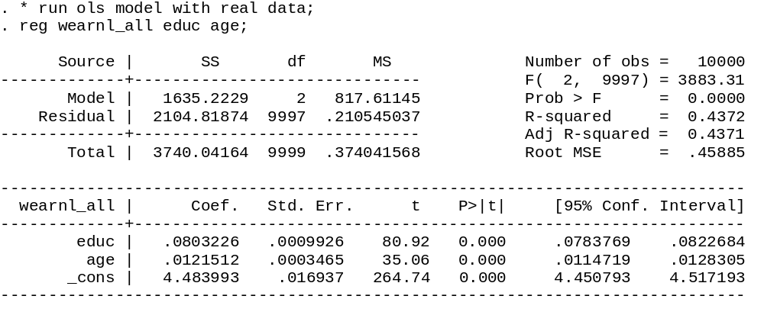
OLS on all data (no missing obs)
Generated by the equation
wearnl=4.49 + 0.08*educ + 0.012*age + ε

Slide 10
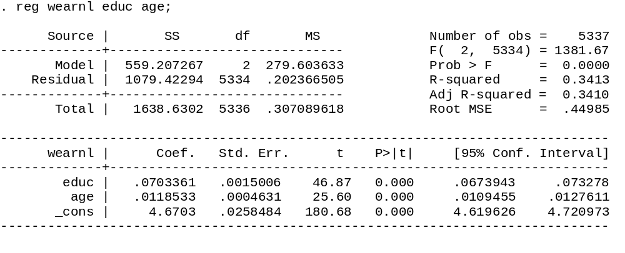
OLS on reported data
Smaller MSE
Notice that the estimates for educ and age are now smaller

Slide 11
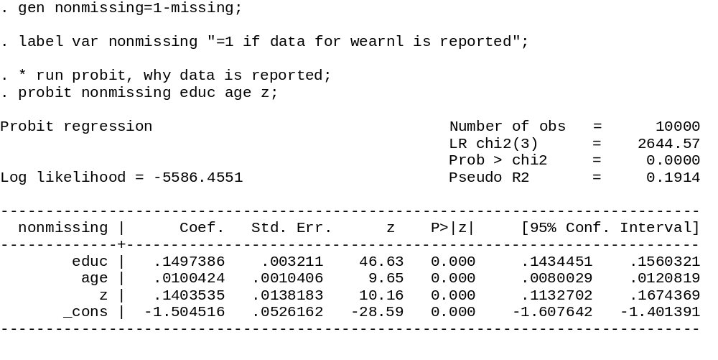
Probit, why is data non-missing
Generated by the equation
d*=-1.5+0.15*educ+0.01*age+0.15*z+v

Slide 12
Syntax for Heckman model in STATA
. heckman wearnl educ age, select(educ age z);
Equation of interest
Variables
in selection
equation

Slide 13
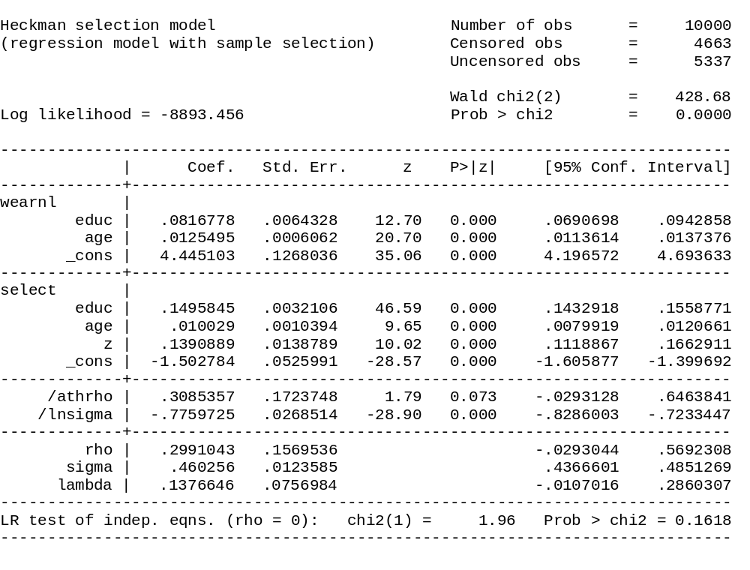
Notice β’s have increased over OLS w/ missing data
Sigma right on
Rho is a little off
Cannot reject null
Rho=0

Slide 14
Comparison of Estimates
Covariate | OLS w/ All data | OLS w/ Selected sample | MLE of Heckman SS model
Educ | 0.0803 (0.0010) | 0.0703 (0.0015) | 0.0817 (0.0064)
Age | 0.0122 (0.0035) | 0.0119 (0.0046) | 0.0125 (0.0006)
Constant | 4.484 (0.169) | 4.670 (0.258) | 4.445 (0.127)

Slide 15
Comparison of Estimates
Covariate | OLS w/ All data | OLS w/ Selected sample | MLE of Heckman SS model
Educ | 0.0803 | 0.0703 [-12.5%] | 0.0817 [1.7%]
Age | 0.0122 | 0.0119 [-2.5%] | 0.0125 [2.5%]
[% difference from OLS w/ all data]

Slide 16
* run heckman sample selection correction;
. * but use functional form to identify the model;
. heckman wearnl educ age, select(educ age);

Slide 17
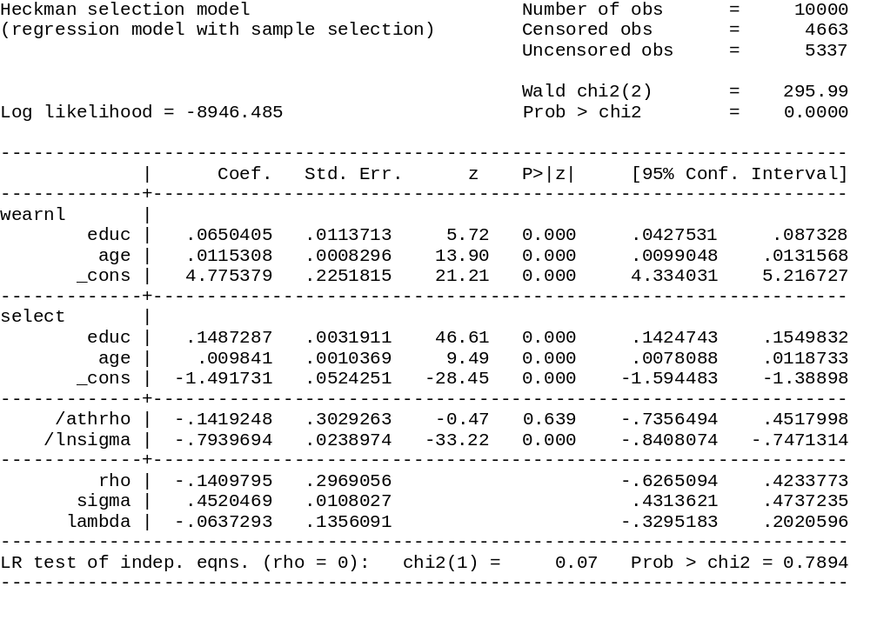
No where close on rho

Slide 18
Comparison of Estimates
Covariate | OLS w/ All data | OLS w/ Selected sample | MLE of Heckman SS model Function form Ident.
Educ | 0.0803 | 0.0703 [-12.5%] | 0.065 [-19.2%]
Age | 0.0122 | 0.0119 [-2.5%] | 0.0115 [-5.7%]
[% difference from OLS w/ all data]

Slide 19
