Slide 1
Signaling

Slide 2
Overview
Private Information in Sequential Games
Adverse Selection
Signaling

Slide 3
Private Information in Sequential Games
Recall that in auctions:
  All bidders privately informed
  Bid simultaneously
  So this was a simultaneous game with private information
In the next two classes, we study the role of private information in sequential games

Slide 4
Signaling and Screening
Basic Situation
  One informed party bargains with an uninformed party
  Two possible sequences of moves:
    Informed goes first, followed by uninformed
      Signaling
    Uninformed moves first, followed by informed
      Screening

Slide 5
Signaling
This lecture centers on the signaling case
By moving first, the informed player’s move can disclose some, none, or all of his private information.
We’ll separate these three types of disclosures into:
  Separating equilibrium: Full information disclosure
  Pooling equilibrium: No information disclosure
  Hybrid equilibrium: Some information disclosure

Slide 6
New Solution Concept
Perfect Bayesian Equilibrium
Same as Bayes-Nash equilibrium except:
  Parties need to act optimally given their beliefs
  Even off the equilibrium path.
Analogous to subgame perfect equilibrium under complete information

Slide 7
Adverse Selection
The key issue in all this is adverse selection
The idea is that because information is private, the uninformed party will end up trading with the wrong “type” of informed party.
We’ll see how informed parties can distinguish their types by signaling in this lecture
We’ll show how uninformed types can separate informed types by cleverly structuring contracts (called screening) in the next lecture.

Slide 8
Signaling Examples
Entry deterrence:
  Incumbent tries to signal its resolve to fight to deter entrants
Credence Goods:
  Used car warranties
Animal Life
  Peacock’s tail

Slide 9
A Classic Example of Adverse Selection
Berkeley is trying to hire new junior faculty.
There are two types of junior faculty: “budding stars” and “overachieving hacks”
Obviously, Berkeley would like to recruit the stars and avoid the hacks, but it’s impossible to tell them apart.
Of course, the potential hire knows whether he is a star or a hack.

Slide 10
Why not Just Ask?
Berkeley could ask each person whether he is a hack or a star.
But everyone says that they are stars (and that the other guys are all hacks for good measure!)
So Berkeley has to choose some sort of compensation package to separate the stars from the hacks.

Slide 11
Outside Options
Suppose that each type can pursue a consulting career and earn r_{s} if they are a star, and r_{h} if they’re a hack.
Suppose r_{s} > r_{h.}
Suppose that they’re productivity in academia is s > h respectively.
Academic services receive compensation in the form of alumni donations at a “price” of 1.

Slide 12
Berkeley’s Profits
Thus, if Berkeley hires a type i faculty at a wage w, they make: U = i – w
Unfortunately, there is stiff competition from Harvard, Yale and MIT that drives the wages up to zero expected profits.
Some additional structure:0 < r_{i} < i, and r_{s} > E(i)
So what should Berkeley do?

Slide 13
Wage Setting
Berkeley could offer a wage, w* = r_{s} in hopes of attracting the stars.
But the hacks will show up too. Berkeley will make: U = E(i) - w* which is a losing proposition.
So catching the rising stars seems pretty tough.

Slide 14
The Lemons Problem
This leave Berkeley with only the option of hiring the hacks at a wage w=h.
Likewise for Harvard and the rest of the boys.
The result: Those who can do, those who can’t teach.

Slide 15
First-best
Suppose that talent was observable, then society would be best off with both types in the halls of academe.
But private information leads to an equilibrium where only the hacks are in the ivory tower.
This is precisely the situation in bidding for Paramount.

Slide 16
No Problem
If r_{s} < E(i), then the private information causes no trouble, and we hire both types at a wage of E(i). In particular, suppose r_{i} = 0.
But this is small consolation for the stars, whose marginal product is h but whose wage is lower.
What’s going on?

Slide 17
Cross Subsidization
When the types are pooled as a result of the private information, the stars end up cross-subsidizing the hacks.
This is a great deal for the hacks (even better than when the stars became consultants.)
Is there a fix for this? Is it even bad?

Slide 18
Star-struck?
The stars come up with a plan: they know that education, while being completely worthless, take less effort for the stars than the hacks.
Specifically, it costs the stars 1/s per unit of education attained, whereas for the hacks it costs 1/h.
What if we start getting advanced degrees say the stars.

Slide 19
Signaling
In an attempt to get what they’re worth, the stars start getting educated. But how much education to get?
Suppose that the completion of e units of education results in a wage of w(e), which is increasing in e.
Remember: Stars want to distinguish themselves from hacks.

Slide 20
Separation
For the hacks not to imitate requires a level of education e* such that
w(e*) - (1/h) •e* < w(0)
Moreover, competition results in w(e*) =s & w(0) = h, so
s - (1/h) •e* <h
And since education is a pure waste, choose e* such that this holds with equality.

Slide 21
Separating Equilibrium
Let h(s - h) = e*
Then both types are employed for their marginal wages.
But we’re not at first-best -- we’ve wasted money on education.
Moreover, hacks are worse off (lower wages)
And high types might also be worse off if they are numerous relative to the h’s

Slide 22
Information Costs
What happened was that the high guys had to “burn money” for their claims to be high types to be credible.
This resulted in their being paid a fair wage, but may not have netted them anything after money burning.
Crucial to the money burning story was the presence of an action that was less costly for the stars than the hacks.

Slide 23
Graphically
e
P_{h}
The equilibrium wage
leaves the hacks indifferent
between pretending to be
stars and dropping out.
P_{s}
The stars have flatter payoff curves!
e*
h
W
s

Slide 24
Recap
With differential costs (the single-crossing property) signaling can generate separation among the types.
But this is not necessarily a good thing relative to pooling
In fact, it can be worse for all than pooling.
Signaling can lead to a type of “arms race.”

Slide 25
Signaling Toughness
The beer & quiche model
An incumbent monopolist can be either tough or a wimp (not tough).
An incumbent monopolist receives 4 if the entrant stays out and 2 if the entrant enters.
An entrant earns 2 if it enters against a wimp incumbent, loses 1 if it enters against a tough incumbent, & gets 0 if it stays out.

Slide 26
Beer & Quiche
Prior to the entrant’s decision to enter or stay out, the incumbent gets to choose its “breakfast.” Specifically, the incumbent can have beer for breakfast or quiche for breakfast. Breakfasts are consumed in public.
A beer breakfast is less desirable than a quiche breakfast.
But costs differ according to type: a beer breakfast costs a tough incumbent 1, but a wimp incumbent 3.

Slide 27
Beer & Quiche
enter
enter
1,-1
Incumbent
2,-1
beer
quiche
3,0
4,0
out
tough
[½]
out
Entrant
Nature
Entrant
enter
wimp
[½]
enter
-1,2
2,2
beer
quiche
1,0
Incumbent
4,0
out
out

Slide 28
Beer & Quiche
Equilibrium: Tough incumbent drinks beer; wimp incumbent eats quiche; entrant stays out against beer drinkers; and entrant enters against quiche eaters.
What are beer & quiche?

Slide 29
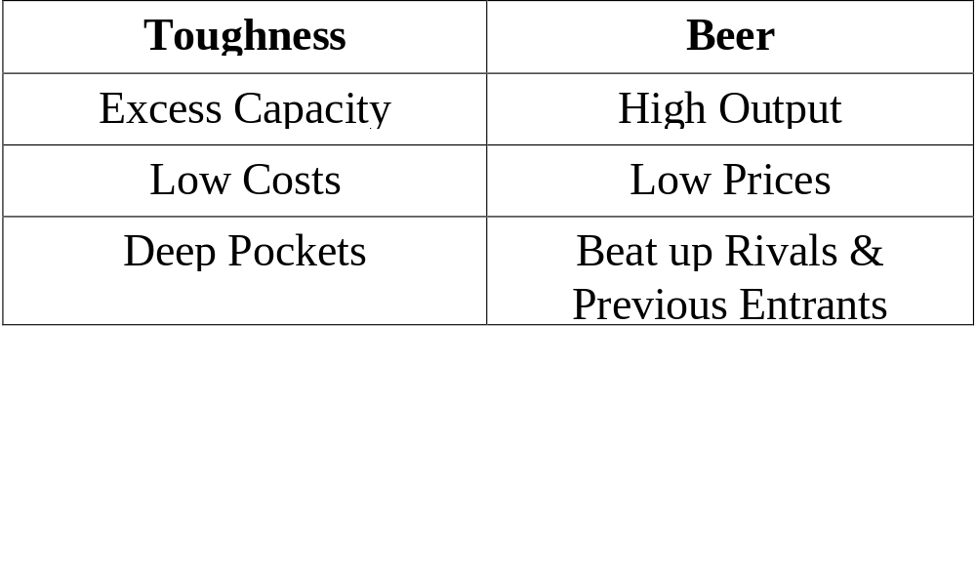
Beer & Quiche

Slide 30
Other Applications
Settlements in court cases
  Suppose the plaintiff knows the expected damages of the case with greater precision than the defendant
  Then the settlement offer of the plaintiff can “signal” the strength of the case
  Effective signaling can avoid costly court battles

