Slide 1
GDELT Projecct THE Price Of Gold analysis with GDELT Running On GCP

Slide 2
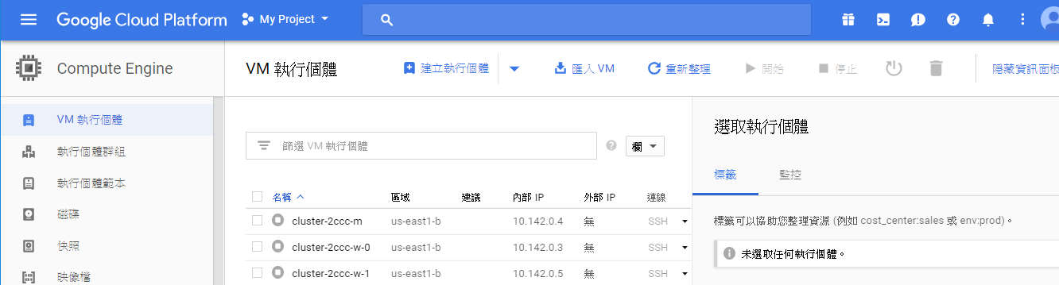
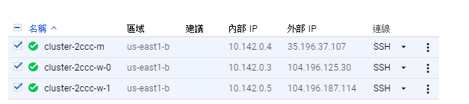
Environment Setup : GCP VM

Slide 3
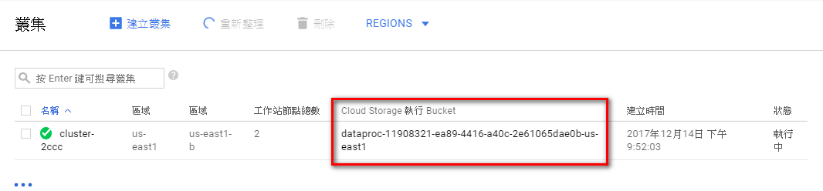
GCP Bucket

Slide 4
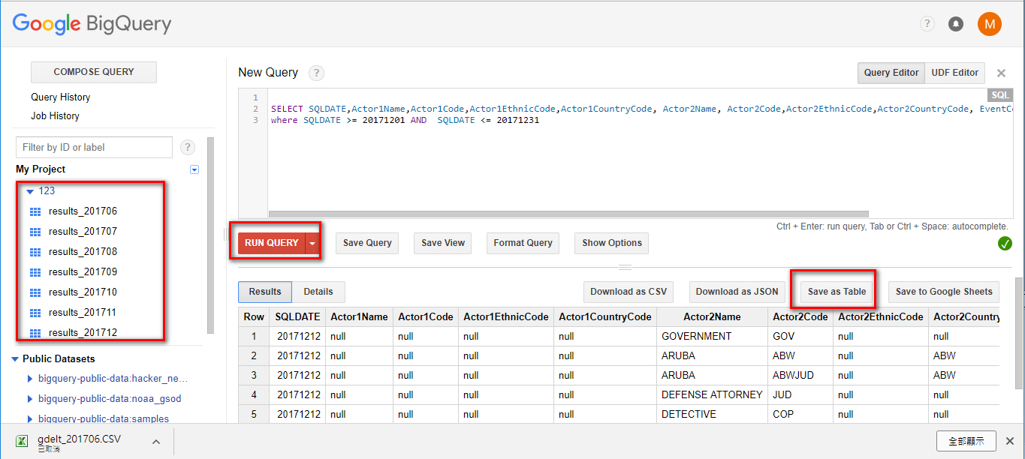
Where’s the DataFrom??? GDELT with BigQuery

Slide 5
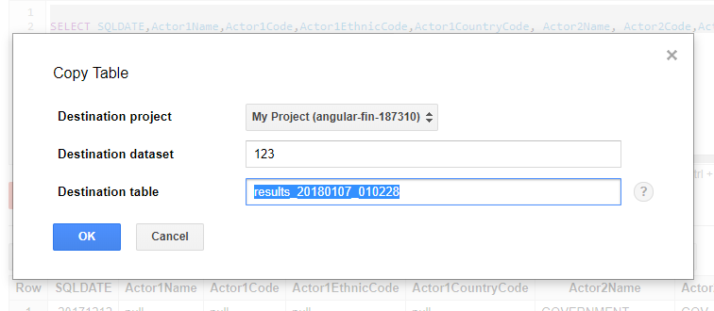
Saveing QueryResult to Bucket

Slide 6
Saveing QueryResult to Bucket

Slide 7
GraphFrame Enviroment SetUp
wget http://dl.bintray.com/spark-packages/maven/graphframes/graphframes/0.2.0-spark2.0-s_2.11/graphframes-0.2.0-spark2.0-s_2.11.jar jar xf graphframes-0.2.0-spark2.0-s_2.11.jar cd graphframes zip graphframes.zip -r * cp graphframes.zip /home/yuhau277/ sudo vi /etc/spark/conf/spark-env.sh export PYTHONPATH=$PYTHONPATH:/home/yuhau277/graphframes.zip:.

Slide 8
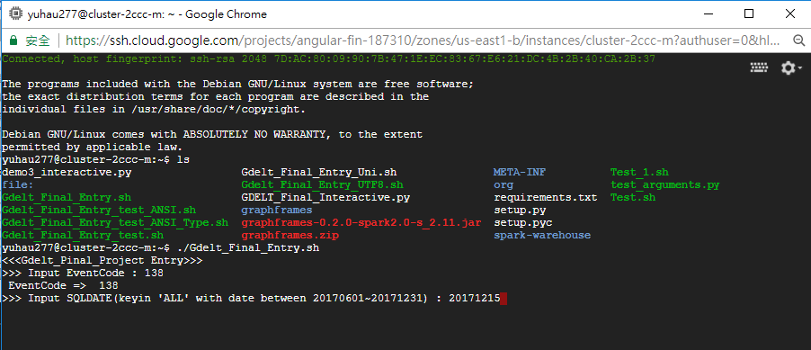
GDELT Project
Entry Point with Shell Script
Argument(EventCode,SQLDATE)

Slide 9
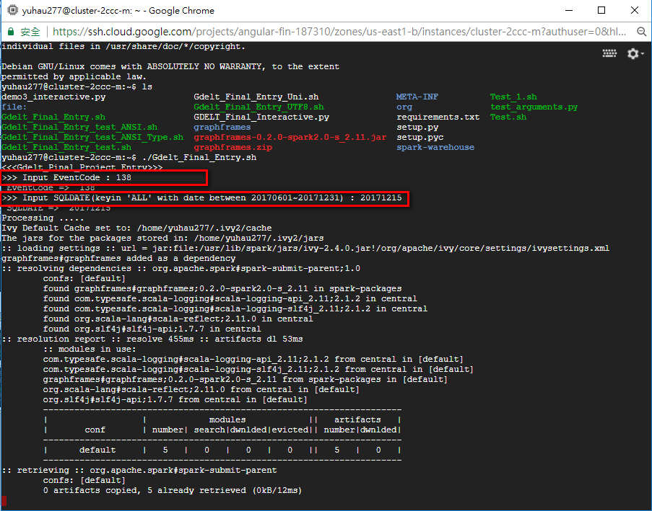
Running SPARK-SUBMIT by ShellScript

Slide 10
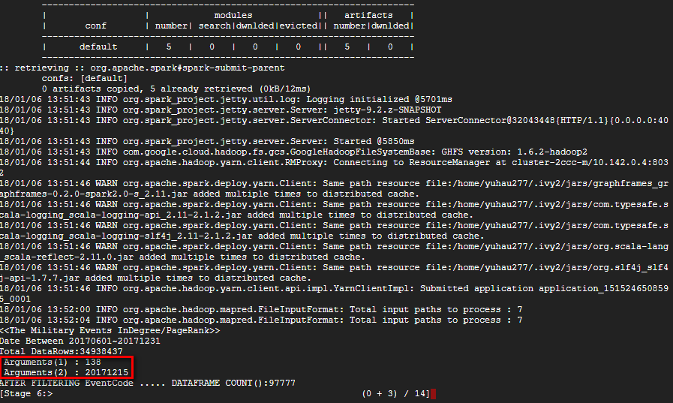
Running SPARK-SUBMIT by ShellScript

Slide 11
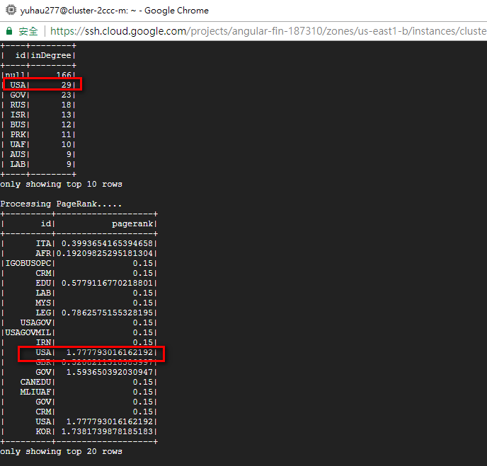
Indegree/outdegree/pagerank

Slide 12
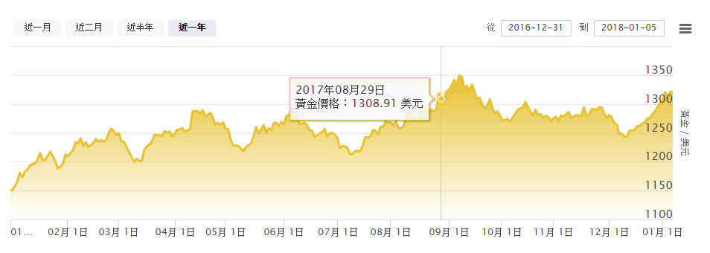
THE Price Of Gold analysis with GDELT (EventCode:138)
TOP：1346.3 DATE：2017/9/8
LOW：1211.1 DATE：2017/7/11 AVG：1277.1

Slide 13
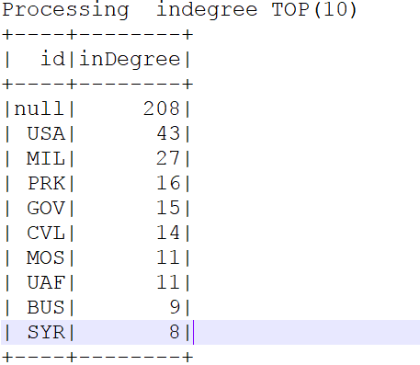
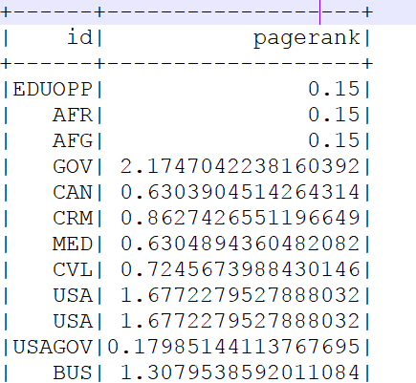
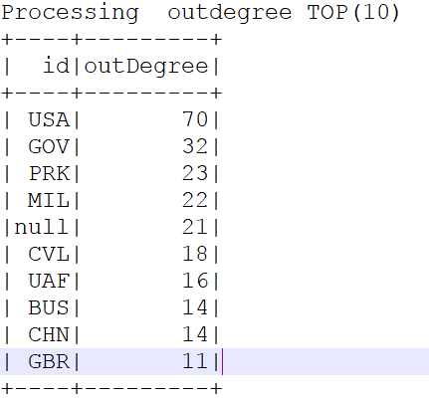
THE Price Of Gold analysis with GDELT (EventCode:138 SQLDATE:20170908)

Slide 14
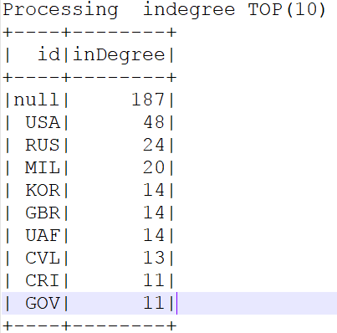
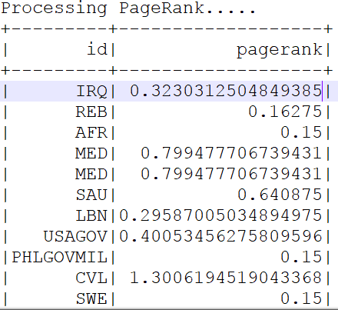
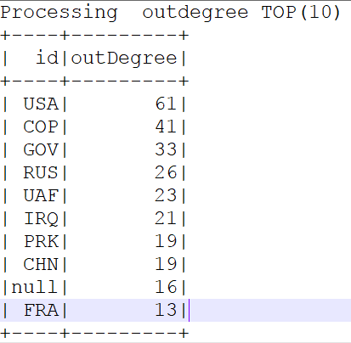
THE Price Of Gold analysis with GDELT (EventCode:138 SQLDATE:20170711)

Slide 15
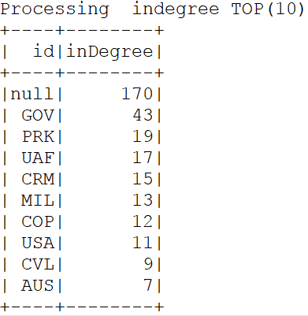
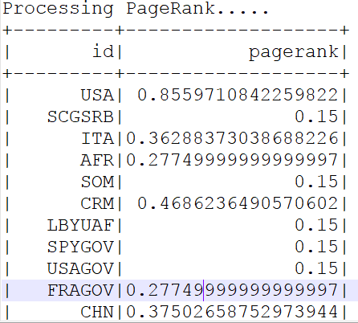
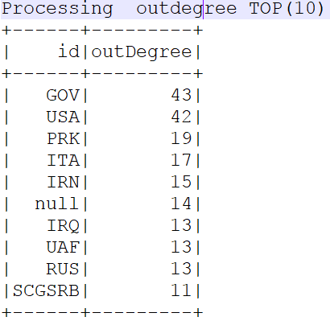
THE Price Of Gold analysis with GDELT (EventCode:138 SQLDATE:20171030)

