Slide 2
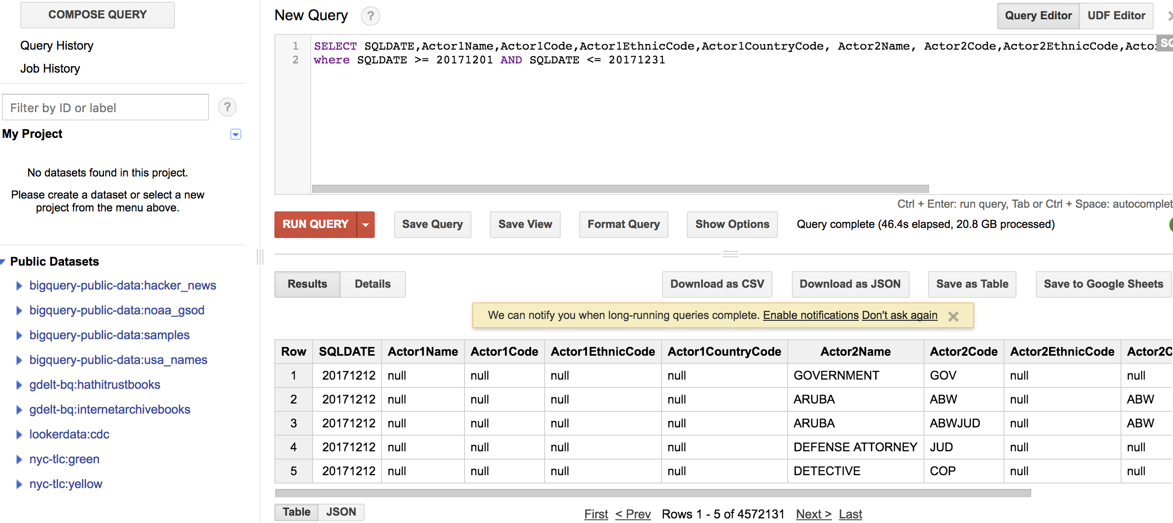
GDELT big query
SELECT SQLDATE,Actor1Name,Actor1Code,Actor1EthnicCode,Actor1CountryCode, Actor2Name, Actor2Code,Actor2EthnicCode,Actor2CountryCode, EventCode, FROM [gdelt-bq:full.events] where SQLDATE >= 20171201 AND SQLDATE <= 20171231
https://blog.gdeltproject.org/google-bigquery-gkg-2-0-sample-queries/

Slide 3
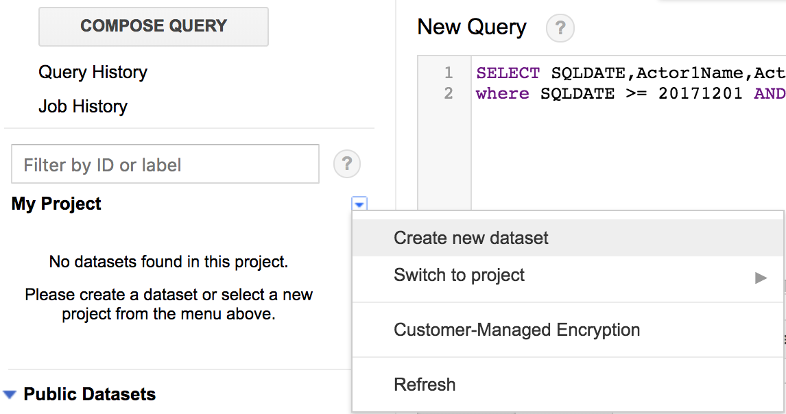
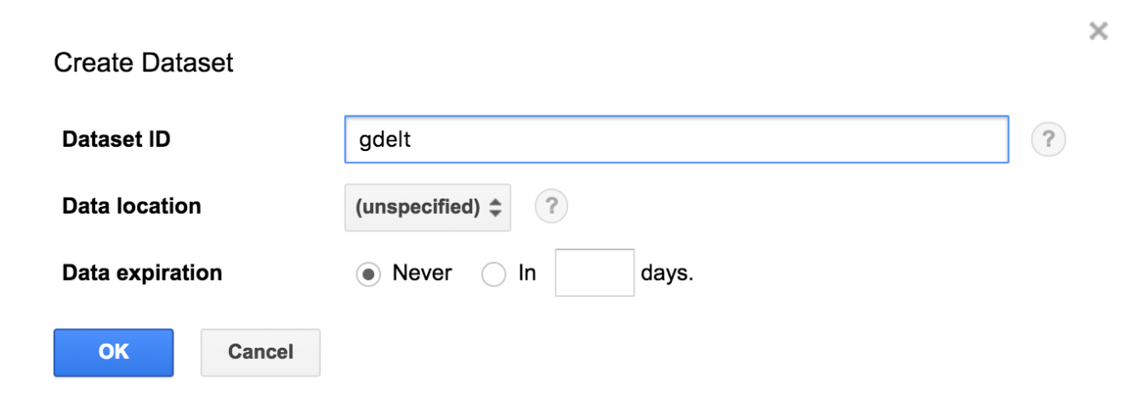
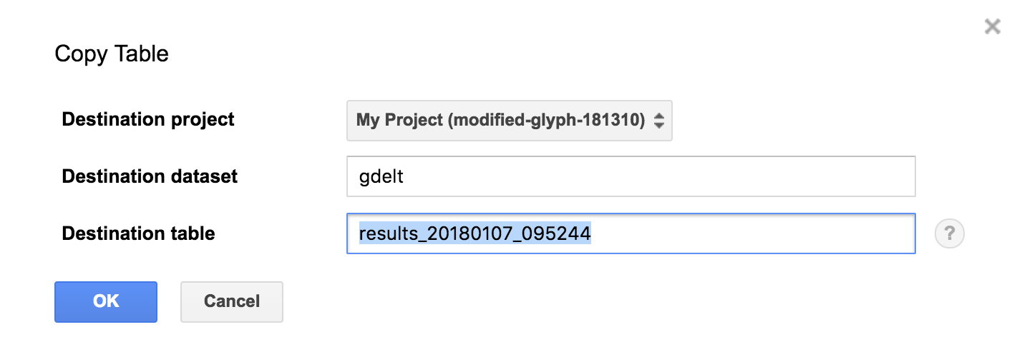
GDELT big query

Slide 4
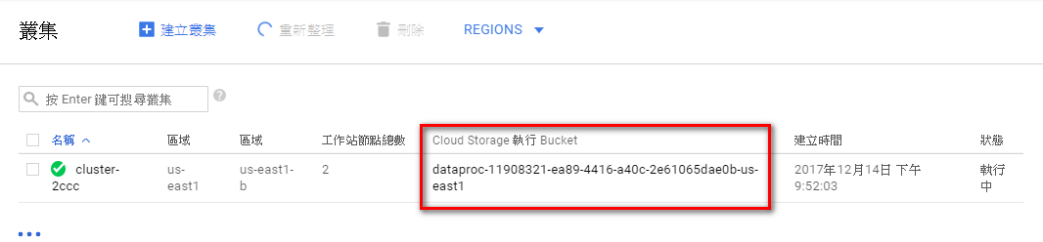
GCP Bucket

Slide 5
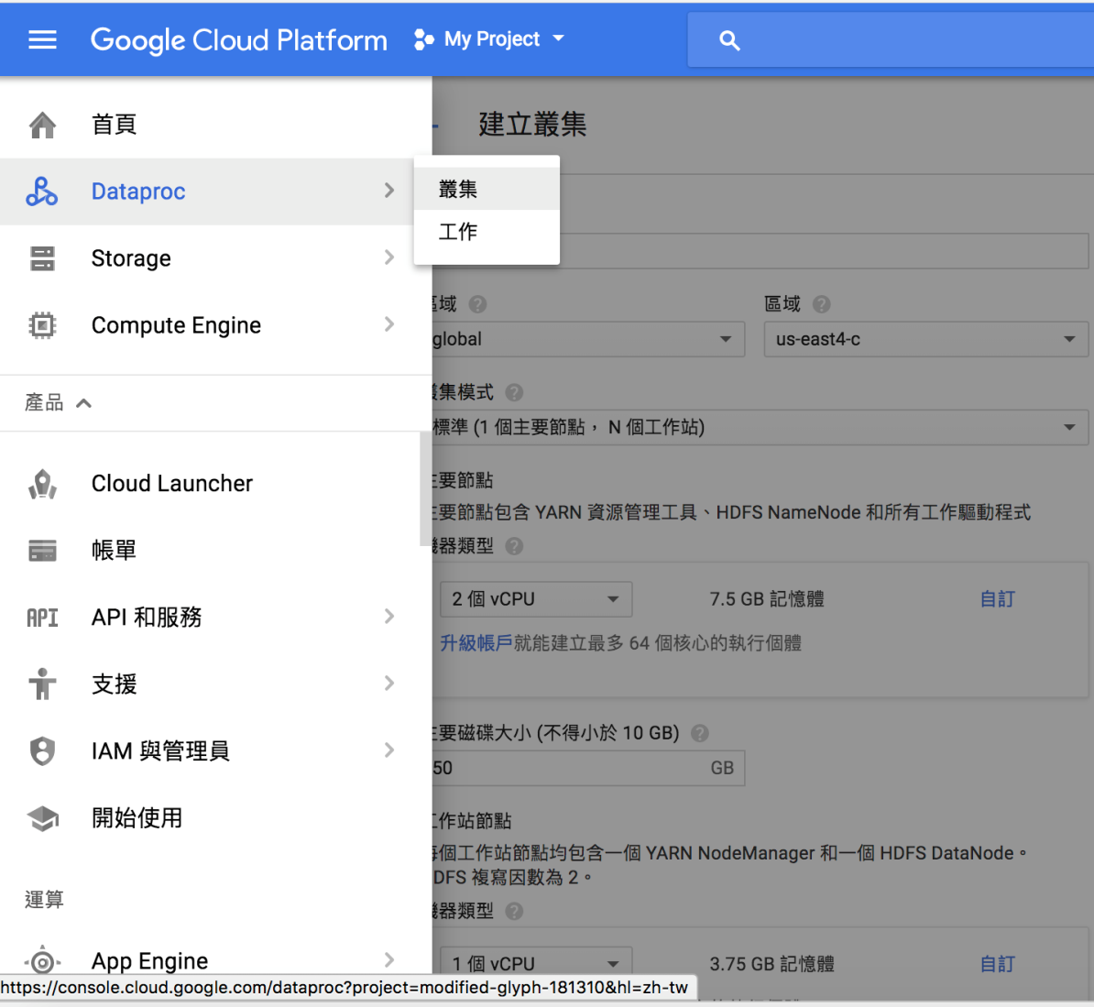
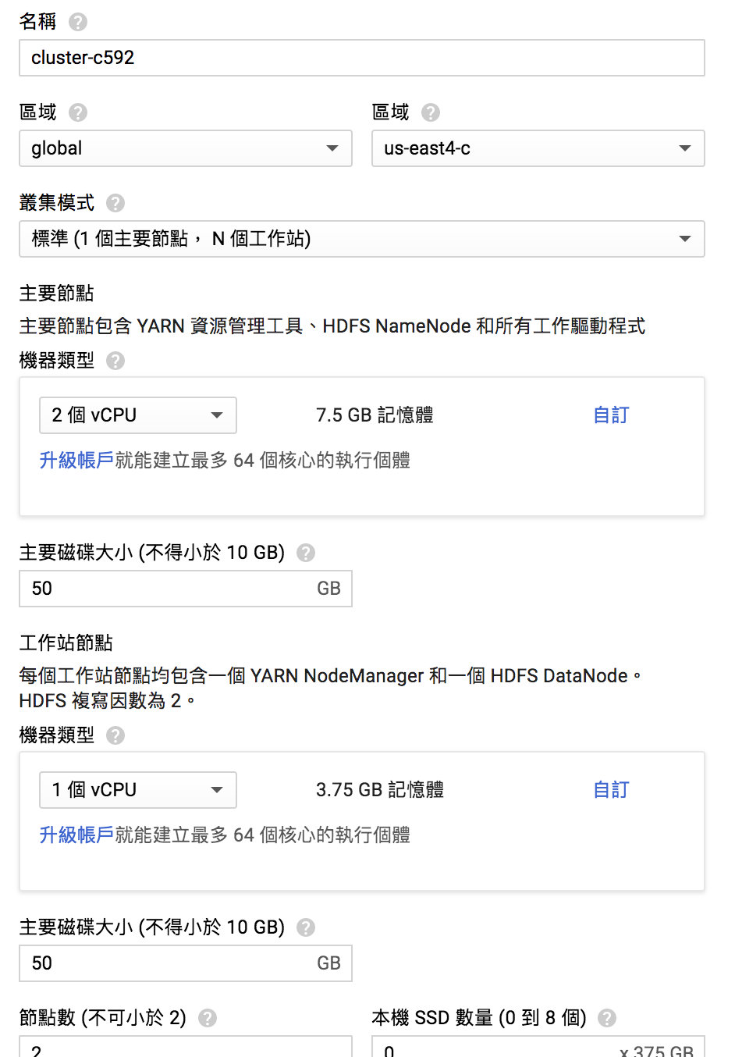
GCP Dataproc

Slide 6
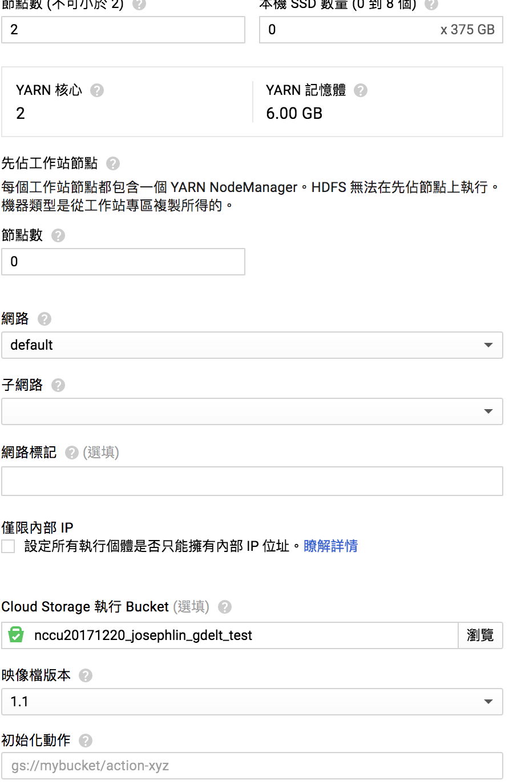
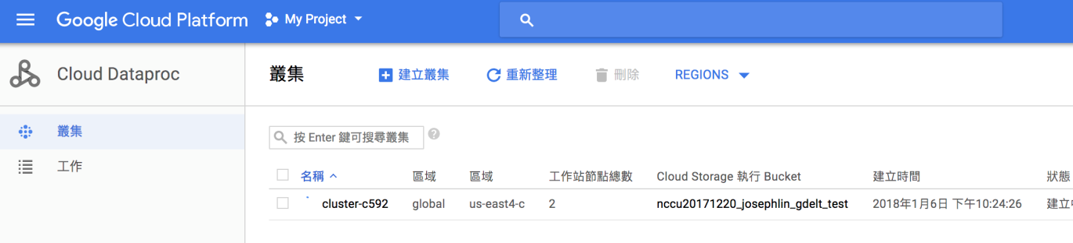
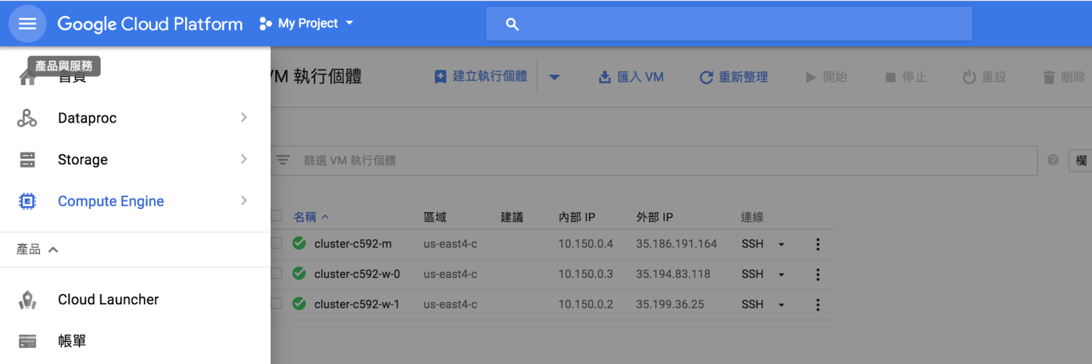
GCP Dataproc

Slide 7
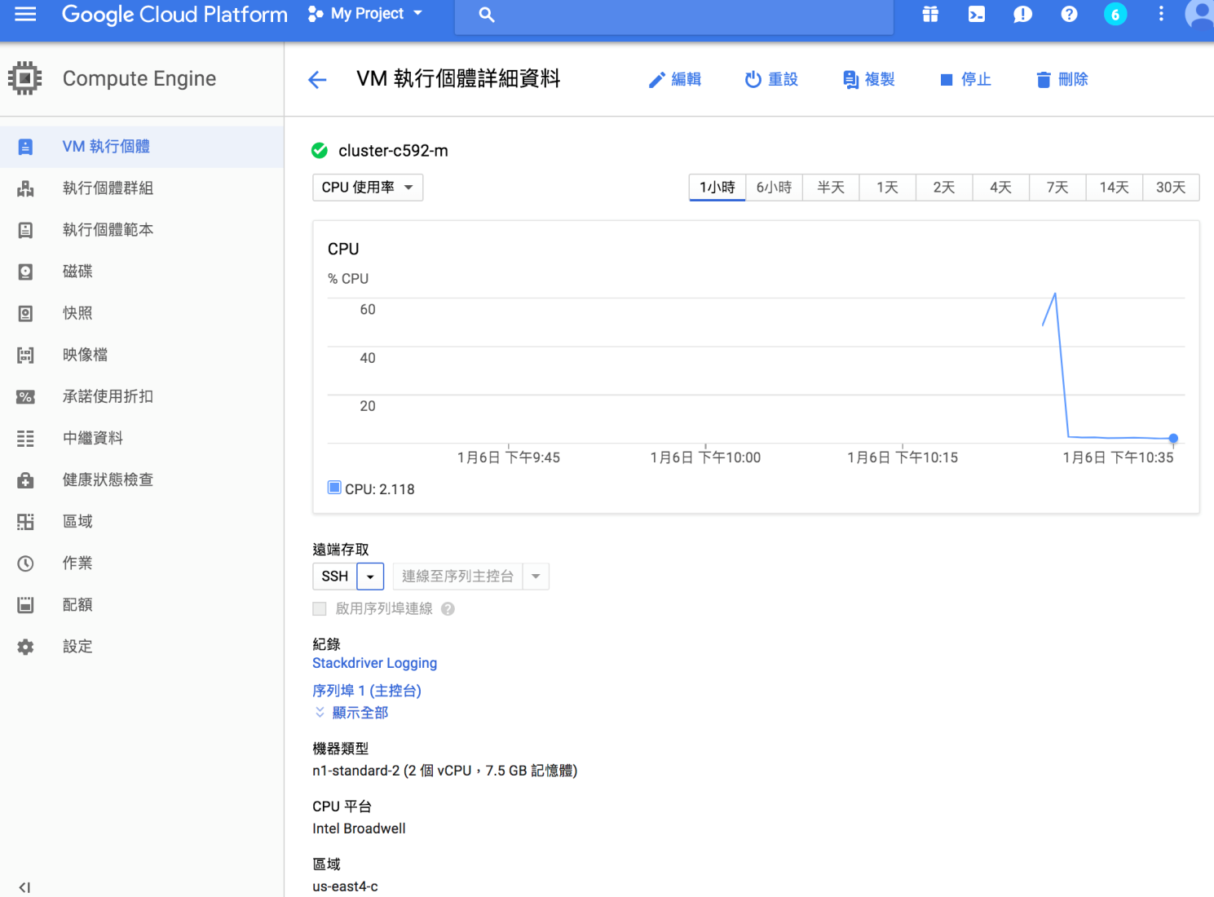
SSH to cluster-master

Slide 8
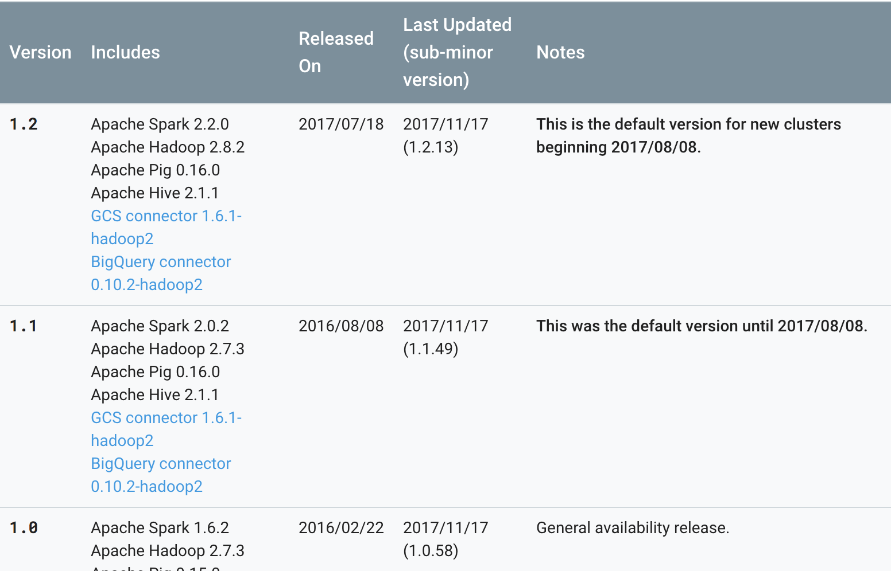
GCP dataproc version
https://cloud.google.com/dataproc/docs/concepts/versioning/dataproc-versions
Graphframe supported

Slide 9
Deploy graphframe
wget http://dl.bintray.com/spark-packages/maven/graphframes/graphframes/0.2.0-spark2.0-s_2.11/graphframes-0.2.0-spark2.0-s_2.11.jar
jar xf graphframes-0.2.0-spark2.0-s_2.11.jar
cd graphframes
zip graphframes.zip -r *
cp graphframes.zip /home/[account]/
sudo vi /etc/spark/conf/spark-env.sh
export PYTHONPATH=$PYTHONPATH:/home/[account]/graphframes.zip:.

Slide 10
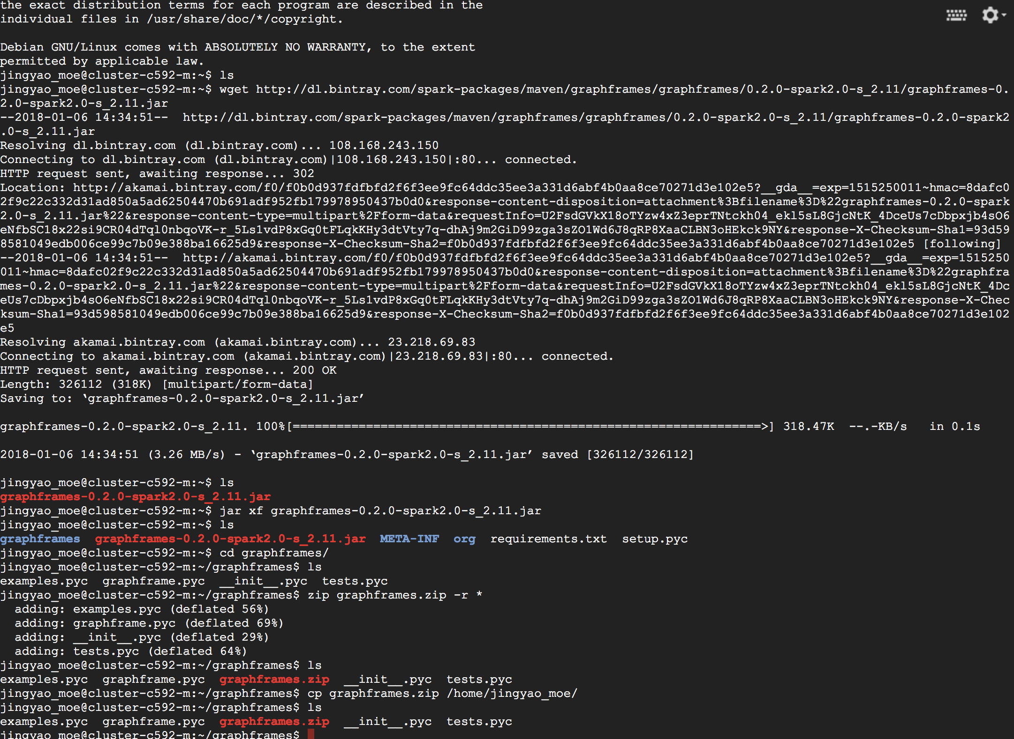
Deploy graphframe

Slide 11
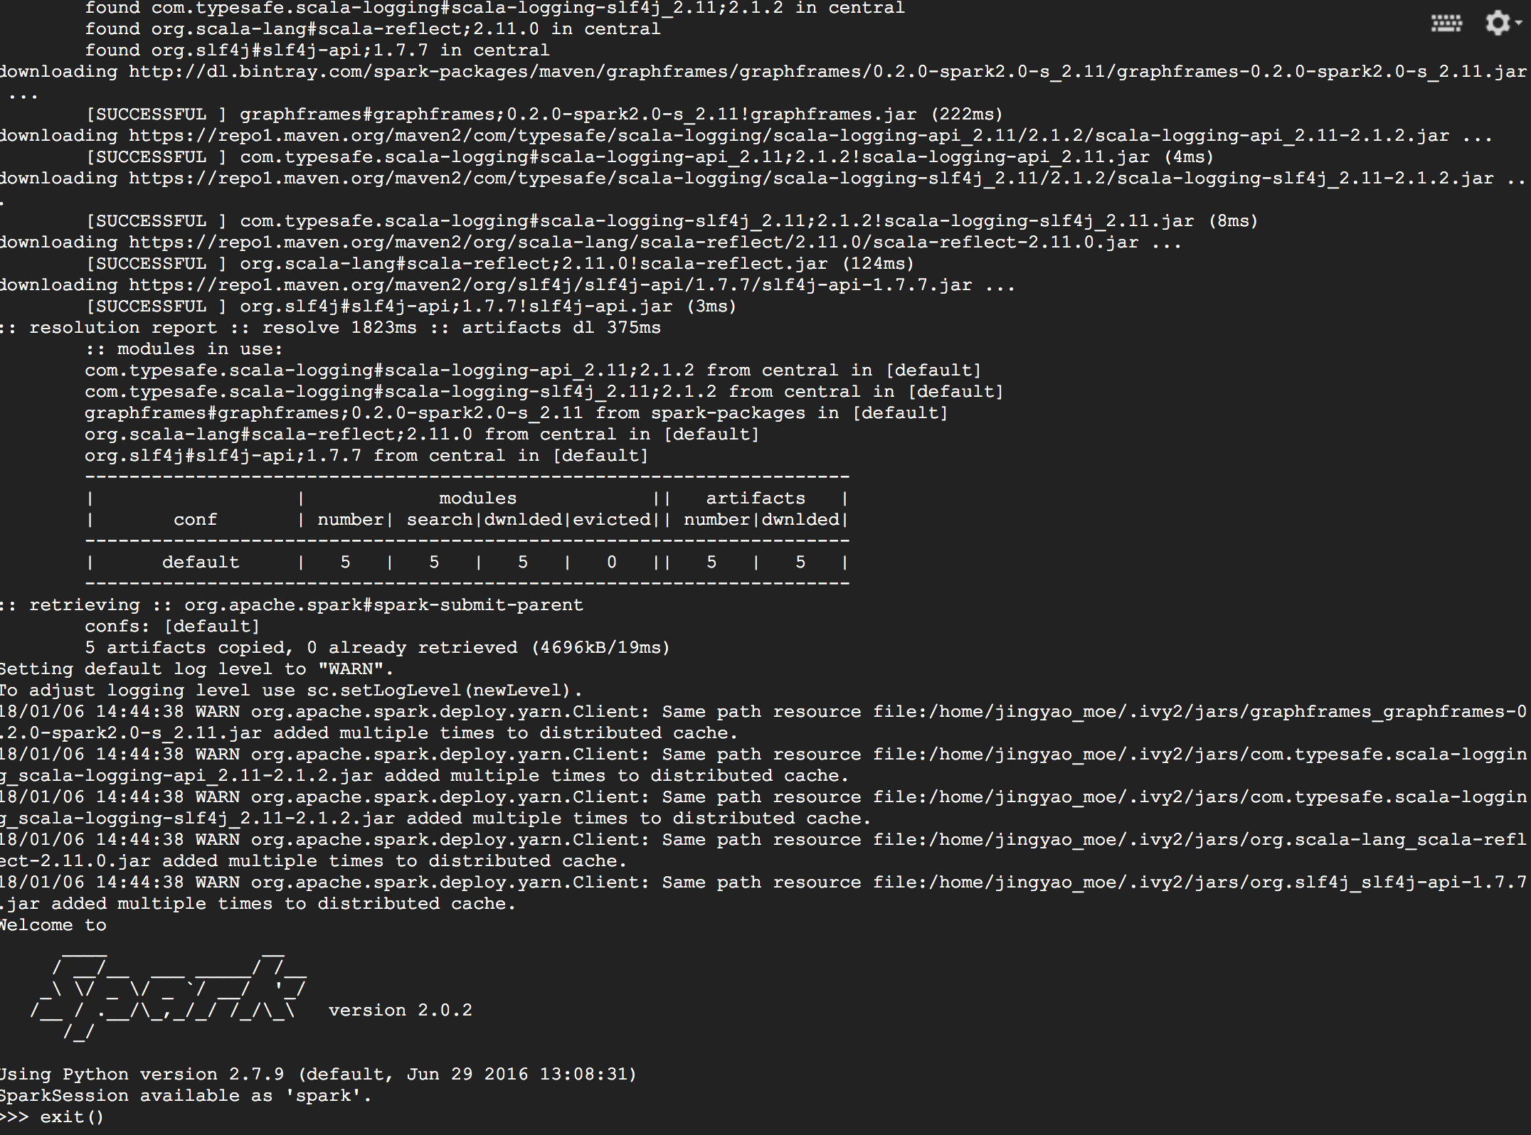
Deploy graphframe
pyspark --packages graphframes:graphframes:0.2.0-spark2.0-s_2.11

Slide 12
Copy program to cluster
gsutil cp gs://nccu20171220_josephlin_gdelt_test/GDELT_Final_Project.py ~
gsutil cp gs://nccu20171220_josephlin_gdelt_test/Gdelt_Final_Entry.sh ~

Slide 13
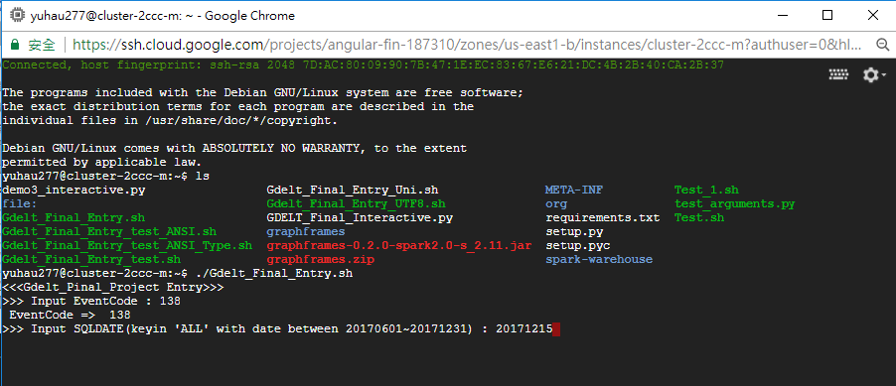
GDELT Project
Entry Point with Shell Script
Argument(EventCode,SQLDATE)

Slide 14
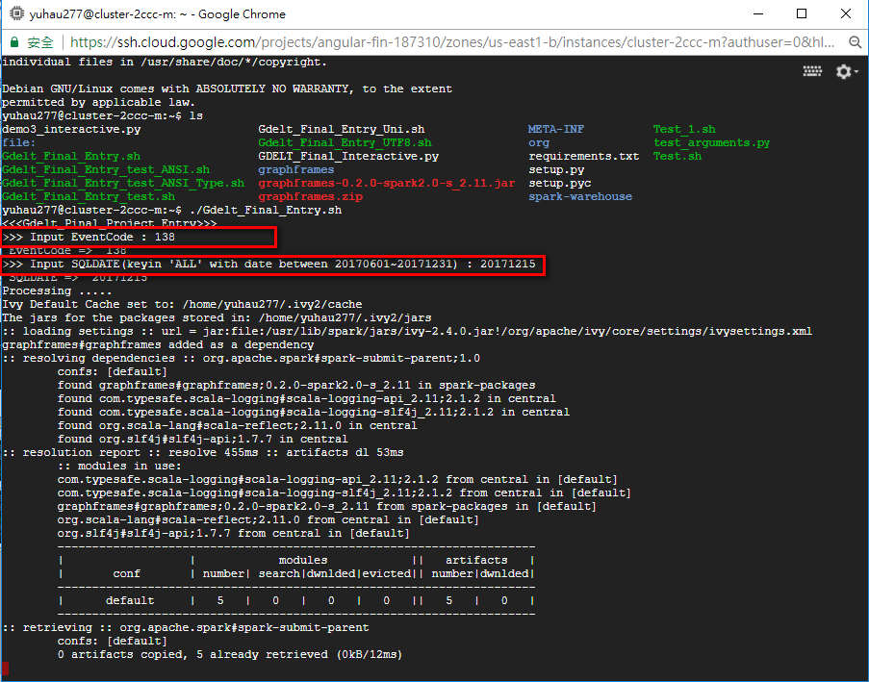
Running SPARK-SUBMIT by ShellScript

Slide 15
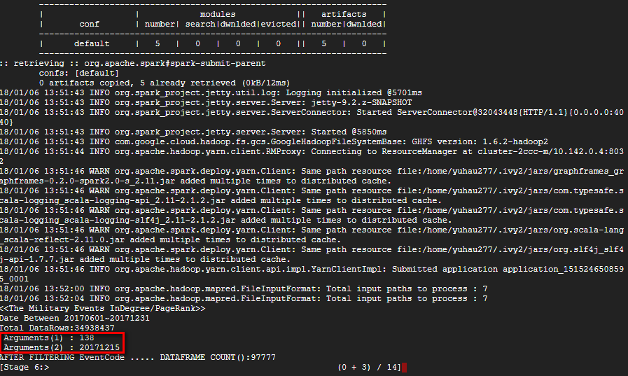
Running SPARK-SUBMIT by ShellScript

Slide 16
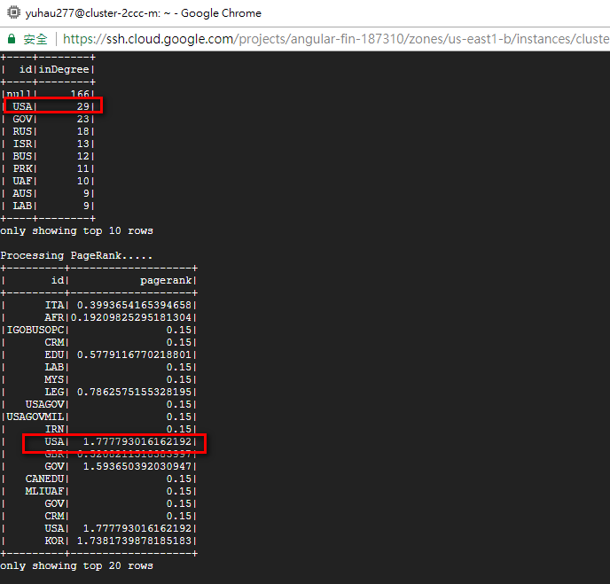
Indegree/outdegree/pagerank

Slide 17
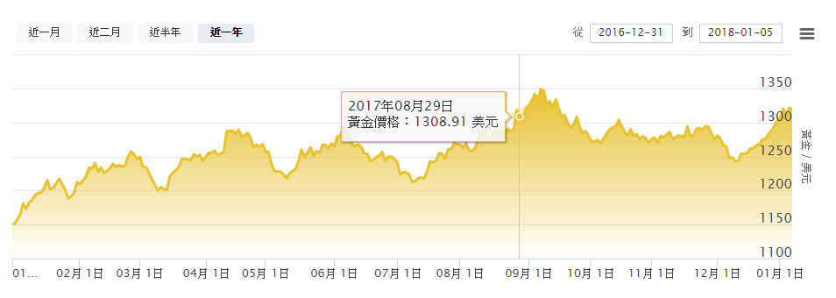
THE Price Of Gold analysis with GDELT (EventCode:138)
TOP：1346.3 DATE：2017/9/8
LOW：1211.1 DATE：2017/7/11 AVG：1277.1

Slide 18
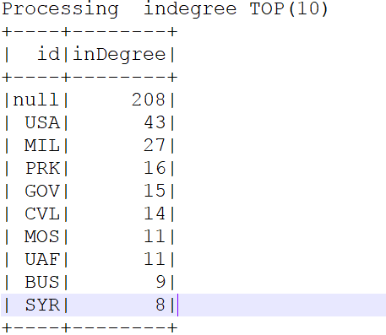
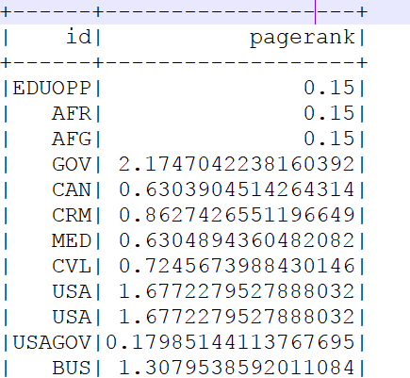
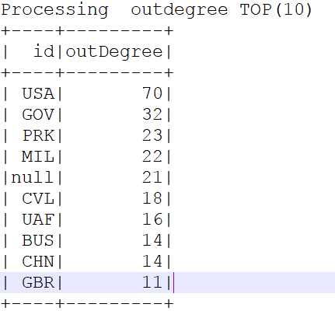
THE Price Of Gold analysis with GDELT (EventCode:138 SQLDATE:20170908)

Slide 19
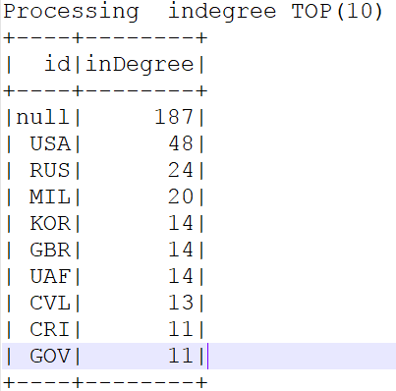
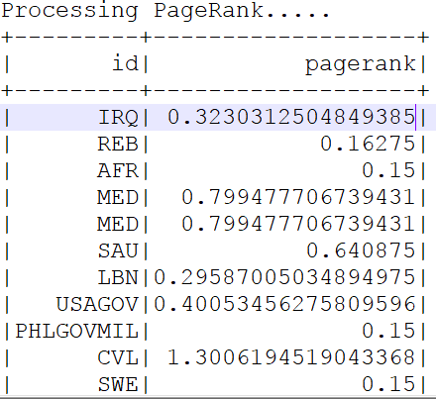
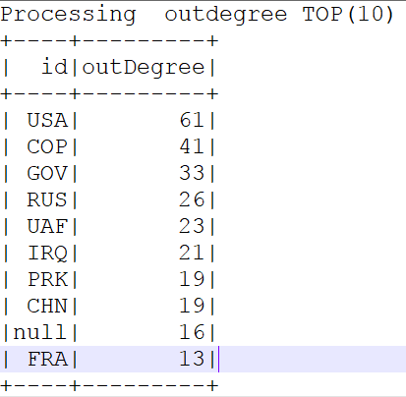
THE Price Of Gold analysis with GDELT (EventCode:138 SQLDATE:20170711)

Slide 20
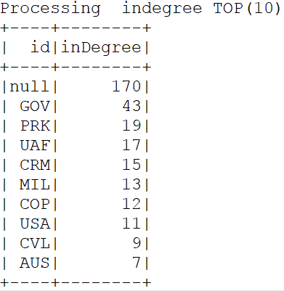
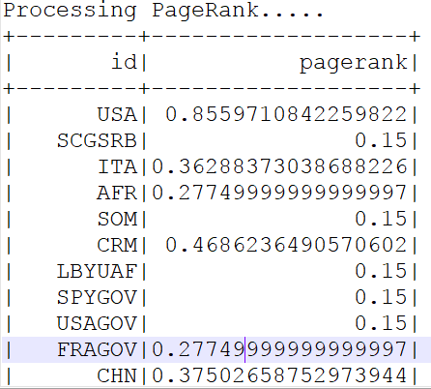
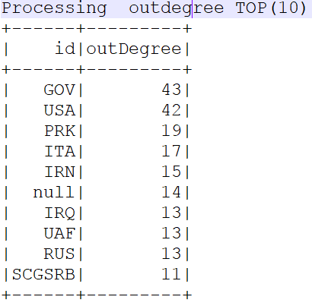
THE Price Of Gold analysis with GDELT (EventCode:138 SQLDATE:20171030)

Slide 21
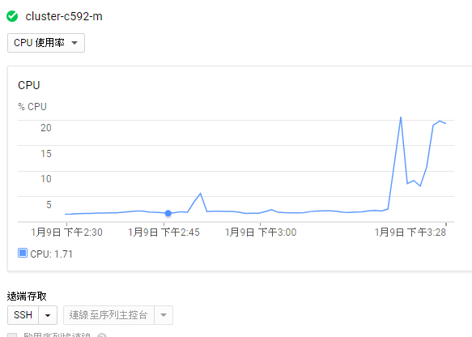
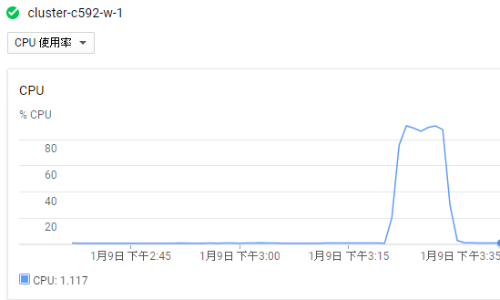
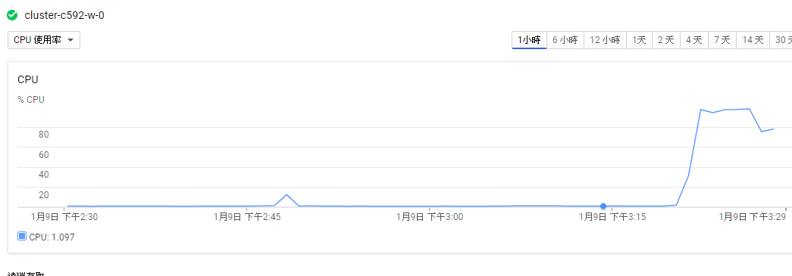
Proof of Clustering

Slide 22
附 件

Slide 23
.sh 設定參數並執行.py
#!/bin/bash
echo "<<<Gdelt_Pinal_Project Entry>>>"
read -e -p ">>> Input EventCode : " EventCode
echo " EventCode => " $EventCode
read -e -p ">>> Input SQLDATE(keyin 'ALL' with date between 20170601~20171231) : " SQLDATE
echo " SQLDATE => " $SQLDATE
echo "Processing ....."
spark-submit --packages graphframes:graphframes:0.2.0-spark2.0-s_2.11 GDELT_Final_Project.py $EventCode $SQLDATE

Slide 25
https://cloud.google.com/dataproc/docs/tutorials/bigquery-connector-spark-example

Slide 26
Spark cluster
http://blog.xuite.net/dain198/study/354588238-Apache+Spark+開發環境+安裝
https://spark.apache.org/docs/latest/spark-standalone.html

Slide 27
Pyspark + bigquery
https://cloud.google.com/dataproc/docs/tutorials/bigquery-connector-spark-example

