Slide 1
Cambodia Vision 2026
Cambodia Vision 2026
Cambodia Vision 2026
Patient management for medical mission trips
What it isA LAN-deployed web app for registering patients, tracking them through 6 clinical stations, and producing PDF/DOCX records — all on a single laptop, no internet required.Who uses it• Volunteers at the registration desk• Station managers at each clinical station• Admins for setup, user management, backupsWhy it matters• Replaces paper-based flow with searchable digital records• Photo capture for patient identification• Bilingual (English + Khmer) UI for local staff• Audit trail + automated daily backups
Cambodia Vision 2026 — slide 1 of 8

Slide 2
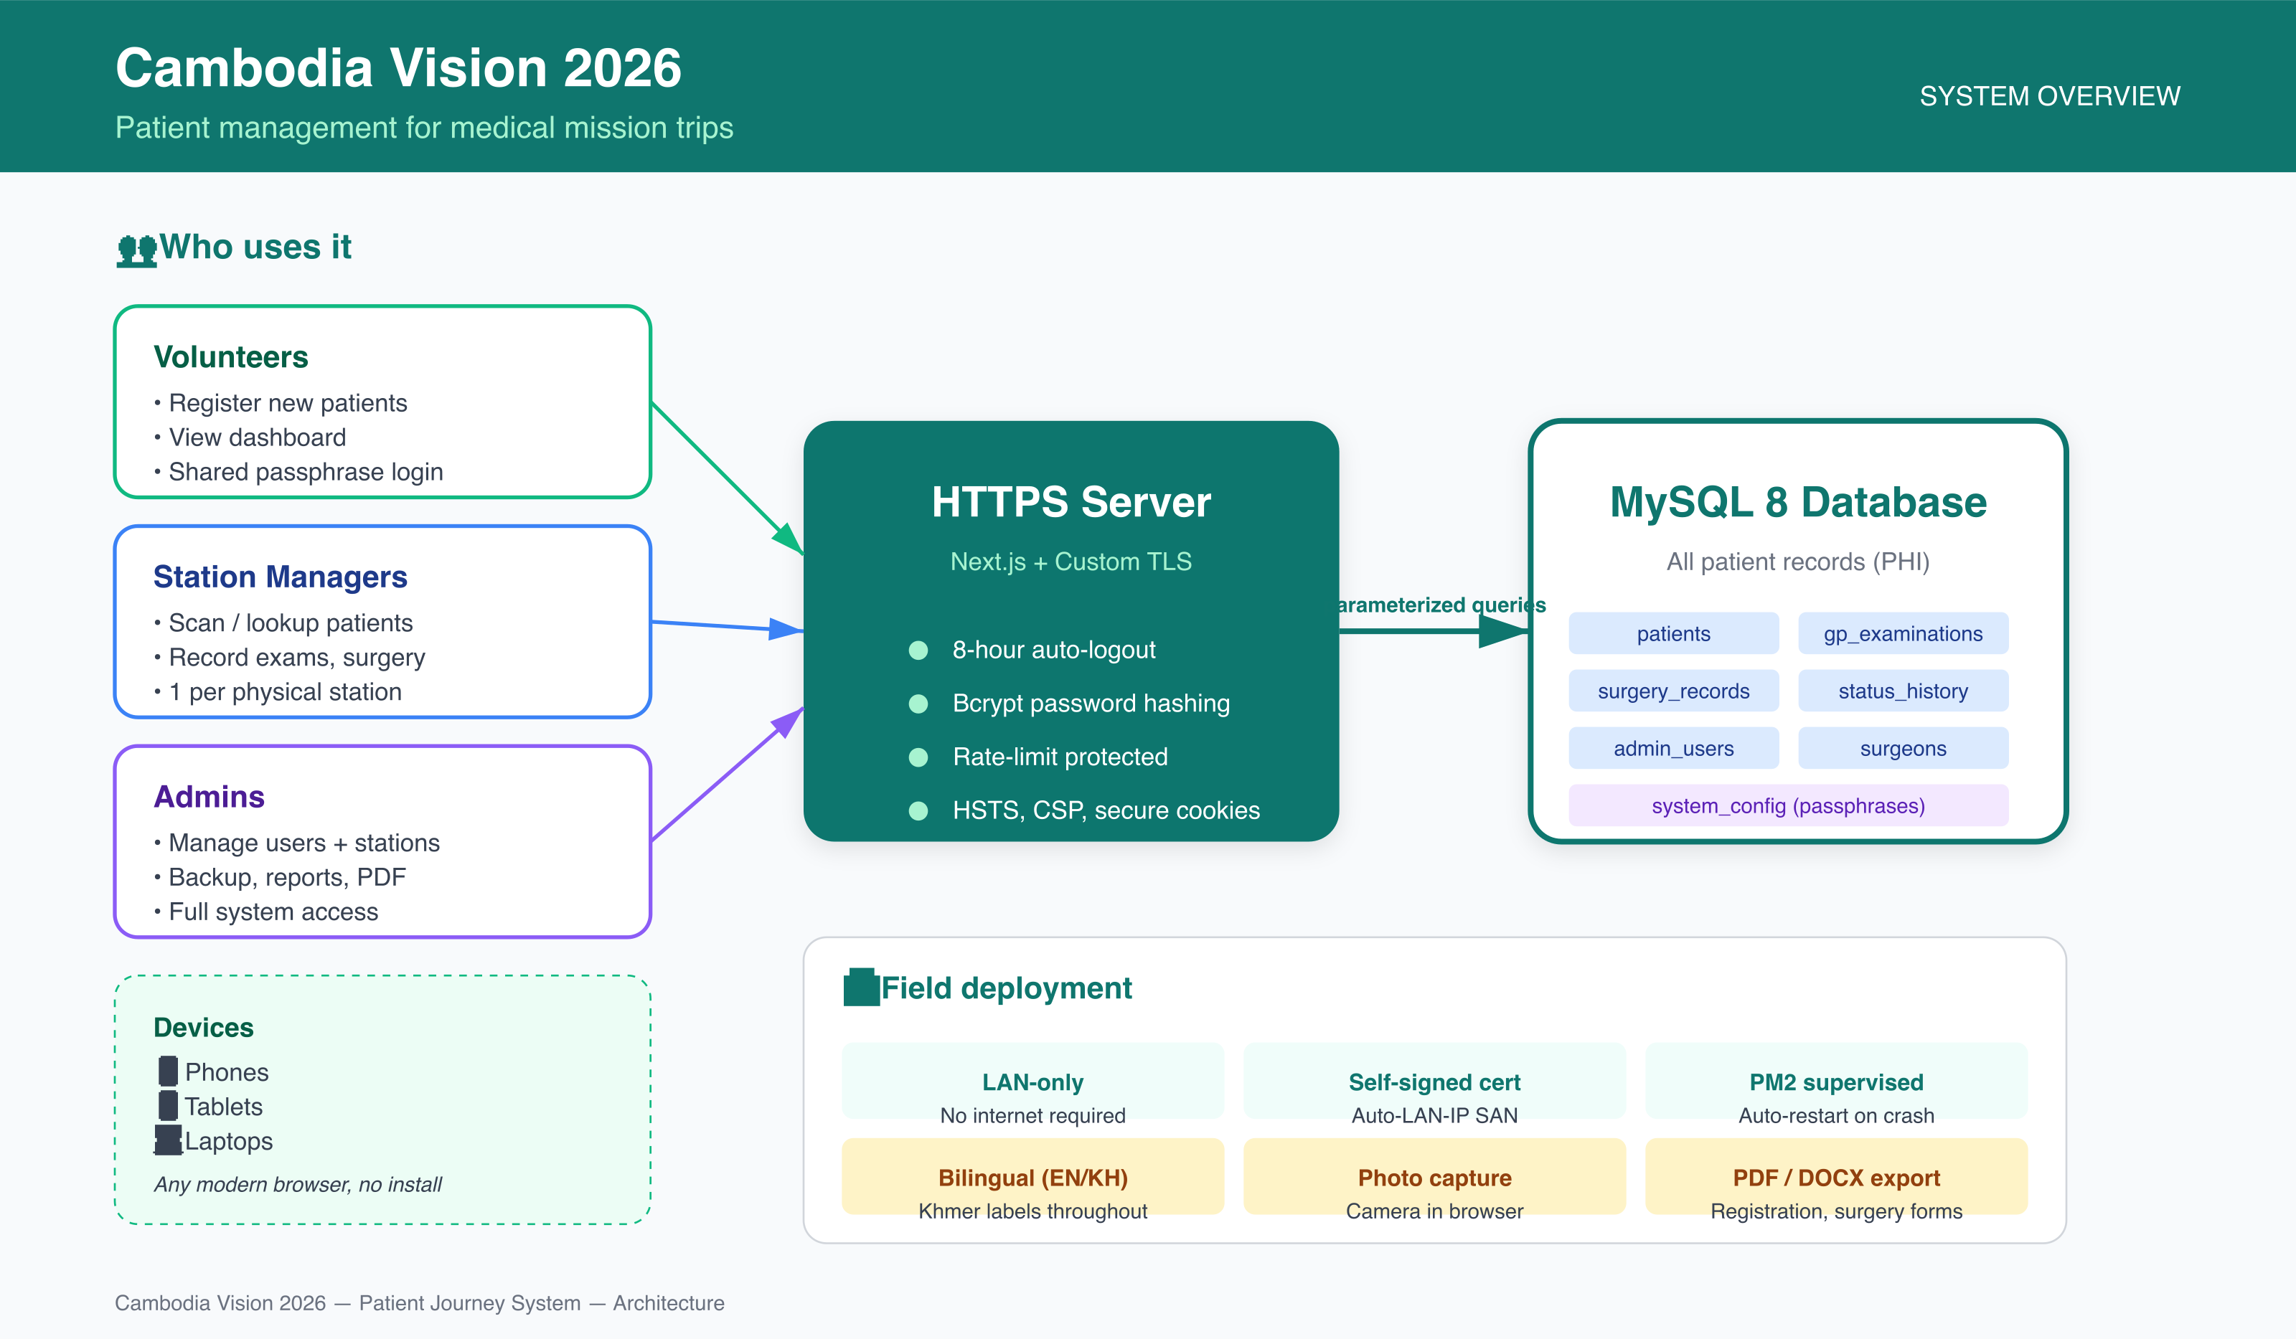
Cambodia Vision 2026
System Overview
System Overview
How users, devices, the server, and the database fit together
Source: docs/presentation/01-system-overview.svg (vector source, editable)
Cambodia Vision 2026 — slide 2 of 8

Slide 3
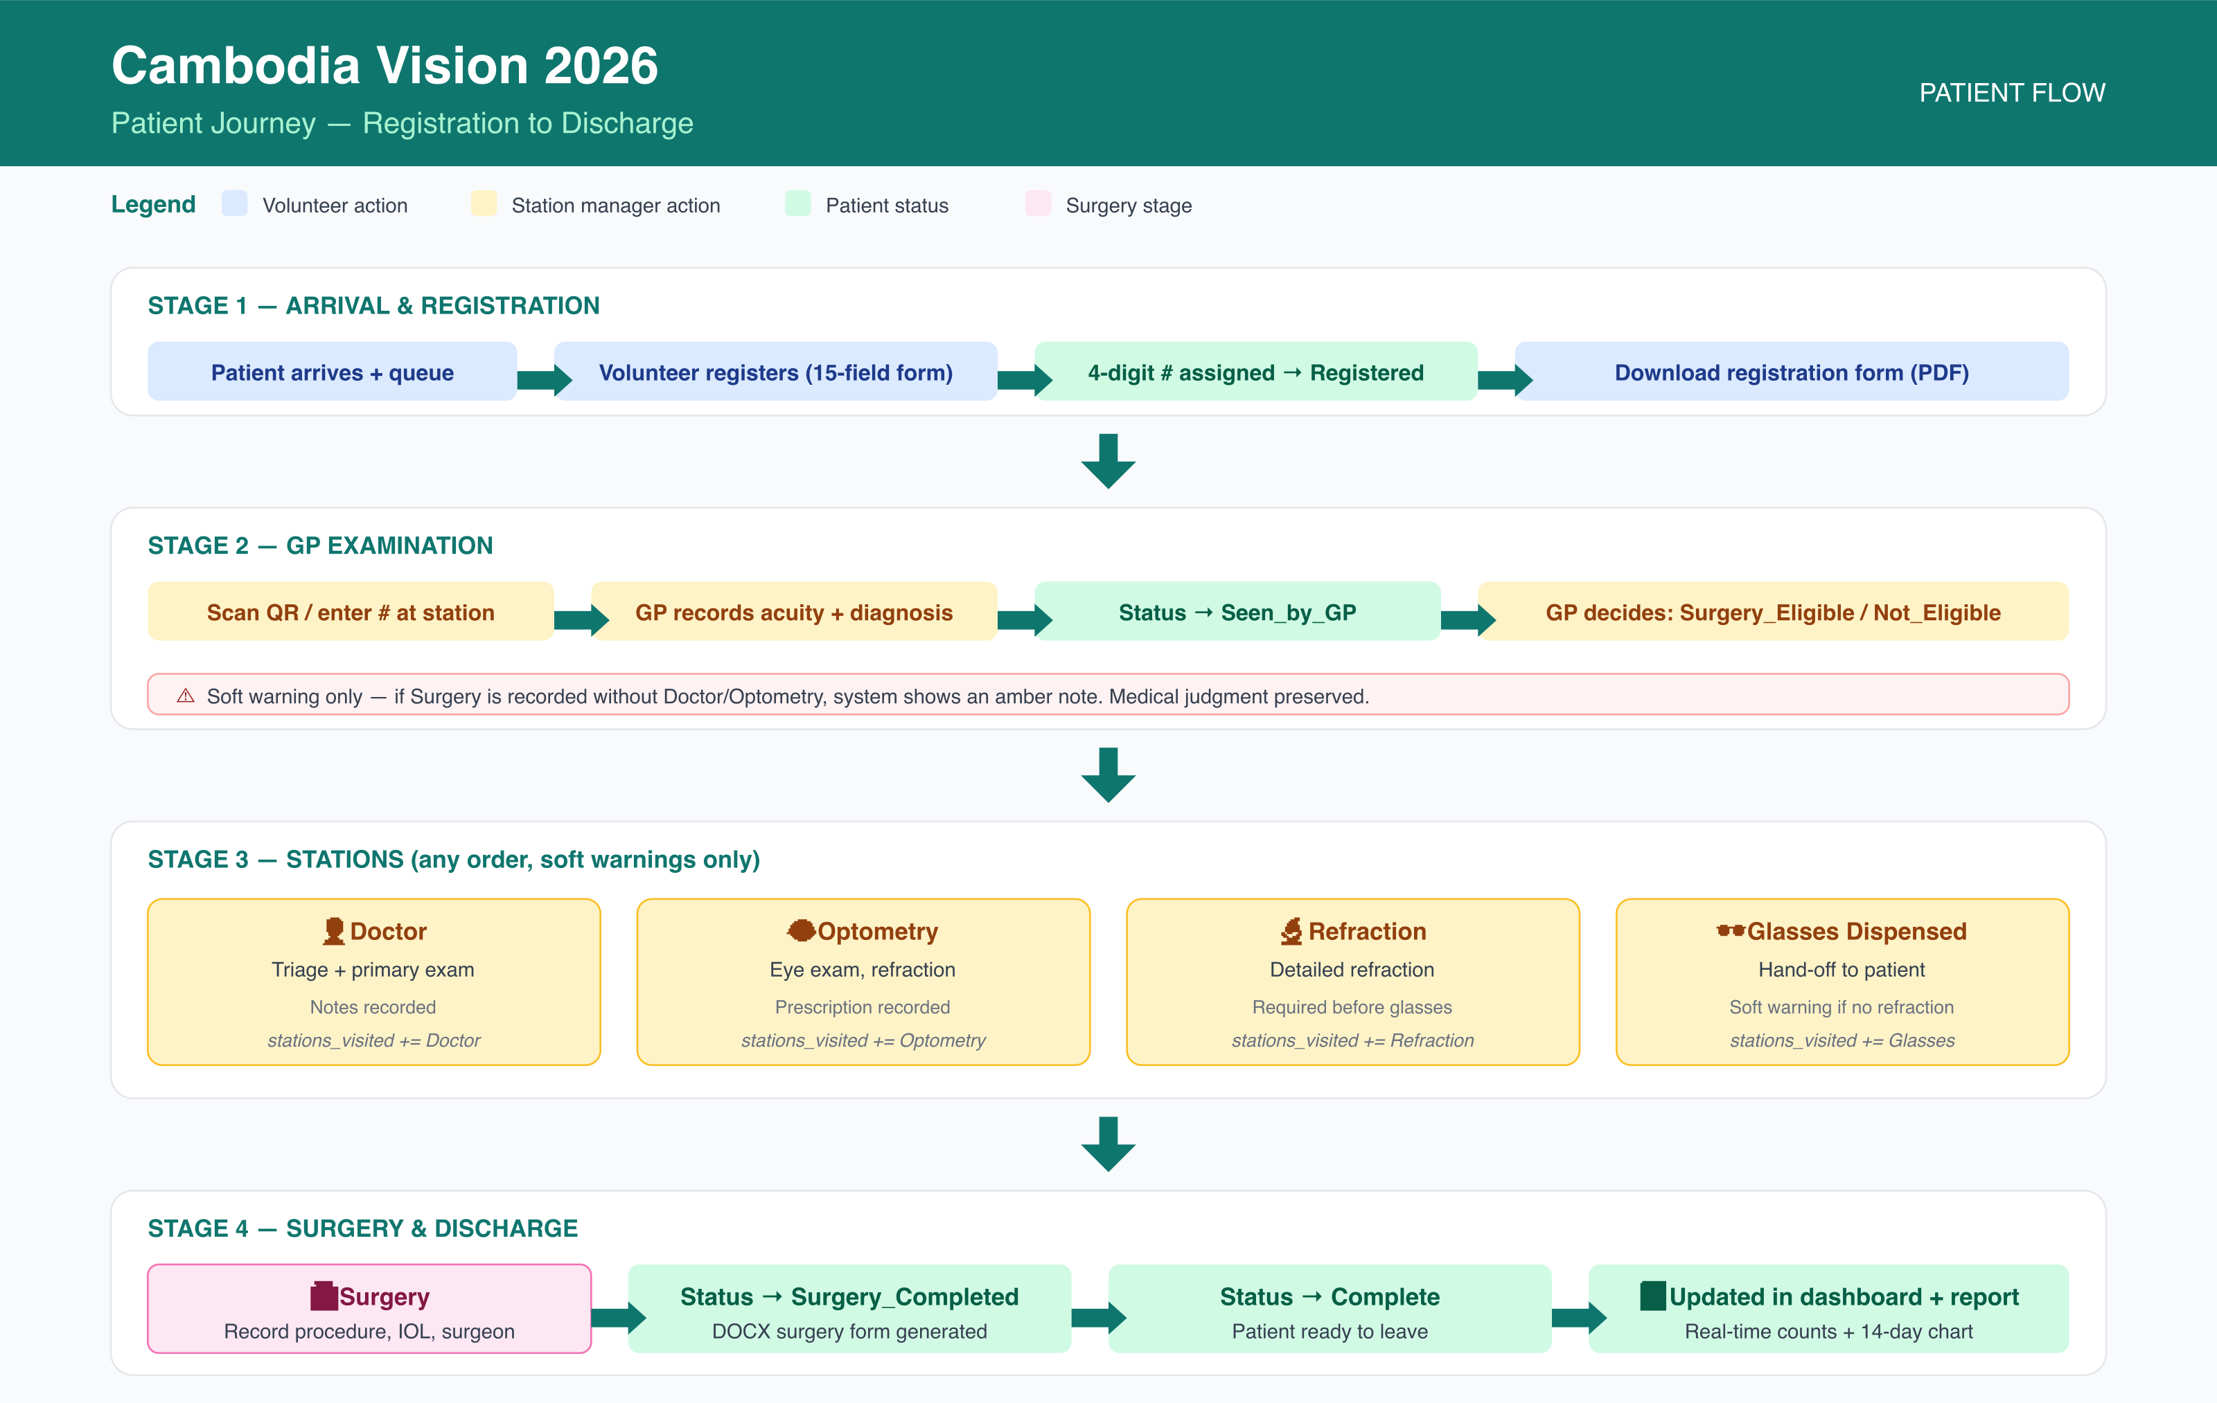
Cambodia Vision 2026
Patient Journey
Patient Journey
From arrival at the registration desk to discharge
Source: docs/presentation/02-patient-journey.svg (vector source, editable)
Cambodia Vision 2026 — slide 3 of 8

Slide 4
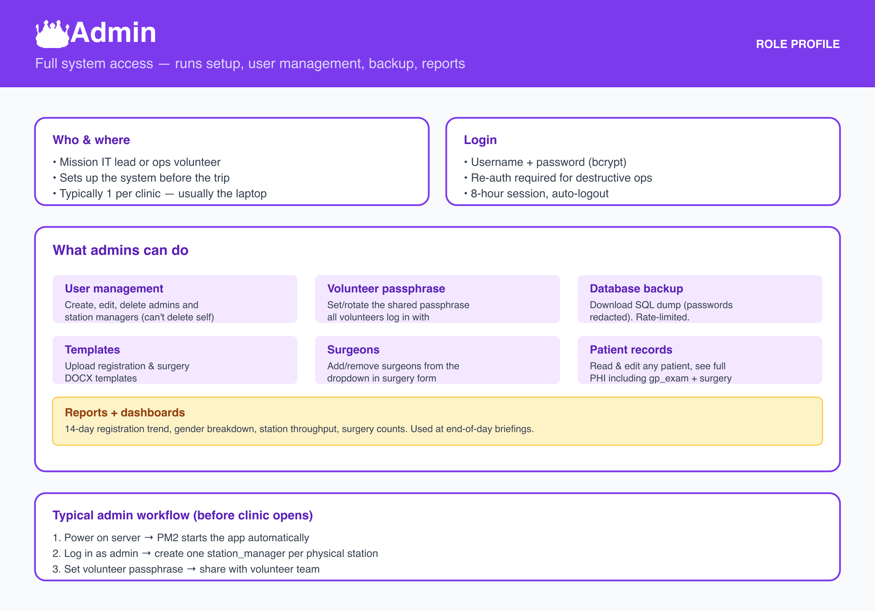
Cambodia Vision 2026
Role: Admin
Role: Admin
Full system access — setup, user management, backup, reports
Source: docs/presentation/03-role-admin.svg (vector source, editable)
Cambodia Vision 2026 — slide 4 of 8

Slide 5
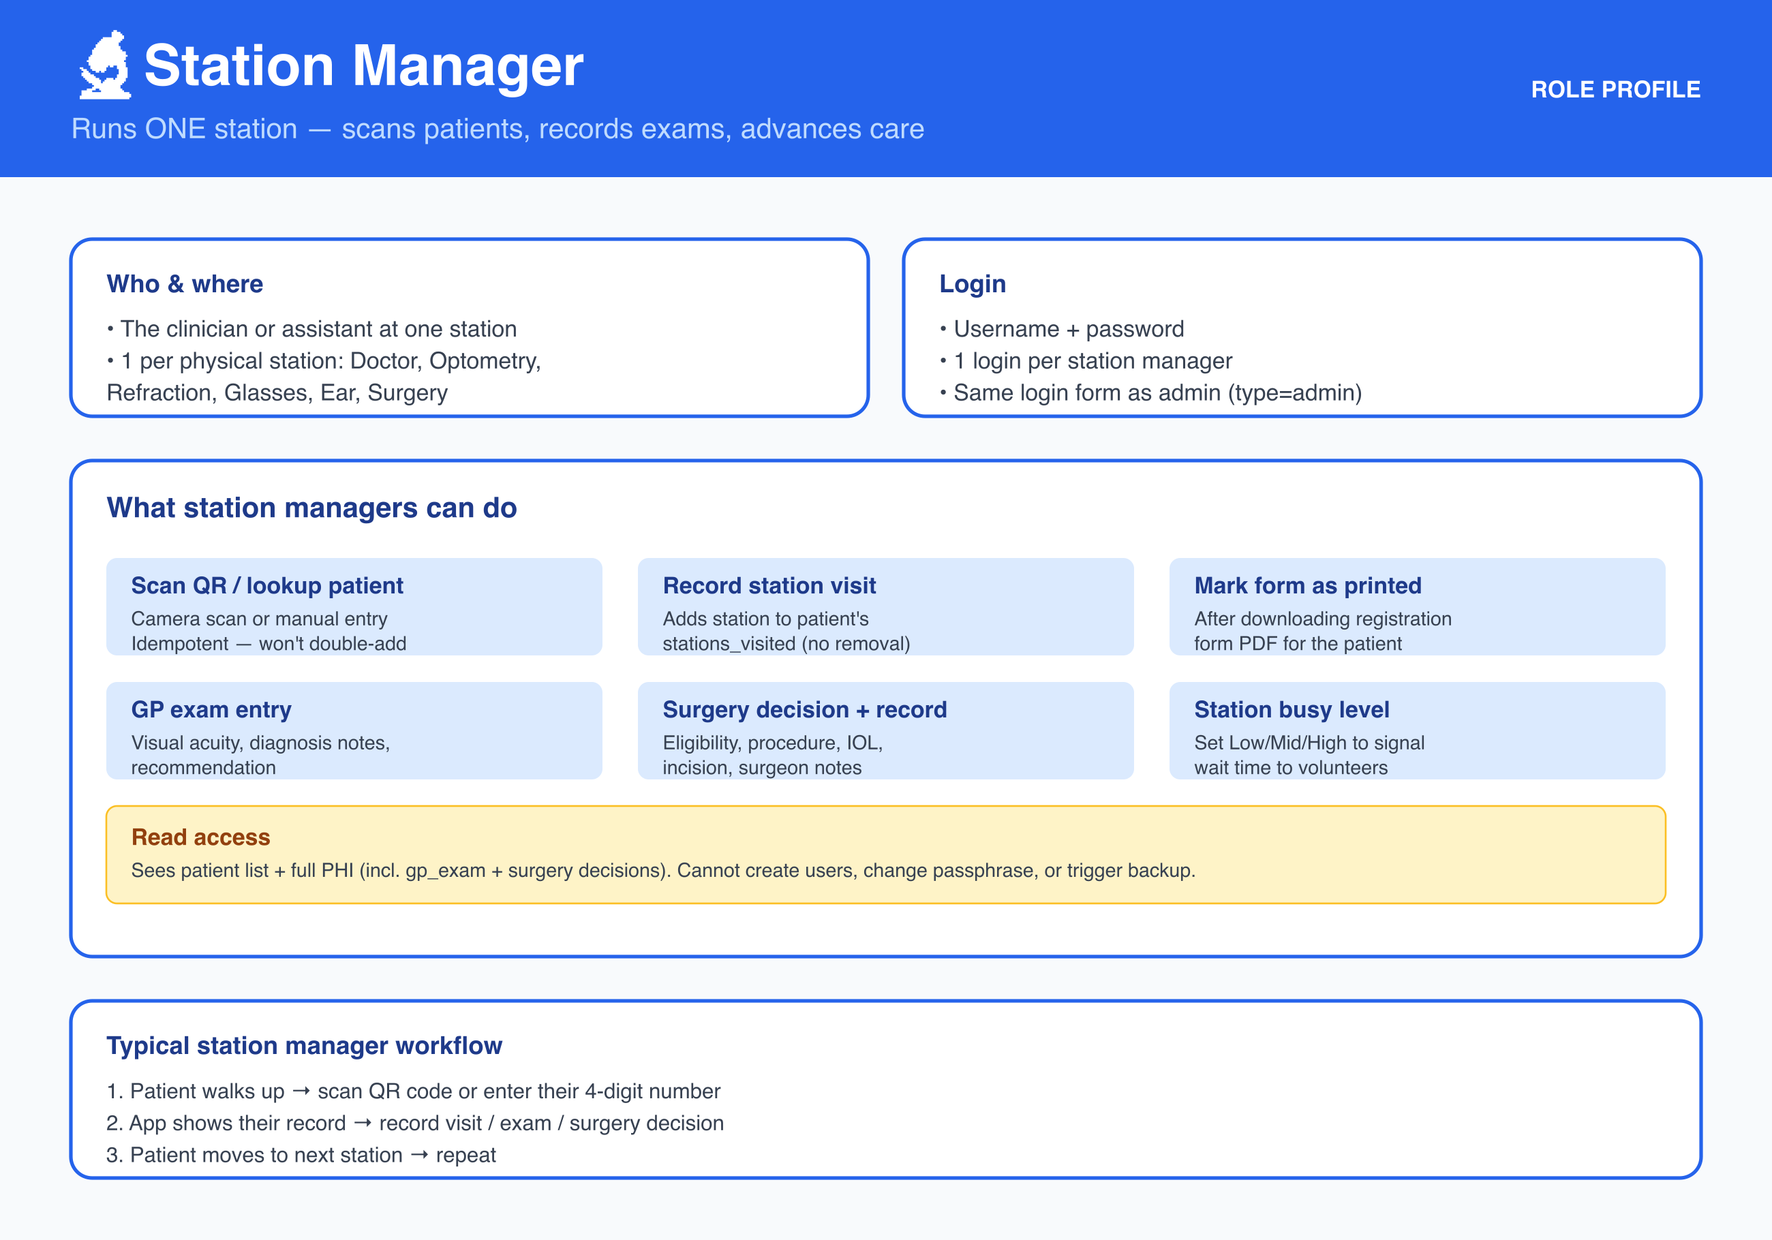
Cambodia Vision 2026
Role: Station Manager
Role: Station Manager
Runs ONE station — scans patients, records exams, advances care
Source: docs/presentation/04-role-station-manager.svg (vector source, editable)
Cambodia Vision 2026 — slide 5 of 8

Slide 6
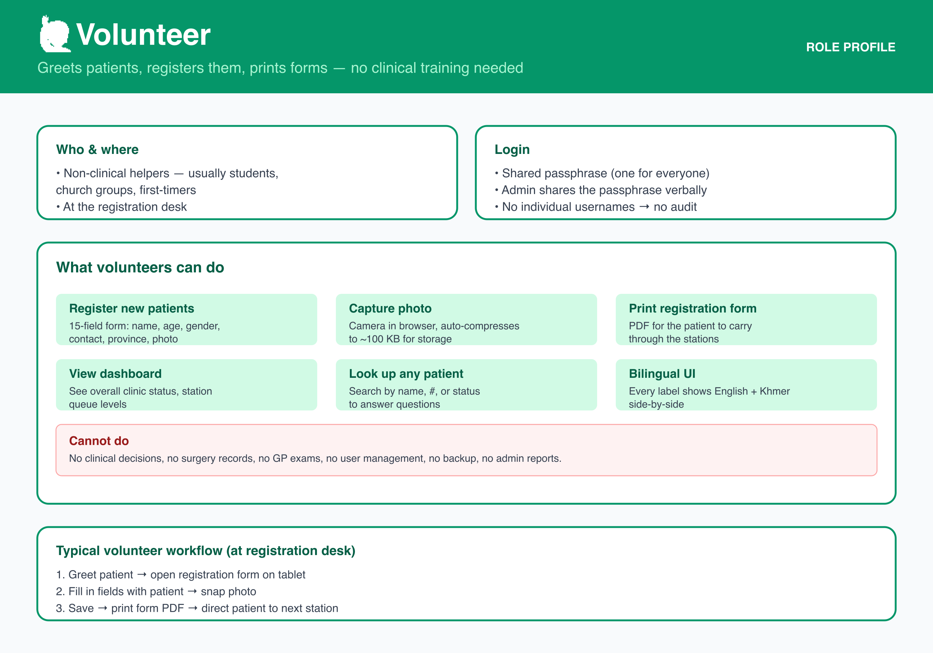
Cambodia Vision 2026
Role: Volunteer
Role: Volunteer
Greets patients, registers them, prints forms — no clinical training needed
Source: docs/presentation/05-role-volunteer.svg (vector source, editable)
Cambodia Vision 2026 — slide 6 of 8

Slide 7
Cambodia Vision 2026
Key Numbers
Key Numbers
What we have today
System capacityUp to 9,999 patients per mission (4-digit patient numbers)6 clinical stations: Doctor, Optometry, Refraction, Glasses, Ear Therapy, Surgery8-hour auto-logout for unattended tabletsField deploymentRuns on a single Ubuntu server (laptop or small box)Self-signed HTTPS certificate (LAN IP auto-detected)PM2 supervises the process — auto-restart on crashSurvives power blips and reconnects automaticallyData safetyBcrypt password hashing (12-round cost factor)Rate-limited login (10 attempts / 15 min) with Retry-AfterOne-click SQL backup with credentials redactedNightly mysqldump cron + weekly restore drill (recommended)
Cambodia Vision 2026 — slide 7 of 8

Slide 8
Cambodia Vision 2026
How to Use This Deck
How to Use This Deck
Pick the slide that fits the audience
→ For managementSlide 1 (intro) + Slide 2 (system overview) + Slide 7 (key numbers)→ For clinicians & station managersSlide 3 (patient journey) + Slides 5–6 (station manager + volunteer)→ For IT / setup leadSlide 2 (system overview) + Slide 4 (admin) + docs/DEPLOYMENT.md in the repo→ For volunteers (training)Slide 3 (patient journey) + Slide 6 (volunteer role)
Cambodia Vision 2026 — slide 8 of 8

