Slide 1
Budget Manager
SAT4650 Final Project
By: wyatt Helzer

Slide 2


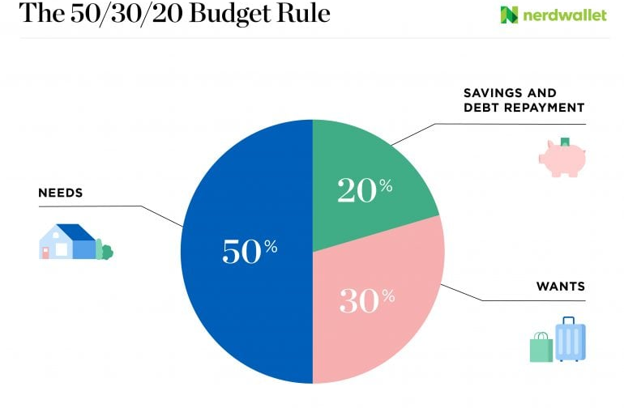
Aim and Major Application
The main aim of this project was to create an application to help the user manager their finances and better understand their financial situation.
It’s easy for one to have a false sense of security with their finances and end up spending money where they shouldn’t.
This application allows the user to input basic information and get a simple financial plan. It calculates how much money the user can spend safely each month based on the user’s budget and the duration of the budget. It also provides the total amount the user would be saving if they adhered to their personal budget.

Slide 3

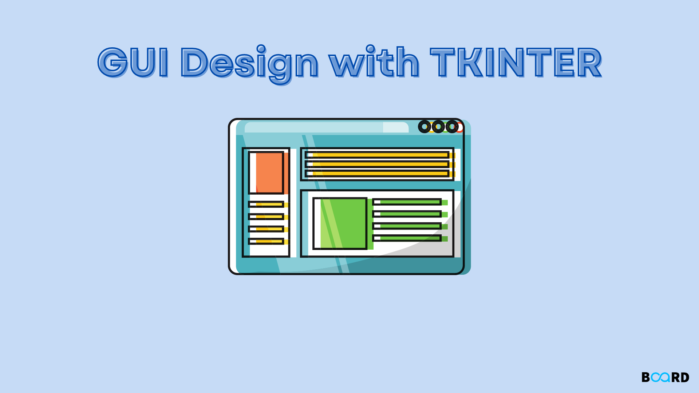
Framework and libraries
Python gui tkinter
Mysql database
The tkinter library was the groundwork for the bulk of the application. This allowed the implementation of a graphical user interface (GUI) which allowed the user to interact with the application.
The python mysql library was used to store the user’s budget and personal information. This allowed the user to leave the application, open it up again, and still have access to the information they last entered.

Slide 4
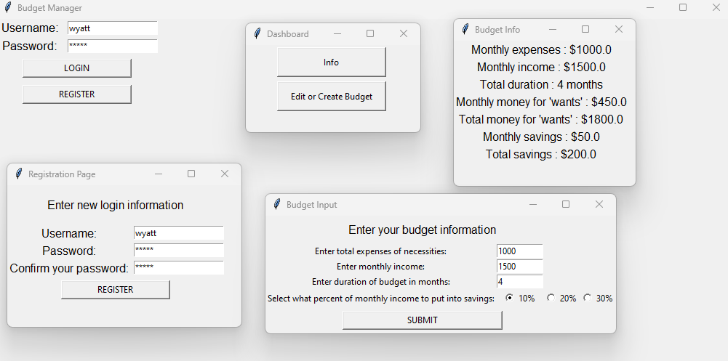

Slide 5
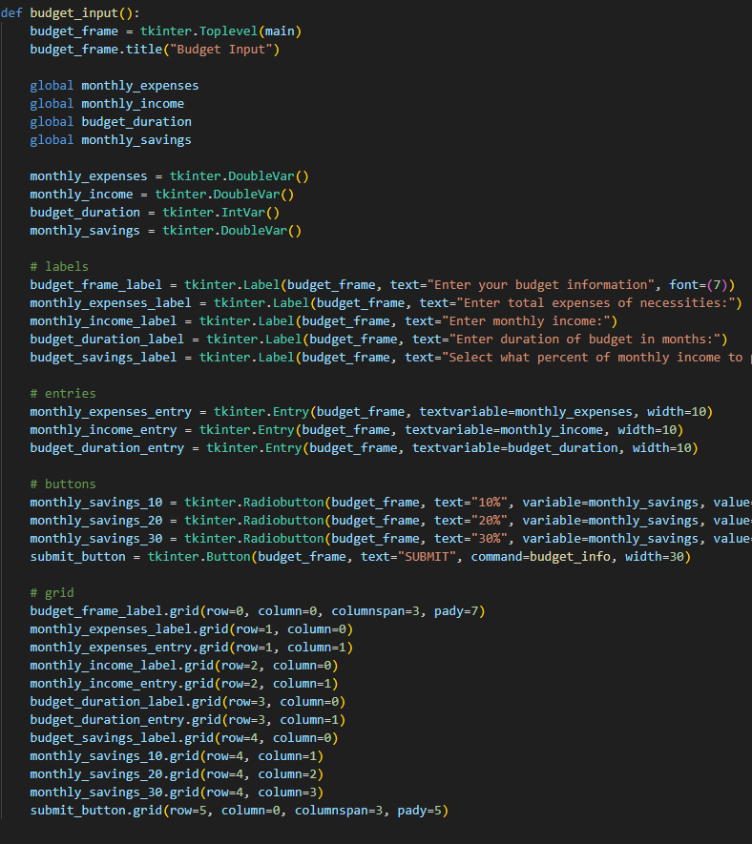
Challenging part of the project
The most difficult part of this project was figuring out how all the different parts of the interface would interlock and work in unison without breaking.
The next difficult task was formatting the GUI the way that looked somewhat appealing. There are design improvements to be made, as always.

Slide 6
Thank you

