Slide 1
PGP viewer a short walkthrough
September 2009 problems/ideas/bugs: pgp-help@sanger.ac.uk

Slide 2
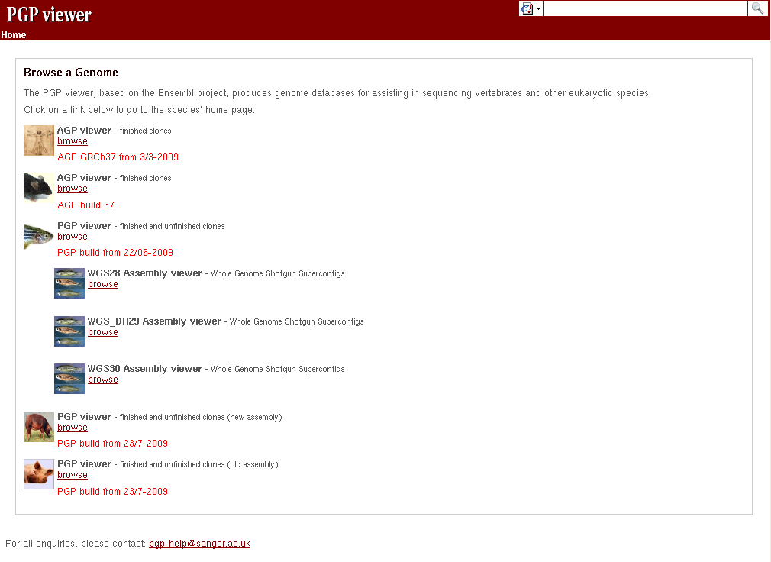

Slide 3

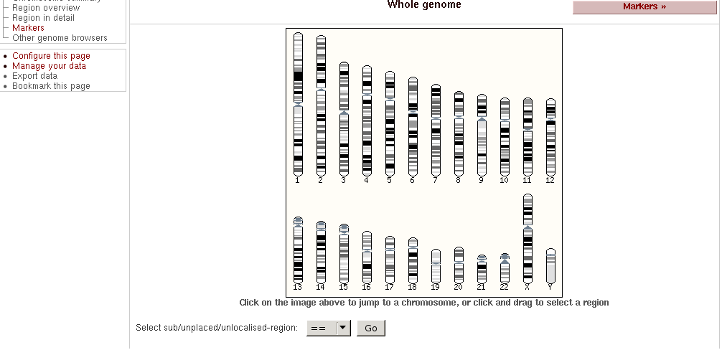

Slide 4




Show whole clone
Show clone region
Show chromosome region

Slide 5
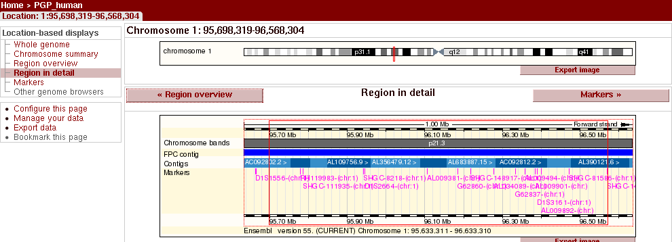
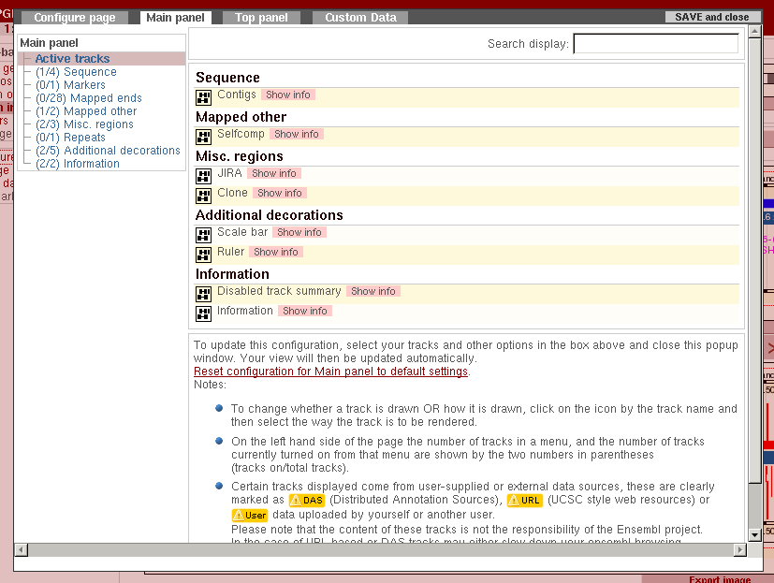

Slide 6
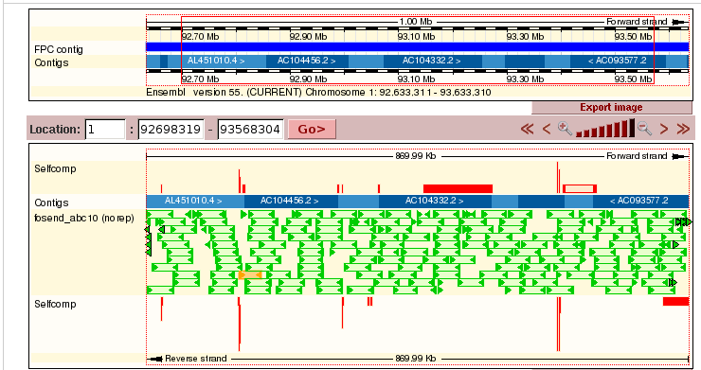


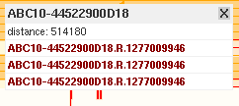
Mapped 1 time
Mapped multiple times
Wrong direction (<<, <>, >>)‏
Wrong distance
Spanner parter in the vicinity

Slide 7

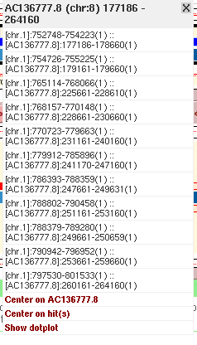

Selfcomp

Slide 8

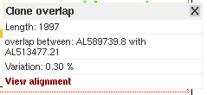
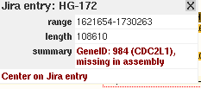

Clones, overlap & Jira

Slide 9

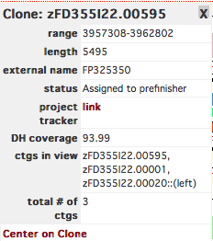
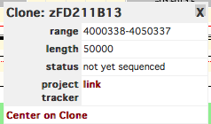
Unfinished sequence

Slide 10


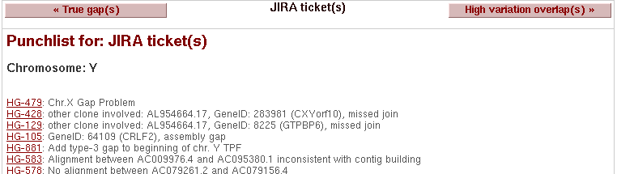
Punchlist

Slide 11
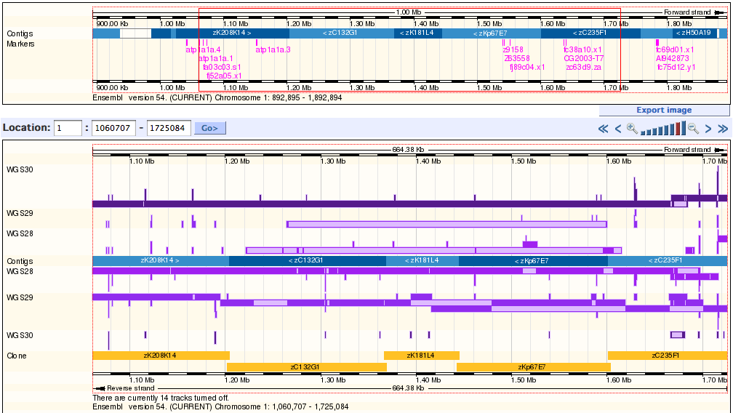
WGS mapping

