Slide 1

Chapter 7
Outpatient and Primary Care Services

Slide 2
Learning Objectives
Outpatient, ambulatory, and primary care
Principles behind patient-centered medical homes and community-based primary care
Reasons for dramatic growth in outpatient services
Various types of outpatient settings and services
Role of complementary and alternative medicine
Primary care delivery in other countries
Impact of ACA on primary care

Slide 3
Introduction
The terms outpatient and ambulatory are used interchangeably.
Hospitals provided majority of outpatient care.
Independent providers faced capital constraints.
Consumer demand fueled growth of complementary and alternative medicine.
ACA addresses access for poor and vulnerable.

Slide 4
What Is Outpatient Care?
Outpatient services or ambulatory care
Ambulatory care
Diagnostic and therapeutic services for the walking patient
Used synonymously with community medicine
Outpatient services
Services not provided with an overnight stay

Slide 5
Scope of Outpatient Services
Primary care is the foundation for ambulatory health services.
Services other than primary care are an integral part of outpatient services.
Technological advances allow treatments to be provided in ambulatory care settings.

Slide 6
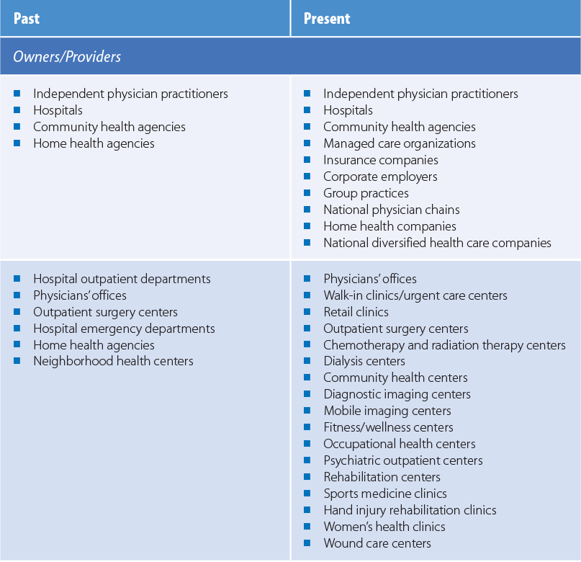
Table 7-1: Owners, Providers, and Settings for Ambulatory Care Services
Data from Barr, K. W., and C. L. Breindel. 2004. Ambulatory care. In: Health care administration: Planning, implementing, and managing organized
delivery systems. L. F. Wolper, ed. 4th ed. Burlington, MA: Jones & Bartlett Learning. pp. 507–546.

Slide 7
Primary Care
Plays a central role in a health care delivery system.
Distinguished from secondary and tertiary care by duration, frequency, and intensity.
Secondary and tertiary care are more complex and specialized.

Slide 8
Secondary Care
Usually short term
Sporadic consultation from a specialist
Includes hospitalization
Routine surgery
Specialty consultation
Rehabilitation

Slide 9
Tertiary Care
Most complex level of care
Uncommon conditions
Institution based
Highly specialized
Technology-driven
Rendered in large teaching hospitals

Slide 10
Health Care Service Frequency
Primary care
75−85% of population requires only primary care
Secondary care
10−12% requires referral to short-term secondary care
Tertiary care
5−10% require tertiary care

Slide 11
World Health Organization Definition
World Health Organization (WHO, 1978)
Three elements for understanding primary care
Point of entry
Coordination of care
Essential care

Slide 12
Institute of Medicine Definition
IOM defined primary care
Comprehensively addresses any health problem at any stage of patient’s life
Coordination ensures a combination of health services to best meet the patient’s needs
Continuity of care administered over time
Emphasizes accessibility and accountability

Slide 13
Primary Care and the Affordable Care Act
Four primary care provisions
Increased Medicare and Medicaid payments
New incentives for primary care providers working in underserved areas
Expansion of the health center program and strengthening of the capacity of health centers
Creation of additional training programs

Slide 14
New Directions in Primary Care (1 of 2)
Patient-centered medical homes (PCMH)
Team-oriented approach for special-needs children requiring constant care coordination
Initially consisted of an interdisciplinary team of physicians and allied health professionals
Studies demonstrated a positive impact
PCMH assessment tools

Slide 15
New Directions in Primary Care (2 of 2)
Community-oriented primary care elements
Reducing exclusion and social disparities
Organizing health services around people’s needs
Integrating health into all sectors
Pursuing collaborative models of policy dialogue
Increasing stakeholder participation

Slide 16
Primary Care Providers
U.S. primary care practitioners
Not restricted to physicians trained in general and family practice
Includes internal medicine, pediatrics, and obstetrics and gynecology
Nonphysician practitioners (NPPs)
Nurse practitioners (NPs), physician assistants (PAs), and certified nurse-midwives (CNMs)

Slide 17
Growth in Outpatient Services
Reimbursement
Technological factors
Utilization control factors
Physician practice factors
Social factors

Slide 18
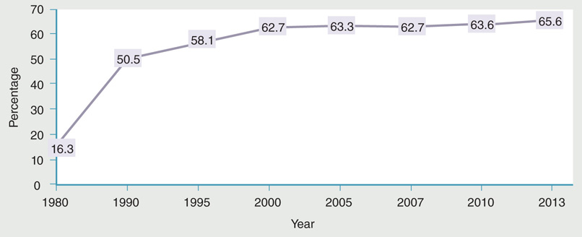
Figure 7-2: Percentage of total surgeries performed in outpatient departments of U.S. community hospitals, 1980–2013.
Data from National Center for Health Statistics. 2016. Health, United States, 2015. U.S. Department of Health and Human Services. p. 281.

Slide 19
Types of Outpatient Care Settings and Methods of Delivery (1 of 6)
Private practice
Hospital-based services
Clinical services
Surgical services
Emergency services
Home health care
Women's services

Slide 20
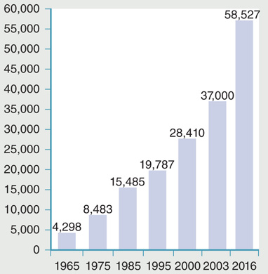
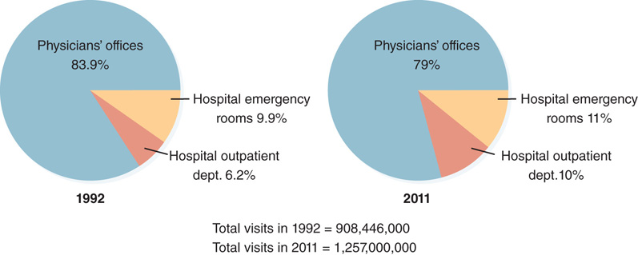
Types of Outpatient Care Settings and Methods of Delivery (2 of 6)
Figure 7-3 Growth in the number of medical group practices in the United States.
Figure 7-4 Ambulatory care visits in the United States.
Data from Medical Group Management Association. Medical group fast
facts. Available at: http://www.mgma.com/uploadedFiles/Store_Content
/Surveys_and_Benchmarking/8523-Table-of-Content-MGMA
-Performance-and-Practices-of-Successful-Medical-Groups.pdf; SK&A
. 2016. Medical group practice list. http://www.skainfo.com/databases
/medical-group-practice-list. Accessed January 2016; VHA Inc. and Deloitte
& Touche. 1997. Environmental assessment: Redesigning health care for the
millennium. Irving, TX: VHA Inc.; SMG Solutions. 2000. Report and directory:
Medical group practices. Chicago, IL: SMG Solutions.
Data from National Center for Health Statistics. 2016. Health, United States, 2015.
U.S. Department of Health and Human Services. p. 265.

Slide 21
Types of Outpatient Care Settings and Methods of Delivery (3 of 6)
Freestanding facilities
Walk-in clinics
Urgent care centers
Surgicenters
Retail clinics
Mobile medical, diagnostic, and screenings
EMTs and paramedics

Slide 22
Types of Outpatient Care Settings and Methods of Delivery (4 of 6)
Home health care
Hospice services
Comprehensive services for terminally ill with life expectance of 6 months or less
Palliation with psychosocial and spiritual support
Specific conditions for Medicare certification

Slide 23
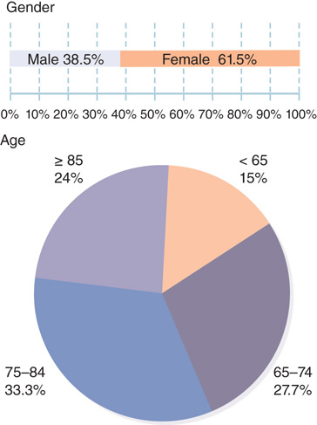
Figure 7-6: Demographic characteristics of U.S. home health patients, 2013.
Data from Alliance for Home Health Quality and Innovation. 2015. Home Health Chartbook 2015. Available at: http://ahhqi.org/images/uploads/AHHQI_2015_Chartbook_FINAL_October_Aug2016Update.pdf. Accessed February 2017.

Slide 24
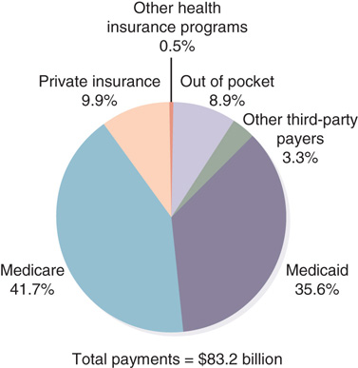
Figure 7-7: Estimated payments for home care by payment source, 2014.
Data from National Center for Health Statistics. 2016. Health, United
States, 2015. U.S. Department of Health and Human Services. p. 298.

Slide 25
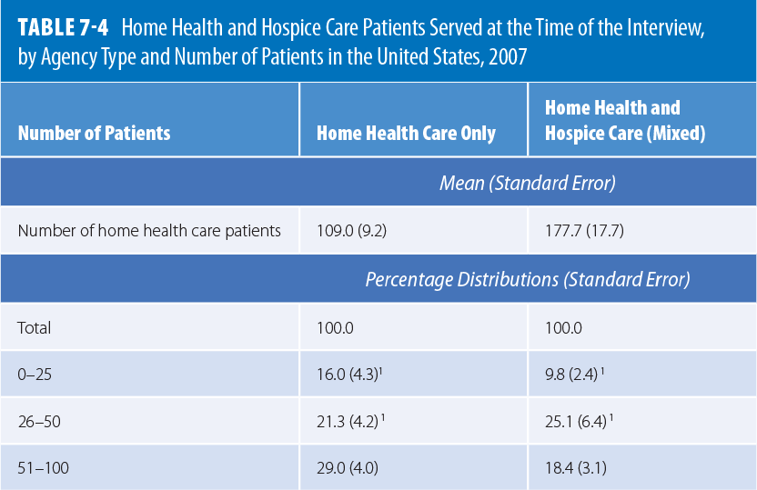
Table 7-4: Home Health and Hospice Care Patients Served at the Time of the Interview, by Agency Type and Number of Patients in the United States, 2007.

Slide 26
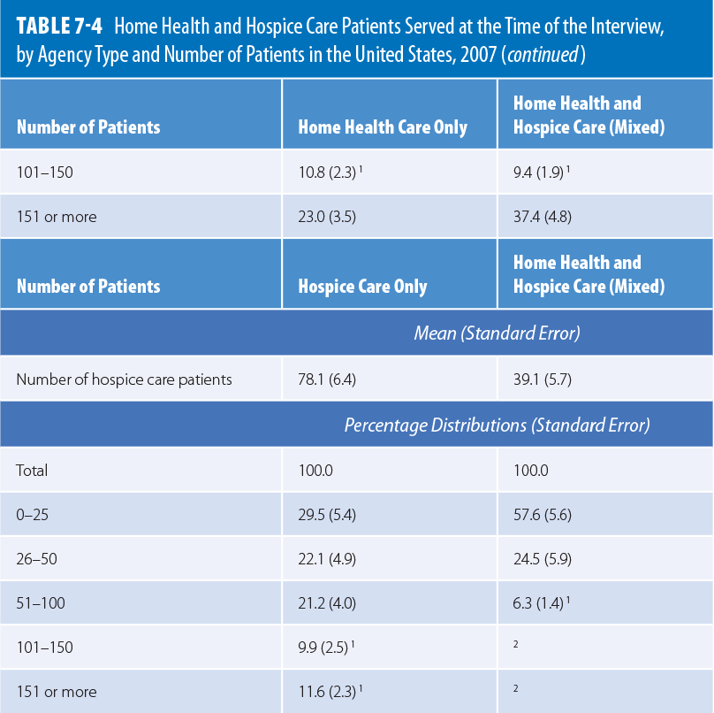
Reproduced from Park-Lee E.Y., and F. H. Decker. 2010. Comparison of home and hospice care agencies by organizational characteristics and services provided: United States, 2007. National Health Statistics Reports no. 30: 1–23.

Slide 27
Types of Outpatient Care Settings and Methods of Delivery (5 of 6)
Ambulatory long-term care services
Nursing homes
Case management
Adult day health care
Public health services
Community health centers

Slide 28
Types of Outpatient Care Settings and Methods of Delivery (6 of 6)
Three characteristics of free clinics
Services provided at no charge or nominal charge
Clinic not directly supported or operated by a government agency
Services delivered by trained volunteer staff
Other clinics
Telephone access

Slide 29
Complementary and Alternative Medicine (CAM) (1 of 2)
Reasons for CAM growth
Most seek CAM therapies following Western treatments that have not helped
Want to avoid/delay complex surgeries or toxic allopathic treatments
Feel in control when empowered with medical and health-related information
Want practitioners to take time to listen to them

Slide 30
Complementary and Alternative Medicine (CAM) (2 of 2)
National Center for Complementary and Alternative Medicine’s (NCCAM) objectives
Explore complementary and alternative healing practices in the context of rigorous science
Train complementary and alternative medicine researchers
Disseminate authoritative information to the public and professionals

Slide 31
Utilization of Outpatient Services (1 of 3)
Visits to physicians
Physicians in general and family practice (22.8%)
Physicians in internal medicine (13.6%)
Pediatrics (11.1%)
Obstetrics and gynecology (6.4%)
Doctors of osteopathy (6.7%)

Slide 32
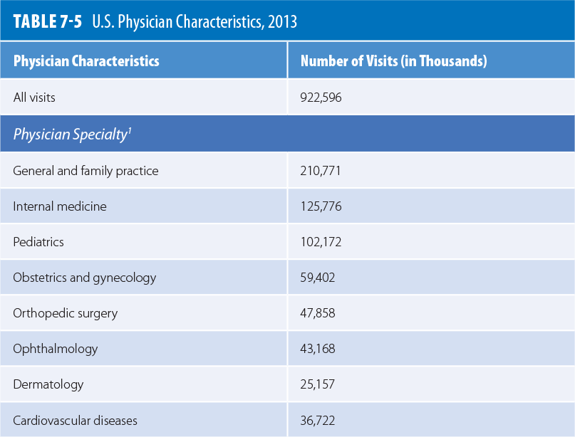
Utilization of Outpatient Services (2 of 3)

Slide 33
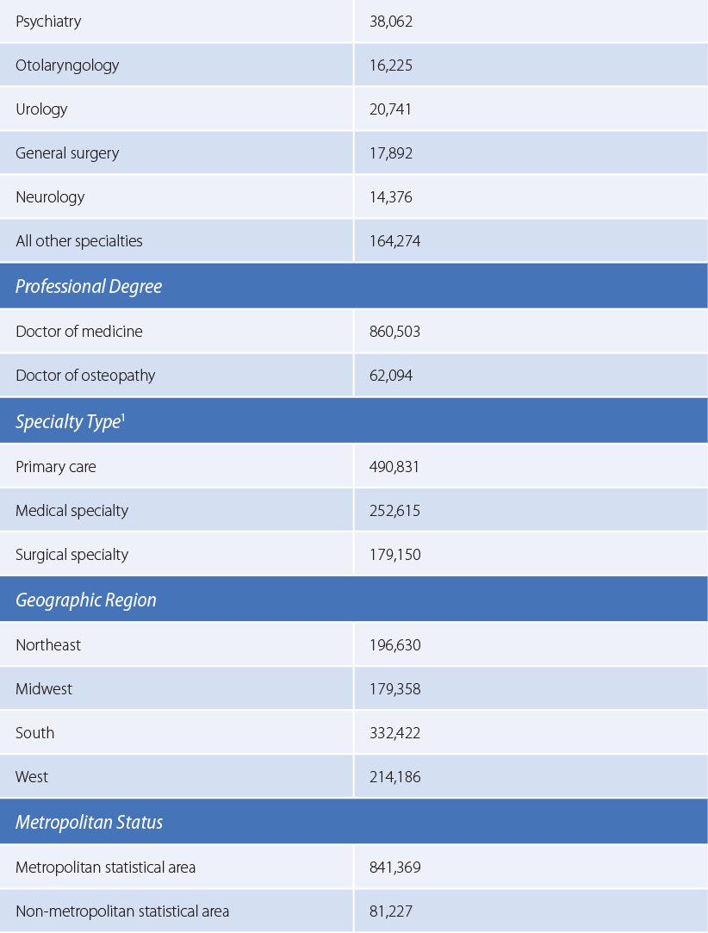
Utilization of Outpatient Services (3 of 3)
Reproduced from Centers for Disease Control and Prevention (CDC). 2013. National Ambulatory Medical Care Survey: 2013 summary tables. Available at: https://www.cdc.gov/nchs/data/ahcd/namcs_summary/2013_namcs_web_tables.pdf. Accessed April 2017.

Slide 34
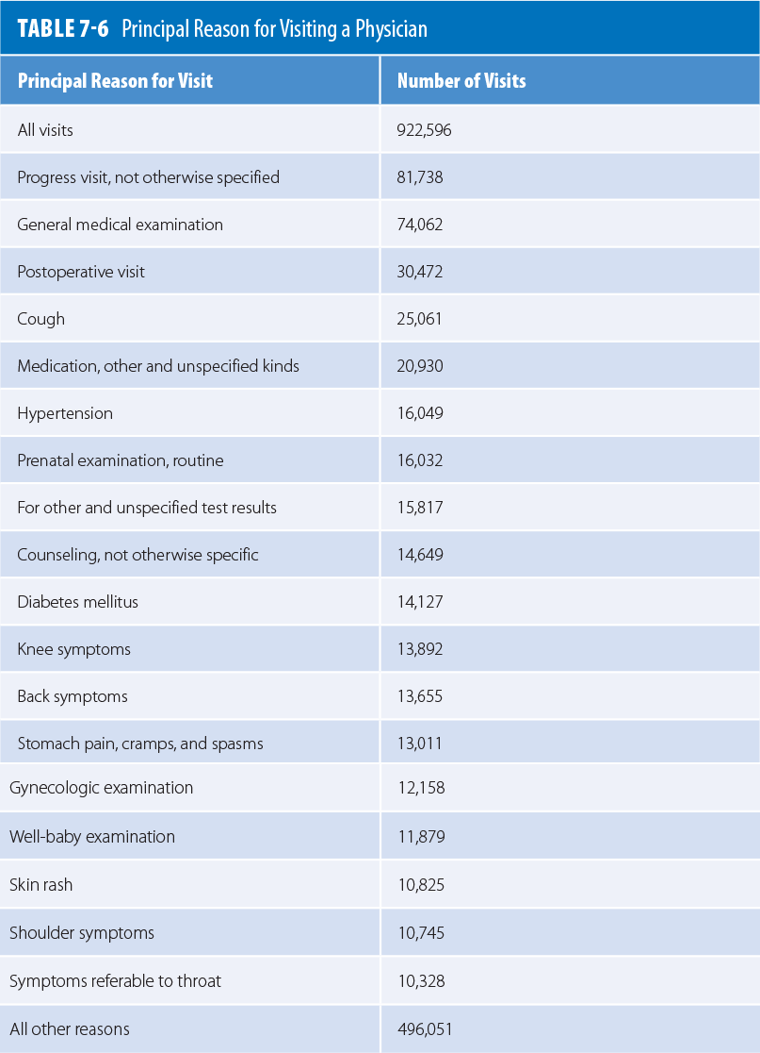
Table 7-6: Principal Reason for Visiting a Physician
"Modified from Centers for Disease Control and Prevention (CDC). 2013. National Ambulatory Medical Care Survey: 2013 summary tables. Available at:
https://www.cdc.gov/nchs/data/ahcd/namcs_summary/2013_namcs_web_tables.pdf. Accessed April 2017."

Slide 35
Primary Care in Other Countries (1 of 2)
United Kingdom
Most comprehensive coverage with little or no patient cost sharing
Canada
Covers physician visits but medication coverage varies
Australia, New Zealand, and Germany
Varying degrees of cost sharing

Slide 36
Primary Care in Other Countries (2 of 2)
Australia, Canada, France, Germany, Switzerland, and the U.S.
Payers typically use fee-for-service payments
Employ performance incentives
Mostly privatized in all countries mentioned except Iceland and Sweden

Slide 37
Summary
Ambulatory services increased outside the hospital setting.
Ambulatory services transcend basic and routine primary care services.
Primary care has become specialized.
Numerous outpatient services have emerged.
A variety of settings for services have developed.

