Slide 1

Chapter 8
Inpatient Facilities and Services

Slide 2
Learning Objectives (1 of 2)
Perspective on hospital evolution
Factors contributing to hospital growth prior to the 1980s
Reasons for the decline of hospitals and their utilization
Measures pertaining to hospital operations and inpatient utilization
Compare utilization measures in U.S. hospitals to other countries

Slide 3
Learning Objectives (2 of 2)
Differentiate among various types of hospitals
How the ACA affected physician-owned specialty hospitals and nonprofit hospitals
Basic concepts in hospital governance
Understand licensure, certification, and accreditation and the Magnet Recognition Program
Get a perspective on ethical issues

Slide 4
Introduction
Inpatient requires overnight stay in a facility
Hospital
Institution with at least six beds
Delivers services including diagnostics and treatment
Evolved from institutions of refuge for homeless and poor
Ultramodern facilities providing advanced services

Slide 5
Hospital Transformation in the U.S.
Five functions in the evolution of hospitals
Primitive institutions of social welfare
Distinct institutions of care for the sick
Organized institutions of medical practice
Advanced medical training and research
Consolidated systems of health services delivery

Slide 6
Expansion Phase: Late 1800s to Mid-1980s
Development of professional nursing
Growth of private health insurance
Role of government
Hill-Burton Act
Public health insurance

Slide 7
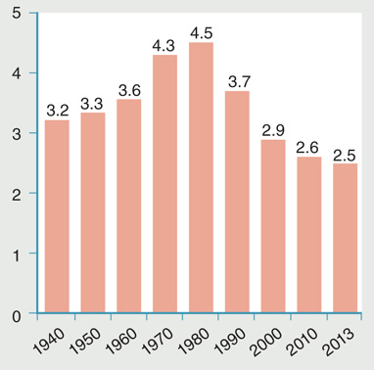
Figure 8-1: Trends in the number of U.S. community hospital beds per 1,000 resident population.
Data from National Center for Health Statistics. 2002. Health, United
States, 2002. Hyattsville, MD: U.S. Department of Health and Human
Services. p. 281; National Center for Health Statistics. 2016. Health, United
States, 2015. Hyattsville, MD: U.S. Department of Health and Human
Services. p. 289.

Slide 8
Downsizing Phase: Mid-1980s Onward
Average hospital has become smaller.
Shift from inpatient to outpatient care.
Changes in reimbursement.
Impact of managed care.
Hospital closures
Since 2000 many government-run hospitals closed.

Slide 9
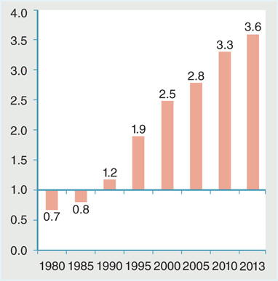
Figure 8-3: Ratio of hospital outpatient visits to inpatient days for all U.S. hospitals, 1980–2013 (selected years).
Data from National Center for Health Statistics. 2002. Health, United
States, 2002. Hyattsville, MD: Department of Health and Human Services.
p. 110; National Center for Health Statistics. 2013. Health, United States,
2012. Hyattsville, MD: Department of Health and Human Services. p. 307;
National Center for Health Statistics. 2016. Health, United States, 2015.
Hyattsville, MD: Department of Health and Human Services. p. 281.

Slide 10
Some Key Utilization Measures and Operational Concepts
Discharges
Inpatient days
Average length of stay
Hospital access and utilization: comparative data
Capacity
Average daily census
Occupancy rate

Slide 11
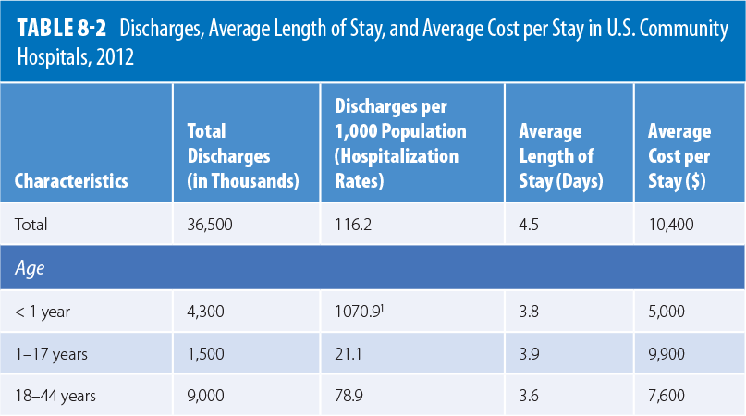
Table 8-2: Ratio of hospital outpatient visits to inpatient days for all U.S. hospitals, 1980–2013 (selected years).

Slide 12
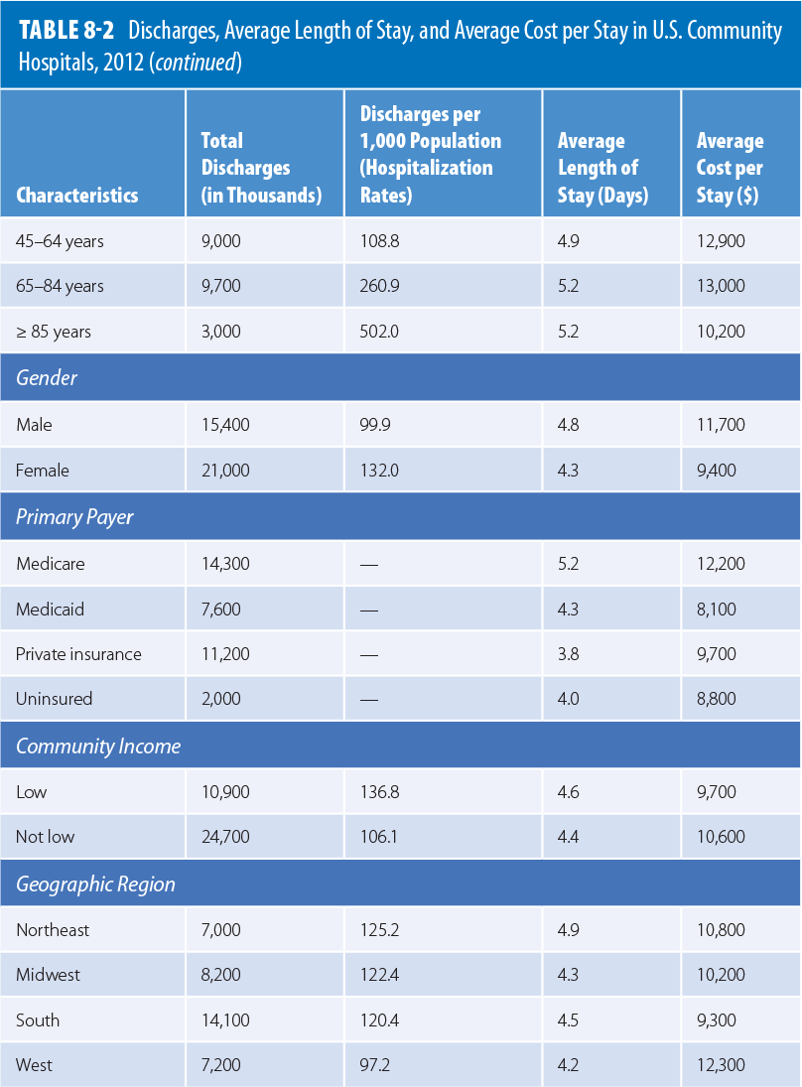
Modified from Weiss, A. J., and A. Elixhauser. 2014. Overview of hospital stays in the United States, 2012 (Statistical Brief #180). Rockville, MD: Agency
for Healthcare Research and Quality. Available at: http://www.hcup-us.ahrq.gov/reports/statbriefs/sb180-Hospitalizations-United-States-2012.pdf.
Accessed May 2017.

Slide 13
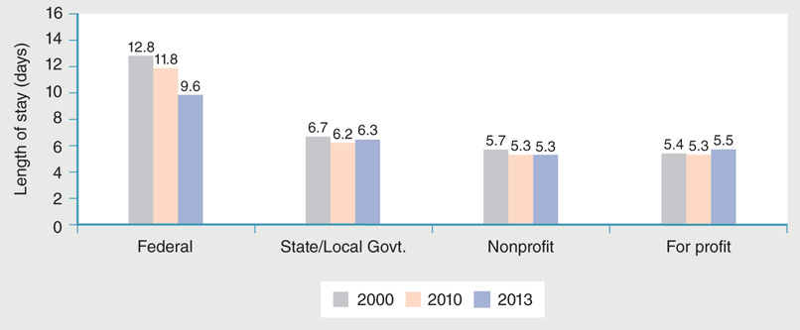
Figure 8-5: Average lengths of stay by U.S. hospital ownership (selected years).
Data from National Center for Health Statistics. 2013. Health, United States, 2012. Hyattsville, MD: U.S. Department of Health and Human Services. p. 307;
National Center for Health Statistics. 2016. Health, United States, 2015. Hyattsville, MD: U.S. Department of Health and Human Services. p. 281.

Slide 14
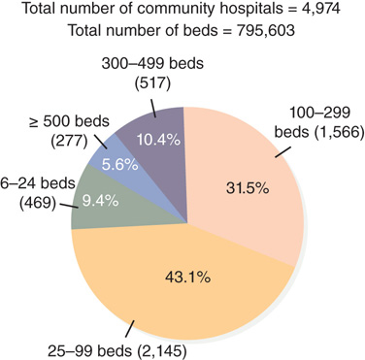
Figure 8-6: Breakdown of U.S. community hospitals by size, 2013.
Data from National Center for Health Statistics. 2016. Health, United States,
2015. Hyattsville, MD: U.S. Department of Health and Human Services. p. 288.

Slide 15
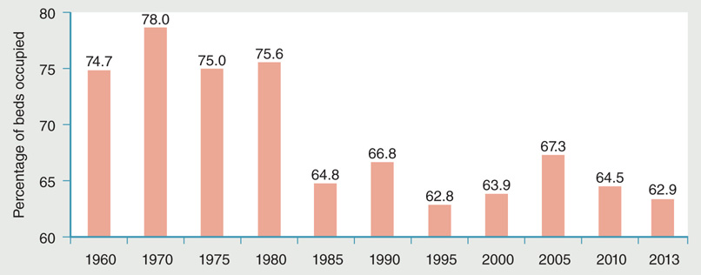
Figure 8-7: Change in occupancy rates in U.S. community hospitals, 1960–2013 (selected years).
Data from National Center for Health Statistics. 2013. Health, United States, 2012. Hyattsville, MD: U.S. Department of Health and Human Services. p. 314;
National Center for Health Statistics. 2016. Health, United States, 2015. Hyattsville, MD: U.S. Department of Health and Human Services. p. 288.

Slide 16
Factors That Affect Hospital Employment
Hospitals accounted for largest number of jobs in the health care industry in 2013.
Workforce represented roughly 39% of total health care employment.
More than 6 million people are employed by U.S. hospitals.
Changes in reimbursement policy can affect employment.
Cannot outsource health care jobs because they generally require personal interaction.

Slide 17
Hospital Costs
Inpatient hospital services are the largest share of total U.S. health care expenditures.
Medicare and Medicaid payments.
Rise in bad debts.
International cost comparisons.

Slide 18
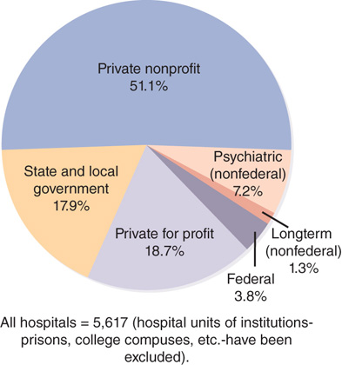
Figure 8-8 Proportion of total U.S. hospitals by type of hospital, 2014.
Data from Health Forum. 2016. Fast facts on U.S. hospitals. Available at: http://www.aha.org/research/rc/stat-studies/fast-facts.shtml. Accessed October 30, 2016.

Slide 19
Types of Hospitals (1 of 4)
Classification by ownership
Public hospitals
Private nonprofit hospitals
Private for-profit hospitals
Classification by public access
Classification by multiunit affiliation

Slide 20
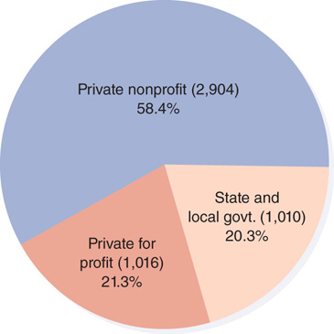
Figure 8-9: Breakdown of U.S. community hospitals by types of ownership, 2013.
Data from National Center for Health Statistics. 2016. Health, United States,
2015. Hyattsville, MD: U.S. Department of Health and Human Services. p. 288.

Slide 21
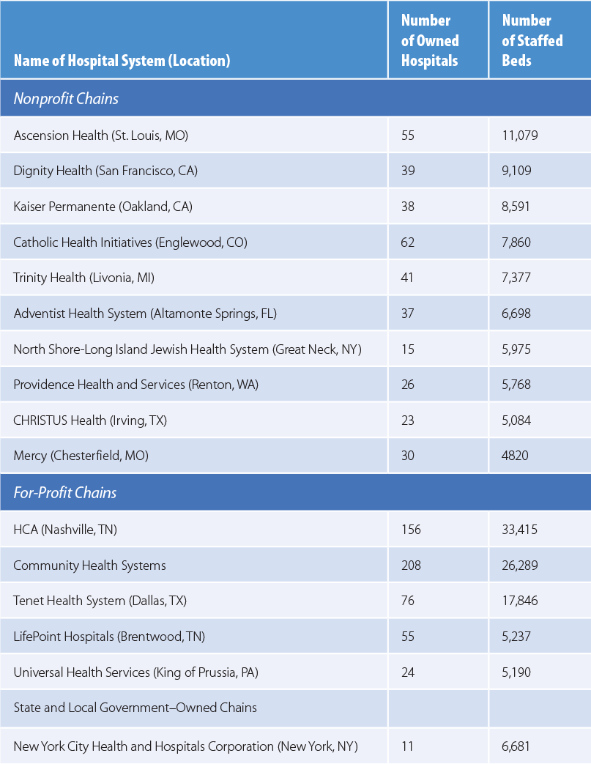
Table 8-6: The Largest U.S. Multihospital Chains, 2014
Data from Sanofi-Aventis. 2016. Managed care digest series: Hospital/systems digest, 2016. Bridgewater, NJ: Author.

Slide 22
Types of Hospitals (2 of 4)
Classification by type of service
General hospitals
Specialty hospitals
Physician-owned specialty hospitals
Psychiatric hospitals
Rehabilitation hospitals
Children’s hospitals

Slide 23
Types of Hospitals (3 of 4)
Classification by length of stay
Short-stay hospitals
Long-term care hospitals
Classification by location
Swing-bed hospitals
Critical access hospitals
Other rural designations

Slide 24
Types of Hospitals (4 of 4)
Classification by size
Other types of hospitals
Teaching hospitals
Church-affiliated hospitals
Osteopathic hospitals
Figure 8-6 Breakdown of U.S. community hospitals by size, 2013.
Data from National Center for Health Statistics. 2016. Health, United States,
2015. Hyattsville, MD: U.S. Department of Health and Human Services. p. 288.

Slide 25
Expectations for Nonprofit Hospitals (1 of 2)
Internal Revenue Code, Section 501(c)(3)
Grants tax-exempt status to nonprofit organizations
Institutions are exempt from federal, state, and local taxes
Nonprofit organizations
Provide some defined public good
Do not distribute any profits to any individuals

Slide 26
Expectations for Nonprofit Hospitals (2 of 2)
Nonprofit institutions face new ACA demands
Establish written financial assistance and emergency care policies.
Limit charges for those eligible for assistance under hospital’s financial assistance policy.
Limit billing and collection actions against those within the guidelines of financial assistance.
Conduct a community health needs assessment.

Slide 27
Some Management Concepts
Hospital’s organizational structure differs from other large business organizations.
Hospital governance
See Figure 8-10
Board of trustees
Chief executive officer
Medical staff

Slide 28
Licensure, Certification, and Accreditation
State governments oversee the licensure of health care facilities.
Certification allows a hospital to participate in Medicare and Medicaid programs.
Accreditation is designed to ensure facilities meet certain basic standards.

Slide 29
Magnet Recognition Program
Designation conferred by the American Nurses Credentialing Center
Affiliate of the American Nurses Association
Recognizes
Quality patient care
Nursing excellence
Innovations in professional nursing practice in hospitals

Slide 30
Ethical and Legal Issues in Patient Care
Principles of ethics
Legal rights
Bill of rights and informed consent
Advance directives
DNR
Living will
Durable power of attorney
Mechanisms for ethical decision making

Slide 31
Summary
Almshouses and pesthouses evolved into public hospitals to serve the poor.
Key measures of inpatient utilization.
Hospitals are classified in numerous ways.
ACA restrictions.
Ethical decision making has been a special area of concern for hospitals.

