Slide 1

Chapter 9
Managed Care and Integrated Organizations

Slide 2
Learning Objectives (1 of 2)
Link between the development of managed care and earlier organizational forms
Basic concepts of managed care and cost savings
Main types of managed care organizations
Distinguish between types of managed care organizations
Advantages and disadvantages of different HMO models

Slide 3
Learning Objectives (2 of 2)
Why managed care did not achieve its cost-control objectives
Driving forces behind organizational integration and integration strategies
Describe highly integrated health care systems

Slide 4
Introduction
Managed care fundamentally transformed the delivery of health care in the U.S.
ACA did not obliterate managed care.
Employer-sponsored insurance enrolled fewer than 1% of employees.
Managed care originated in the U.S. and its tools spread internationally.

Slide 5
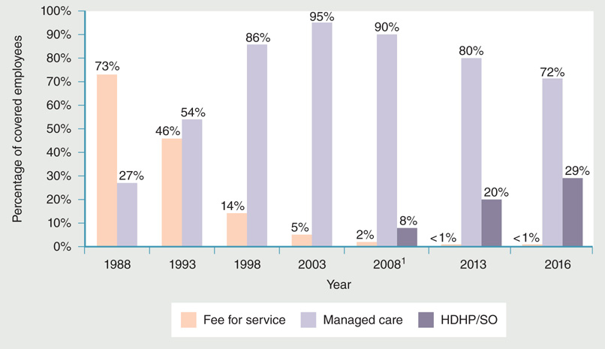
Figure 9-1: Percentage of worker enrollment in health plans (selected years).
Data from Kaiser Family Foundation and Health Research and Educational Trust (Kaiser/HRET). 2003. Employer health benefits: 2003 annual survey. Menlo Park, CA:
Author; Kaiser Family Foundation and Health Research and Educational Trust (Kaiser/HRET). 2016. Employer health benefits: 2016 annual survey. Menlo Park, CA: Author.

Slide 6
What Is Managed Care?
Integration of financing, insurance, delivery, and payment within one organization
Formal control over utilization
Financing
Insurance
Delivery
Payment

Slide 7
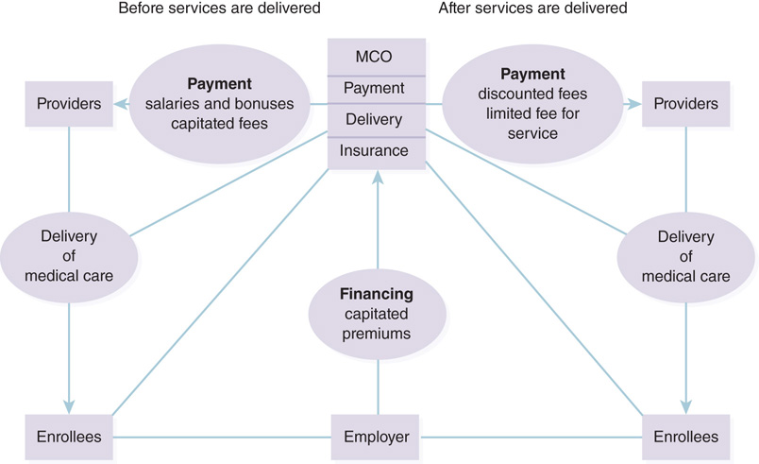
Figure 9-2: Integration of health care delivery functions through managed care.

Slide 8
Evolution of Managed Care
Contract practice takes capitation further by incorporating a defined group of enrollees.
Prepaid group practice
Principles of capitation, bearing of risk by provider, group of enrollees financed by employer
Delivery of comprehensive services
Accreditation of managed care organizations.
Quality assessment in managed care.

Slide 9
Growth of Managed Care
Flaws in the fee-for-service model
Uncontrolled utilization
Uncontrolled prices and payment
Focus on illness rather than wellness
Employers’ response to rise in premiums
Weakened economic position of providers

Slide 10
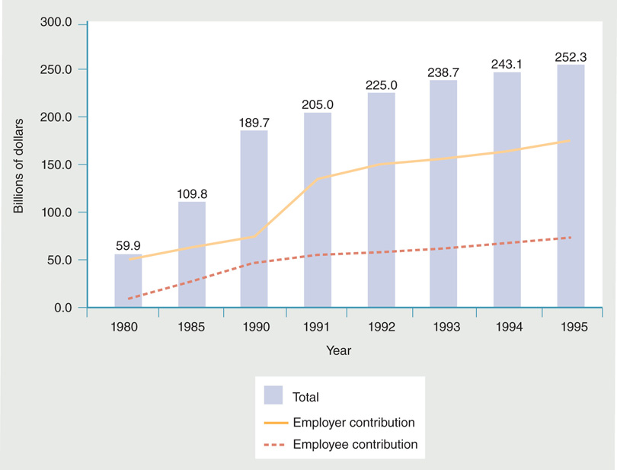
Figure 9-3: Growth in the cost of U.S. health insurance (private employers), 1980–1995.
Data from National Center for Health Statistics. 1998. Health, United States, 1998. Hyattsville, MD: U.S. Department of Health and Human Services. p. 348.

Slide 11
Efficiencies and Inefficiencies in Managed Care
Integrating the quad functions of health care delivery.
MCOs control costs by sharing risk with providers or extracting discounts.
Cost savings.
Administrative inefficiencies created for providers.
Contracts with providers exclude some services.

Slide 12
Cost Control in Managed Care (1 of 3)
Choice restriction
Closed-panel
Open-panel
Care coordination

Slide 13
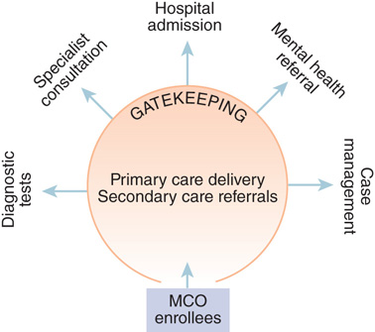
Figure 9-4: Care coordination and utilization control through gatekeeping.

Slide 14
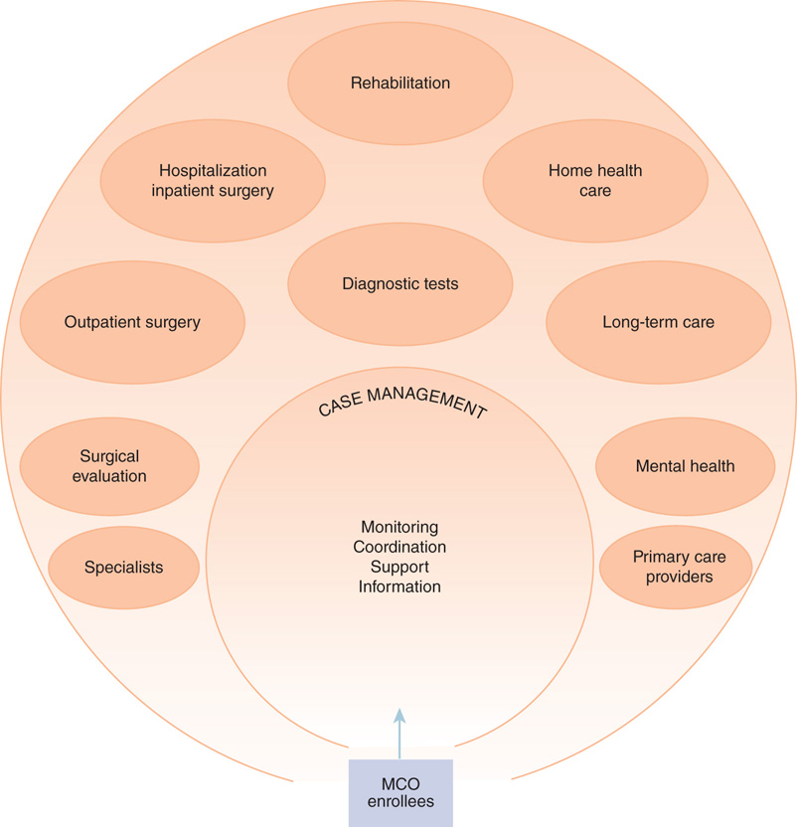
Figure 9-5: Case management function in care coordination.

Slide 15
Cost Control in Managed Care (2 of 3)
Disease management
Pharmaceutical management
Three strategies
Use of drug formularies
Use of tiered cost sharing
Use of pharmacy benefits managers (PBMs)

Slide 16
Cost Control in Managed Care (3 of 3)
Utilization review
Prospective utilization review
Concurrent utilization review
Retrospective utilization review
Practice profiling

Slide 17
Types of Managed Care Organizations (1 of 2)
Health maintenance organization (HMO)
Staff model
Group model
Network model
Independent practice association model

Slide 18
Types of Managed Care Organizations (2 of 2)
Preferred provider organization
Establishes contracts with a select group of physicians and hospitals
Allows an open-panel option
Discounted fee arrangements with providers
Fewer restrictions to the care-seeking enrollees
Point-of-service plans
Combine HMO and PPO options

Slide 19
Trends in Managed Care
Employment-based health insurance enrollment
Medicaid enrollment
Primary care case management (PCCM)
Medicare enrollment and payment reforms

Slide 20
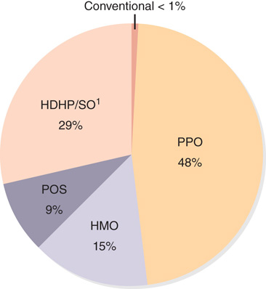
Figure 9-10: Share of managed care enrollments in employer-based health plans, 2016.
Data from Kaiser Family Foundation and Health Research and Educational
Trust (Kaiser/HRET). 2016. Employer health benefits: 2016 annual survey.
Menlo Park, CA: Author.

Slide 21
Impact on Cost, Access, and Quality
Influence on cost containment
Backlash from enrollees and providers prompted MCOs to end aggressive cost control measures.
Impact on access
Medicaid-insured patients may have difficulty accessing medical care services.
Influence on quality of care
HMO and non-HMO plans provided roughly equal quality of care.

Slide 22
Managed Care Backlash, Regulation, and the Aftermath (1 of 2)
Three reasons for discontentment toward managed care
Employers switch to manage care to restrain costs of health insurance premiums.
Insureds did not see a reduction in their premiums or out-of-pocket expenses.
Physicians hostile toward managed care.

Slide 23
Managed Care Backlash, Regulation, and the Aftermath (2 of 2)
Regulation of managed care
Two types of state-legislated statutes
Any willing provider laws
Freedom of choice laws
Aftermath

Slide 24
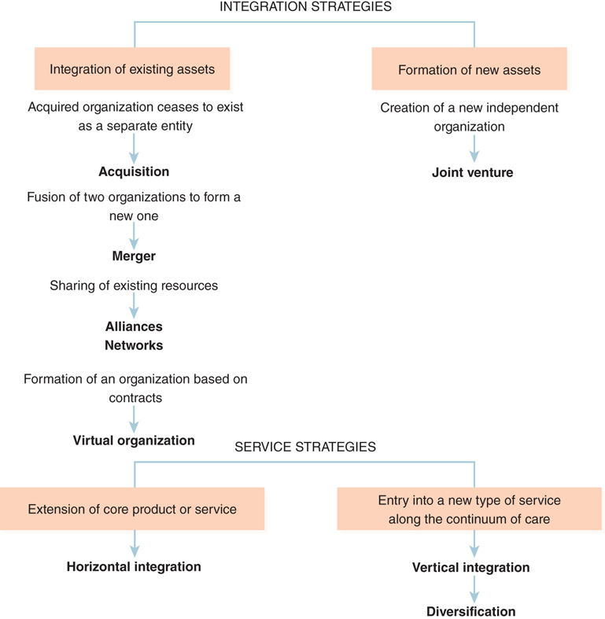
Organizational Integration
Integration strategies
Mergers and acquisitions
Joint ventures
Alliances
Horizontal integration
Vertical integration
Figure 9-11 Organizational integration strategies.

Slide 25
Basic Forms of Integration
Major participants in organizational integration have been physicians and hospitals.
Clinical and nonclinical entities may be involved.
Management services organizations.
Physician‒hospital organizations.
Provider-sponsored organizations.

Slide 26
Highly Integrated Health Care Systems
Integration in the U.S. health care system continues to intensify.
Organizational integration does not negatively affect the quality of care.
Integrated delivery systems.
Accountable care organizations.
Payer–provider integration.

Slide 27
Summary
Participation in the HEDIS program improved the quality of services provided by MCOs.
Growing power of managed care triggered integration among health care providers.
Highly integrated organizations are held accountable.
Must achieve specific objectives related to costs, quality, and consumer satisfaction

