Slide 1

Chapter 10
Long-Term Care

Slide 2
Learning Objectives (1 of 2)
Concept and features of long-term care (LTC)
Discuss the various types of LTC services
Describe who needs long-term care and why
Home- and community-based LTC services, and who pays

Slide 3
Learning Objectives (2 of 2)
LTC institutions and levels of services provided
Specialized LTC facilities and continuing care retirement communities
Institutional trends, utilization, and costs
Explore the aspects of private LTC insurance

Slide 4
Introduction (1 of 2)
Long-term care (LTC) is a complex subsystem.
Numerous sources of financing.
Community-based services.
More economical and preferred by older people
Individuals may require LTC from functional deficits arising from chronic conditions.

Slide 5
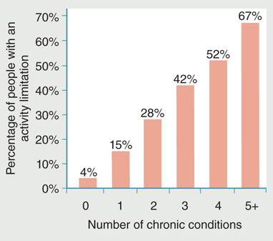
Figure 10-1: People with multiple chronic conditions are more likely to have activity limitations.
Reproduced from Partnership for Solutions and Johns Hopkins University.
2002. Chronic conditions: Making the case for ongoing care. Baltimore, MD:
Johns Hopkins University. p. 12.

Slide 6
Introduction (2 of 2)
Cognitive impairment may lead to functional decline.
Two indicators assess functional limitations
Activities of daily living (ADLs) scale
Instrumental activities of daily living (IADLs)

Slide 7
Nature of Long-Term Care (1 of 2)
Variety of services
Individualized services
Well-coordinated total care
Maintenance of residual function
Extended period of care

Slide 8
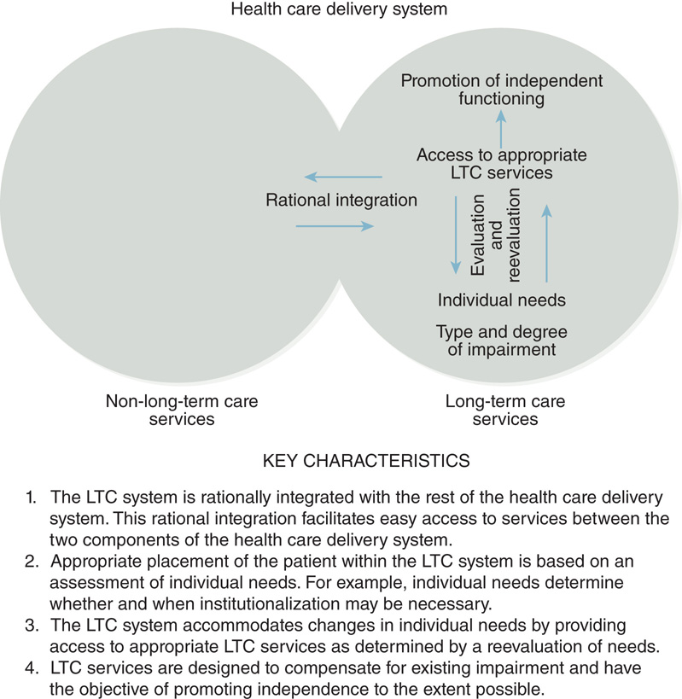
Figure 10-3: Key characteristics of a well-designed long-term care system.

Slide 9
Nature of Long-Term Care (2 of 2)
Holistic care
Quality of life
Loss of self-worth accompanies disability.
Patients remain in LTC settings for long periods.
Use of current technology
Personal emergency response system (PERS)
Use of evidence-based practices

Slide 10
Long-Term Care Services (1 of 2)
Medical care, nursing, and rehabilitation
Mental health services and dementia care
Caring for dementia patients is a major focus in LTC.
Social support
Preventive and therapeutic long-term care
Informal and formal care

Slide 11
Long-Term Care Services (2 of 2)
Respite care
Community-based and institutional services
Housing
Private and public housing
End-of-life care

Slide 12
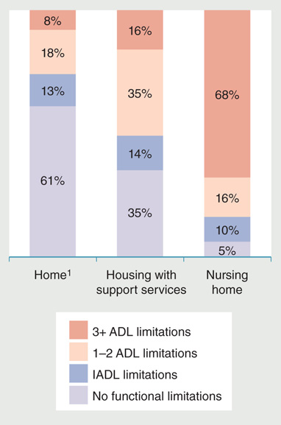
Figure 10-2: Medicare enrollees age 65 and older with functional limitations according to where they live, 2009.
Reproduced from Federal Interagency Forum on Aging-Related Statistics.
2012. Older Americans 2012: Key indicators of well-being. Washington, DC:
US Government Printing Office. p. 61.

Slide 13
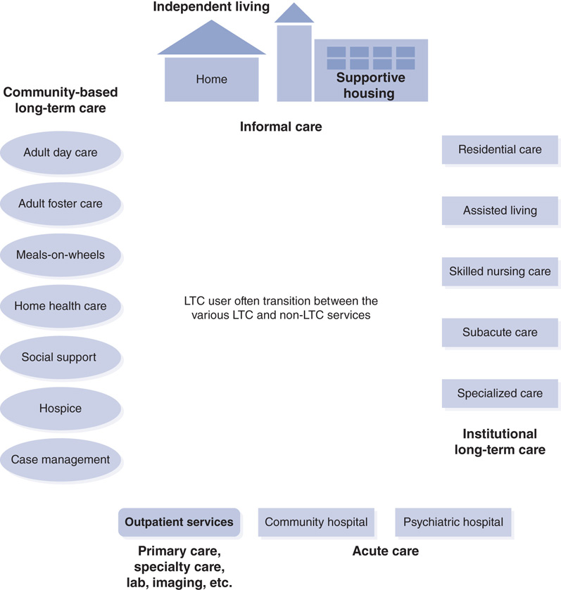
Figure 10-4: Range of services for those in need of long-term care.
Modified with permission from Taylor & Francis from Singh, D. A. 1997. Nursing home administrators: Their influence on quality of care. New York: Garland
Publishing, Inc. p. 15.

Slide 14
Users of Long-Term Care
50% of LTC users are younger than age 65.
Developmental disability (DD)
Intellectual disability (ID)
Patients with HIV/AIDS

Slide 15
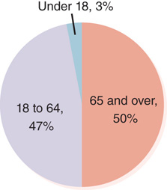
Figure 10-5: Users of long-term care by age group.
Data from Iglehart, J.K. 2016. Future of long-term care and the expanding role of Medicaid managed care. New England Journal of Medicine 374: 182–187.

Slide 16
Level of Care Continuum (1 of 2)
Personal care
Paraprofessionals
Custodial care
Restorative care
Skilled nursing care
Rehabilitation is an important component.

Slide 17
Level of Care Continuum (2 of 2)
Four categories of subacute care services
Extensive care
Special
Clinically complex care
Intensive rehabilitation

Slide 18
Home- and Community-Based Services (1 of 4)
Home health care
Adult day care
Medicaid provides funding.
Adult foster care

Slide 19
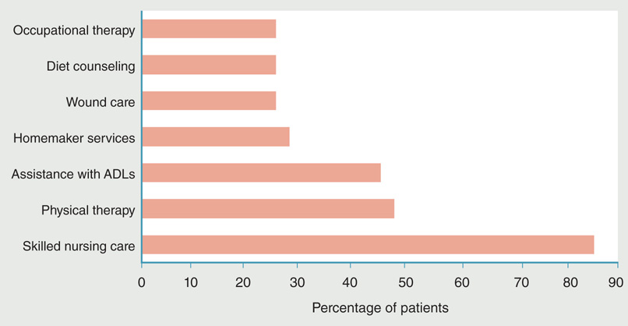
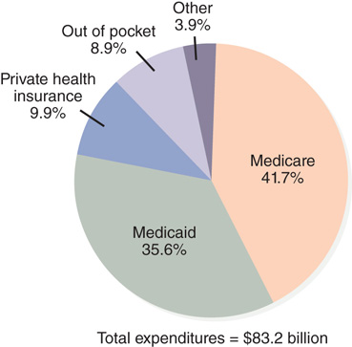
Home- and Community-Based Services (2 of 4)
Figure 10-6 Most frequently provided services to home health patients.
Figure 10-7 Sources of payment for home health care, 2014.
Data from Jones, A. L., et al. 2012. Characteristics and use of home health care by men and women aged 65 and over. National health statistics reports, No. 52. Hyattsville, MD: National Center for Health Statistics.
Data from National Center for Health Statistics. 2016. Health, United States, 2015. Hyattsville, MD: U.S. Department of Health and Human Services.
p. 298.

Slide 20
Home- and Community-Based Services (3 of 4)
Senior centers
Home-delivered and congregate meals
Elderly nutrition program (ENP)
Meals-on-wheels
Homemaker services
Continuing care at home

Slide 21
Home- and Community-Based Services (4 of 4)
Case management
Brokerage model
Managed care/integrated model
Recent policies related to community-based services
Money follows the person
Community first choice

Slide 22
Institutional Long-Term Care Continuum
Residential and personal care facilities
Assisted living facilities
Skilled nursing facilities
Subacute care facilities—three main locations
Long-term care hospitals (LTCHs)
Hospital transitional care units certified as SNFs
Freestanding nursing homes

Slide 23
Specialized Care Facilities
Intermediate care facilities for individuals with intellectual disabilities
Most patients have disabilities in addition to ID
Alzheimer’s facilities

Slide 24
Continuing Care Retirement Communities
Three common types of CCRC contracts
Life care or extended contract
Modified contract
Fee-for-service contract

Slide 25
Institutional Trends, Utilization, and Costs
Community-based services and assisted living absorbed much of the nursing home care.
Rising cost of institutional care.
Five nursing home chains operate more than 9% of U.S. nursing homes.

Slide 26
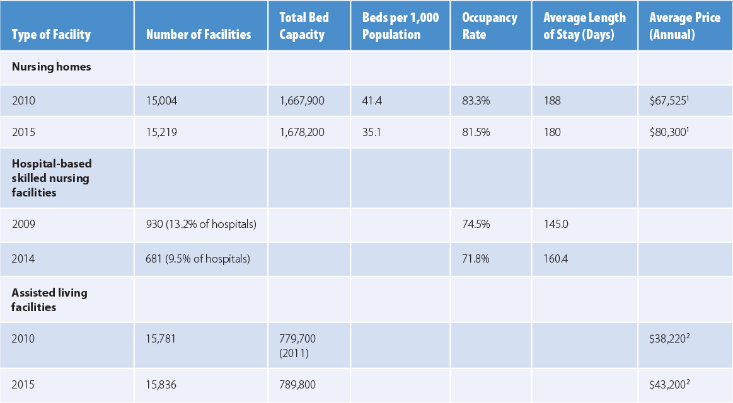
Table 10-1: Trends in Number of Long-Term Care Facilities, Beds/Resident Capacity, and Prices, Selected Years
Data from Genworth Financial, Inc. 2010. Genworth 2010 cost of care survey. Richmond, VA: Author; Genworth Financial, Inc. 2015. Genworth 2015 cost of care survey. Richmond, VA: Author; Sanofi-Aventis. 2016. Managed care digest series: Public payer digest, 2016. Bridgewater, NJ: Author.

Slide 27
Insurance for Long-Term Care
Medicare does not cover most LTC services.
Medicaid requires spending one’s assets to poverty levels to qualify.
Public policy created few incentives to spur LTC insurance growth.
ACA did little to address the LTC dilemma.

Slide 28
Summary (1 of 2)
Need for LTC increases
Due to severe chronic condition, multiple illnesses, or cognitive impairment
LTC includes
Medical care, nursing, rehabilitation, social support, and mental health care
Housing alternatives and end-of-life care

Slide 29
Summary (2 of 2)
Nursing homes require
SNF certification to admit Medicare patients
NF certification to admit Medicaid patients
Industry has become more competitive.
Medicaid and Medicare expenditures for LTC will be unsustainable in the long term.

