Slide 1

Chapter 12
Cost, Access, and Quality

Slide 2
Learning Objectives (1 of 2)
Meaning of health care costs and trend review
Factors that led to past cost escalations
Describe regulatory and market-oriented approaches to contain costs
Why some regulatory cost-containment approaches were unsuccessful
Discuss the access to care framework and various dimensions of access to care

Slide 3
Learning Objectives (2 of 2)
Describe access indicators and measurements
The nature, scope, and dimensions of quality
Differentiate between quality assurance and quality assessment
Implications of the ACA for health care costs, access, and quality

Slide 4
Introduction (1 of 2)
Three cornerstones of health care delivery
Cost
Access
Quality
Expansion of access will increase health care expenditures.

Slide 5
Introduction (2 of 2)
Costs of health care from a macro and micro perspective.
Equal access to high quality care.
Cost is important in the evaluation of quality.
Quality
Up-to-date capabilities, evidence-based processes, and measuring outcomes

Slide 6
Cost of Health Care
Trends in national health expenditures
Should health care costs be contained?
Three sources to assess if spending too much
International comparisons
Rise in private sector health insurance premiums
Government spending on health care for beneficiaries

Slide 7
Reasons for Cost Escalation (1 of 3)
Third-party payment
Imperfect market
Growth of technology
Increase in the elderly population
Medical model of health care delivery

Slide 8
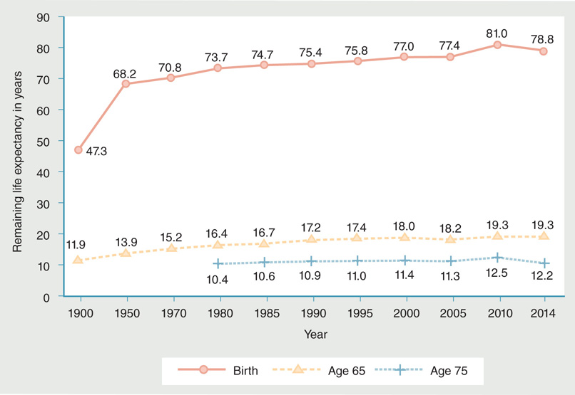
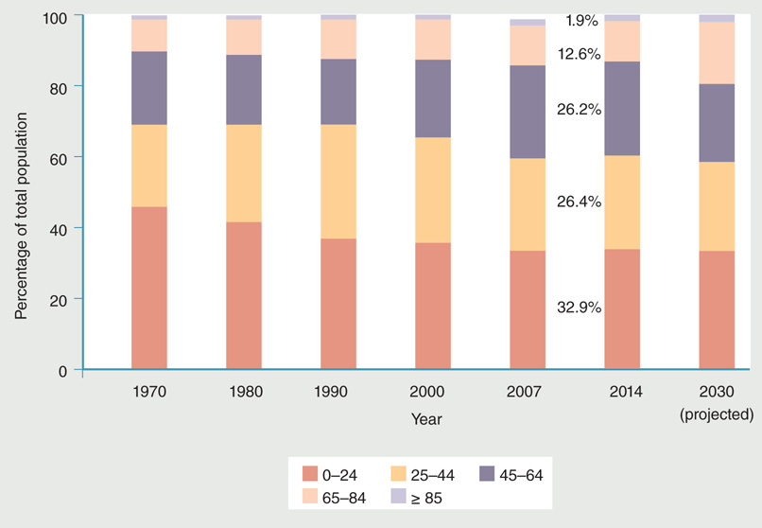
Reasons for Cost Escalation (2 of 3)
Figure 12-5 Life expectancy of Americans at birth, age 65, and age 75, 1900–2014 (selected years).
Figure 12-6 Change in U.S. population mix between 1970 and 2014, and projections for 2030.
Data from National Center for Health Statistics (NCHS). 2002. Health, United States, 2002. Hyattsville, MD: U.S. Department of Health and Human Services. p. 116; National Center for Health Statistics (NCHS). 2010. Health, United States, 2009. Hyattsville, MD: U.S. Department of Health and Human Services. p. 187; National Center for Health Statistics (NCHS). 2016b. Health, United States, 2015. Hyattsville, MD: U.S. Department of Health and Human Services. p. 95.
Data from National Center for Health Statistics (NCHS). 2013. Health, United States, 2012. Hyattsville, MD: U.S. Department of Health and Human Services. p. 45; U.S. Census Bureau. 2000. Projections of the total resident population by 5-year age groups, and sex with special age categories: middle series, 2025 to 2045. Available at: https://www.census.gov/population/projections/files/natproj/summary/np-t3-f.pdf. Accessed April 2017.

Slide 9
Reasons for Cost Escalation (3 of 3)
Multipayer system and administrative costs
Defensive medicine
Fraud and abuse
Upcoding
Anti-kickback statute
Practice variations
Small area variations (SAV)

Slide 10
Cost Containment: Regulatory Approaches
Health planning
Health planning experiments in the U.S.
Certificate-of-need statutes (CON)
Price controls
Peer review

Slide 11
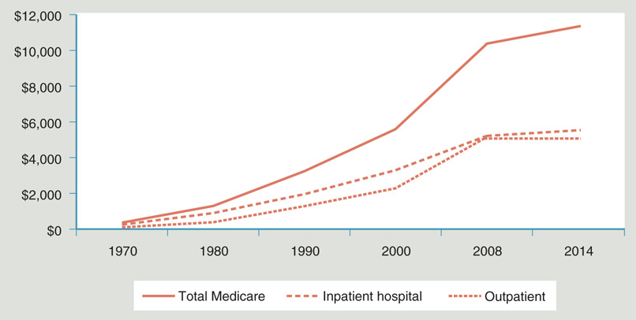
Figure 12-7: Increase in U.S. per capita Medicare spending, selected years, 1970–2014.
Data from Health, United States, 2015, p. 327; National Center for Health Statistics.

Slide 12
Cost Containment: Competitive Approaches
Competition refers to rivalry among sellers for customers.
Technical quality, amenities, access or others
Demand-side incentives.
Supply-side regulation.
Payer-driven price competition.
Utilization controls.

Slide 13
Cost Containment under Health Reform
Medicare payment cuts to providers.
New taxes imposed.
Reforms contributed to a health care spending slowdown.
Tightening provider payment rates
Providing incentives to reduce costs
Medicare projected to spend $1 trillion less by 2020.

Slide 14
Access to Care (1 of 2)
Key implications of access for health and health care delivery
Access to medical care, along with environment, lifestyle, and heredity factors.
Access is a benchmark in assessing the effectiveness of the delivery system.
Measures of access reflect if delivery is equitable.
Access is linked to quality of care and efficient use.

Slide 15
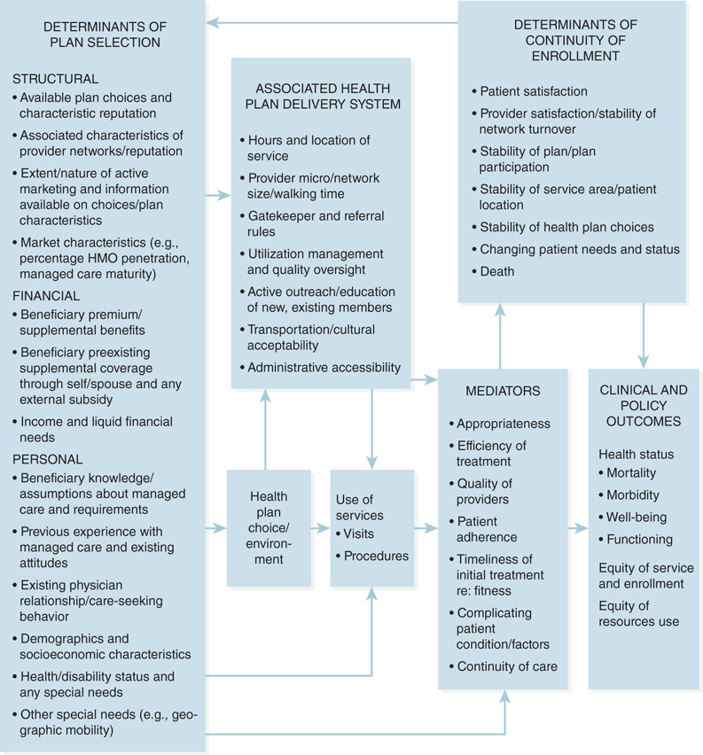
Access to Care (2 of 2)
Framework of access
Five dimensions of access
Availability
Accessibility
Accommodation
Affordability
Acceptability
Figure 12-8 Framework for access in the managed care context.
Reproduced from E.R. Docteur, D.C. Colby, and M. Gold, “Shifting the Paradigm,” Health Care Financing Review 17, no. 4 (1996): p. 12.

Slide 16
Four Main Types of Access
Potential access
Realized access
Equitable or inequitable access
Effective and efficient access

Slide 17
Measurement and Current Status of Access
Measurement of access
Using conceptual models access is measured at three levels
Individual
Health plan
Delivery system
Current status of access

Slide 18
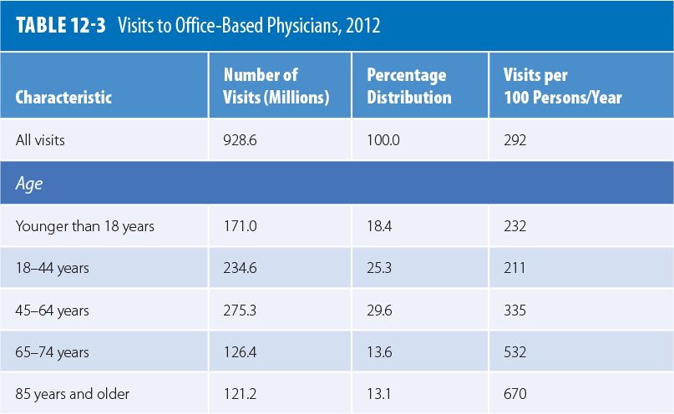
Current State of Access
Data from US Census Bureau. Statistical Abstracts of the United States, 2015, Washington, DC, p. 265.

Slide 19
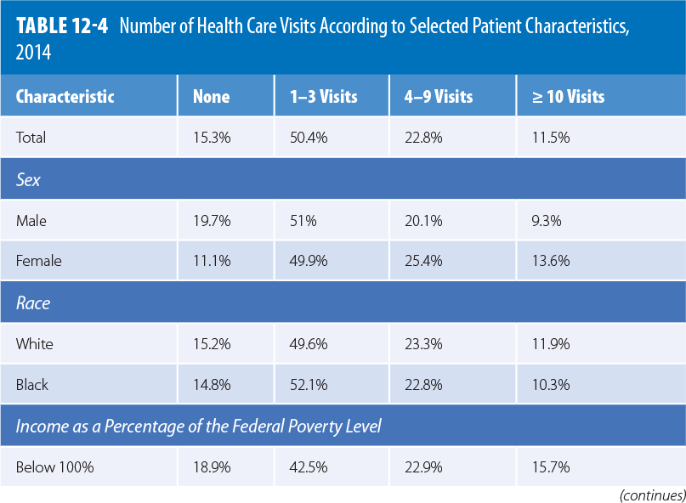

Slide 20
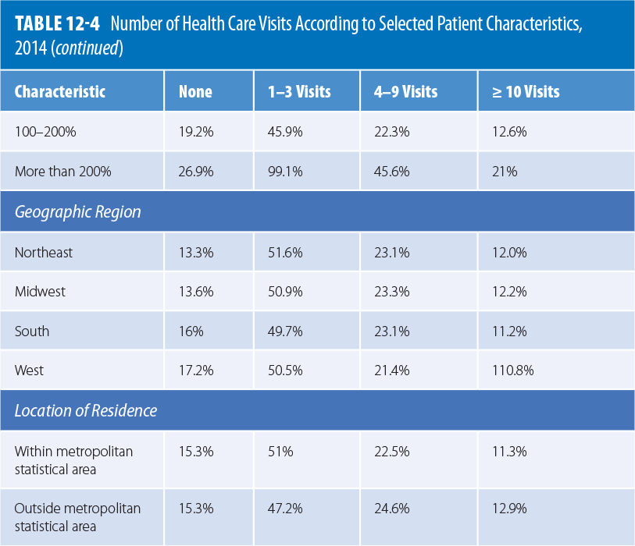
Data from Health, United States, 2015, pp. 235, National Center for Health Statistics, Division of Health Interview Statistics, 2016.

Slide 21
Affordable Care Act and Access to Care
Insurance coverage and access to health care have increased.
Fewer report problems with medical bills and financial barriers.
Gaps in access to and affordability of care.
Preventive services without cost sharing expanded.

Slide 22
Quality of Care
IOM’s quality implications
Quality performance has a range from unacceptable to excellent.
Focuses on services provided by the health care delivery system.
Quality may be evaluated from the perspective of individuals and populations or communities.
Emphasis on desired health outcomes.

Slide 23
Dimensions of Quality
Micro view focuses on services at the point of delivery and their subsequent effects.
Clinical aspects
Interpersonal aspects
Quality of life
Macro view looks at quality from the standpoint of populations.

Slide 24
Quality Assessment and Assurance (1 of 2)
Quality assurance is based on the principles of total quality management (TQM).
Referred to as CQI
Donabedian model.
See Figure 12-9

Slide 25
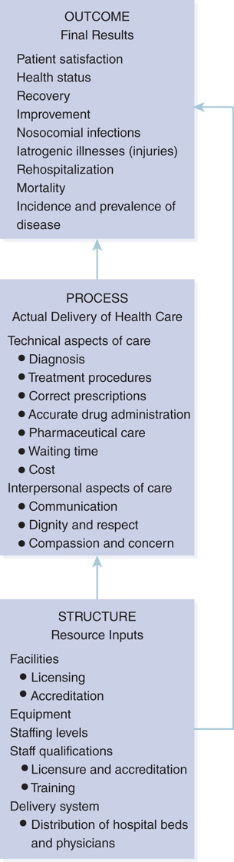
The Donabedian Model
Figure 12-9 The Donabedian model.

Slide 26
Quality Assessment and Assurance (2 of 2)
Processes that improve quality
Clinical practice guidelines
Cost-efficiency
Critical pathways
Risk management

Slide 27
Public Reporting of Quality
CMS programs on quality
Initiatives to improve care provided to Medicaid and CHIP enrollees
AHRQ quality indicators
Prevention, inpatient, patient safety, and pediatric
States’ public reporting of hospital quality

Slide 28
Affordable Care Act and Quality of Care (1 of 2)
Three objectives
Make health care more accessible, safe, and patient centered
Address environmental, social, and behavioral influences on health and health care
Make care more affordable

Slide 29
Affordable Care Act and Quality of Care (2 of 2)
Organizations are incentivized to provide high-quality care in two ways.
Penalized for failing to report quality measures
Sharing in the savings generated by quality measures
The number of patient safety and medical errors has decreased since 2010.
Patient-Centered Outcomes Research Institute (PCORI).

Slide 30
Summary
Increasing costs, lack of access, and quality concerns pose the greatest challenges.
Lack of universal coverage negatively affects the health status of uninsured groups.
Access to medical care is one of the key determinants of health status.
Health care quality at the micro and macro levels.

