Slide 1
Identifying Fast Food Franchise Restaurants in Houston, Texas to Pursue for Purchase
Applied Data Science Capstone Project by Joe McReynolds¶

Slide 2
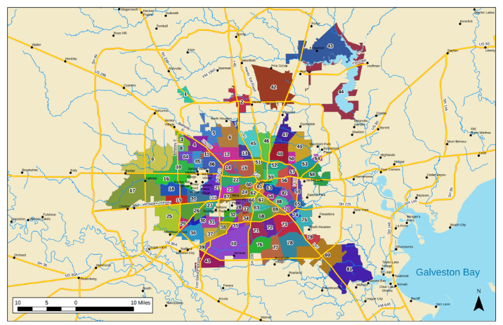
Project Goal : Identify lower rated fast-food franchise restaurants as candidates for purchase and investment in Houston, TX area

Slide 3
DATA FOR PROJECT
City of Houston Neighborhood Polygons
Foursquare Venue Data Service

Slide 4
METHODOLOGY FOR PROJECT
Develop workflow for identifying underperforming fast food franchise restaurants in Houston, Texas for restaurant investors to purchase. It is a four part process.
PART 1. Neighborhood Polygon Preprocessing
Capture Polygon and centroids for analysis
PART 2. General Venue Category Neighborhood Comparison
Use K cluster analysis to group Neighborhoods
with similar overall venue composition
PART 3. Fast Food Restaurant Franchise Neighborhood Comparison
Use K cluster analysis to group Neighborhoods
with similar fast food venue composition
PART 4. Fast Food Restaurant Ratings Analysis for select Neighborhoods
Create 2 Reports for identifying lower rated venues.
Report venue ratings grouped by neighborhood.
Report venue ratings grouped by fast food franchise.

Slide 5
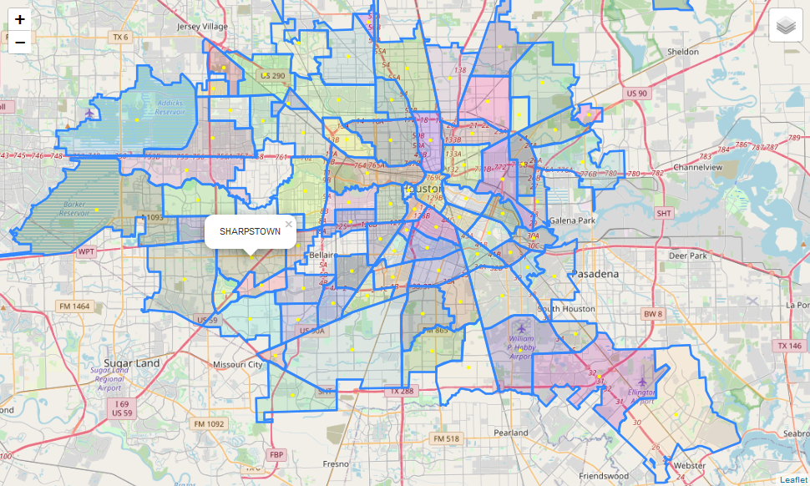
PART 1. Map Polygons of Neighborhoods of Houston

Slide 6
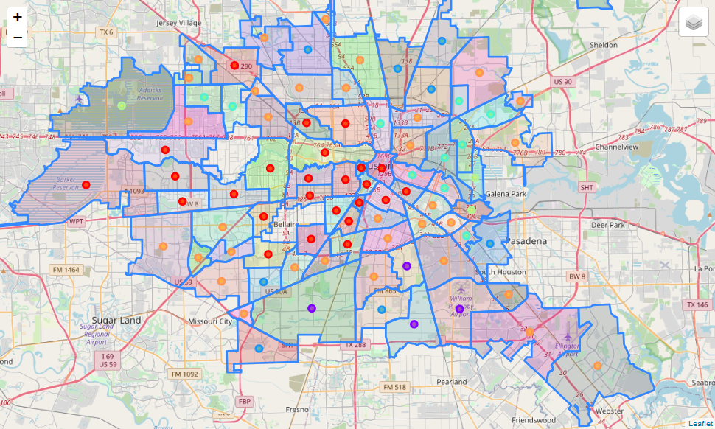
PART 2. General Venue Category Neighborhood Comparison
CLUSTER 0
CLUSTER 1
CLUSTER 2
CLUSTER 3
CLUSTER 4
CLUSTER 5
Selected Neighborhoods
K cluster analysis for all venue categories

Slide 7
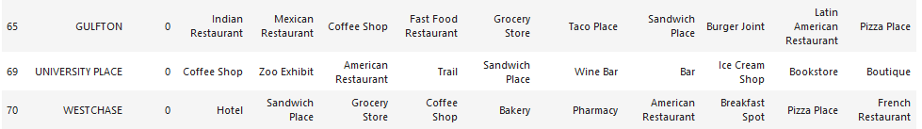

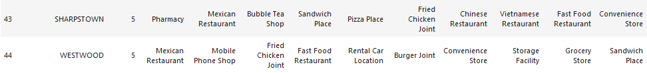
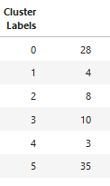
PART 2. General Venue Category Neighborhood Comparison
Analyzed 5009 venues in 332 categories
28 in cluster 0 and 35 in cluster 5

Slide 8
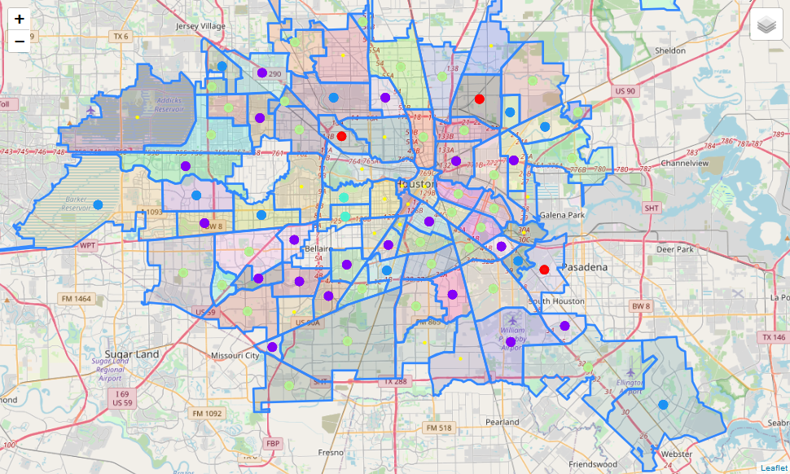
PART 3. Fast Food Restaurant Franchise Neighborhood Comparison
CLUSTER 0
CLUSTER 1
CLUSTER 2
CLUSTER 3
CLUSTER 4
Selected Neighborhoods
K cluster analysis for fast food only

Slide 9
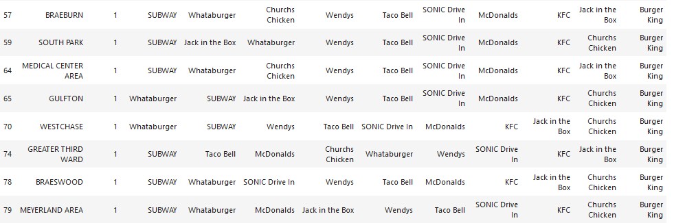
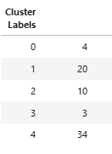
PART 3. Fast Food Restaurant Franchise Neighborhood Comparison
Analyzed 350 venues in 19 categories
20 in cluster 1 and 34 in cluster 4

Slide 10
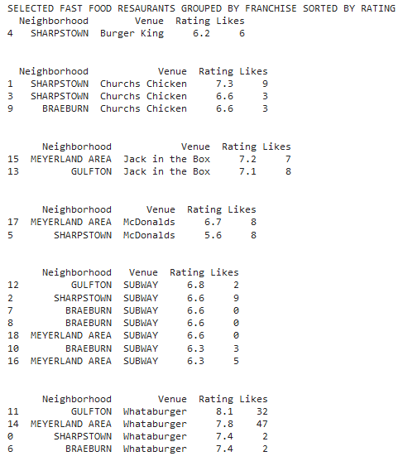
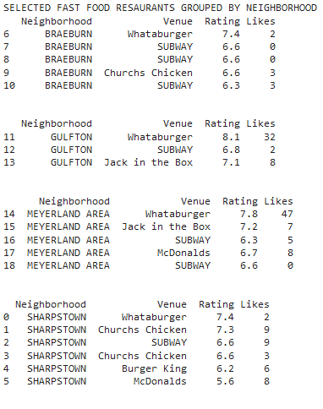
PART 4. Fast Food Restaurant Ratings Analysis for select Neighborhoods
Grouped by Neighborhood
Grouped by Fast Food Venue

Slide 11
PROJECT CONCLUSION
The McDonalds in Sharpstown was the lowest rated both for all fast food restaurants in Sharpstown and similar Neighborhoods analyzed. It is also the lowest rated of McDonalds. This venue should be on your list of underperformers.
The lower rated Churchs Chicken in Sharpstown is also on the list of underperformers.
Most restaurants had very similar ratings and no other venues stood out as low rated in our select area
Whataburger stands out as best overall rated restaurant. Consider a New Whataburger in a Neighborhood lacking Whataburger.
The "Likes" information was only useful in a qualitative sense and best identified the most popular individual restaurants such as the Whataburgers in Gulfton and Meyerland.

