Slide 1
Applications of VR in Hand Rehabilitation
By William Kaminski

Slide 2
Introduction
Pain from traumatic injury is a major issue
burn and wound cleaning
broken bones
phantom limb syndrome
muscle therapy
Excessive pain can cause long term issues
chronic pain
psychological issues (PTSD)

Slide 3
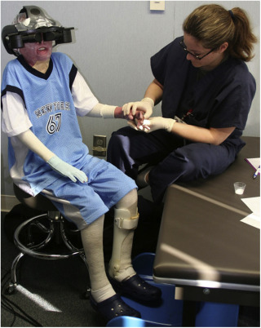
New Treatment: VR assisted Rehabilitation
Virtual Reality Exercises
Haptic feedback gloves, smartphones, head mounted displays
Supplemental to traditional therapy
Serves as distraction during routine treatments

Slide 4
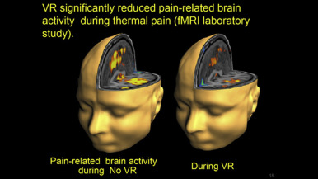
Why VR?
Scalable therapy
Can help to reduce pain
Reduces psychological strain
Increases patient engagement
Tool to measure recovery progress

Slide 5
Too Costly?
Is VR assisted rehabilitation too costly?

Slide 6
Too Costly?
Cost of VR technology has dropped significantly
Consumer VR headsets are now mass produced
Easy to train patients/physicians
Can reduce long-term healthcare costs

Slide 7
Conclusion
VR can improve hand rehabilitation
Can improve patient comfort
Reduces long-term healthcare costs
Reduces negative long-term effects on patients
VR has unexpected applications

Slide 8
References
Pereira, M. F., Prahm, C., Kolbenschlag, J., Oliveira, E., & Rodrigues, N. F. (2020, October 2). Application of AR and VR in hand rehabilitation: A systematic review. Journal of Biomedical Informatics. Retrieved March 2, 2022, from https://www.sciencedirect.com/science/article/pii/S1532046420302136
A virtual reality serious game for hand rehabilitation therapy. IEEE Xplore. (n.d.). Retrieved March 2, 2022, from https://ieeexplore.ieee.org/document/9201789

