Slide 1
Predicting 5-Year Survival Among Colorectal Cancer Patients By: Ayush Shrivastava Ashutosh Masulkar Rahul Swami Rishikesh Mankar Shantanu Dahiphale
Mentor:
Prof. Hamed Zolbanin
University of Dayton, MBAN 710 Capstone Project
May 2025

Slide 2
Business Background
What is SEER ?
The Surveillance, Epidemiology, and End Results (SEER) Program is a flagship initiative of the National Cancer Institute (NCI).
It collects comprehensive cancer data from population-based cancer registries covering approximately 48% of the U.S. population.
Key Highlights :
Established in 1973.
Tracks cancer incidence, survival, and treatment patterns.
Used extensively in clinical research, public health, and policymaking.
Considered one of the most reliable cancer datasets globally.
Why SEER for This Project ?
Offers detailed, longitudinal data on colorectal cancer
Enables real-world, evidence-based modeling
Perfect for training robust machine learning models for survival prediction

Slide 3
Problem Statement
Background : Colorectal cancer is the second leading cause of cancer-related deaths in the U.S. Despite treatment advancements, survival outcomes vary widely based on patient and tumor characteristics.
Challenge : Clinicians often lack predictive tools to assess long-term survival at diagnosis, limiting personalized care and effective resource planning.
Goal : Leverage SEER colorectal cancer data to:
Predict 5-year survival using machine learning.
Identify key survival factors
Support clinical and public health decisions
Target Variable :
1 = Survived ≥ 60 months
0 = Died within 60 months

Slide 4
Objective
Main Objective : To predict the 5-year survival outcome of patients diagnosed with colorectal cancer using historical clinical and demographic data from the SEER program.
Specific Goals : -
Build predictive models using machine learning techniques to classify whether a patient will survive 5 years post-diagnosis.
Clean and preprocess the SEER colorectal cancer dataset to handle real-world challenges like missing values, data leakage, and multicollinearity .
Identify the most influential features affecting long-term survival — such as tumor grade, size, and patient demographics.
Evaluate model performance using appropriate metrics like accuracy, ROC-AUC, and precision/recall.
Translate findings into insights that can support:
Clinical decisions (e.g., monitoring high-risk patients)
Public health policy (e.g., resource allocation)
Future research (e.g., survival factors across subgroups)

Slide 5
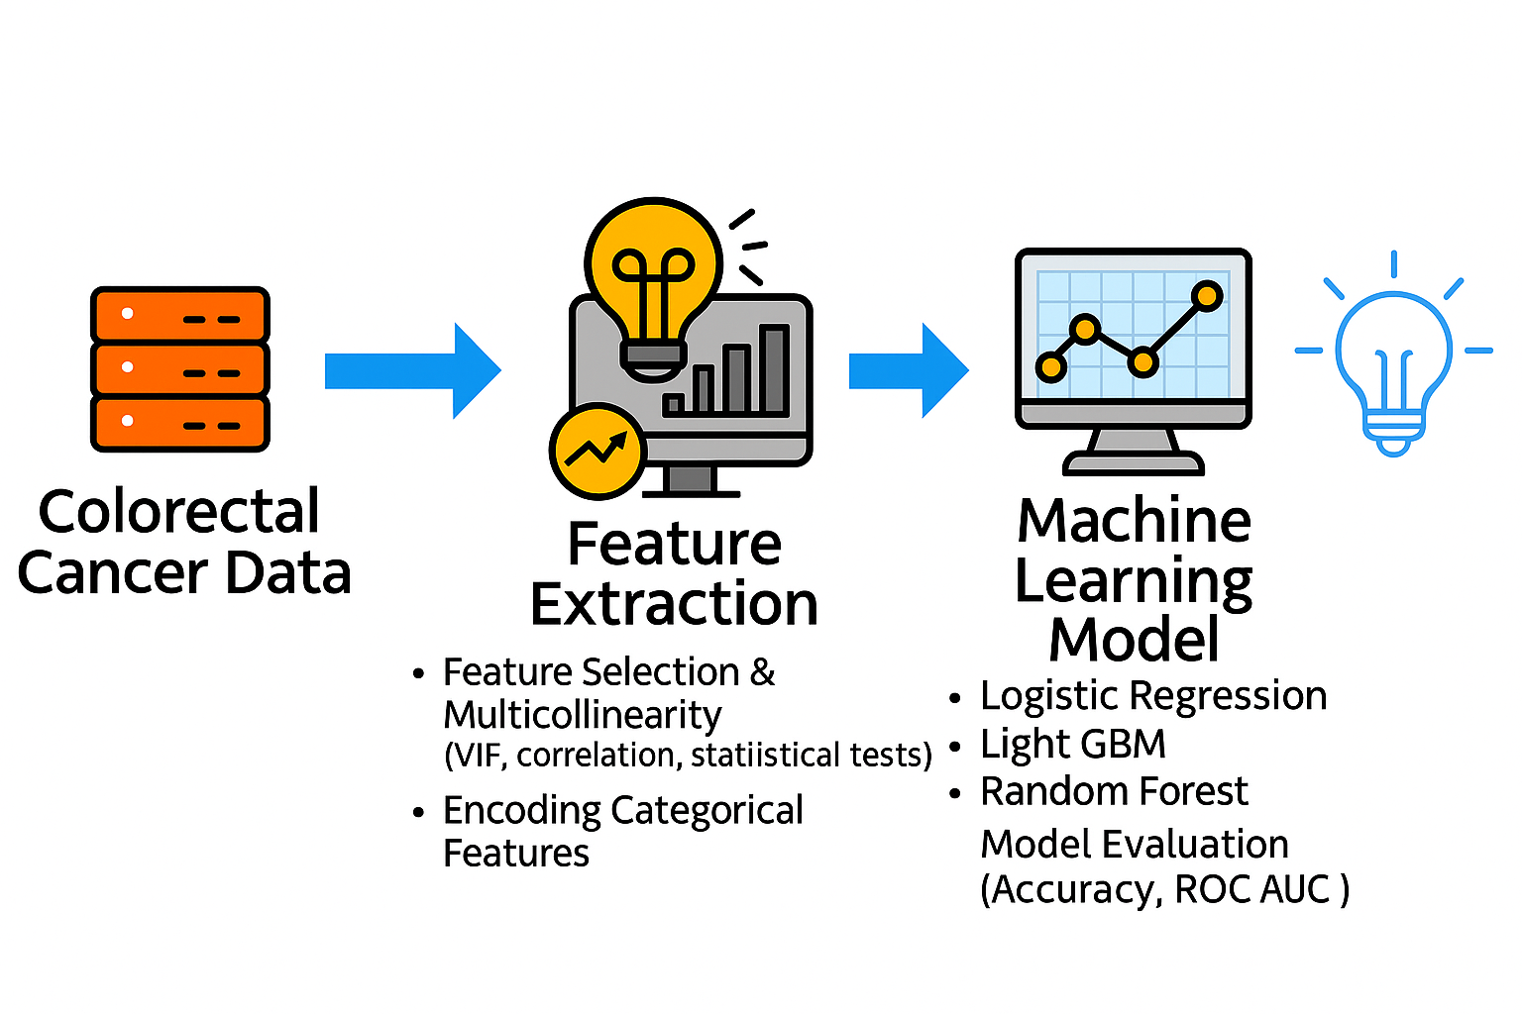
End-to-End Model Development Process

Slide 6
Data Description
Source: SEER (Surveillance, Epidemiology, and End Results) Program, NCI
Total Cases: Over 800,000 records
Focus : Colorectal cancer patient records.
Timeframe : Includes patients diagnosed between 1975–2020.
Features : Demographics (age, sex, race), tumor details (site, grade, histology), treatment, and outcomes.
Target Variable : target (binary: 1 = survived ≥ 5 years, 0 = did not)

Slide 7
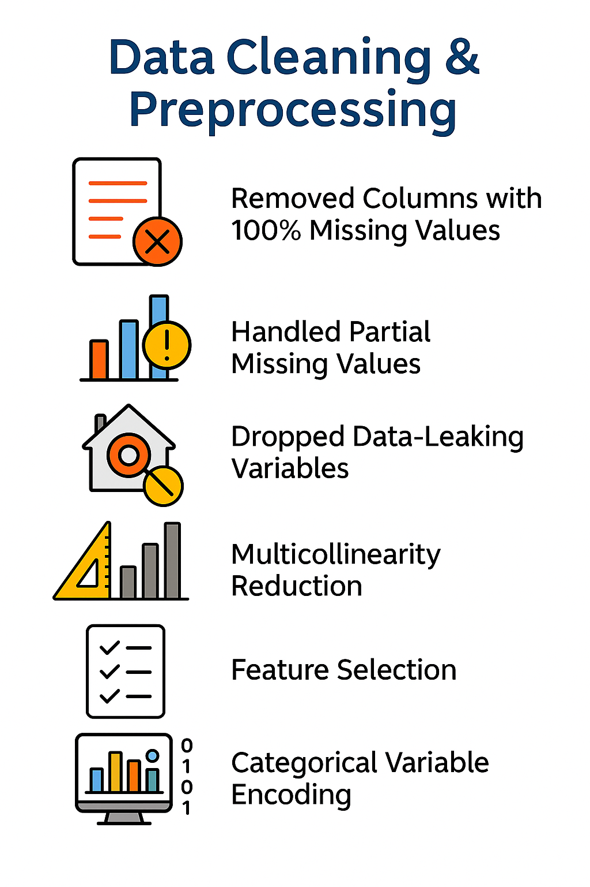
Data Cleaning &Preprocessing
Steps Performed :
Removed Columns with 100% Missing Values. Initial dataset had 149 columns; reduced after dropping fully null columns.
Handled Partial Missing Values : -
< 25% missing: Imputed using median or mode (e.g., YR_BRTH, IHS)
25%–65% missing: Imputed + added missing indicators (e.g., CS_SIZE, D_AJCC_T)
> 65% missing: Columns were dropped due to excessive nulls or low predictive power
Label encoding avoided to prevent ordinal bias

Slide 8
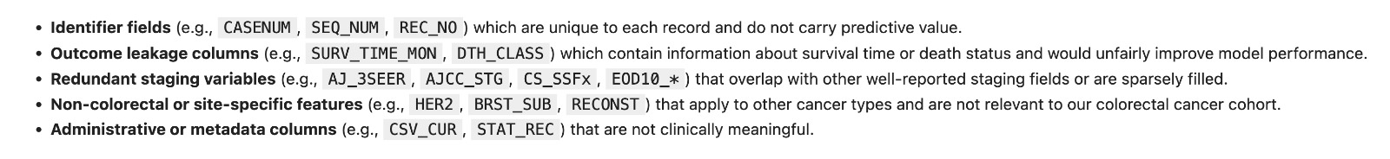
Data Cleaning &Preprocessing
Dropped Data-Leaking Variables : -
Example: SRV_TIME_MON, DTH_CLASS — these contain post-outcome info and lead to leakage.
Multicollinearity Reduction : - Used VIF (Variance Inflation Factor) to drop highly collinear features (VIF > 10 threshold)
Feature Selection : - Based on chi-square, ANOVA, correlation with target, and domain understanding
Categorical Variable Encoding : - Applied One-Hot Encoding to nominal categorical features

Slide 9
Feature Selection
Initial Feature Count: After cleaning — e.g., "Started with 110 features".
Techniques Used : VIF (Variance Inflation Factor): Removed features with high multicollinearity (VIF > 10).
Correlation Matrix : Identified redundant predictors.
Domain Knowledge : Dropped post-outcome variables to prevent data leakage.
Final Feature Count : Example: Reduced to 40 most informative variables.
Benefits : Improves model performance and generalizability. Reduces overfitting and training time.

Slide 10
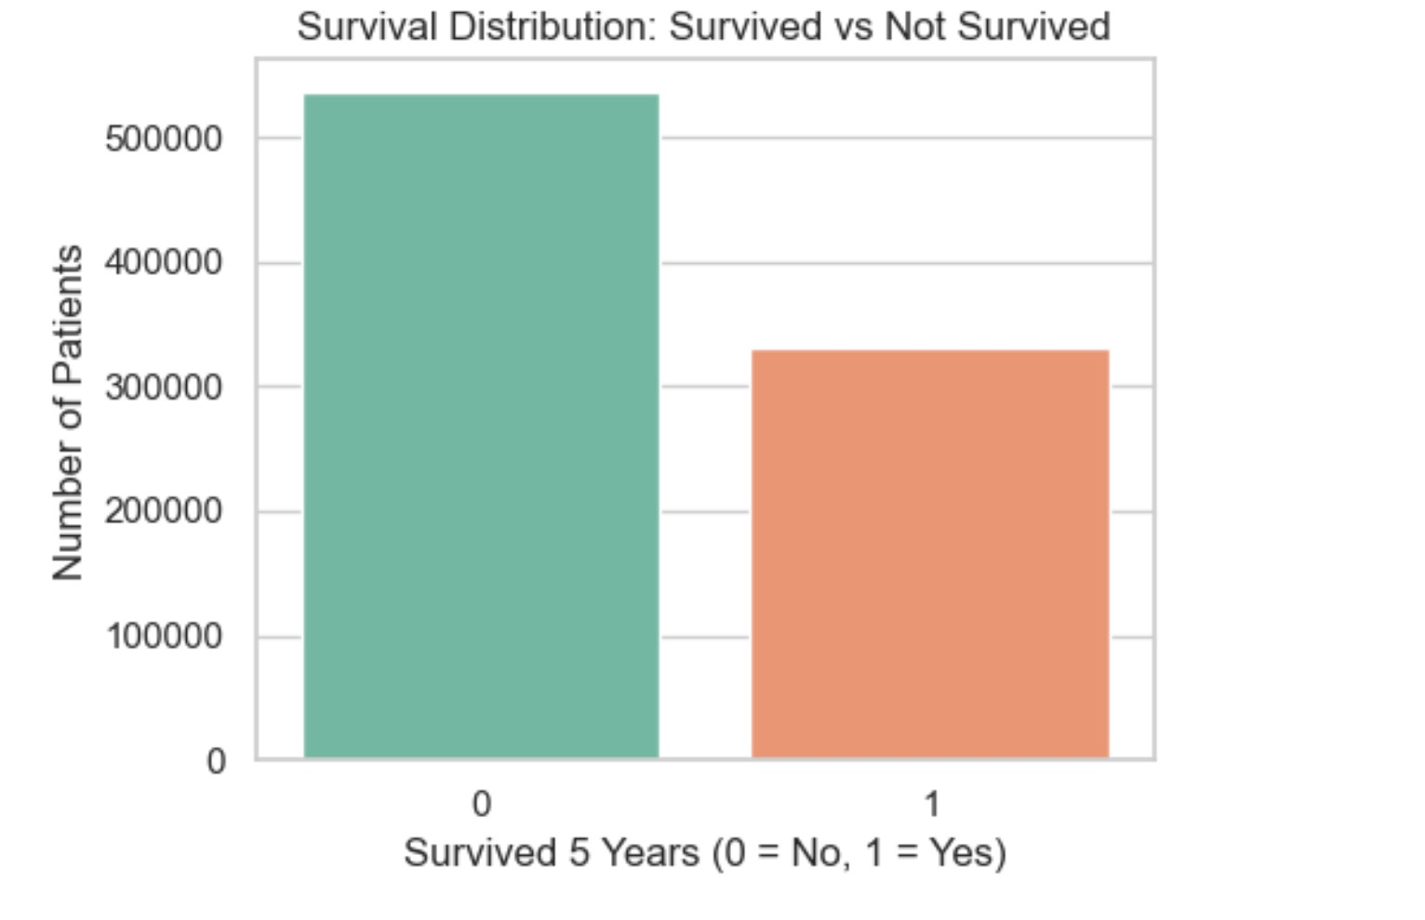
Target Variable
We created a binary target variable (target) based on the SRV_TIME_MON (Survival Time in Months) column from SEER data.
target = 1 → Patient survived ≥ 60 months (5 years)
target = 0 → Patient survived < 60 month
Class Distribution :
Survived (1): 331,232 patients
Not Survived (0): 535,508 patients

Slide 11
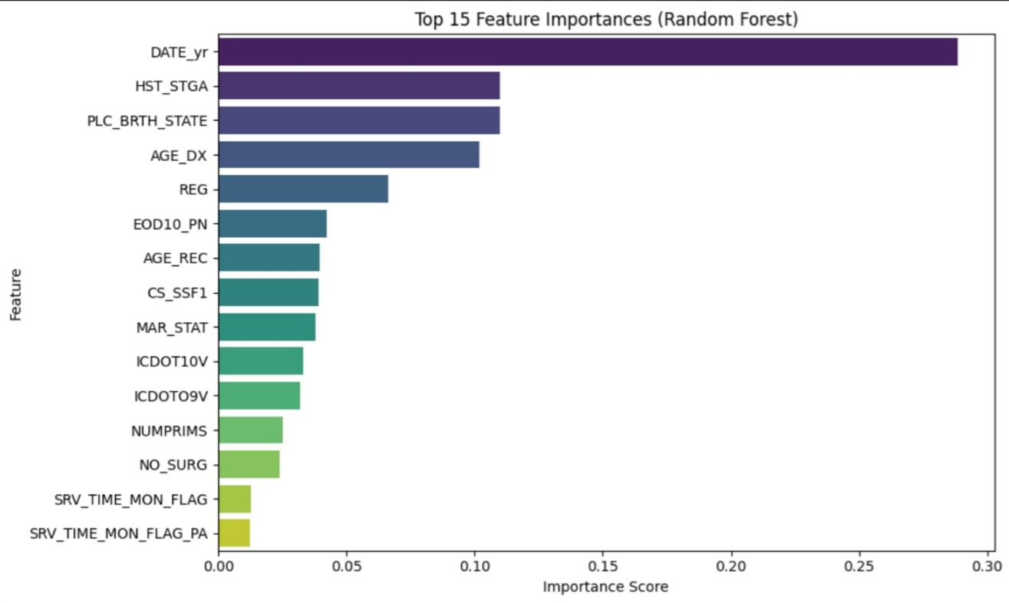
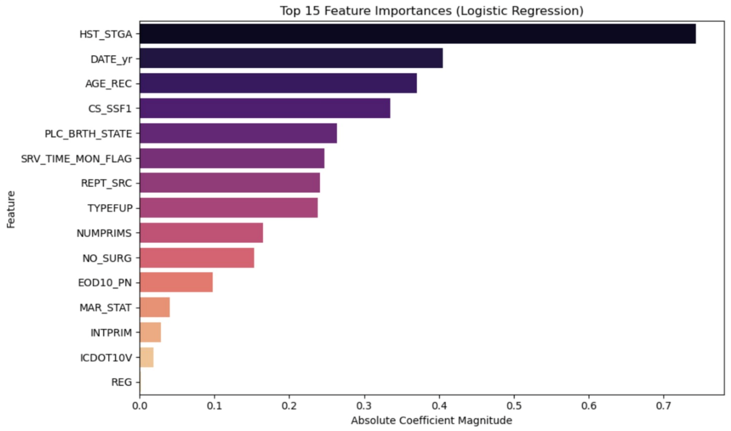
Feature Importance: Logistic vs Random Forest

Slide 12
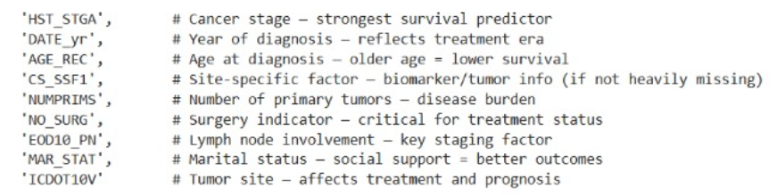
Final Feature

Slide 13
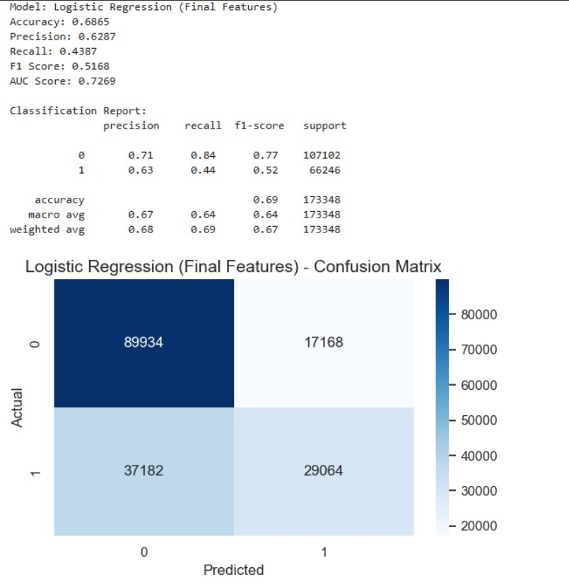
Logistic Regression
The model correctly predicted 52,662 true survivors, resulting in a high recall of 0.79 for the positive class.
However, 41,530 non-survivors were incorrectly predicted to survive lowering the precision to 0.56.
The model achieved an AUC score of 0.77, indicating good but not perfect separation between the classes

Slide 14
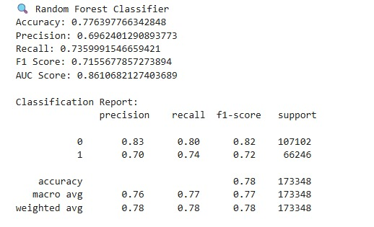
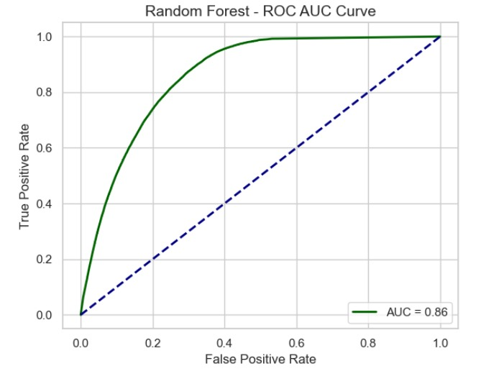
Random Forest
The model correctly predicted 48,757 true survivors, yielding a recall of 0.74, which indicates it correctly identified 74% of all actual survivors.
It misclassified 21,272 non-survivors as survivors, resulting in a precision of 0.70 — a tradeoff between false alarms and correct survivor detection.
The overall accuracy was 77.6% ,and the AUC score was 0.86, reflecting strong model discrimination.
The F1 score of 0.72 confirms a solid balance between recall and precision.

Slide 15
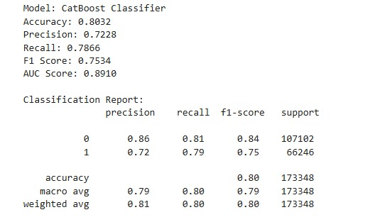
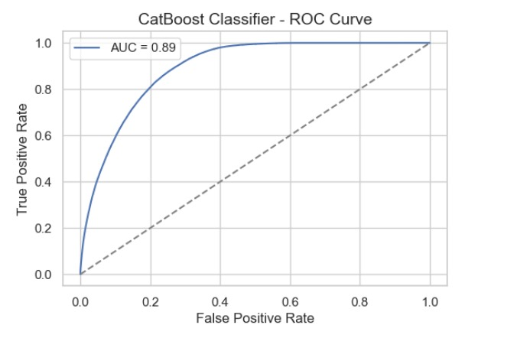
CatBoost
The model correctly predicted 52,107 true survivors, yielding a recall of 0.79, which reflects strong sensitivity to the positive class (survivors).
It misclassified 19,980 non-survivors as survivors, resulting in a precision of 0.72 — a solid tradeoff between false positives and true positives.
The accuracy of 80.3% and a strong AUC score of 0.8910 indicate very good overall discrimination.
The F1 score of 0.7534 confirms a solid balance between recall and precision for survivor prediction.

Slide 16
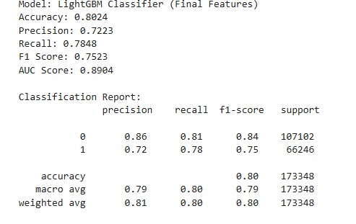
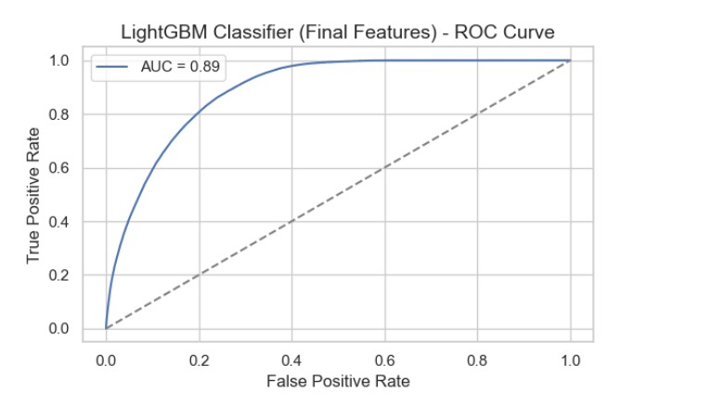
LightGBM
The model correctly identified 51,992 survivors, achieving a strong recall of 0.78, which is critical in identifying patients with a higher survival probability.
It misclassified 19,992 non-survivors as survivors, resulting in a precision of 0.72, showing a balanced ability to reduce false positives.
The model achieved an overall accuracy of 80.2%, with a solid F1 score of 0.75.
A strong AUC score of 0.89 confirms the model’s excellent ability to distinguish between survivors and non-survivors

Slide 17
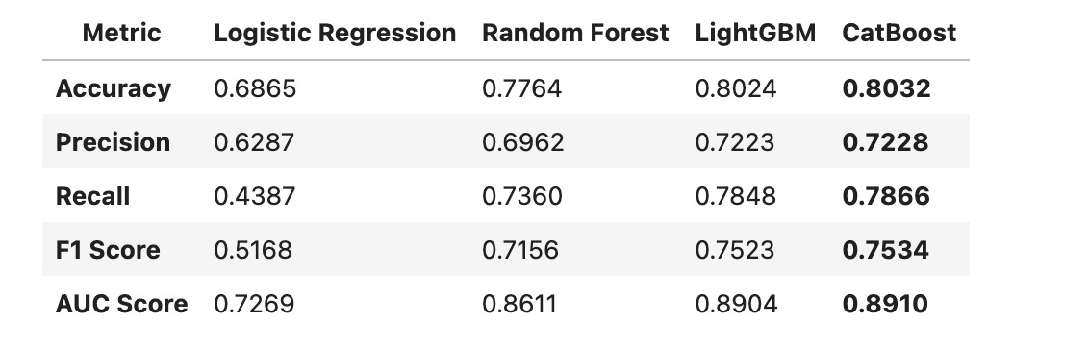
Model Performance Comparison

Slide 18
Model Summary
CatBoost outperformed all models, achieving the highest precision, recall, and AUC, making it the most balanced and robust classifier for survivor prediction. CatBoost delivered the highest AUC, F1 score, and recall, showing the most balanced and consistent performance.
LightGBM performed nearly as well and may be considered when computational speed is a priority. LightGBM was fast, resource-efficient, and nearly as strong as CatBoost in overall accuracy.
Random Forest showed good performance but slightly lagged in recall and AUC. Logistic Regression was simple and interpretable but had the lowest performance, especially in recall (0.44).
Logistic Regression, while interpretable, struggled to capture the complexity of the data, particularly with recall. Random Forest was balanced and robust, performing better than Logistic Regression but slightly behind the boosting models.

Slide 19
Recommendations
Add Survival Prediction Tools to SEER Dashboards.
SEER can include our machine learning model (like CatBoost) in its dashboards.
This would help doctors and researchers estimate a patient’s chance of surviving for 5 years, using their basic medical details. It could support better treatment planning and help health professionals make more informed decisions.
2. Identify High-Risk Patients for Extra Care.
The model can flag patients who are less likely to survive 5 years.
These patients can get closer follow-up, earlier care, or special attention.
This is especially helpful in rural or underserved communities where extra support is needed..

Slide 20
THANK YOU!!

