Slide 1
Chicago Crime Classifier
Will Collins

Slide 2
Mission Statement
The city of Chicago has made a dataset of every non-murder crime reported from 2001 to the present.
Using this data, I wanted to create a model that could predict if a given crime would lead to an arrest.

Slide 3
Limitations
Large amounts of data
Access to more computational resources

Slide 4
The Data
Column
ID
Case Number
Date
Block
IUCR
Primary Type
Description
Location Description
Arrest
Domestic
Beat
Description
Unique ID
Case number
Date of the crime
Block where the crime happened
Illinois Uniform Crime Reporting code
Type of crime
Additional details about the crime
Type of place the crime happened
Was an arrest made?
Was the crime a domestic incident?
Beat where the crime happened
Column
District
Ward
Community Area
FBI Code
X Coordinate
Y Coordinate
Year
Updated On
Latitude
Longitude
Location
Description
District where the crime happened
Ward where the crime happened
Community area where the crime happened
FBI crime classification
X coordinate of where the crime happened
Y coordinate of where the crime happened
Year when the crime happened
When the crime’s record was last updated
Latitude where the crime happened
Longitude where the crime happened
Where the crime happened
7.3 million rows of data

Slide 5
Data Alterations
Dropped nulls in Case Number, Location Description, District
Dropped all rows where Primary Type appears less than 100 times
Aggregated Primary Type, Description, Location Description, and Domestic into a single column for NLP analysis

Slide 6
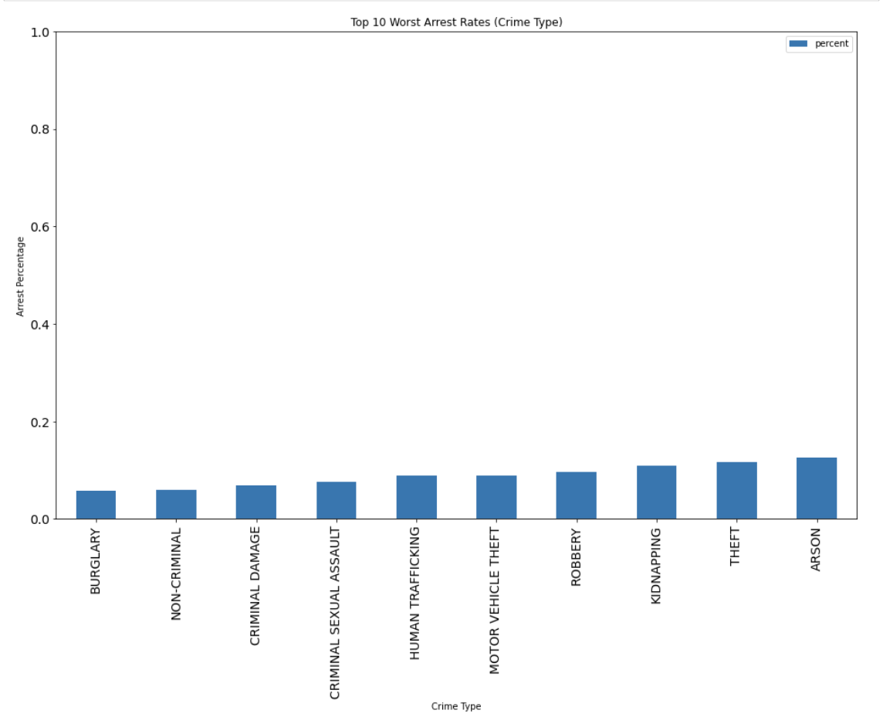
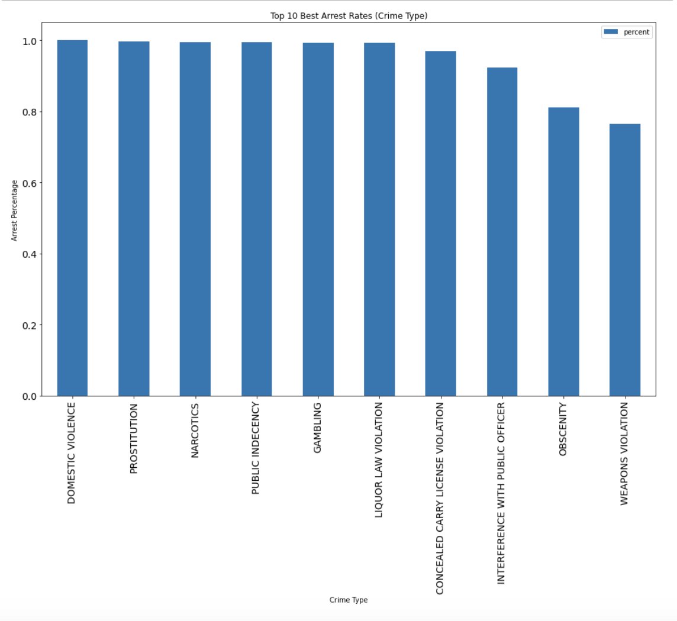
EDA

Slide 7
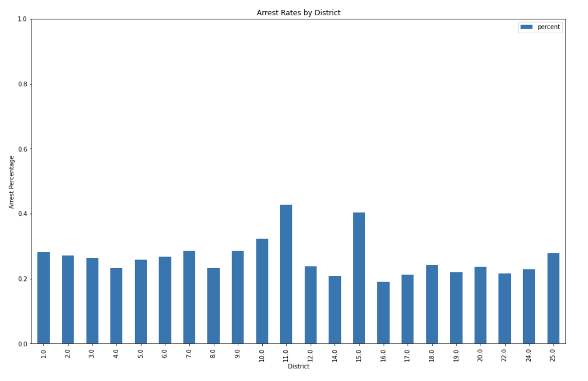
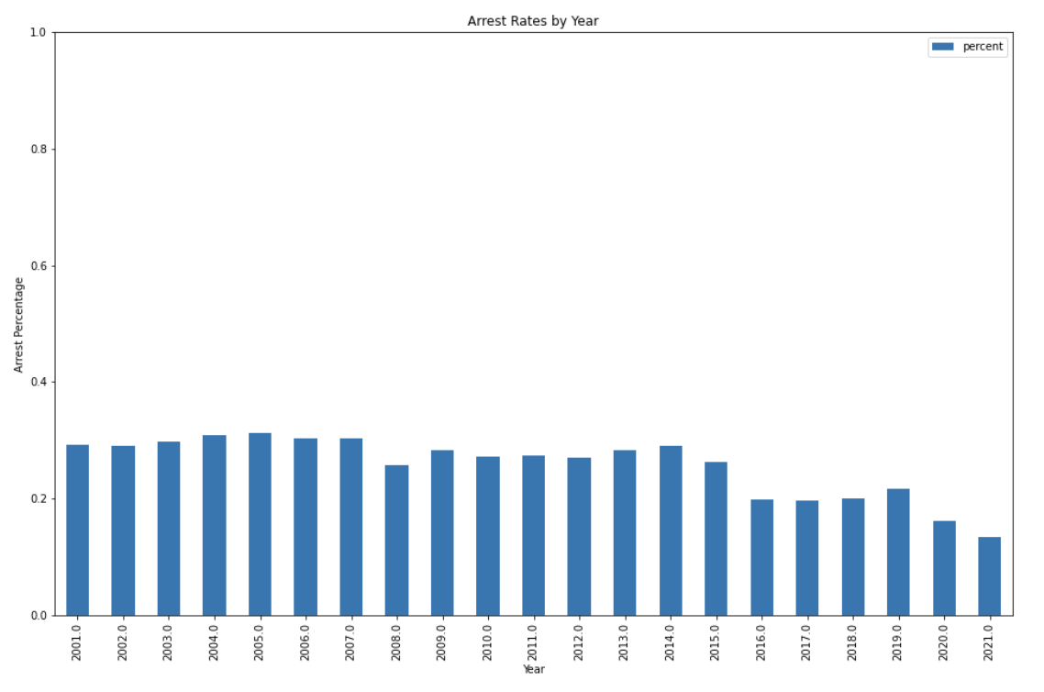
EDA (continued)

Slide 8
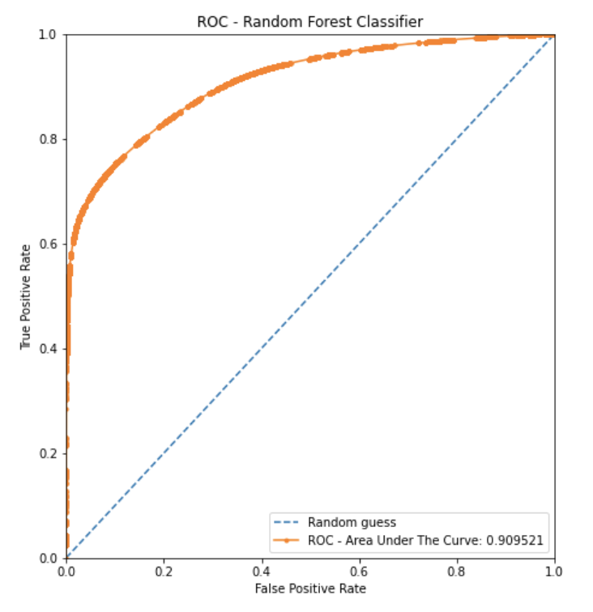
Random Forest Classifier
Training Accuracy: 89%
Test Accuracy: 89%
 | Precision | Recall
No Arrest | 0.88 | 0.98
Arrest | 0.91 | 0.64
 | Predicted NO | Predicted YES
Actual NO | 0.98 | 0.02
Actual YES | 0.36 | 0.64

Slide 9
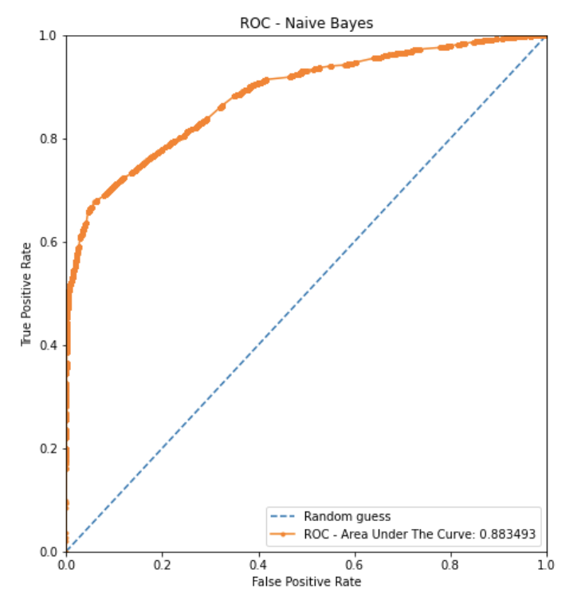
Naïve Bayes Classifier
Training Accuracy: 87%
Test Accuracy: 87%
 | Precision | Recall
No Arrest | 0.88 | 0.96
Arrest | 0.86 | 0.63
 | Predicted NO | Predicted YES
Actual NO | 0.96 | 0.04
Actual YES | 0.37 | 0.63

Slide 10
Business Value
Helping the Chicago PD allocate resources
Could see what factors to look into if they are leading to a lot of non-arrests
High model precision makes this feasible

Slide 11
Future Plans
More location-based analysis
Different classification models (SVM, K-Nearest Neighbors, etc.)
More extensive NLP modeling

Slide 12
Questions?

