Slide 1
Citi Bike Continued Analysis
Will Collins

Slide 2

About Me
Graduated from Georgia Tech a year ago
Have been doing data science for a few months now
Background in full-stack development

Slide 3


Agenda
Citi Bike Overview
Previous Analysis/Findings
About the Data
New Analysis/Findings
Recommendations/Next Steps

Slide 4


What is Citi bike?
New York City bike sharing service
Operated by Lyft
Steady growth since opening in 2013

Slide 5
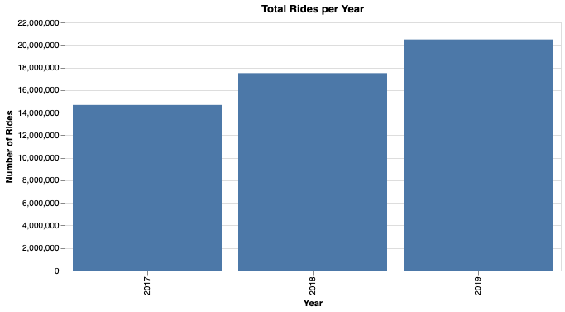
Reasons for Success
New York is a very bike-friendly city
Over 500,000 bike rides a day
Extremely accessible pricing
Many different community discounts
NYC employees, veterans/military, local government programs, etc.
Only $15/month, single ride and day pass options

Slide 6
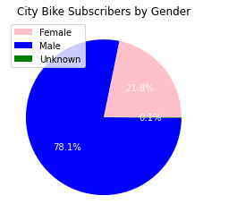
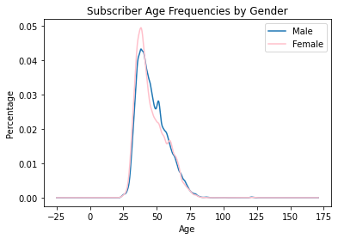
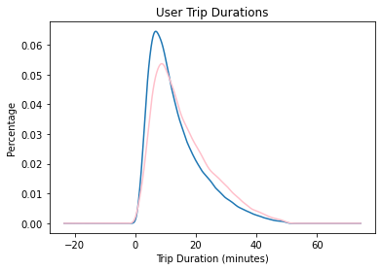
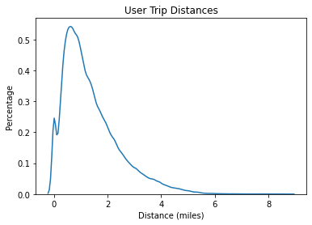

Previous findings
Userbase was mostly male, over 35, and preferred shorter rides

Slide 7

Current Research Goal
Find out if these trends have changed with more recent data

Slide 8
The Data
~50 million rows from 2017 to 2019
Column Name | Description
tripduration | How many seconds the trip took
starttime | Time and date of the start of the trip
stoptime | Time and date of the end of the trip
start station id | ID of the station where the trip started
start station name | Name of the station where the trip started
start station latitude | Latitude of the station where the trip started
start station longitude | Longitude of the station where the trip started
end station id | ID of the station where the trip started
Column Name | Description
end station name | Name of the station where the trip ended
end station latitude | Latitude of the station where the trip ended
end station longitude | Longitude of the station where the trip ended
bikeid | ID of the bike used on the trip
usertype | Type of user on the trip (Subscriber or Customer
birthyear | User’s birth year (Subscribers only)
gender | 0=unknown, 1=male, 2=female
age | Age of the user derived from their birth year
sex | Description based on gender code

Slide 9
Cleaning Steps
Major focus on removing outliers
Less than 2% of the data being displayed
Existing data made more readable
Latitude and longitude to distance, trip seconds to trip minutes, etc.

Slide 10
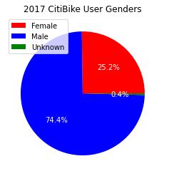
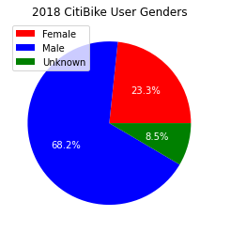
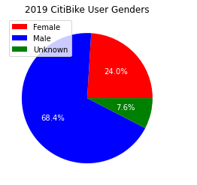
Gender
Still mostly men, but the ratio remains nearly the same despite growth

Slide 11
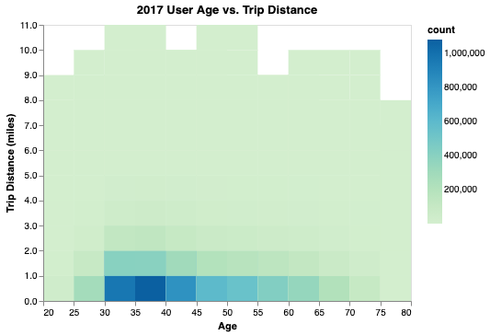
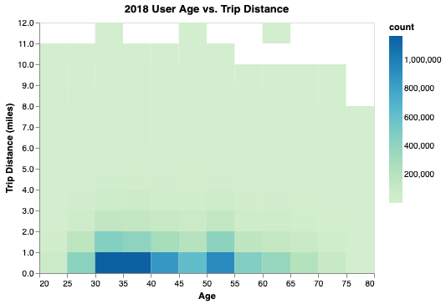
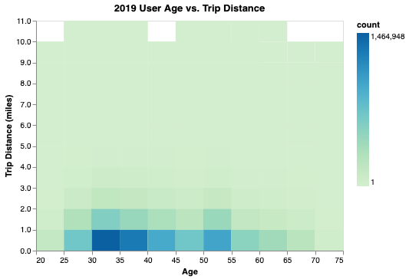
Shorter trips are still preferred, but longer trips are becoming more common over time

Slide 12
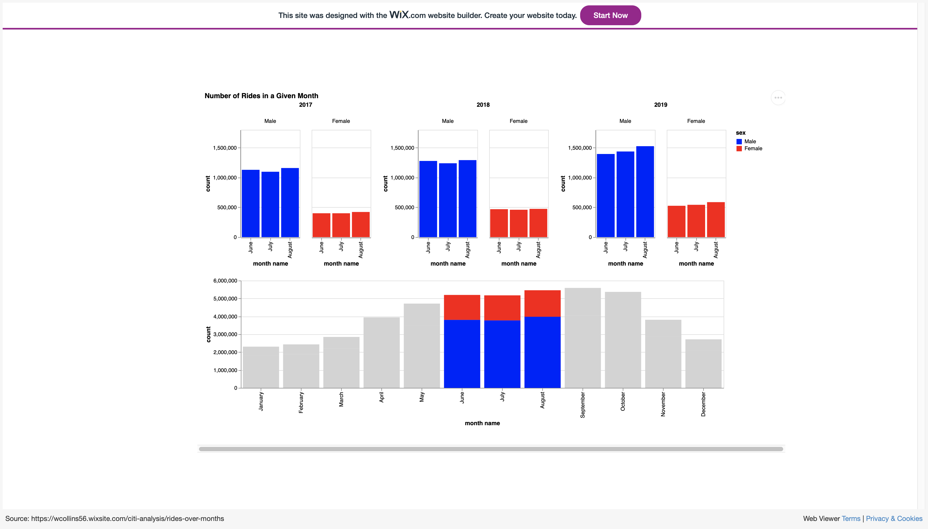

Slide 13
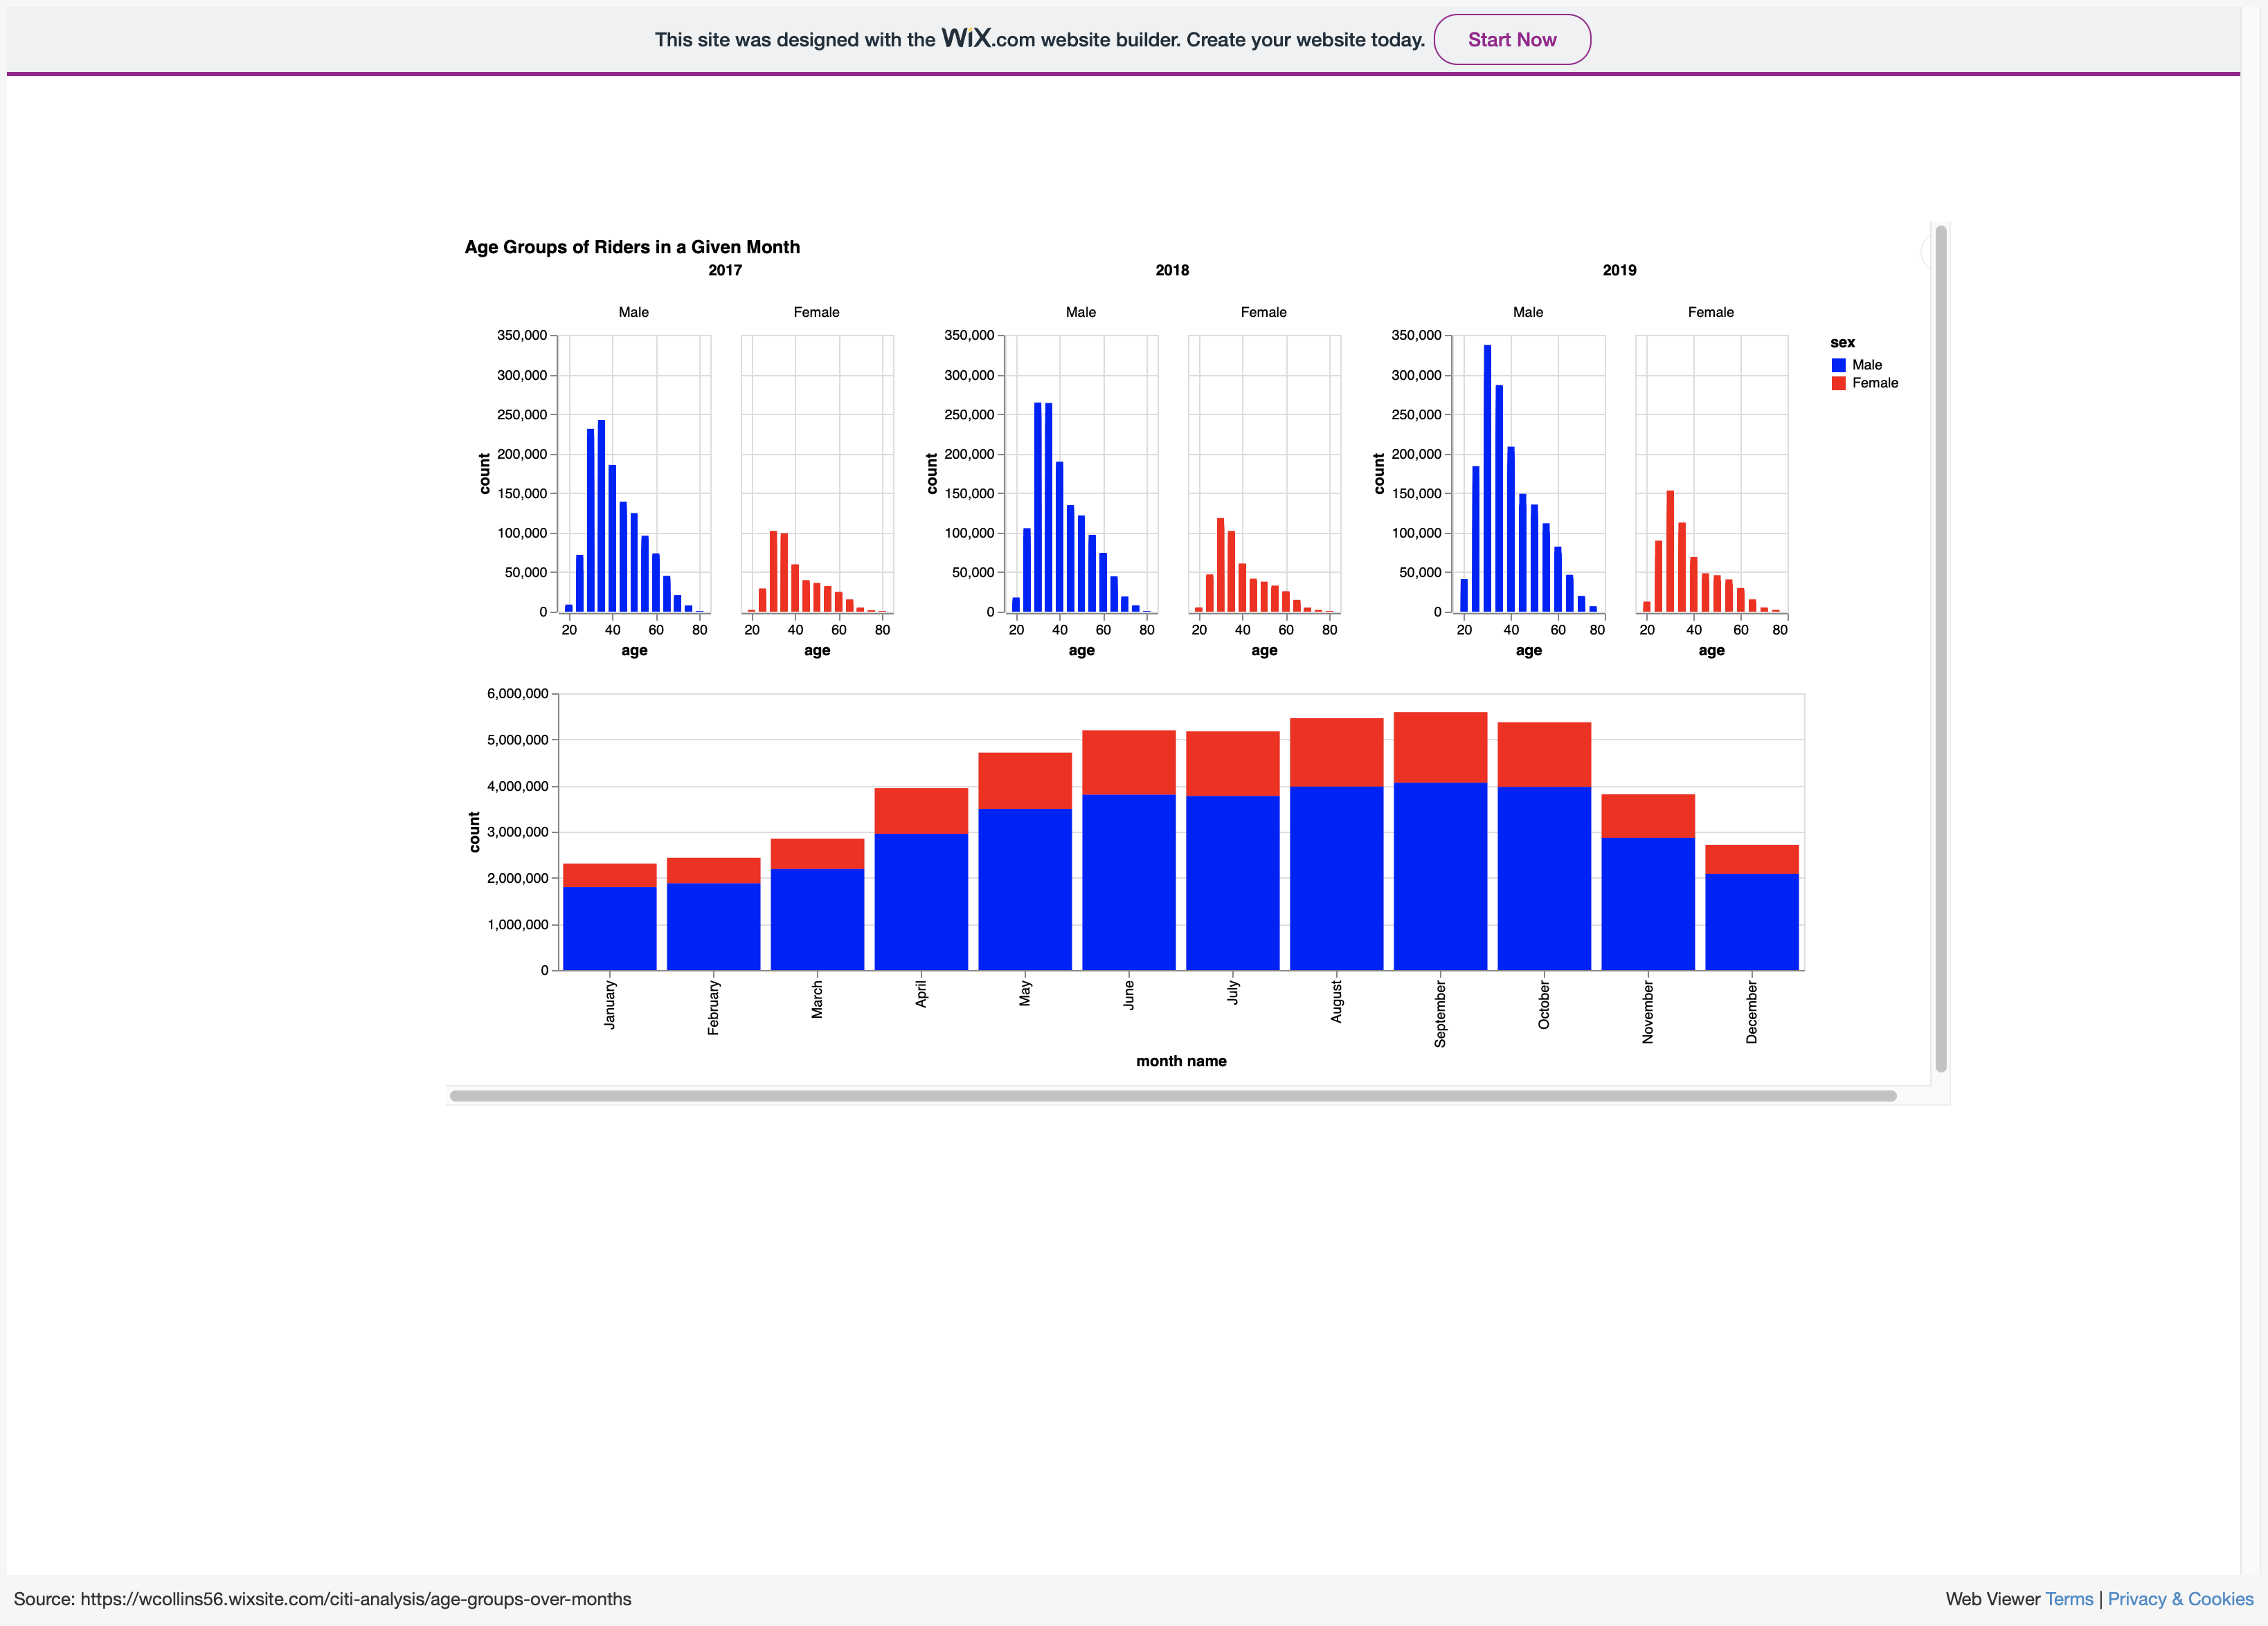

Slide 14
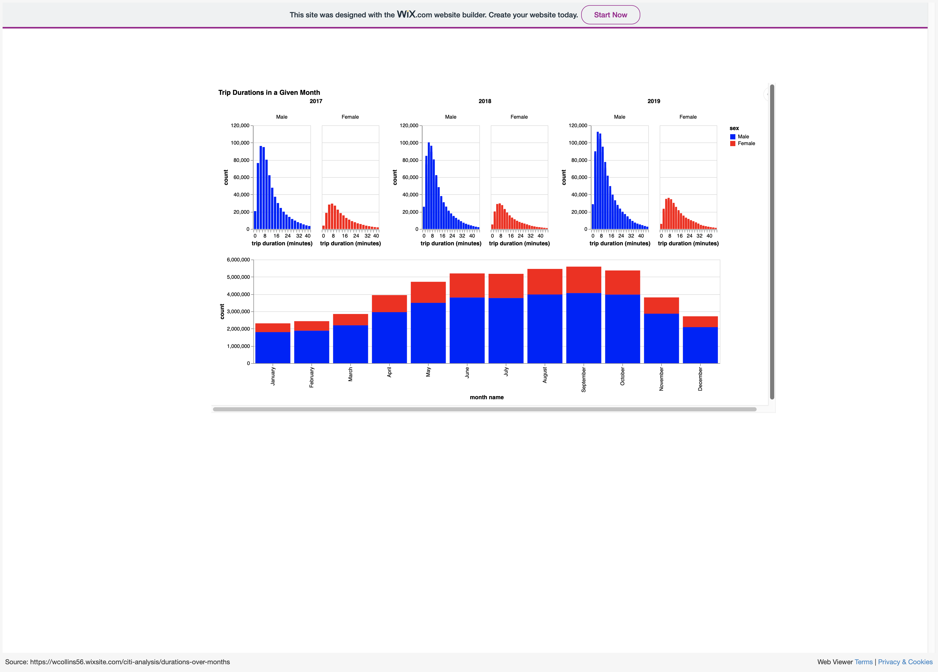

Slide 15

Conclusions
Steady growth appealing to the same core demographics since the start of the company
Peak riding months are June-October

Slide 16

Next Steps
New discount programs
Ramp up marketing during peak months
Even more gender tracking
GPS tracking on bikes

Slide 17

Questions?

