Slide 1
KeyChain
Miranda McClellan, Elorm Koto, Anthony Rolland, William Lopez-Cordero

Slide 2
Problem
Private Key Management
Private Key abstraction

Slide 3
Current Solutions
Recovery seed
3rd party machine dedicated to backups

Slide 4

Private Key Recovery via Fingerprint

Slide 5

The technology:
Bitcoin Test Net
Fuzzy Vault

Slide 6
How it works
Fingerprint + Private Key
Vault
Put Vault on Blockchain

Slide 7
Private Key Recovery
Get Vault from Blockchain
Fingerprint + Vault
Private Key

Slide 8
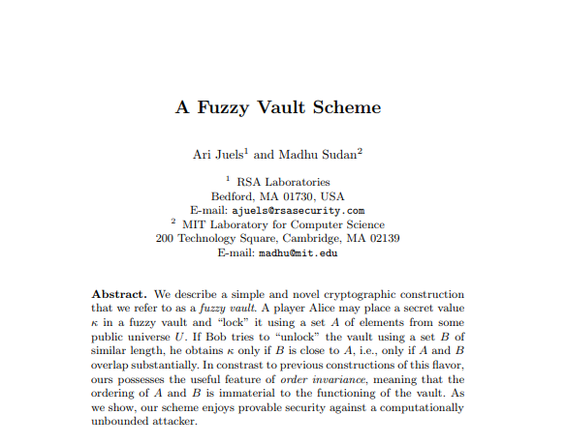
http://www.arijuels.com/wp-content/uploads/2013/09/JS02.pdf

Slide 9
Fuzzy Vault
G O O D

Slide 10
Fuzzy Vault
71
79
79
68

Slide 11
Fuzzy Vault
1 2 3 4

Slide 12
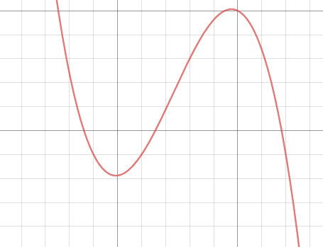
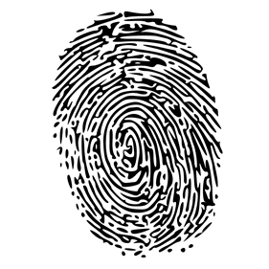
Fuzzy Vault

Slide 13
Fuzzy Vault

Slide 14
Fuzzy Vault

Slide 15
Fuzzy Vault
1 2 3 4

Slide 16
Putting Vault on Blockchain Constraints
Vault data type ([][]float64) mismatch with data field ([]byte) in Bitcoin transactions
520

Slide 17
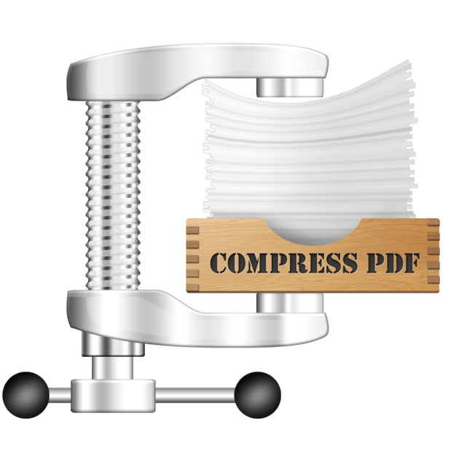

Putting Vault on Blockchain
[][]Float64
[]Byte
Vault

Slide 18
Recovering Private Key From Blockchain
Piece together Vault from different transactions
Decompress Vault
Convert Vault into [][]Float64
Private Key = Unlock(Vault, FingerPrint)

Slide 19
Scaling Concerns
Vault grows with size of Fingerprint Data
Processing real Fingerprint Data into correct format

Slide 20
Future Work
Phone Integration
Reducing size of data
User prompts for transaction input
Fingerprint generation

Slide 21
Questions?

Slide 22



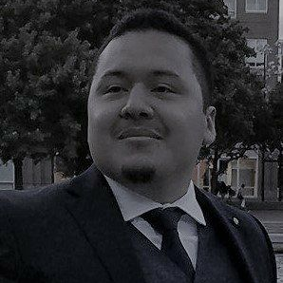
The Team
The team using biometric data for private key recovery
Miranda McClellan
Elorm
Koto
Anthony
Rolland
William Lopez-Cordero
MIT 2018
6-3 | Computer Science
MIT 2020
6-3 | Computer Science
MIT 2019
6-3 | Computer Science
MIT 2018
16 | AeroAstro

