Slide 1

1
3
4
6
3
4
6
1
2
4
1
2
4
1
1
1
4
6
3
4
6
4
2
4
1
1
2
3
By 红烛
1
1
2
21 合并两个有序列表

Slide 2
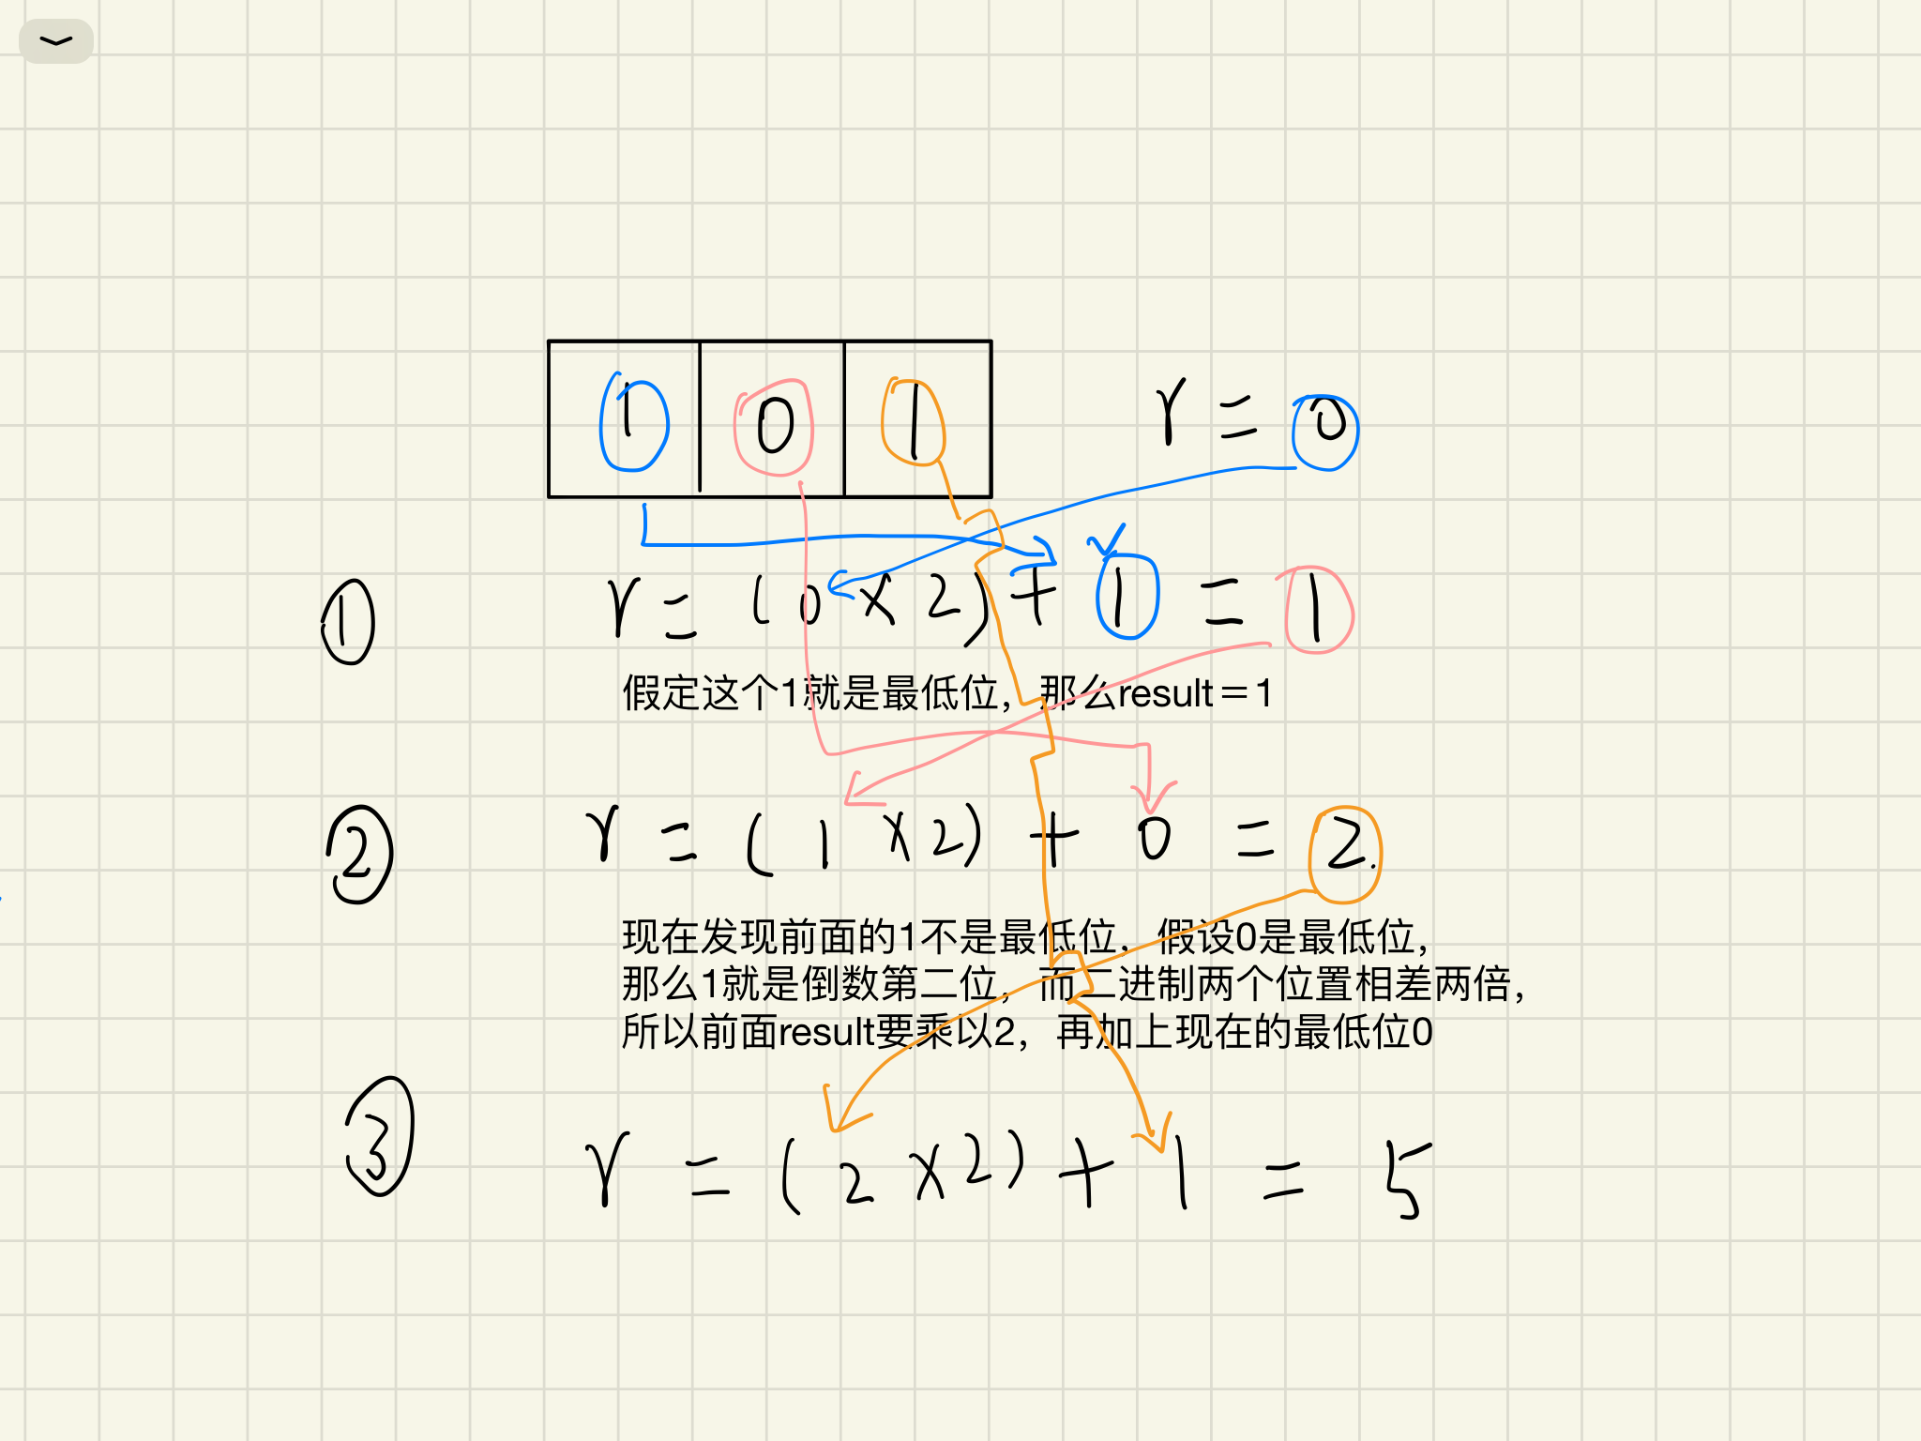
By 红烛
1290-二进制链表转十进制

Slide 3
head
head.next
head
head.next
head
1
1
4
6
By 红烛

Slide 4
cur
cur
1
3
4
6
1
3
4
6
newHead
null
newHead
null
cur
newHead
1
3
4
6
null

Slide 5
newHead
head
1
3
4
6
null
newHead
head
1
3
4
6
null
newHead
head
1
3
4
6
null

