Slide 1

From Shape Analysis to Heap Indexing
Chengpeng Wang
Dec 17th, 2020
Notes:
Good morning, everyone. Today I want to share my new finding about shape analysis.

Slide 2
Outline
Shape analysis
Problem
Application
Possible solution
Notes:
I will start from the limitation of current shape analysis and define a new problem, and discuss some applications if the problem is well solved. The insight and possible solution will be delivered at the end.
Firstly, let’s go back to traditional shape analysis and one of its typical extensions

Slide 3

Shape Analysis
How memory locations are connected?
Different logics
Three value logic
Separation logic
$$sll\left(a, nil\right)∗sll\left(b, nil\right)$$
Node* curr = a;
while (curr->next != NULL) {
curr = curr->next;
}
curr->next = b;
$$sll\left(a, curr\right)∗sll\left(curr, b\right)∗sll\left(b, NULL\right)$$
Notes:
As we all know, shape analysis concerns the connectivity relation of memory locations.
Logical based method … fixed points… logical formula for each program location(Click!)
For example, concat(Click), … pre/post
However, connectivity relation alone is not enough. According to these two SL formulae, we don’t know whether there is a node in list a lost in the concat.

Slide 4






Multi-domain Shape Analysis
How the size of memory evolves?
Add numeric domain to abstract numeric quantities
Numeric quantity: Dis
a
b
Before concat
$$v_{1}$$
$$v_{2}$$
$$v_{3}$$
dis(a, nil) = 2 dis(b, nil) = 1
After concat
a
dis’(a, curr) = 1 dis’(b, nil) = 1
dis’(curr, b) = 1
$$v_{1}$$
$$v_{2}$$
$$v_{3}$$
cur
b
dis(a,nil) + dis(b,nil) = dis’(a, curr) + dis’(b,nil) + dis’(cur, b)
Notes:
Multi-domain shape analysis provides an additional abstraction of memory.
Track how the size of memory evolves (Click)
Existing work: Convert heap program to numeric program, get relation of numeric quantities

Slide 5
Limitation
Combination of size and shape domain can not model semantics precisely
Example: func is reverse or traversal
Shape domain: {sll(x, nil)} func(x) {sll(x, nil)}
Numeric domain: dis(x, nil) = dis’(x, nil)
Notes:
Unfortunately, cannot model precisely
Given this spec, we don’t know whether func is reverse or traversal, because they have the same abstraction on these two domains
Therefore, in order to have a better understanding of the function and get a precise summary, it is necessary to focus on a detailed property of data structure and the program manipulating it.

Slide 6
Outline
Shape analysis
Problem
Application
Possible solution
Notes:
Now, let’s come to the definition of thr problem

Slide 7
Problem
Given recursive data structures and a program, we concern the evolvement of locations of nodes in the data structures

Slide 8
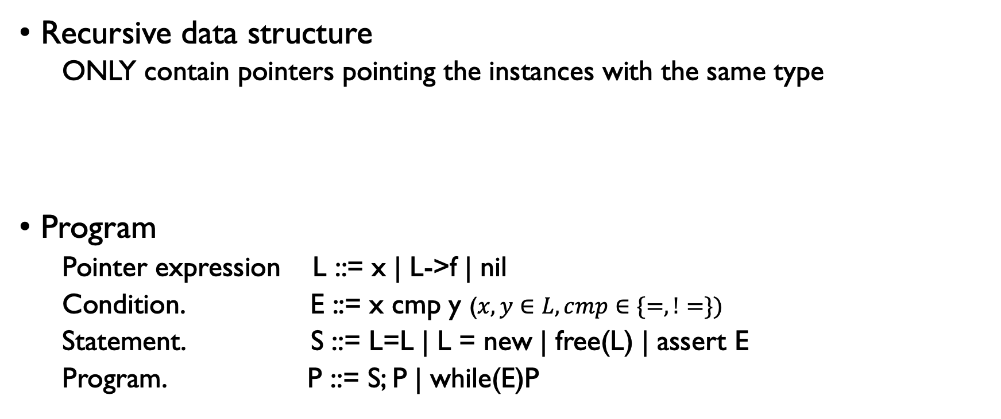
Program Syntax
Recursive data structure
ONLY contain pointers pointing the instances with the same type
Program
Pointer expression L ::= x | L->f | nil
Condition. E ::= x cmp y ($x, y∈L, cmp∈\{=, !=\})$
Statement. S ::= L=L | L = new | free(L) | assert E
Program. P ::= S; P | while(E)P
Node {
int data;
Node* n;
}
Notes:
Recursive data structure
(Click) List
(Click) Pointer expre, cond
(Click) Statement,program

Slide 9

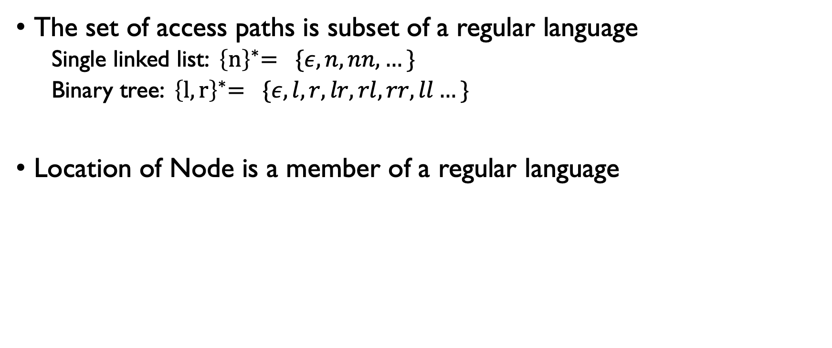





Location of Node
The set of access paths is subset of a regular language
Single linked list: ${ \left\{n\right\}}^{∗}= \{ε, n, nn, …\}$
Binary tree: ${ \left\{l, r\right\}}^{∗}= \{ε, l, r, lr, rl, rr, ll…\}$
Location of Node is a member of a regular language
a
a
$$ε$$
$$n_{a}$$
$$n_{a}n_{a}$$
$$0_{a}$$
$$1_{a}$$
$$2_{a}$$
Notes:
The third concept, Locatio of Node is defined by access paths. The universe of acess paths is a subset of a regular language. For example..
(Click) Location is a member of rl
(Click) The second loc is Na
(Click) Map to integer for short, use intger notation

Slide 10




Example
Insert_head
Node* Insert_head(Node* a, Node* b)
b
a
$$I_{a}=\{0_{a}, 1_{a}\}$$
$$I_{b}=\{0_{b}\}$$
c
$$I_{c}=\{0_{c}, 1_{c}, 2_{c}\}$$
Node* c = insert_head(a, b);
$$f_{a→c}\left(i_{a}\right)=i_{c}+1$$
$$f_{b→c}\left(0_{b}\right)=0_{c}$$
Find a transformer to abstract the evolvement of locations of nodes
Notes:
Under such definition, the location envolvement can be represented by the numeric function.
For example
(Click!)

Slide 11
Outline
Shape analysis
Problem
Application
Functional correctness verification
Termination analysis
Worst-Case-Execution-Time analysis
Possible solution
Notes:
Location involvement can support some interesting applications possibly.

Slide 12












Application: Functional Correctness
Check the consistency of implementation and functional specification
Functional specification in documentation, assertion
A particular form of taint specification
b
a
$$sll\left(a, nil\right)∗sll\left(b, nil\right)$$
$$v_{3}$$
$$v_{1}$$
$$v_{2}$$
c = insert_head(a, b)
c
$$v_{3}$$
$$v_{1}$$
$$v_{2}$$
$$sll\left(c, nil\right)$$
d = delete_front(c)
d
c
$$v_{3}$$
$$v_{1}$$
$$v_{2}$$
$$sll\left(c, nil\right)∗sll\left(d, nil\right)$$
Notes:
Documentation and assertion in the program provides functional spec
Check consistency of implementation and specification
(Click!) taint spec

Slide 13
Application: Functional Correctness
DFS
Challenge: Mapping the regular language to integer might be difficult
2
1
a
3
a
n
l
0
l
0
1
2
3
4
r
r
4

Slide 14


Application: Termination Analysis
Prove a program halts for arbitrary valid inputs
Node* insert_tail(Node* a, Node* b) {
Node* curr = a;
while (curr->next != NULL) {
curr = curr->next;
}
curr->next = b;
return a;
}
$$sll\left(a, nil\right)∗sll(b, nil)$$
$$sll\left(a, cur\right)∗sll\left(cur, nil\right)∗sll\left(b, nil\right)$$
a
b
0
1
curr
Node accessed by curr: $0_{a}$
Notes:
Another application is to prove whether a program halts.
(Click!) For example,assume input is single link list
(Click!) When analyze the location evolvment, it can be found that the location accessed by curr increases, in the first iteration

Slide 15

Application: Termination Analysis
Prove a program halts for arbitrary valid inputs
Node* insert_tail(Node* a, Node* b) {
Node* curr = a;
while (curr->next != NULL) {
curr = curr->next;
}
curr->next = b;
return a;
}
$$sll\left(a, nil\right)∗sll(b, nil)$$
$$sll\left(a, cur\right)∗sll\left(cur, nil\right)∗sll\left(b, nil\right)$$
a
b
0
1
curr
Monotone + Finite
Node accessed by curr: $1_{a}$
Must terminate
Notes:
In the second
(Click) Monotone+Finite-> terminate

Slide 16


Application: Worst-Case-Execution-Time analysis
Determine the worst-case time complexity
Node* insert_tail(Node* a, Node* b) {
Node* curr = a;
while (curr->next != NULL) {
curr = curr->next;
}
curr->next = b;
return a;
}
a
$$dis\left(a, nil\right)=2$$
0
1
curr
$$O(dis\left(a, nil\right))$$
a
0
1
curr
Notes:
Furthermore, the worst-case execution time can be obtained based on this fact.
The iteration number is bounded by dis(a,nil)

Slide 17
Outline
Shape analysis
Problem
Application
Possible solution
Notes:
In the end, I’d like to introduce possible solution
It is not well designed, not sure whether it is workable to encode in the static analysis framework or not.

Slide 18

Insight
Separation logic bridges shape domain to numeric domain
Memory abstracted by a separating conjunction is well structured
Natural to embed a numeric domain for a conjunction to index heap
$$sll\left(a, b\right)∗sll\left(b, nil\right)$$
a
b

Slide 19
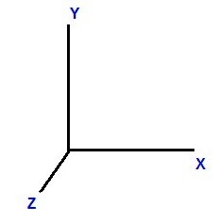
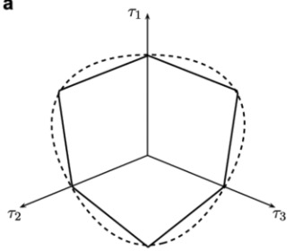











Heap Indexing
$$sll\left(a, nil\right)∗sll\left(b, nil\right) ∗sll(c, nil)$$
$$sll\left(a, nil\right)$$
$$sll\left(b, nil\right)$$
$$tree(t)$$
$$f_{a→t_{1}}$$
$$f_{b→t_{1}}$$
$$f_{c→t_{1}}$$
$$sll\left(c, nil\right)$$
decompose
$$f_{a→t_{1}}:I_{a}→I_{t_{1}}$$
compose
Indexing partition
$$sll\left(a, nil\right)$$
$$tree(t1)$$
$$I_{a}⊂\{ε, n_{a}, n_{a}n_{a}, …\}$$
$$I_{t_{1}}⊂\{ε,l, r, lr, ll, rl, rr…\}$$
Find a transformer to abstract the evolvement of locations of nodes

Slide 20

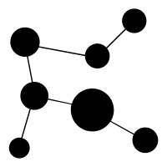
Workflow
Shape Analysis
Heap Indexing
source code
Heap Partition
Location Evolvement
Notes:
This is workflow of the whole analysis. I want to propose a heap indexing approach as the post layer of shape analysis and summarize the index of nodes in recursive data structure, which decribles the location evovlement.

Slide 21
Example
Insert_head
Node* Insert_head(Node* a, Node* b) {
assert(b->next == nullptr);
b->next = a;
a = b;
return a;
}
Notes:
Let’s take a simple program for example

Slide 22
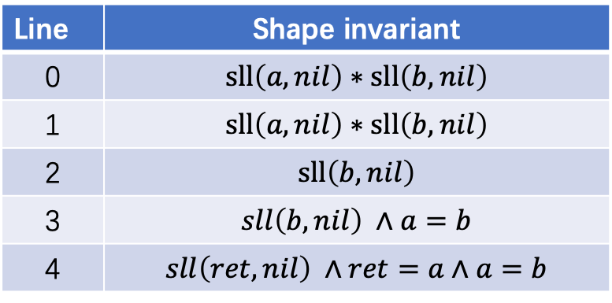
Phase 1: Shape Analysis
Shape invariants at all program locations
Node* Insert_head(Node* a, Node* b) {
assert(b->next == nullptr);
b->next = a;
a = b;
return a;
}
Line | Shape invariant
0 | $$sll\left(a, nil\right)∗sll\left(b, nil\right)$$
1 | $$sll\left(a, nil\right)∗sll\left(b, nil\right)$$
2 | $$sll\left(b, nil\right)$$
3 | $$sll\left(b, nil\right) ∧a=b$$
4 | $$sll\left(ret, nil\right) ∧ret=a∧a=b$$
Notes:
After shape analysis, we get shape invariants for all locations

Slide 23
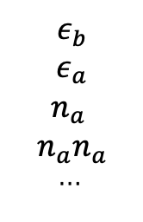
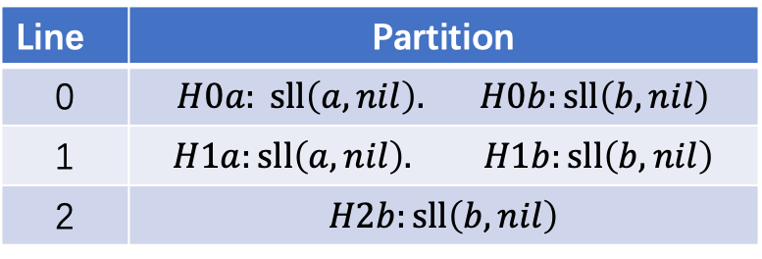
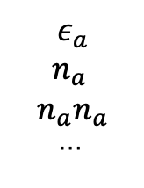

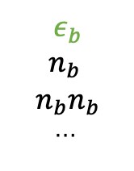

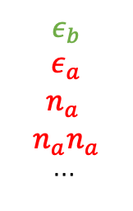
Phase 2: Heap Indexing
Construct index and relational index domain
Node* Insert_head(Node* a, Node* b) {
assert(b->next == nullptr);
b->next = a;
a = b;
return a;
}
Line | Partition
0 | $$H0a: sll\left(a, nil\right). H0b:sll\left(b, nil\right)$$
1 | $$H1a:sll\left(a, nil\right). H1b:sll\left(b, nil\right)$$
2 | $$H2b:sll\left(b, nil\right)$$
$$ε_{a}$$
$$n_{a}$$
$$n_{a}n_{a}$$
…
f(x) = x
$$ε_{a}$$
$$n_{a}$$
$$n_{a}n_{a}$$
…
f(x) = x+1
$$ε_{b}$$
$$ε_{a}$$
$$n_{a}$$
$$n_{a}n_{a}$$
…
f(x) = x
$$ε_{b}$$
$$ε_{a}$$
$$n_{a}$$
$$n_{a}n_{a}$$
…
$$ε_{b}$$
$$n_{b}$$
$$n_{b}n_{b}$$
…
$$ε_{b}$$
f(x) = x
Notes:
partition heap
(Click) Model the effect of statement on the index
Summarize the location changing

Slide 24
Reference
Thomas Reps, A relational approach to interprocedural shape analysis, TOPLAS 2004
Sumit Gulwani, A combination framework for tracking partition sizes, POPL 2009
Stephen Magill, Automatic numeric abstractions for heap-manipulating programs, POPL 2010
Noam Rinetzky, From shape analysis to termination analysis in linear time, CAV 2016
Xavier Rival, A relational shape abstract domain, NFM 2017
ThanhVu Nguyen, SLinG: Using dynamic analysis to infer program invariants in separation logic, PLDI 2019

Slide 25

Thank you for your listening!
Notes:
4:20 + 4:20 + 10:17 + 9:45 + 2:41 = 31:23

Slide 26
Heap vs Numeric
assert(sll(a, b) * sll(b, nil));
Node* curr = a;
while (b->next != NULL) {
curr = curr->next;
b = b->next;
}
assert(m>=n && n >= 0)
int i = m;
while (n >= 0) {
i--;
n--;
}

Slide 27

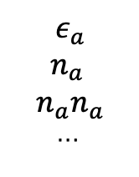

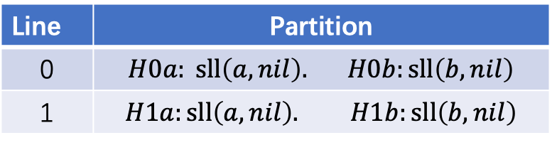

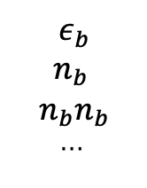

Phase 2: Heap Indexing
Construct index and relational index domain
Node* Insert_head(Node* a, Node* b) {
assert(b->next == nullptr);
b->next = a;
a = b;
return a;
}
Line | Partition
0 | $$H0a: sll\left(a, nil\right). H0b:sll\left(b, nil\right)$$
1 | $$H1a:sll\left(a, nil\right). H1b:sll\left(b, nil\right)$$
$$H0a$$
$$ε_{a}$$
$$n_{a}$$
$$n_{a}n_{a}$$
…
f(x) = x
$$ε_{a}$$
$$n_{a}$$
$$n_{a}n_{a}$$
…
$$H10$$
$$ε_{b}$$
$$n_{b}$$
$$n_{b}n_{b}$$
…
$$H0b$$
$$ε_{b}$$
$$H11$$

Slide 28





Phase 2: Heap Indexing
Construct index and relational index domain
Node* Insert_head(Node* a, Node* b) {
assert(b->next == nullptr);
b->next = a;
a = b;
return a;
}
Line | Partition
0 | $$H0a: sll\left(a, nil\right). H0b:sll\left(b, nil\right)$$
1 | $$H1a:sll\left(a, nil\right). H1b:sll\left(b, nil\right)$$
2 | $$H2b:sll\left(b, nil\right)$$
$$ε_{a}$$
$$n_{a}$$
$$n_{a}n_{a}$$
…
f(x) = x
$$ε_{a}$$
$$n_{a}$$
$$n_{a}n_{a}$$
…
$$H1a$$
f(x) = x+1
$$ε_{b}$$
$$ε_{a}$$
$$n_{a}$$
$$n_{a}n_{a}$$
…
$$H2b$$
$$k≥0$$
$$ε_{b}$$
$$n_{b}$$
$$n_{b}n_{b}$$
…
$$ε_{b}$$
f(x) = x
$$k≥0$$
$$H1b$$
Notes:
TODO: f(x)

Slide 29
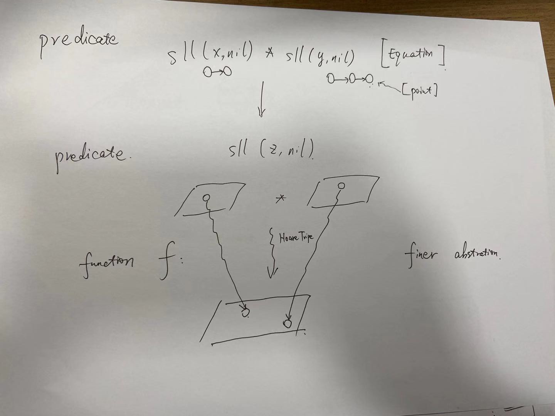

Slide 30
Memo
Technical detail II
Encode location as string
Model transformer by Uninterpreted function
Solve out transformer by Z3

