Slide 1
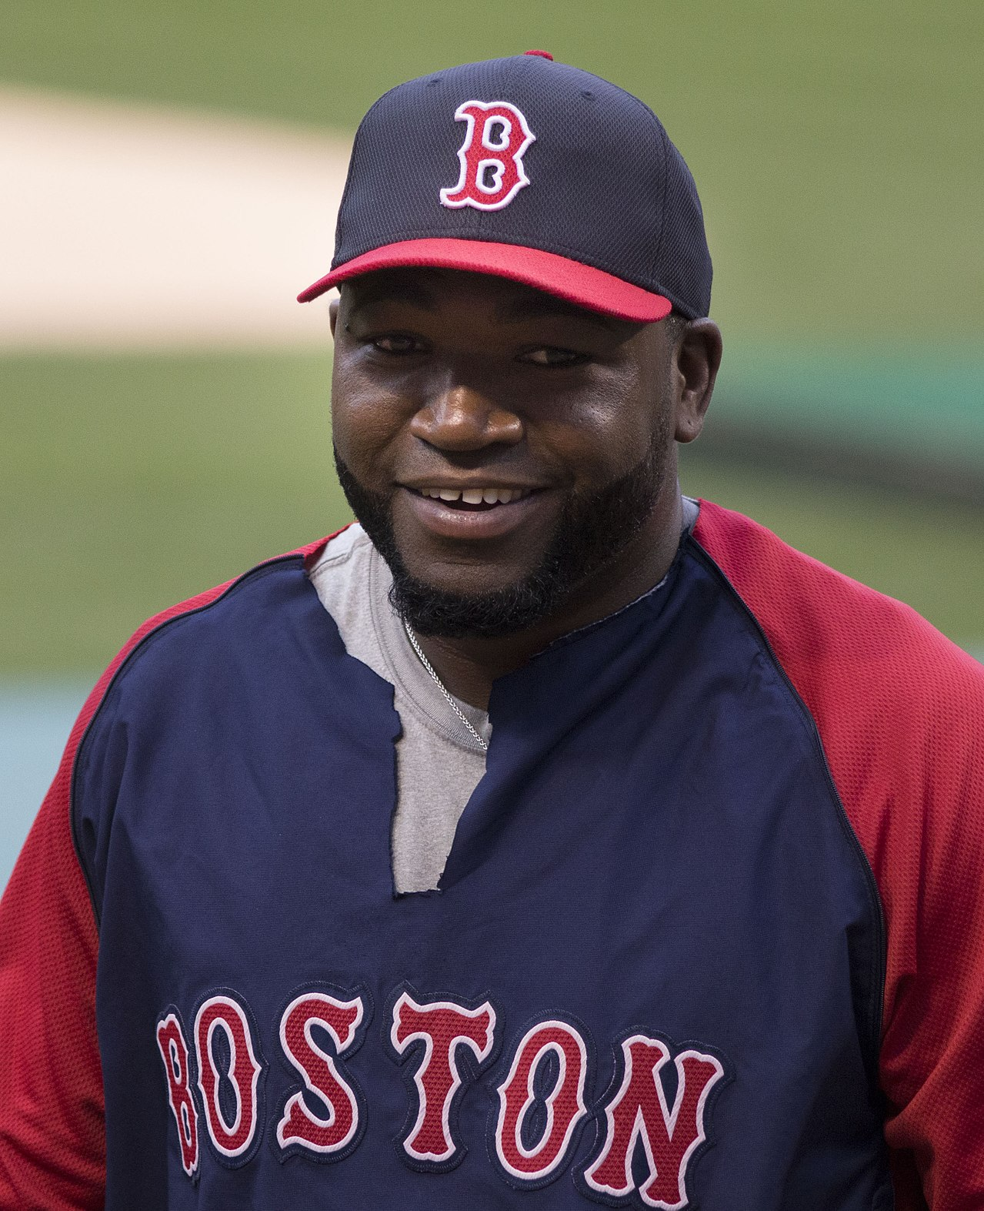
34
DAVID
ORTIZ
DH
BOS
2006 SEASON STATS
AVG
HR
RBI
.287
54
137

