Slide 1
ICESat-2 Attitude Determination Code Study
Dae Young Lee
Center for Space Research
University of Texas at Austin
Aug 18, 2016

Slide 2
Overview
Based on Perl script named “atti06.pl”
Data interface
Printing
Compiling “atti06.c”
Estimation Data generation
Compiling “quat_true_six.c”
Estimation Data comparison
Compiling “quat_true_quest.c”

Slide 3
atti06.c
Gyro data
Star data
q initial
Measurement data read
star()
celladj()
starcell()
Star catalog data read
read_gyro()
read_CCD()
Process measurement data
starID_pm(…)
Star catalog search
starID_dm(…)
Star catalog search
while
q_method(…)
Quaternion estimation
curvf(…)
EKF vector update
no_star(…)
EKF gyro propagation
5/13/2015
ICESAT-2 PPD ATBD REVIEW

Slide 4
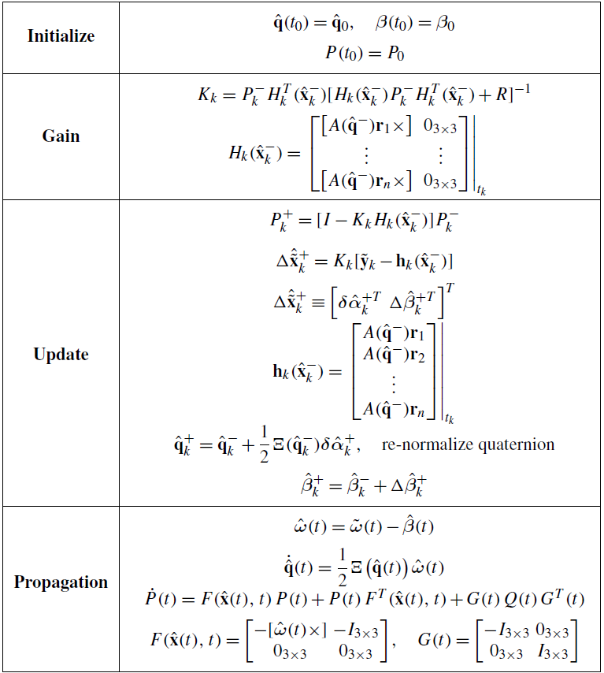




Extended Kalman Filter
$$r_{1,⋯n}$$
: reference vector from star catalog
$${\tilde{y}}_{k}$$
: measurement vector from LRS
$${\tilde{ω}}_{k}$$
: Gyro measurement
Gyro model :
Crassidis, John L., and John L. Junkins. Optimal estimation of dynamic systems. CRC press, 2011.

Slide 5
atti06.c
q initial
FOV star data
starID_pm(…)
starID_dm(…)
Star reference
while
q_method(…), QUEST
curvf(…), EKF
Gyro data
no_star(…)
5/13/2015
ICESAT-2 PPD ATBD REVIEW

Slide 6
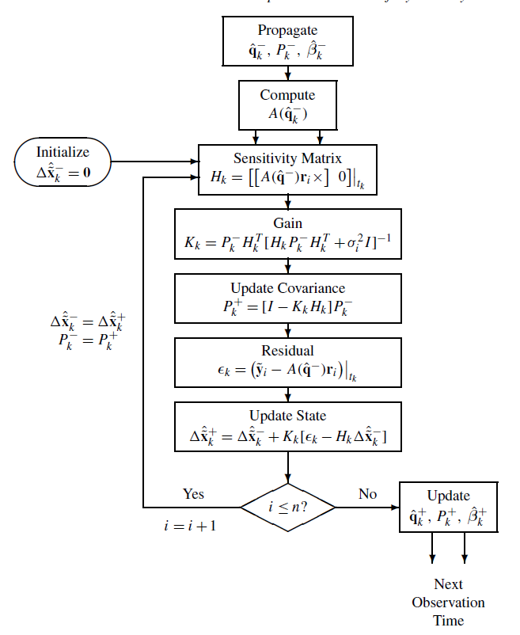
atti06.c
FOV star data
Gyro data
starID_pm(…)
starID_dm(…)
cuvf(…)
vs
q_method(…)
no_star(…)
5/13/2015
ICESAT-2 PPD ATBD REVIEW

Slide 7
Star search methods
StarID_pm : Pattern match methods
Check bore direction.
Find a cell ID and adjacent cell ID
Make a DB for all star in the above cell
Find a star based on the relative angle and magnitude
StarID_dm : Direct match methods
Check bore direction and we use the angular velocity information
Find a zone based on the elevation.
Compare it is moved star and a new star.

Slide 8
Work Status
Star measurement distortion (caused by the star color)
Now reviewing documents.
…
9/2
9/9
11/25
Estimation
EKF
QUEST
6 states
15 states
21 states(?)
Star search and calibration
Pattern match
Direct match
Star measurement distortion
Simulator
Attitude Dynamics
Star catalog

Slide 9
Sub functions

Slide 10
star()
Main data file : /lib/lrs_5p25.cat
Format : %s %s %s %s %s
To compare with LRS measurement.
stars (structure)
cat_num : integer, catalog reduced number
cat_mom : integer, catalog original number
ra : float, azimuth
dec : float, elevation
mag : float, brightness magnitude

Slide 11
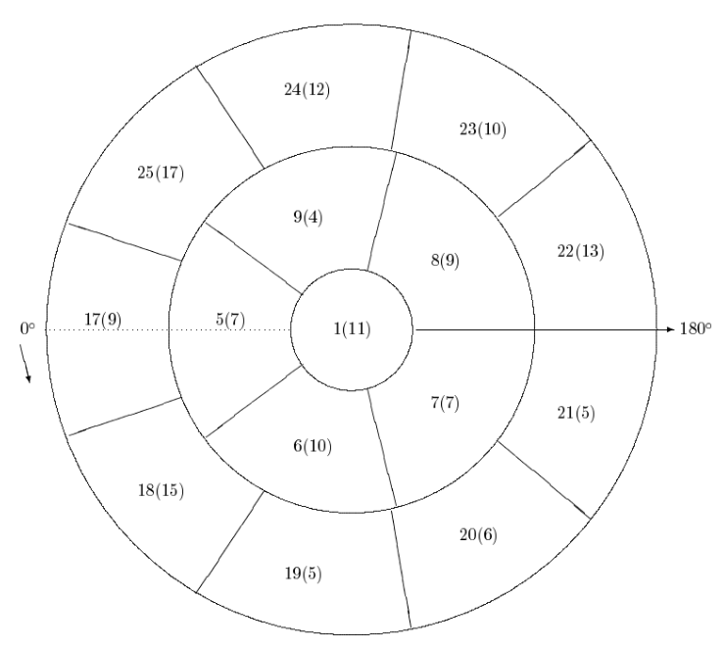
starcell()
Main data file : /lib/scel525.dat
Format : %s %s(number of star) (%s, …. )
Line is 225. This means 225 cell
scell(structure) : 225 structures
cell_id: integer, cell id
num_stars : integer, the number of stars in cell
Star_num[num_stars] : Integer, star ID (for the position, we need to look at star catalog

Slide 12
celladj()
Main data file : /lib/sadj.dat
Format : %s (number of cell) (%s, …. )
Line is 225, each line means each cell and the id number on each line means the adjacent cell ID
adjcell(structure) : 225 structures
num_adj: integer, cell number
cell_num[num_adj] : Integer, Adjacent cell ID
For example, first line has [1, 5, 6, 7, 8, 9 ]

Slide 13
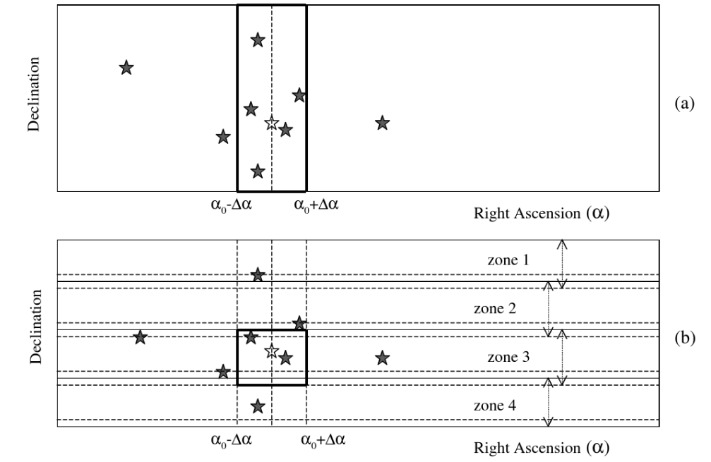
starcell2()
Main data file : /lib/x525_tab.dat
Format : %s %s(number of star) (%s, …. )
Line is 34, each line is zone number.
This is for the direct matching methods.
scell2(structure) : 34 structures
cell_id: integer, zone id
num_stars : integer, the number of stars in zone
Star_num[num_stars] : Integer, star catalog number

Slide 14
read_gyro(t_gyro, u, b, w, gyro)
File format
%s (time), %s, %s, %s (x, y, z)
Input
t_gyro : double
u : double, gyro data, file read (atof)
b : bias data (given by EKF?)
w = u – b : double, estimated data (actual output)
gyro : file descriptor.

Slide 15
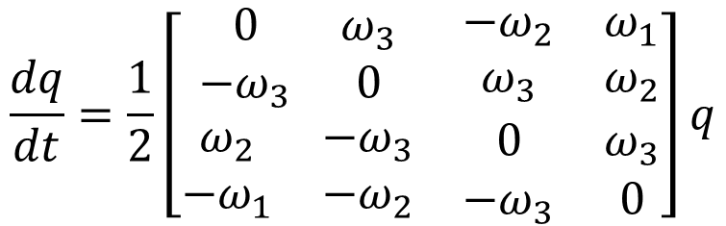
no_stars(t, t_gyro, q, w)
Purpose
Quaternion propagation based on the gyro data
Input
t : no use
t_gyro : no use
q : double, quaternion of previous step is updated
w : double, angular velocity
$$\frac{dq}{dt}=\frac{1}{2}\left[\begin{matrix}\begin{matrix}0 & ω_{3} \\ {−ω}_{3} & 0\end{matrix} & \begin{matrix}{−ω}_{2} & ω_{1} \\ ω_{3} & ω_{2}\end{matrix} \\ \begin{matrix}ω_{2} & −ω_{3} \\ {−ω}_{1} & {−ω}_{2}\end{matrix} & \begin{matrix}0 & ω_{3} \\ {−ω}_{3} & 0\end{matrix}\end{matrix}\right]q$$

Slide 16
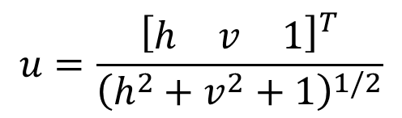

read_CCD(t, sttr, x, y, xmag)
Purpose
Star data read and filtering (-2.0 < mag <7.5)
2 data (phi, lambda) converted to 3 data (x, y, z)
Input
t : time
sttr : file descriptor
x : horizontal factor
y : vertical factor
xmag : brightness
$$h=tanθ_{h}=\frac{u_{1}}{u_{3}}$$
$$v=tanθ_{v}=\frac{u_{1}}{u_{2}}$$
$$u=\frac{{\left[\begin{matrix}h & v & 1\end{matrix}\right]}^{T}}{{\left(h^{2}+v^{2}+1\right)}^{1/2}}$$

Slide 17
sort_CCD(nstar, x, y, xmag)
Purpose
Bubble sort based on the xmag(brightness)
The most bright star becomes first of the array
Input
Number of total star (-2.0 < mag <7.5)
x : horizontal measurement
y : vertical measurement
xmag : vector magnitude

Slide 18
q_method(W, V, wgt, mag)
Purpose
Estimate the optimal quaternion based on the star vector measurement.
Input
W : measured star vector
V : reference star vector
wgt : weighting of each vector (star magnitude is mixed in the routine)
mag : measured star magnitude

Slide 19
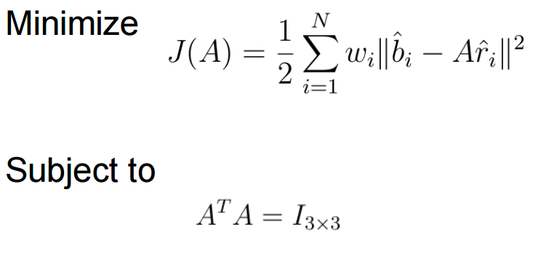
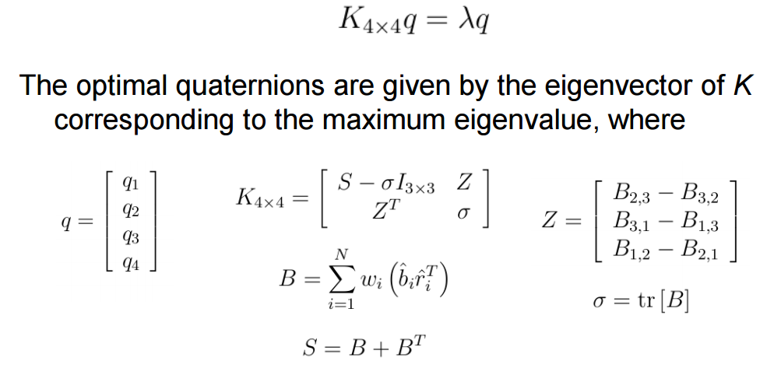
q_method(W, V, wgt, mag)

Slide 20
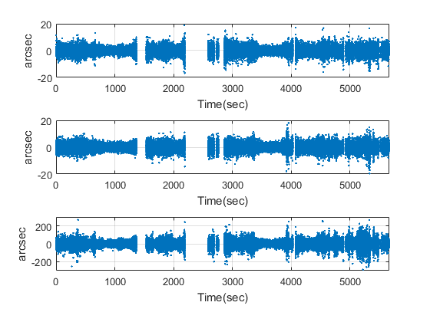
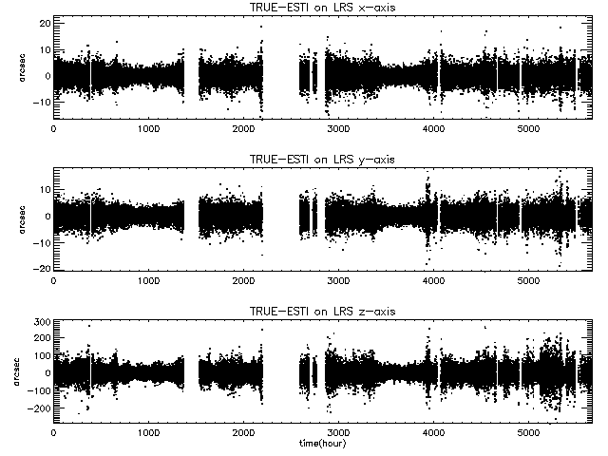
q_method(W, V, wgt, mag)
Original
MATLAB ver.

Slide 21
Work Status
Star measurement distortion (caused by the star color)
Now reviewing documents.
…
9/2
9/9
11/25
Estimation
EKF
QUEST
6 states
15 states
21 states(?)
Star search and calibration
Pattern match
Direct match
Star measurement distortion
Simulator
Attitude Dynamics
Star catalog

Slide 22
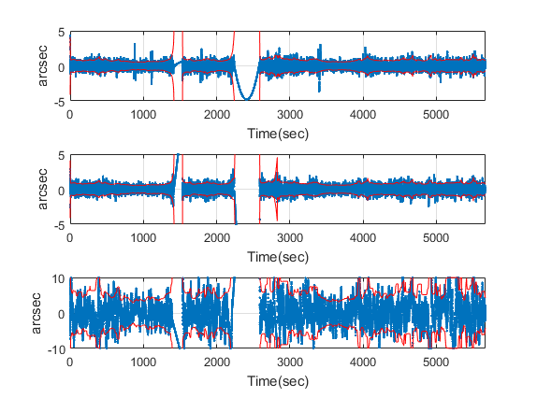
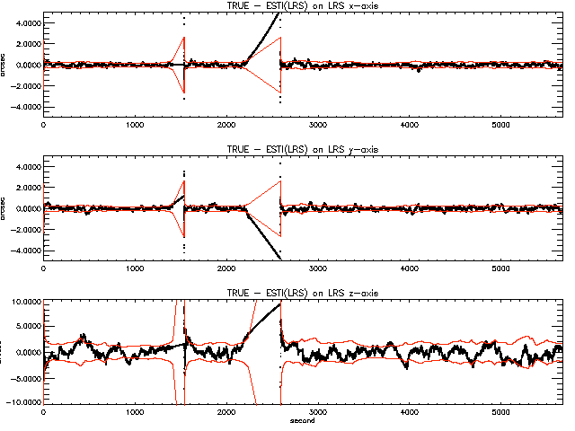
Extended Kalman Filter
Original
MATLAB ver.
Tune gain : 10,000

Slide 23
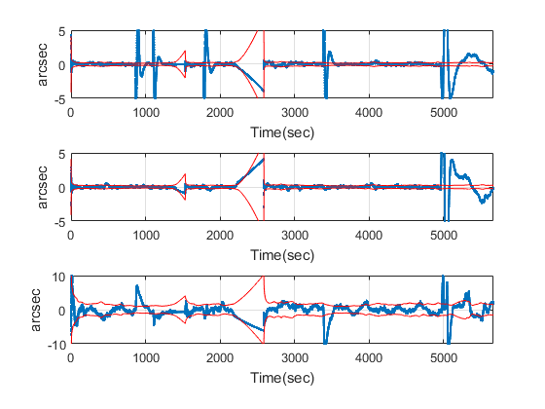
Extended Kalman Filter
Original
MATLAB ver.
Tune gain : 0.5

Slide 24
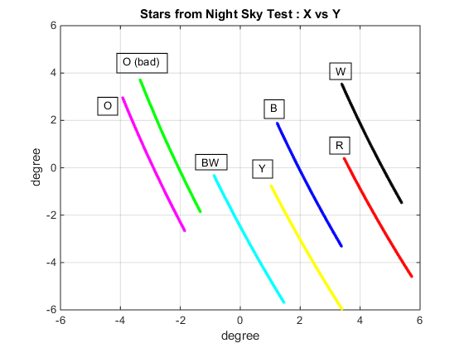
Night Sky Test Data : 7 long tracks
Ang. Vel: Earth Rate
Data length: 32 minutes
The paths of the star movement
in the plot look like parallel to each
other in the given scale, but they are
not parallel in tens of arc-seconds level
Angular distances between tracks were computed for all possible combinations to evaluate color correction (CC) formulae
Direction of tracks

Slide 25
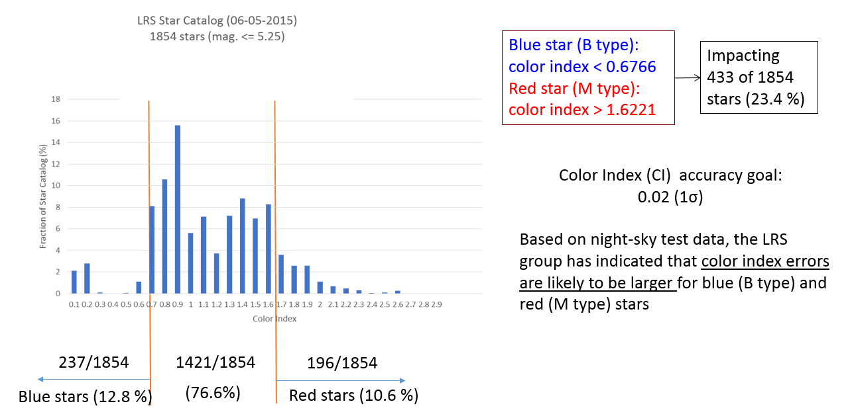
Color Index Statistics

Slide 26
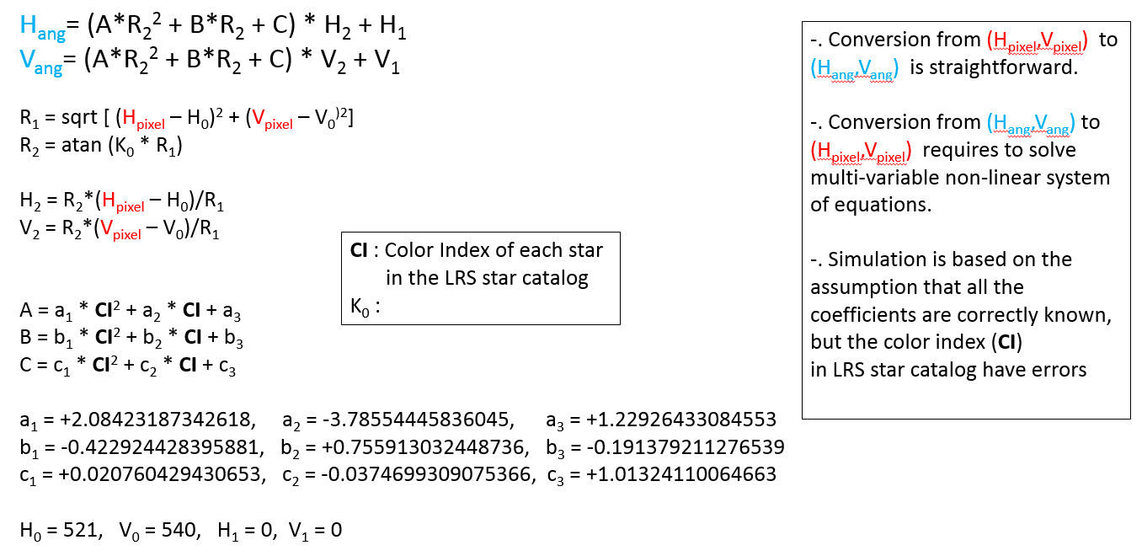
Convert LRS Star’s Pixel Value to Angle Value

