Slide 1
15 Puzzle Project
Web Programming-2020 Fall
Tianqi Luan, Jingjing Wang

Slide 2
Team information
Leader’s Name: Luan, Tianqi
Project Name: 15 Puzzle Game
Description: HTML based 15 puzzle game
Team member: Tianqi Luan, Jingjing Wang
Luan, Tianqi: user, designer, programmer, tester
Wang, Jingjing: user, designer, programmer, tester

Slide 3
User
A classic 15-puzzle game that was implemented in HTML form
User would be shown a finished 15-puzzle to start with
User can then click on the “shuffle” to shuffle the puzzle then start to play
At any point of the game, user can shuffle the puzzle again
Or user can click on “cheat” to jump to the solved puzzle
Each click on the puzzle will be registered and counted steps will be displayed once the user has finished the puzzle
A pop-up page will be displayed once the user has finished the puzzle and ask if the user would like to play again

Slide 4
Design
Homepage
Shuffle
Play Puzzle
Cheat
Pop-up

Slide 5
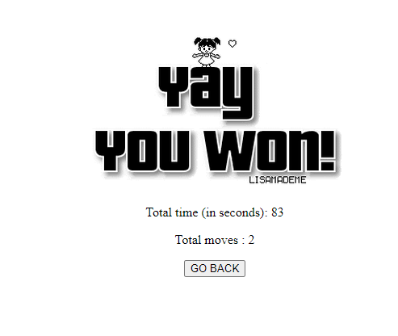
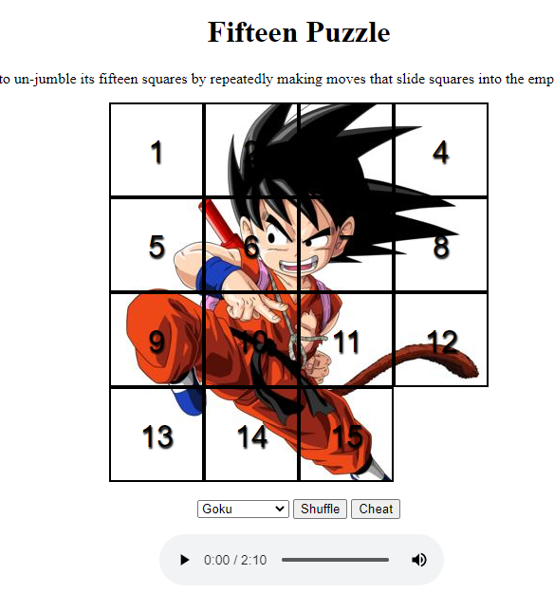
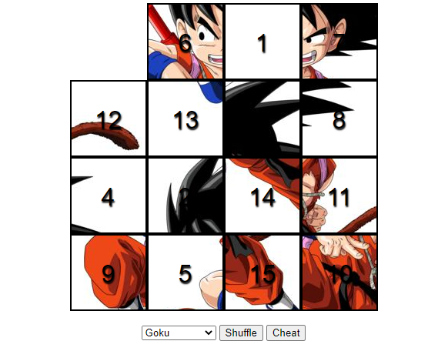
User Interface
The puzzle was originally displayed in a picture pattern at users selection
All the pieces will remain their pattern while playing that also includes while shuffling
Page will display message (time took, total moves) once puzzle is finished

Slide 6

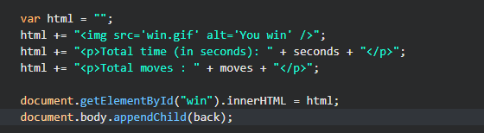

Codes Demo
HTML DOM createElement() Method

Slide 7
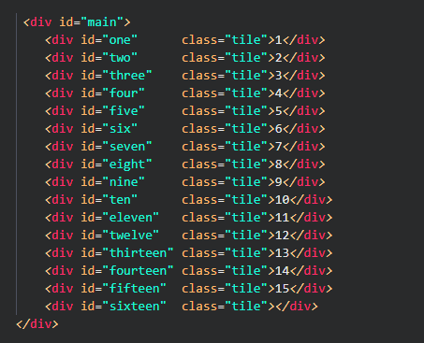
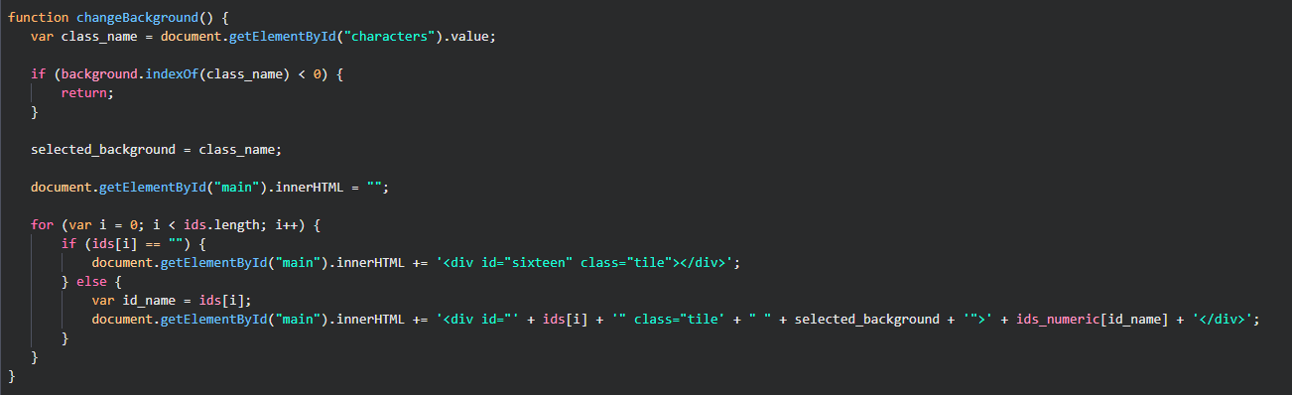
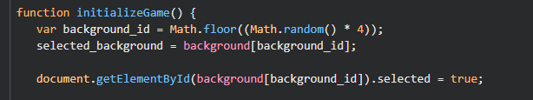
Codes Demo

Slide 8
Demo Run

Slide 9
Test Cases

