Slide 1
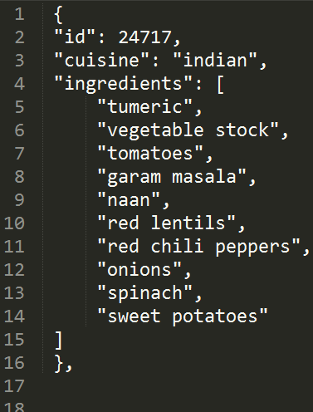
What’s Cooking [kaggle]
The Problem: Use recipe ingredients to categorize the cuisine
Data: Kaggle competition provides train and test JSON data.
Hypotheses: Using ingredients we can predict cuisine.
https://www.kaggle.com/dipayan/whats-cooking/

Slide 2
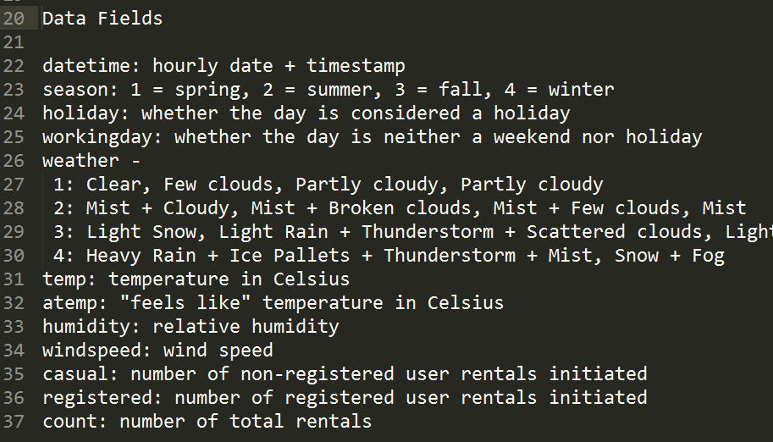
Bike Sharing Demand [kaggle]
The Problem: Forecast use of a D.C.’s bike share system
Data: Kaggle competition provides train and test CSV data.
Hypotheses: Using datetime, season, weather, and temp we can predict ridership.
https://www.kaggle.com/yaroshevskiy/bike-sharing-demand
http://brandonharris.io/kaggle-bike-sharing/

