Slide 1
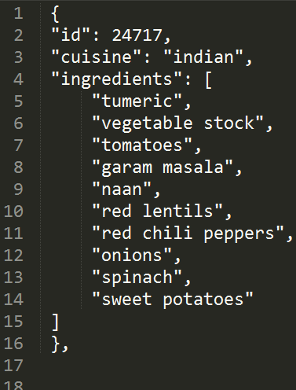
What’s Cooking [kaggle]
The Problem: Use recipe ingredients to categorize the cuisine
Data: Kaggle competition provides train and test JSON data.
Hypotheses: Given this is a classification problem I’ll need test out various classification models (SVC)
https://www.kaggle.com/dipayan/whats-cooking/

Slide 2
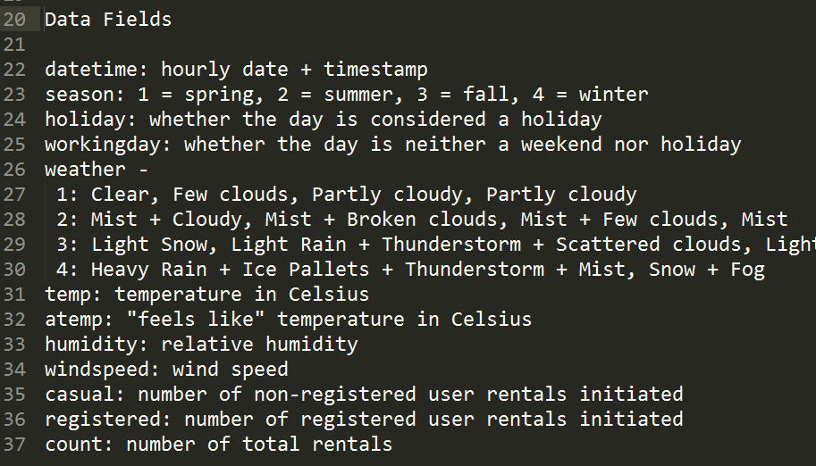
Bike Sharing Demand [kaggle]
The Problem: Forecast use of a D.C.’s bikeshare system
Data: Kaggle competition provides train and test CSV data.
Hypotheses: Given this is a regression problem with just a few independent variables a basic decision tree could work.
https://www.kaggle.com/yaroshevskiy/bike-sharing-demand
http://brandonharris.io/kaggle-bike-sharing/

Slide 3
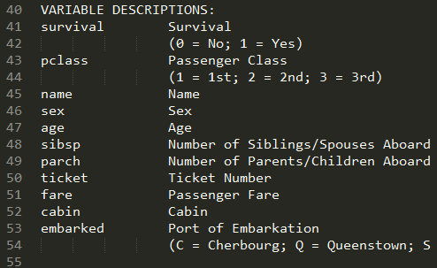
Titanic: ML From Disaster [kaggle]
The Problem: Predict survival on the Titanic.
Data: Kaggle competition provides train and test CSV data.
Hypotheses: Predicting a binomial outcome, will need to evaluate various classification models for best outcome.
https://www.kaggle.com/c/titanic/data

