Slide 1
Cyberbullying Tweets
Will Sharpe

Slide 2
Data
47,692 tweets stored as comma-separated-values (.csv)
Table contains just two columns: tweet_text and cyberbullying_type
There are 6 classes that each tweet may be classified as:
Religion
Age
Gender
Ethnicity
Not cyberbullying
Other cyberbullying
This is a multiclass and not multilabel classification

Slide 3
Approach and Techniques
To cast a wide net in techniques tried, thereby trying many but not going too deep into any one
All models received data that was vectorized by sklearn’s CountVectorizer
stop_words = “english”
47,692 rows by 59,970 (except for n-grams)
All models received data that was split by sklearn’s train_test_split the same way:
70% training 30% testing
Same random state number: 132

Slide 4
Overview - 5 Main Sections
Initial phase of testing with no preprocessing, only looking over data for validity
Check for missing values
Check for types of data
Check for a near equal amount of representation for each of the 6 classes
Cleaning and modifying the data before running some of the same tests from before
Unigrams - Bigrams - Trigrams
Building a Neural Network
Cross Validation of top performer

Slide 5
Initial Phase
The first batch of testing 6 models used:
Logistic Regression: 0.8364
Random Forest: 0.8265
Support Vector Machine: 0.8254
Decision Tree: 0.8079
Multinomial Naïve Bayes: 0.7807
K-nearest Neighbor: 0.618
Just the accuracy is provided here. Each model’s accuracy is within a small percentage of all other fields.

Slide 6
Preprocessing
In this second approach 3 of the 6 previous models were selected
The top performer, a middle performer and the worst performer
The approach this time was to manipulate the data more than we have so far
All capitalizations were removed for lowercase to make more uniform and simplified
Punctuations were removed to be replaced by a space
These two steps were done in an effort simplify data and improve models.

Slide 7
Preprocessing
Logistic Regression: 0.8299 previous of: 0.8364
Decision Tree: 0.8014 previous of: 0.8079
K-Nearest Neighbor: 0.6665 previous of: 0.6818

Slide 8
Issues for Sections 3 and 5
The volume of data created issues when attempting to use the whole dataset in N-grams and Cross Validation
The kernel would die due to RAM being overloaded
Attempted but failed to resolve:
Use of different IDE’s, different computers and modifying allotted RAM
Google Colab and Google Colab Pro
Resolution:
Seperate a random sample of 10,000 tweets from the data
Random_state of 132 used consistently
Random sample was checked for balance of classes

Slide 9
Unigrams - Bigrams - Trigrams
N-grams: made 1, 2 and 3 word tokens
10,000 rows by 217,279 columns
Bigrams: only made of 2 word tokens
10,000 rows by 93,392 columns
3 of 6 models from initial section used for testing:
K-nearest Neighbors
Decision Tree
Logistic Regression

Slide 10
Unigrams - Bigrams - Trigrams Results
N-grams
K-Nearest Neighbors: 0.3987
Decision Tree: 0.7990
Logistic Regression: 0.8223
Bigrams
K-Nearest Neighbors: 0.2717
Decision Tree: 0.6100
Logistic Regression: 0.5907

Slide 11
Neural Network
70% training 30% testing
Out of the training group 2,500 was put into a validation group
Set 1st hidden layer to 300 nodes
Set 2nd hidden layer to 100 nodes
Initial training: 100 epochs
Second attempt, new model, training: 16 epochs

Slide 12
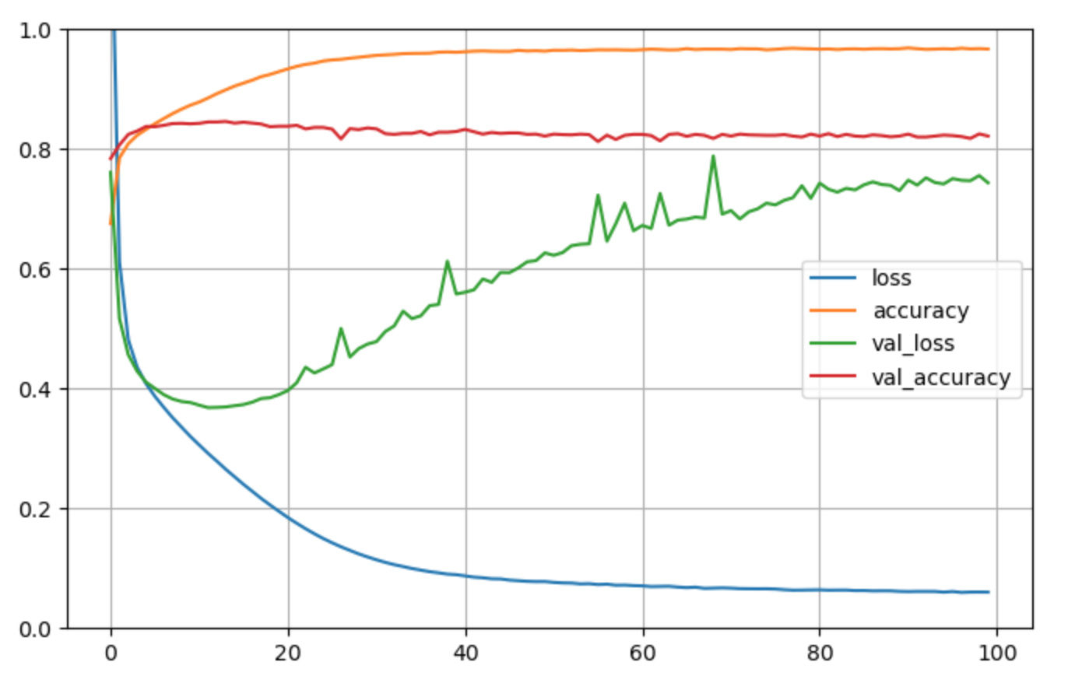
100 epochs
Training Accuracy: 0.9758
Testing Accuracy: 0.8228
Validation Accuracy: 0.8216

Slide 13
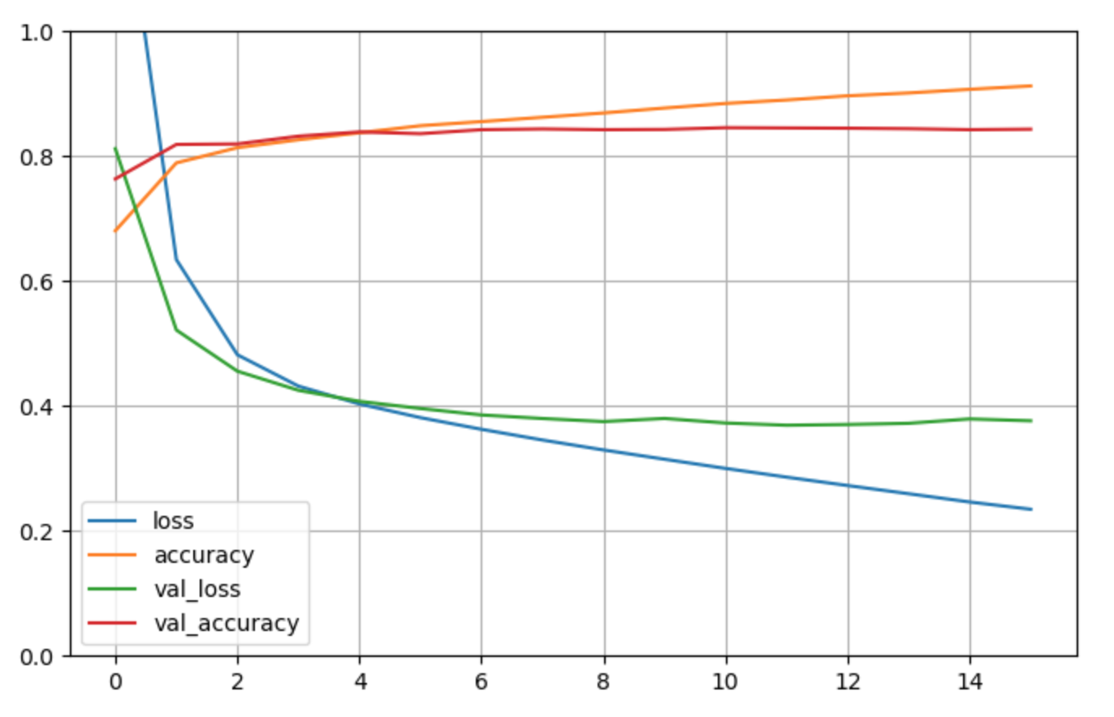
16 epochs
Training Accuracy: 0.9209
Testing Accuracy: 0.8402
Validation Accuracy: 0.8432

Slide 14
Cross Validation
Only Logistic Regression was explored for cross validation
10,000 taken out of entire dataset
Cross validation set to 10
Test Score Accuracies for each of the 10
0.809; 0.837; 0.840; 0.832; 0.815; 0.833; 0.823; 0.825; 0.827; 0.833;
Mean of scores: 0.83

Slide 15
Logistic Regression Cross Validation Results
 | Precision | Recall | F1-Score | Support
Age | 0.98 | 0.98 | 0.98 | 1,668
Ethnicity | 0.98 | 0.97 | 0.98 | 1,713
Gender | 0.91 | 0.83 | 0.87 | 1,634
Not Cyberbullying | 0.57 | 0.56 | 0.56 | 1,639
Other | 0.59 | 0.68 | 0.63 | 1,642
Religion | 0.97 | 0.94 | 0.95 | 1,704
Accuracy |  |  | 0.83 | 10,000

Slide 16
Source of Data used for this Project
J. Wang, K. Fu, C.T. Lu, “SOSNet: A Graph Convolutional Network Approach to Fine-Grained Cyberbullying Detection,” Proceedings of the 2020 IEEE International Conference on Big Data (IEEE BigData 2020), December 10-13, 2020.

